Slide 1

Drought Impacts on Isoprene Emissions
The Most Important BVOC
EAS6792 Review Project
Shengjun Xi
Apr 14th, 2021

Slide 2
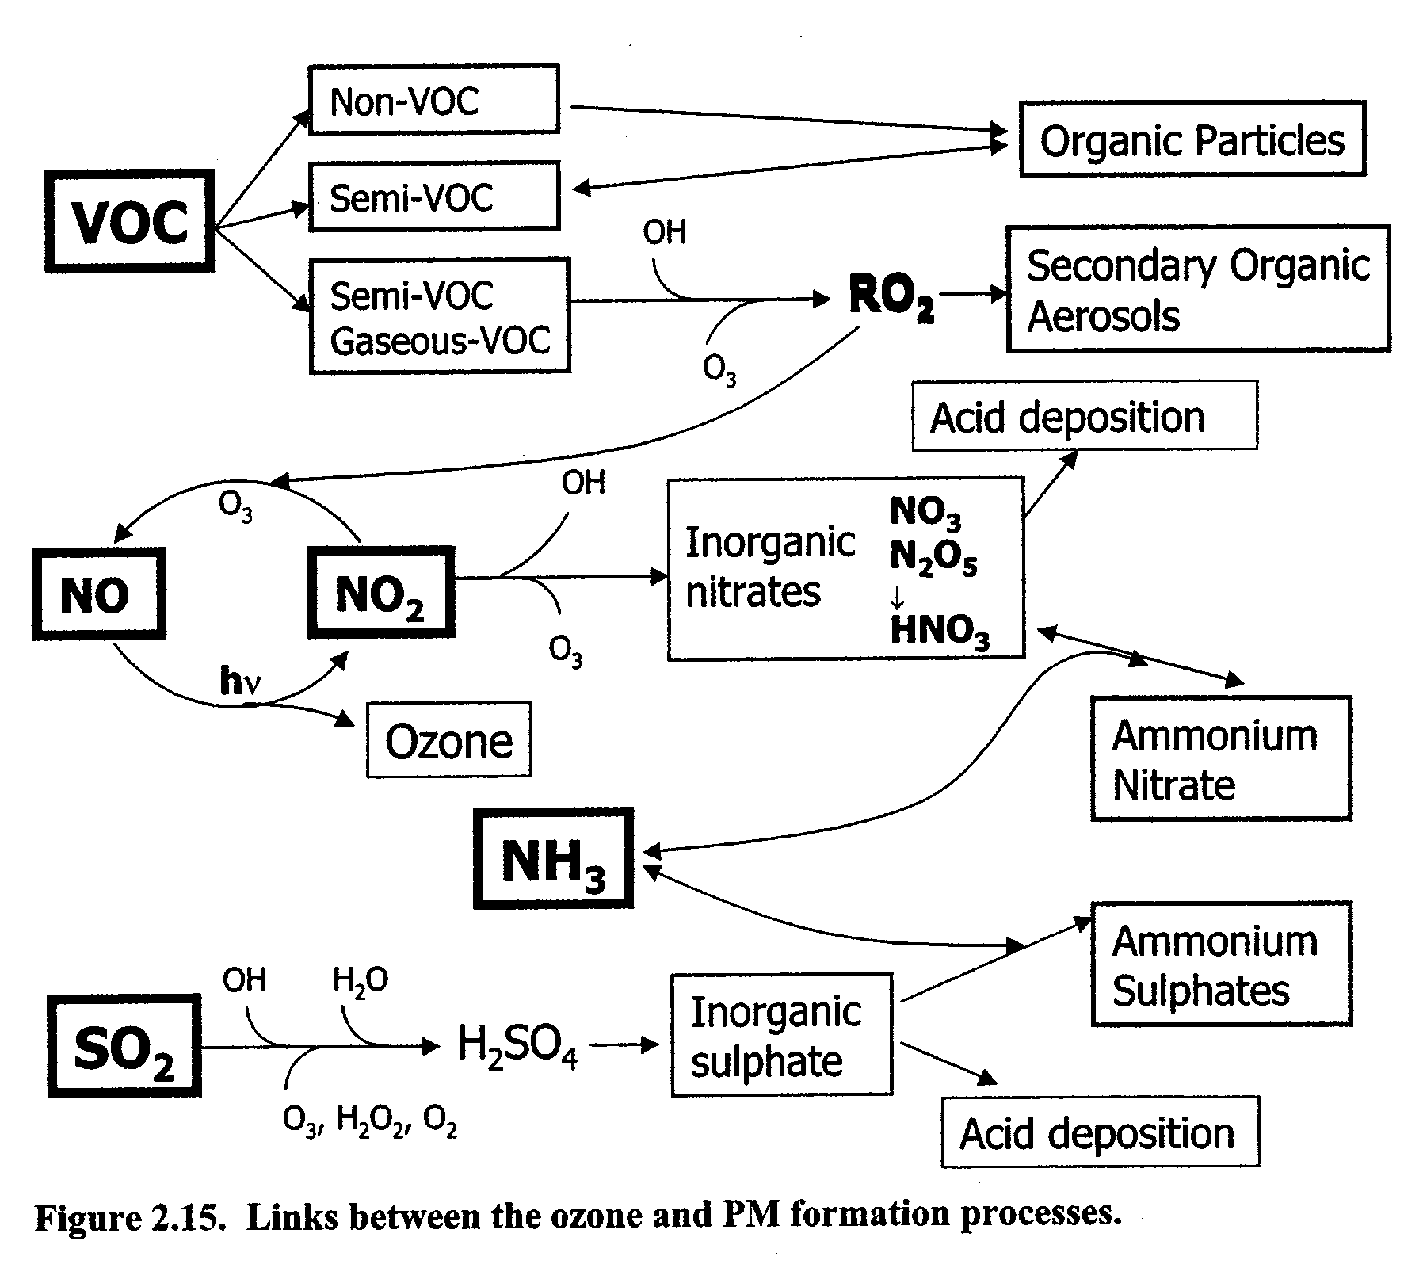
1. What is BVOC?
Biogenic Volatile Organic Compounds
(90% of the annual global VOC emissions)
Role in Atmospheric Environment
Notes:
Because we have different background, I would do a brief introdruction of BVOC and isoprene first.
BVOC is the abbr for ; directly/ indirectly affect partcle formation and ozone production, the most important two research area in air pollution.

Slide 3
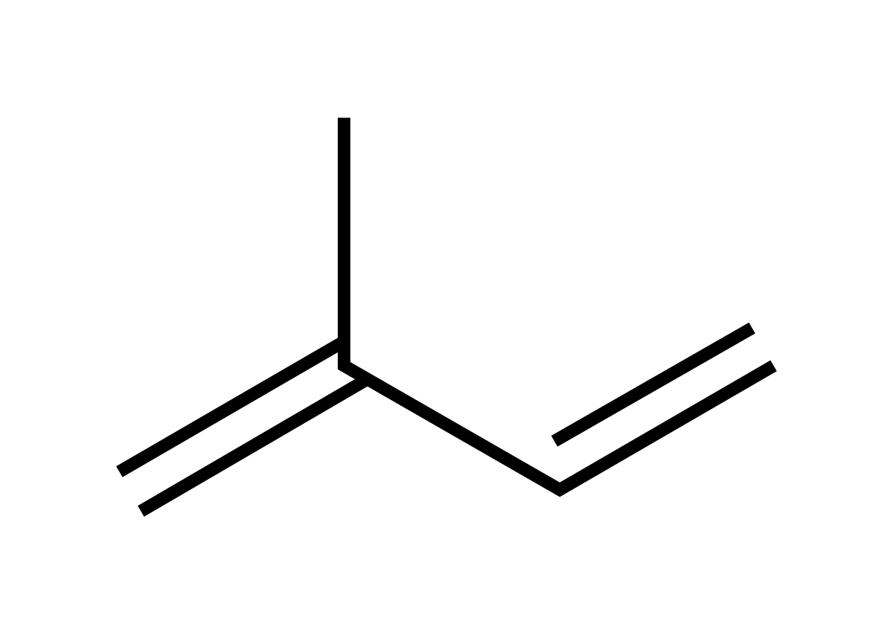
2. Isoprene?
C₅H₈
The most important non-methane BVOC.
  One third of the global total VOC emissions and half of the global BVOC emissions (Guenther et al. 2006, 2012).
  High reactivity:
    Day: mainly reacts with OH – Ozone production and SOA formation
    Night: NO₃ (main) and O₃ – SOA formation
    (Seinfeld &Pandis, 1998)
Emissions are highly dependent on environmental conditions.
  Originates from recently assimilated photosynthetic intermediates and alternative sources (Brilli et al. 2007).
  Never stored in plants after its production and Emitted through stomata to the atmosphere (Kesselmeier and Staudt 1998).
  Temperature, Light, Leaf Age and Soil Moisture.
Drought?
Notes:
double-bonds → high reactivity

Slide 4
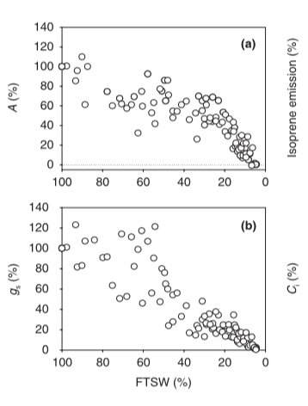
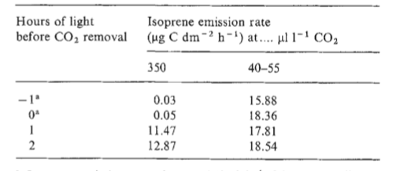
3. Mechanism (Physiology)
Lower Leaf conductance
Lower Photosynthetic rate
Higher internal CO₂ concentration.
Photosynthetic rate
stomata conductance
Tingey et al. 1981
Isoprene emissions simply decrease?
Brilli et al. 2007
No! Drought effects on isoprene emissions are complex.
Notes:
I will present some field measurements and experiments results to show how isoprene emissions

Slide 5
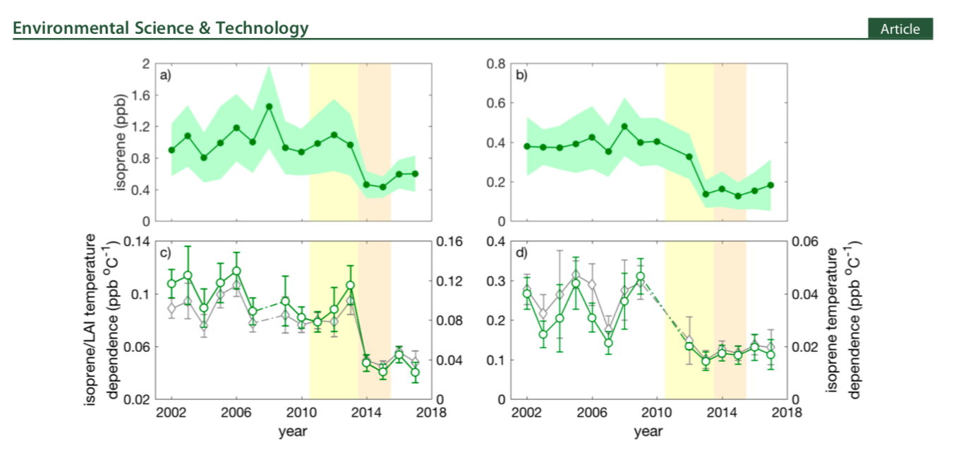
4. Field Measurements
Observed Isoprene of Two sites in California (June-September: Ozone season).
Mild drought : Isoprene stay stable
Severe drought: Decrease dramatically
Long-term drought: It took long for plants to recover.
Demetillo et al. 2019

Slide 6
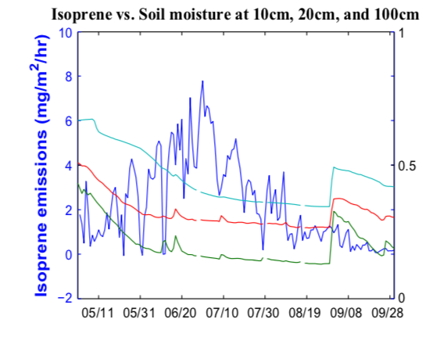
4. Field Measurements
Missouri Ozarks AmeriFlux Site
2012 summer: severe drought
Isoprene increases at the beginning of drought and decrease later.
Jiang et al. 2019

Slide 7
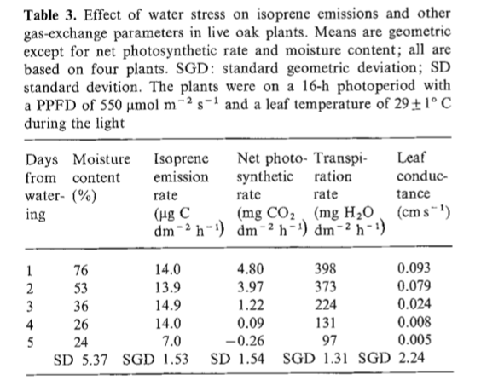
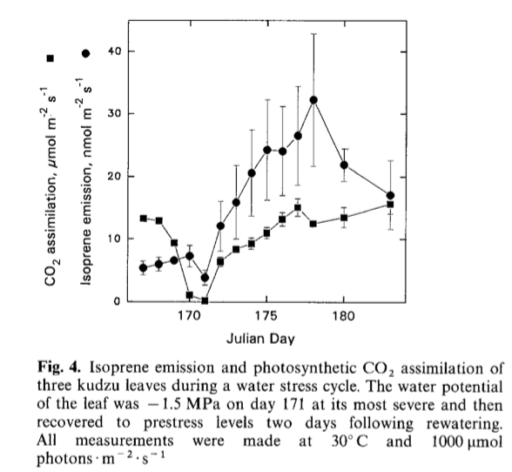
5. Experiments
Live oak:
Kudzu:
day 171: most severe
day 173: rewater
Tingey et al. 1981
Sharkey et al. 1993
Isoprene emissions only dropped a lot when severe drought happens.
A slight increase during the stress.
Fell when severe stress.
Increased to five times the prestress level and remain 12 days.

Slide 8
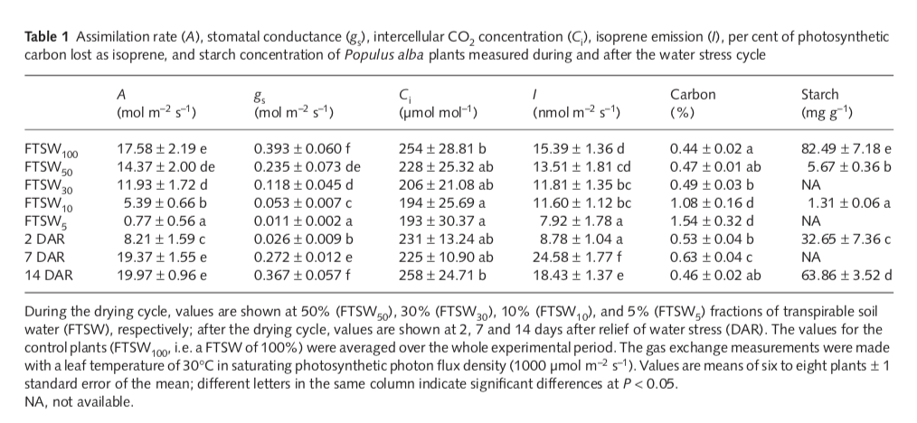
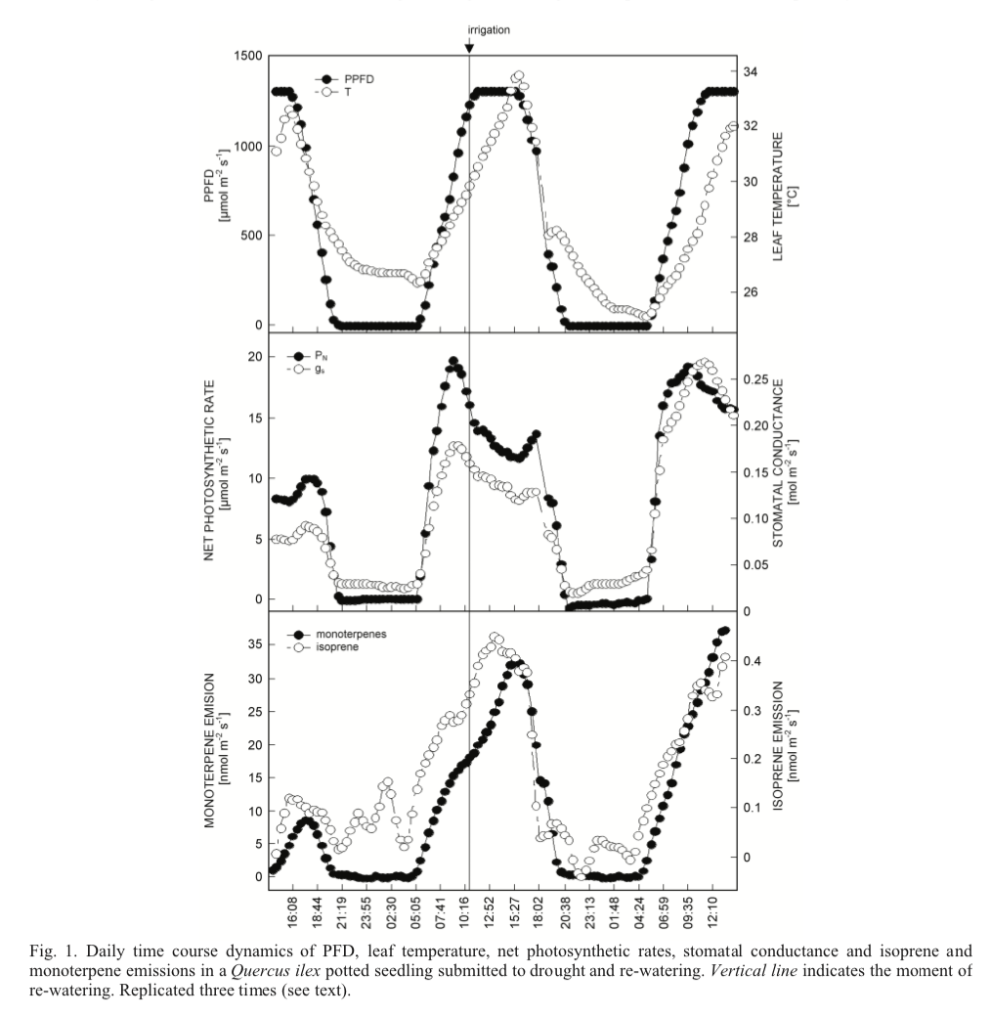
5. Experiments
rewater
Brilli et al. 2007
Increase at early drought;
Increase above the normal range after recovery
There is an alternative sources for photosynthetic intermediates for isoprene.
Penuelas et al. 2007

Slide 9
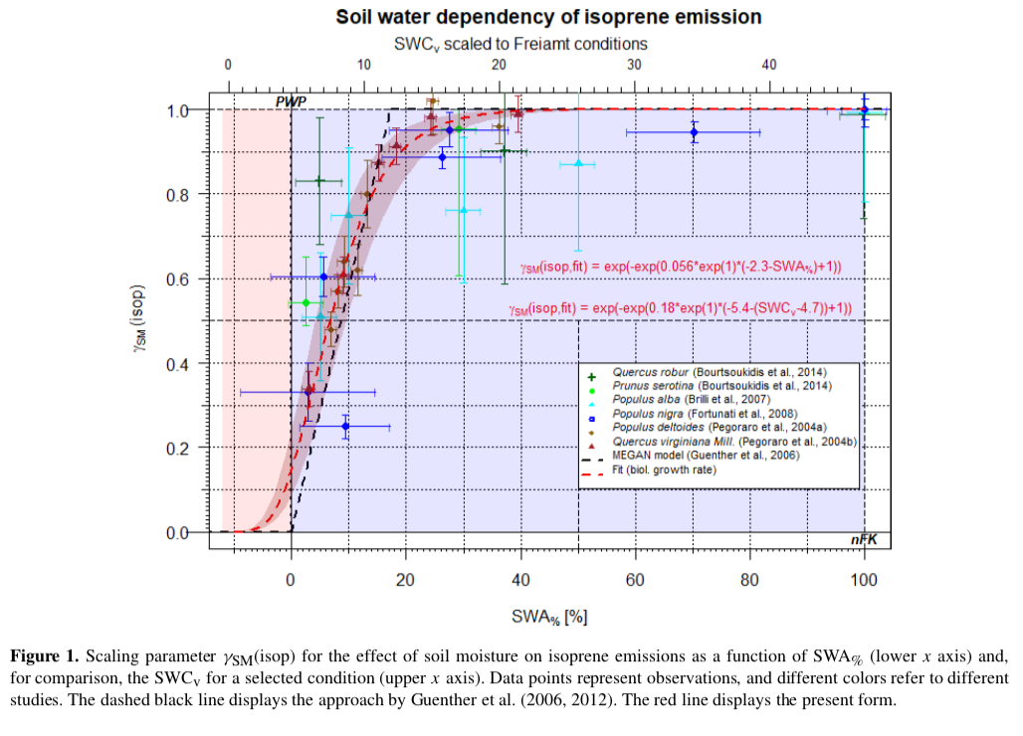
6. General Conclusions
Drought’s impacts on isoprene still suffer uncertainty, but there are some trends:
Isoprene emissions stay stable or increase at the beginning of drought events.
Long-term/severe drought would cause a reduction of isoprene emissions.
After short-term/mild drought, the plants would recover and even emit more isoprene than normal.
7. Simulations?
☹ Unfortunately, the model is not able to simulate the trends.
Bonn et al. 2019

Slide 10
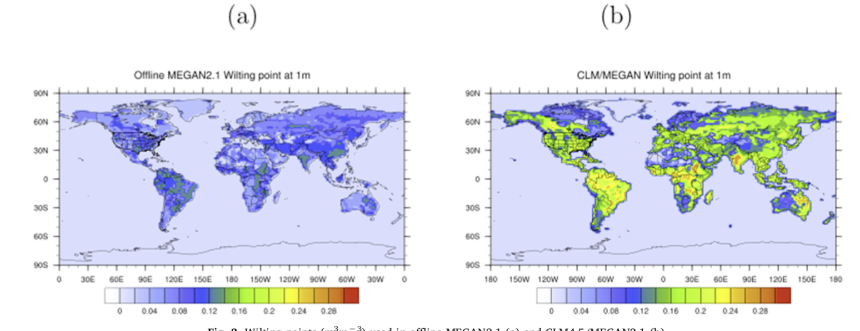
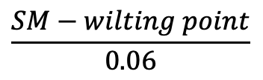


7. Simulations?
How does MEGAN account for drought?
1
SM > wilting point + 0.06
$$\frac{SM−wilting point}{0.06}$$
$$γ_{SoilMoisture}=$$
wilting point$≤$SM$≤$ wilting point +0.06
0
SM < wilting point
Hard to estimate wilting point.
Jiang et al. 2019

Slide 11
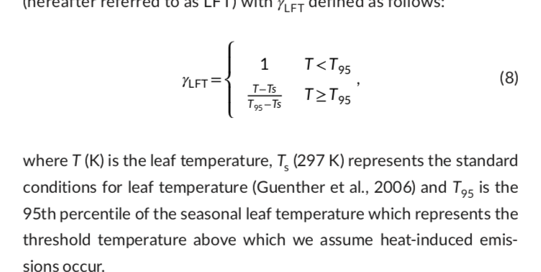
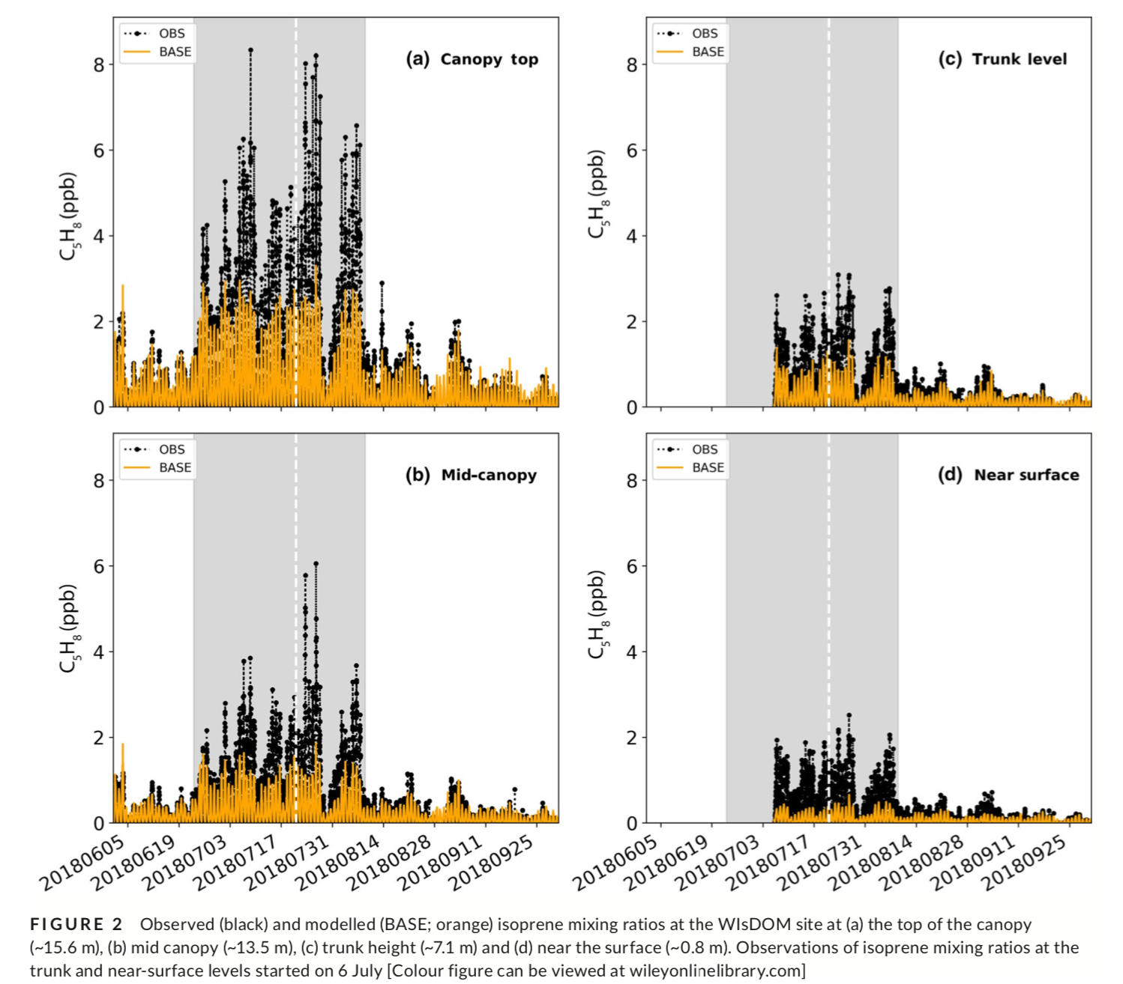
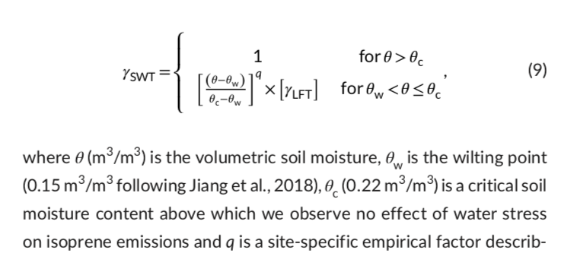
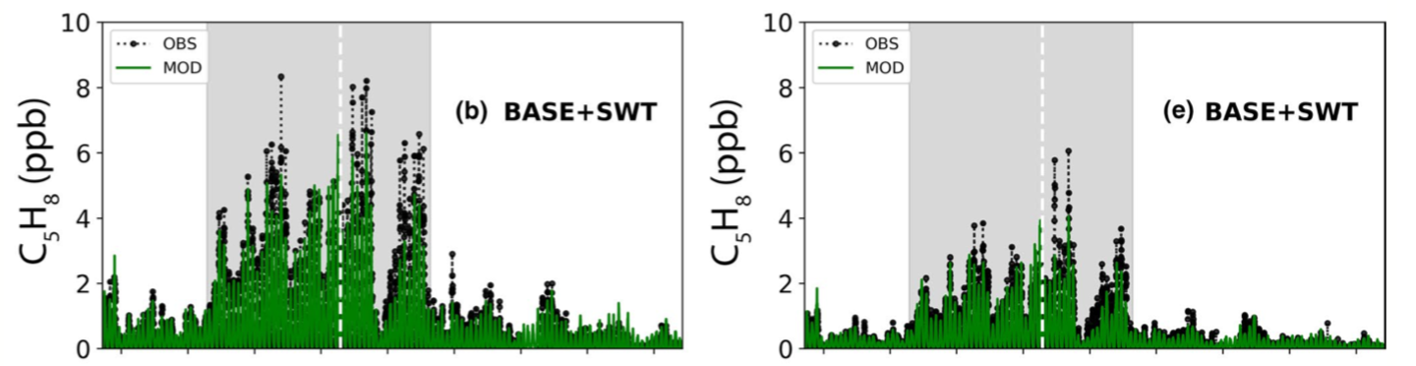
7. Simulations?
Modified case in a UK woodland (Summer 2018)
Out-larbi et al. 2019
Base MEGAN
Modified MEGAN
top-canopy: 15.6m
middle-canopy: 15.6m
Notes:
There still a lot of work to do for accurately estimating isoprene emissions

Slide 12
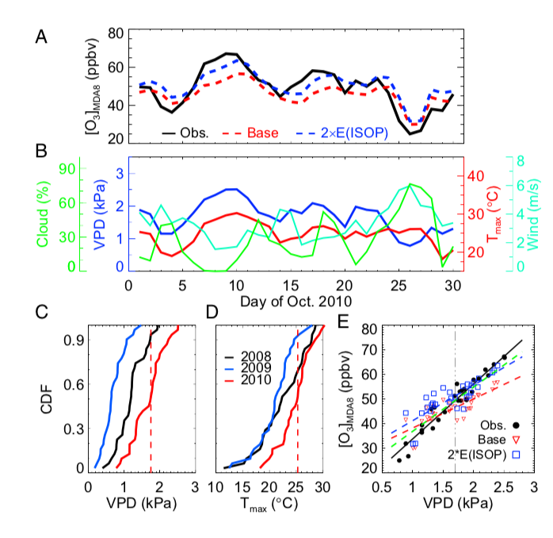
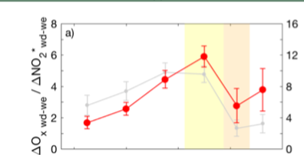
7. Impacts on Air Pollution
Tropospheric Ozone
Demetillo et al. 2019
Zhang et al. 2016
Change of Ozone Production Regime :
Severe drought--→More NOx- Saturated
High Ozone Concentration in October.

Slide 13
8. Conclusions
Drought can affect isoprene emissions from plants significantly. Though its effects contains great uncertainties.
Short-term Drought is in favor of the high isoprene emissions. The plants can emit an abnormally large amount of isoprene after rewatering.
The MEGAN model is not able to capture the effects of droughts. The wilting points given in the model contains great uncertainties.
A more accurate isoprene emission estimates is in need for future air quality simulation.

Slide 14
Reference
[1] Tingey, D. T., Evans, R., & Gumpertz, M. (1981). Effects of environmental conditions on isoprene emission from live oak. Planta, 152(6), 565-570.
[2] Sharkey, T. D., & Loreto, F. (1993). Water stress, temperature, and light effects on the capacity for isoprene emission and photosynthesis of kudzu leaves. Oecologia, 95(3), 328-333.
[3] Penuelas, J., et al. "Increase in isoprene and monoterpene emissions after re-watering of droughted Quercus ilex seedlings." Biologia plantarum 53.2 (2009): 351-354.
[4] Pegoraro, Emiliano, et al. "The interacting effects of elevated atmospheric CO 2 concentration, drought and leaf-to-air vapour pressure deficit on ecosystem isoprene fluxes." Oecologia 146.1 (2005): 120-129.
[5] Yuan, X., Calatayud, V., Gao, F., Fares, S., Paoletti, E., Tian, Y., & Feng, Z. (2016). Interaction of drought and ozone exposure on isoprene emission from extensively cultivated poplar. Plant, cell & environment, 39(10), 2276-2287.
[6] Kesselmeier, J., & Staudt, M. (1999). Biogenic volatile organic compounds (VOC): an overview on emission, physiology and ecology. Journal of atmospheric chemistry, 33(1), 23-88.
[7] Brilli, F., Barta, C., Fortunati, A., Lerdau, M., Loreto, F., & Centritto, M. (2007). Response of isoprene emission and carbon metabolism to drought in white poplar (Populus alba) saplings. New Phytologist, 175(2), 244-254.
[8] Pegoraro, E., Abrell, L., Van Haren, J., Barron‐Gafford, G., Grieve, K. A., Malhi, Y., ... & Lin, G. (2005). The effect of elevated atmospheric CO2 and drought on sources and sinks of isoprene in a temperate and tropical rainforest mesocosm. Global Change Biology, 11(8), 1234-1246.
[9] Bonn, B., Magh, R. K., Rombach, J., & Kreuzwieser, J. (2019). Biogenic isoprenoid emissions under drought stress: different responses for isoprene and terpenes. Biogeosciences, 16(23), 4627-4645.
[10] Demetillo, M. A. G., Anderson, J. F., Geddes, J. A., Yang, X., Najacht, E. Y., Herrera, S. A., ... & Pusede, S. E. (2019). Observing severe drought influences on ozone air pollution in California. Environmental science & technology, 53(9), 4695-4706.
[11] Pegoraro, E., Potosnak, M. J., Monson, R. K., Rey, A., Barron-Gafford, G., & Osmond, C. B. (2007). The effect of elevated CO2, soil and atmospheric water deficit and seasonal phenology on leaf and ecosystem isoprene emission. Functional Plant Biology, 34(9), 774-784.
[12] Jiang, X., Guenther, A., Potosnak, M., Geron, C., Seco, R., Karl, T., ... & Pallardy, S. (2018). Isoprene emission response to drought and the impact on global atmospheric chemistry. Atmospheric Environment, 183, 69-83.

