Slide 1
Meteorology of Extreme Air Pollution Events
Zhenyu YOU
04/15/2021

Slide 2
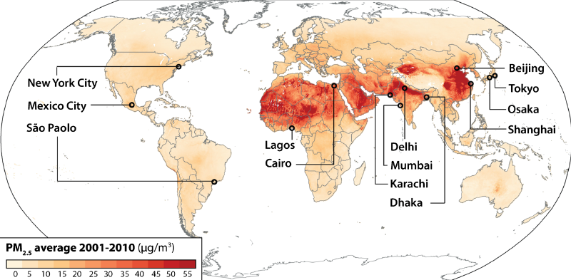
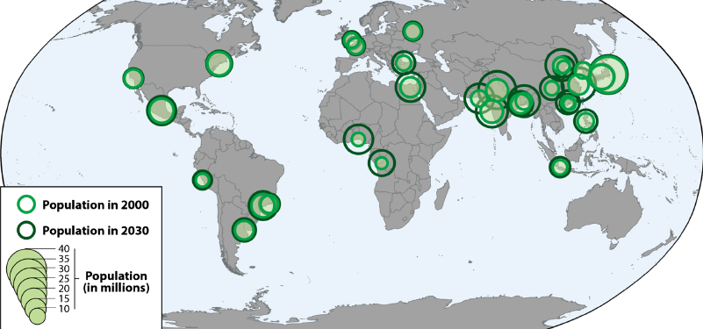
Global PM2.5 distribution
Population in global megacities

Slide 3
Outlines
Severe pollution events
Beijing (January 2013)
Shanghai (December 2013)
Ozone pollution event
Reunion Island (August 1995)
Mexico City (March 2016)

Slide 4
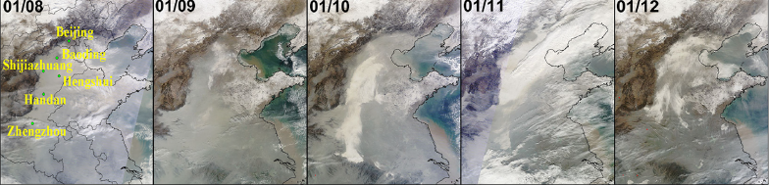
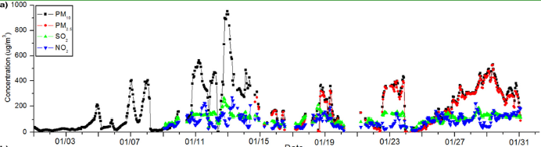
Beijing (January 2013)
Tao et al. (2014)
Distribution of Haze Clouds
Pollutant Concentration in Beijing

Slide 5
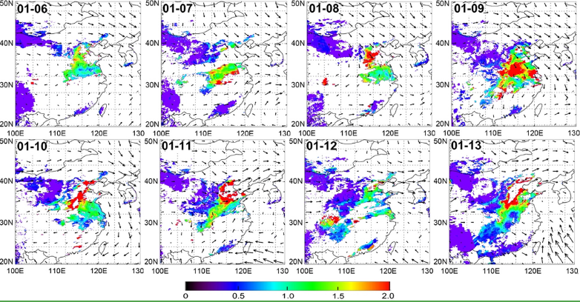
Beijing (January 2013)
MODIS 550 nm AOD
& wind speed field at 850 mb

Slide 6
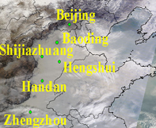
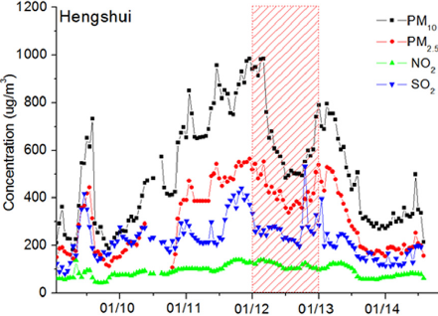
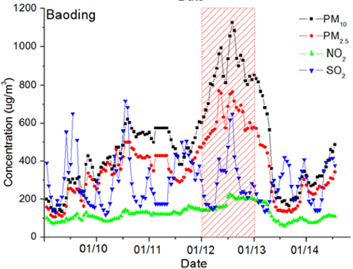
Beijing (January 2013)
Evidence of northward transport of air pollutants

Slide 7
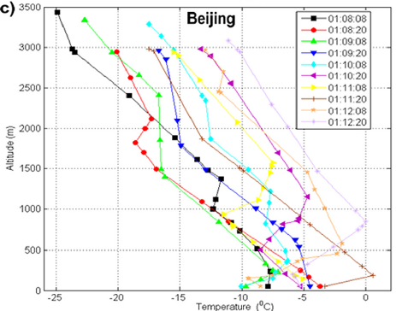
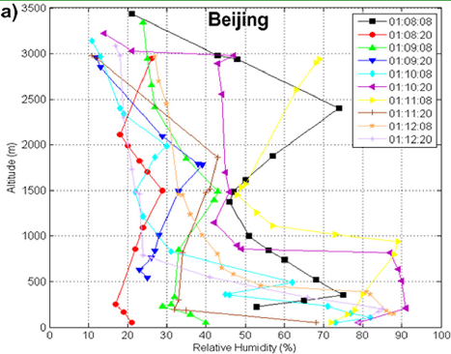
Beijing (January 2013)
Local meteorolgy conditions
Temperature
Relative humidity

Slide 8
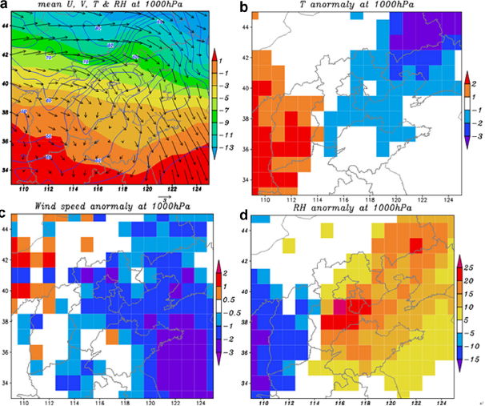
Beijing (January 2013)
The average situation
&
Anomalous in surface temperature, wind speed, and relative humidity

Slide 9
Beijing (January 2013)
Weak northwesterly winds at 850 mb at first did not blow the pollutants out of northern China, but transport them southward.
The following southerly winds blew the haze clouds back and persisted for several days.
Anomalous weather conditions played a crucial role in formation of
this extensive and prolonged haze pollution.

Slide 10
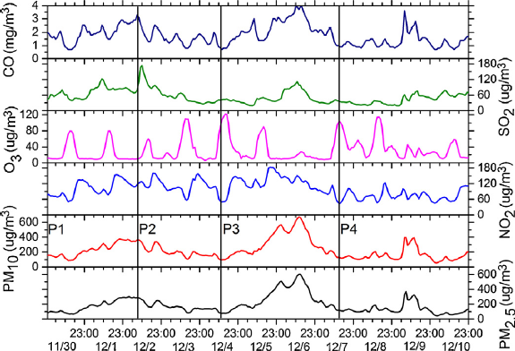
Shanghai (December 2013)
Pollutant Concentration in Shanghai
P1: steady increase
P2: steady decrease
P3: first peak
P4: second peak

Slide 11
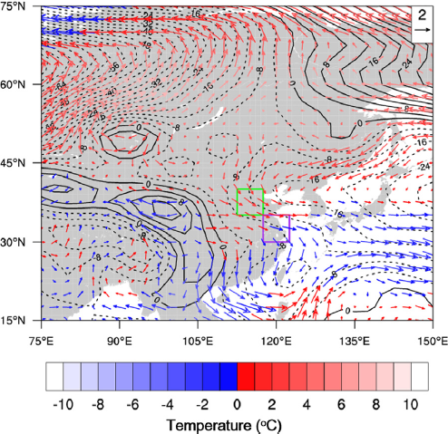
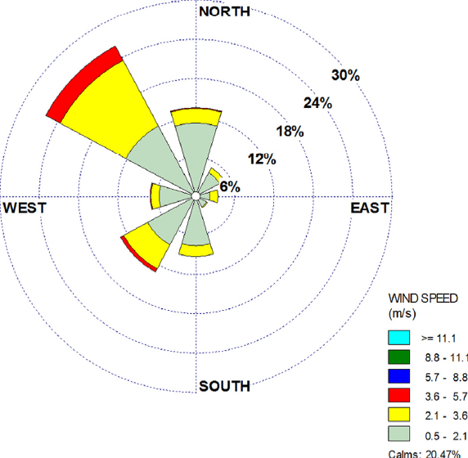
Shanghai (December 2013)
Large-scale background
Local surface wind

Slide 12
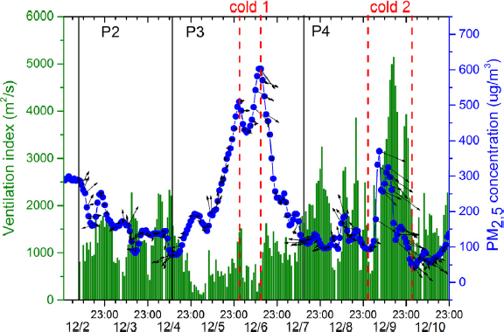

Shanghai (December 2013)
The impact of passing cold fronts
Ventilation index

Slide 13
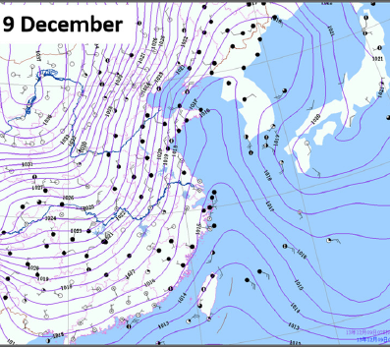
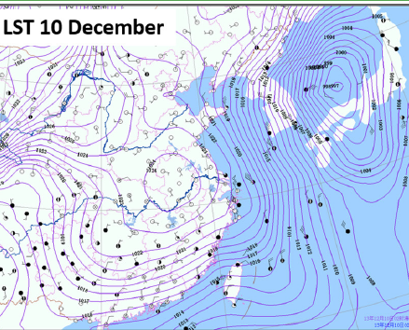
Shanghai (December 2013)
Cold front 2 passing Shanghai

Slide 14
Shanghai (December 2013)
Weather during December 2013: lower near-surfacewind speed, more sigificant northwesterly winds.
The passage of weak cold fronts enhanced the northwesterly winds and transport pollutants from upstream.

Slide 15
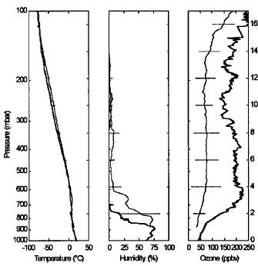
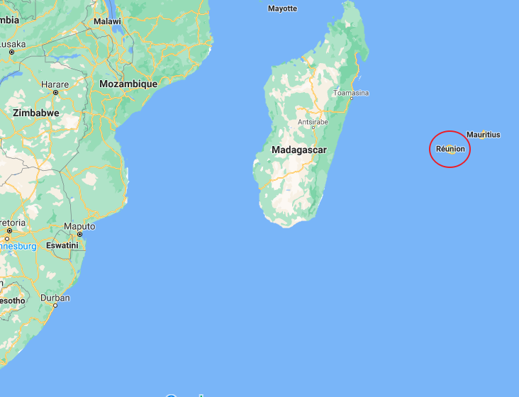
Reunion Island (August 25 1995)

Slide 16
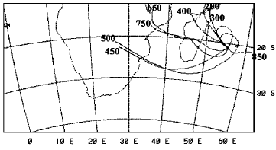
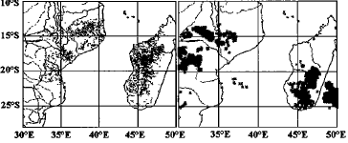
Reunion Island (August 25 1995)
Trajectories of air parcels on different pressure layers
biomass burning (left)
deep convection clouds (right)

Slide 17
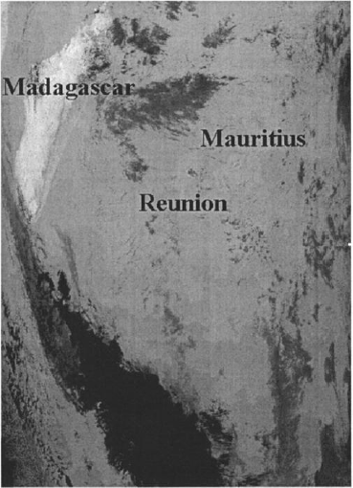
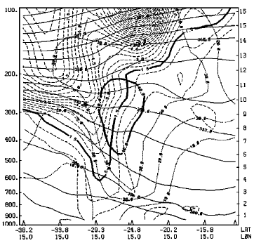
Reunion Island (August 25 1995)
A deep tropopause folding upstream on August 21 (South Africa)
Frontal cloud zone on August 24

Slide 18
Summary
Pollutant events in Beijing and Shanghai:
Synoptic transport of air pollutants.
Meteorological conditions: stagnent weather, low wind speed, high relative humidity, temperature inversions.
Ozone pollution events:
Photochemical reactions: NOx, CO, VOCs.
Stratospheric injections also plays a role.

Slide 19
References
[1] Marlier, M.E., Jina, A.S., Kinney, P.L. et al. Extreme Air Pollution in Global Megacities. Curr Clim Change Rep 2, 15–27 (2016).
[2] Tao, M., Chen, L., Xiong, X. et al. Formation Processes of the widespread extreme haze pollution over northern China in January 2013: Implications for regional air quality and climate. Atmos Environ. 93, 417- 25 (2014).
[3] Xu, J., Yan, F., Xie, Y. et al. Impact of conditions on a nine-day particulate matter pollution event observed in December 2013, Shanghai China. Particuology. 20, 69-79 (2015).
[4] Randriambelo, T., Baray, J.L., and Bremaud, P. A case study of extreme tropospheric ozone contamination in the tropics using in-situ satellite and meteorological data. Geophysical Research Letters. 26(9), 1287-1290 (1999).
[5] Barrett, B.S., Raga, G.B., Retama, A. et al. A multiscale analysis of the tropospheric and stratospheric mechanisms leading to the March 2016 extreme surface ozone event in Mexico City. Jour Geophys Research. 124(8), 4782-4799 (2019).
[6] Zhang, H., Wang, Y., Park T-W. et al. Quantifying the relationship between extreme air pollution events and extreme weather events. Atmos Research. 188, 64-79 (2017).

