Slide 1
Numerical Scheme For Advection Equation
Fanghe Zhao
EAS 6792
04/2021

Slide 2
Outlines
Introduction of numerical schemes for advection equation
Comparison of schemes
Future of numerical schemes

Slide 3
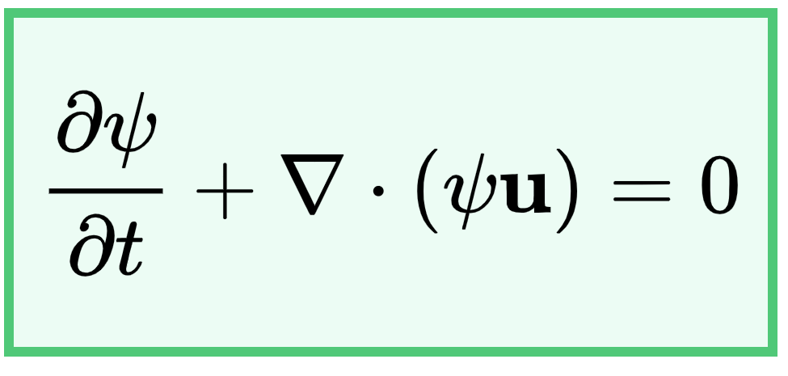
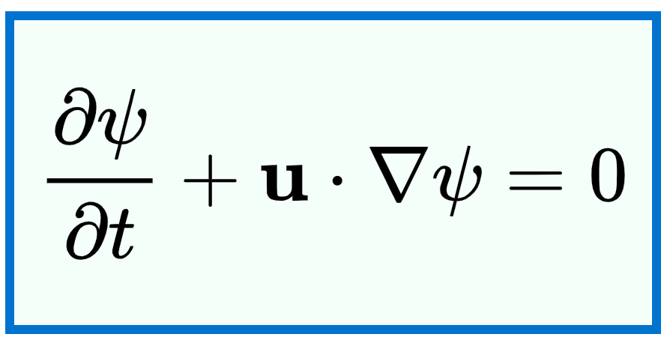
Advection Equation

Slide 4
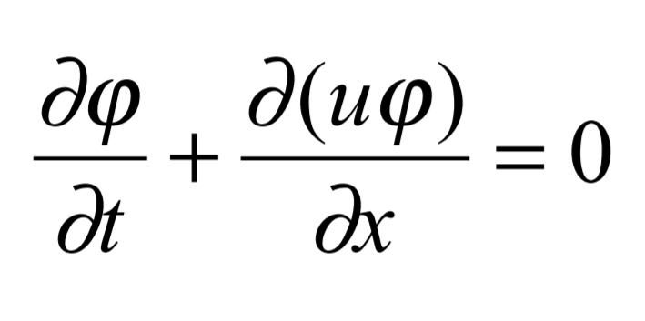
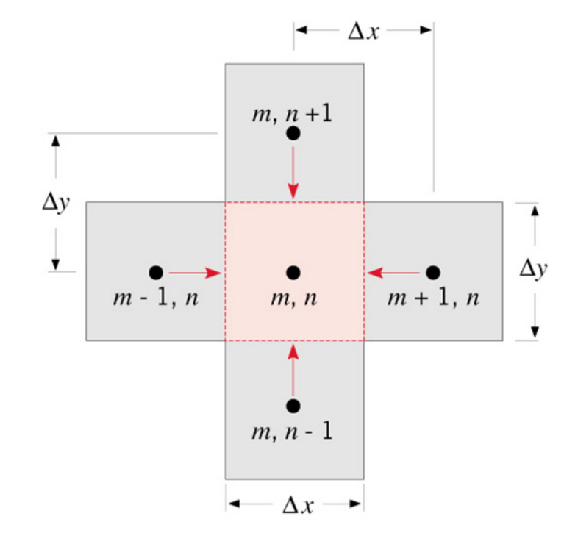
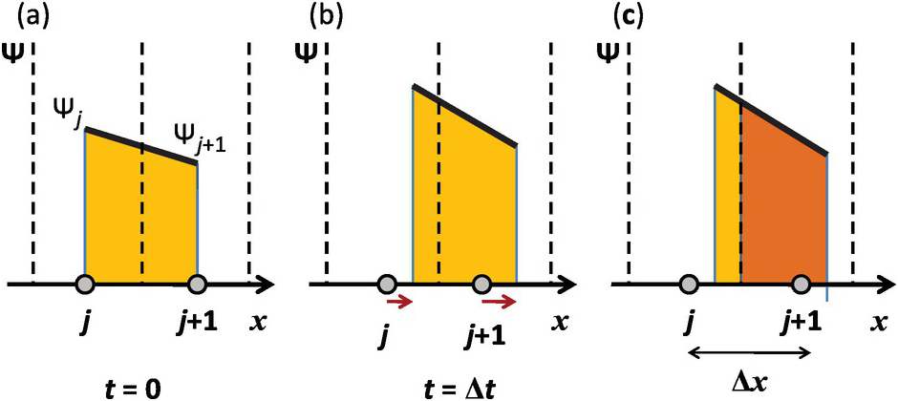
Advection Equation
Physical parameter changes = total flux
Brasseur et al. 2017
Hanryansyah 2014

Slide 5
Principle for Numerical Scheme
They should be free of mass conservation errors to accurately account for pollutant sources and sinks.
They should have small numerical diffusion to minimize the spread of a signal in every direction and the smoothing of spatial gradients.
They should also have small phase errors since disturbances that propagate at different speeds produce spurious oscillations.
Given initial positive concentrations, the schemes should be positive-definite (i.e., they should not produce negative concentrations.)
They should be monotonic (i.e., they should not produce new extrema).

Slide 6
Type of schemes
Finite difference schemes
Finite volume schemes
Flux corrected schemes
Lagrangian Schemes
Finite element schemes, Spectral schemes

Slide 7
Numerical Scheme for Advection
Bott scheme (Bott 1988)
Prather Scheme (Prather 1986)
Piecewise parabolic method (Colella and Woodward 1984)
Yamartino-Blackman Cubic scheme (Yamartino 1993)
Accurate space derivative scheme (Grazdag 1972)
Walcek Scheme (Walcek 2000)
Modified Bott Scheme (Easter 1993; Chlond 1994)
TRAP Scheme (Syrakov 2004)
…
Subgrid distribution

Slide 8
Numerical Scheme for Advection
Determine the Subgrid distribution
Calculate latent flux
Apply the limiter
Polynomial
Special function
Fourier series
Fitting
Moment
positive-definite
monotonic

Slide 9
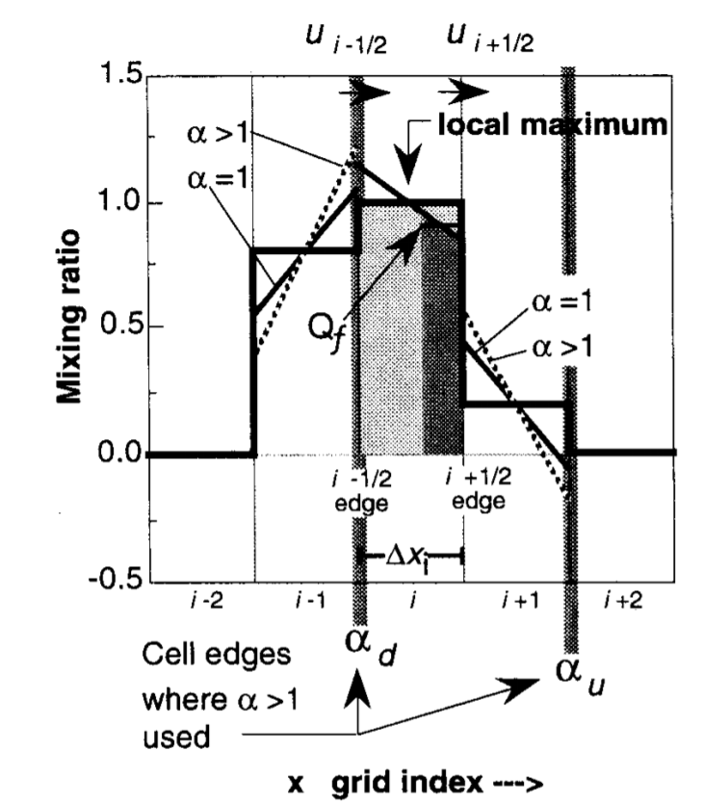
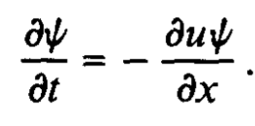
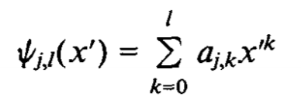
Bott Scheme
Polynomial Fitting
(Walcek 2000)

Slide 10
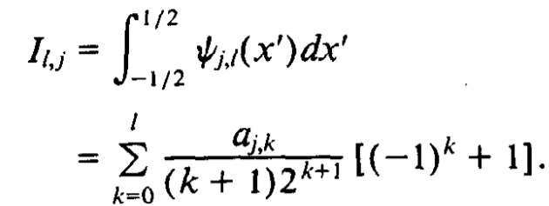
Bott Scheme
Flux derivation
Positive Definiteness

Slide 11
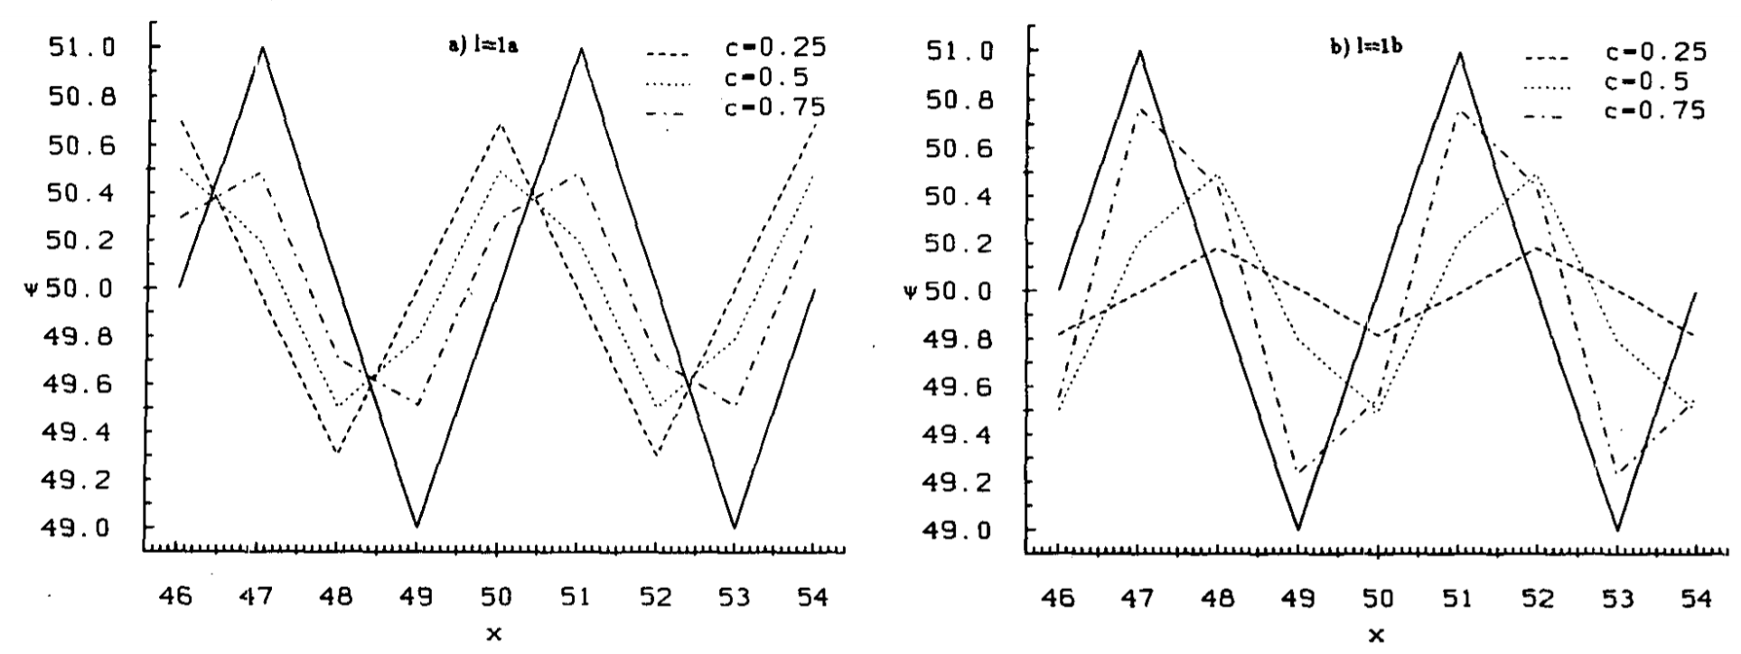
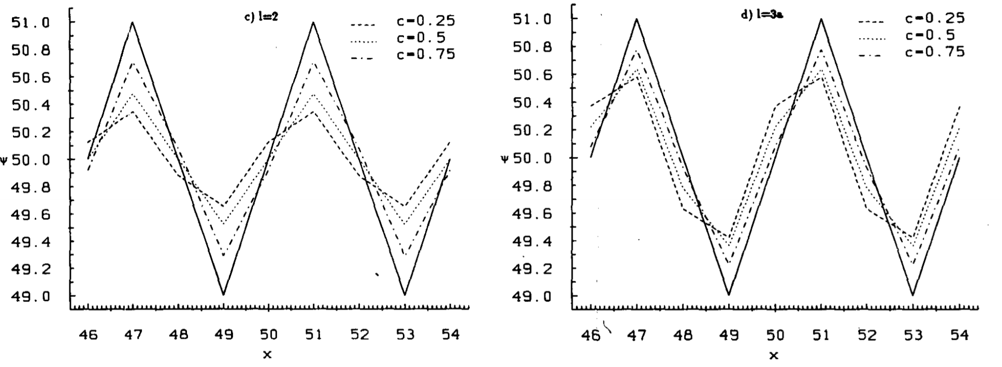
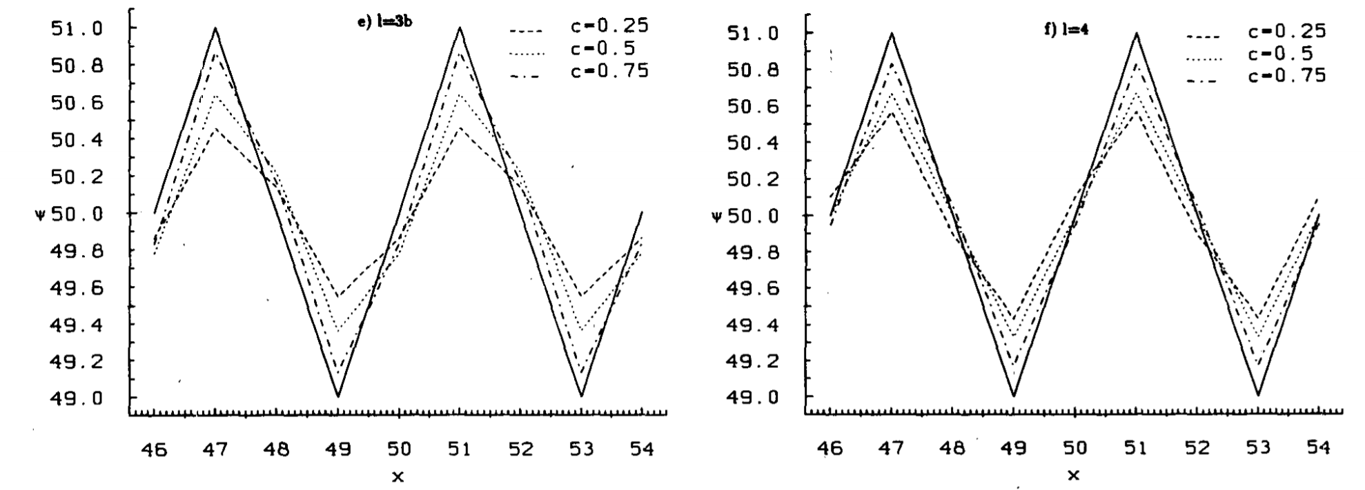
Bott Scheme
Single Fourier mode with wavelength 4 delta x

Slide 12
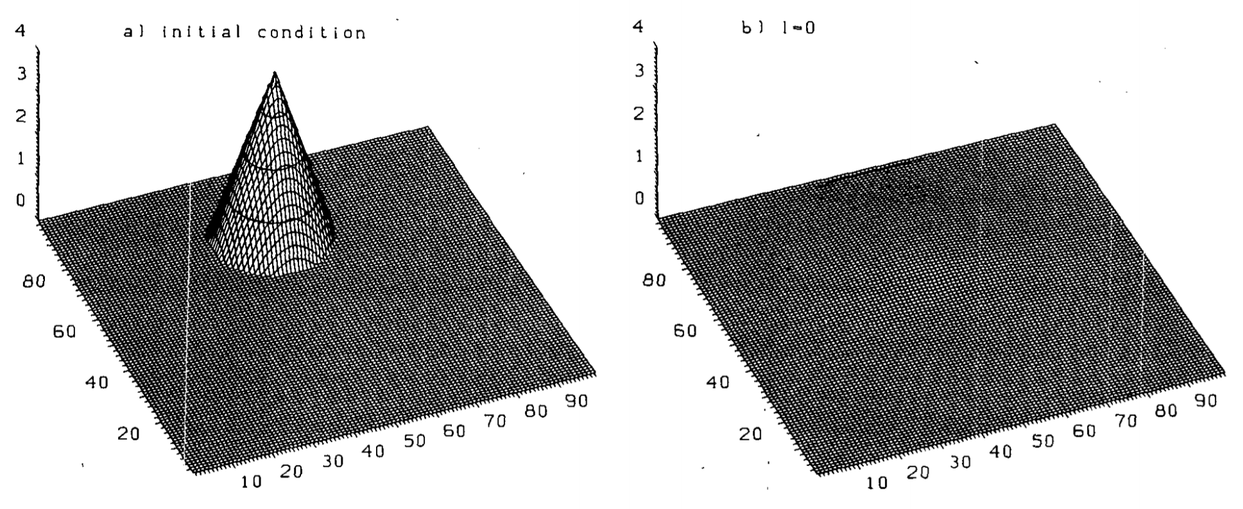
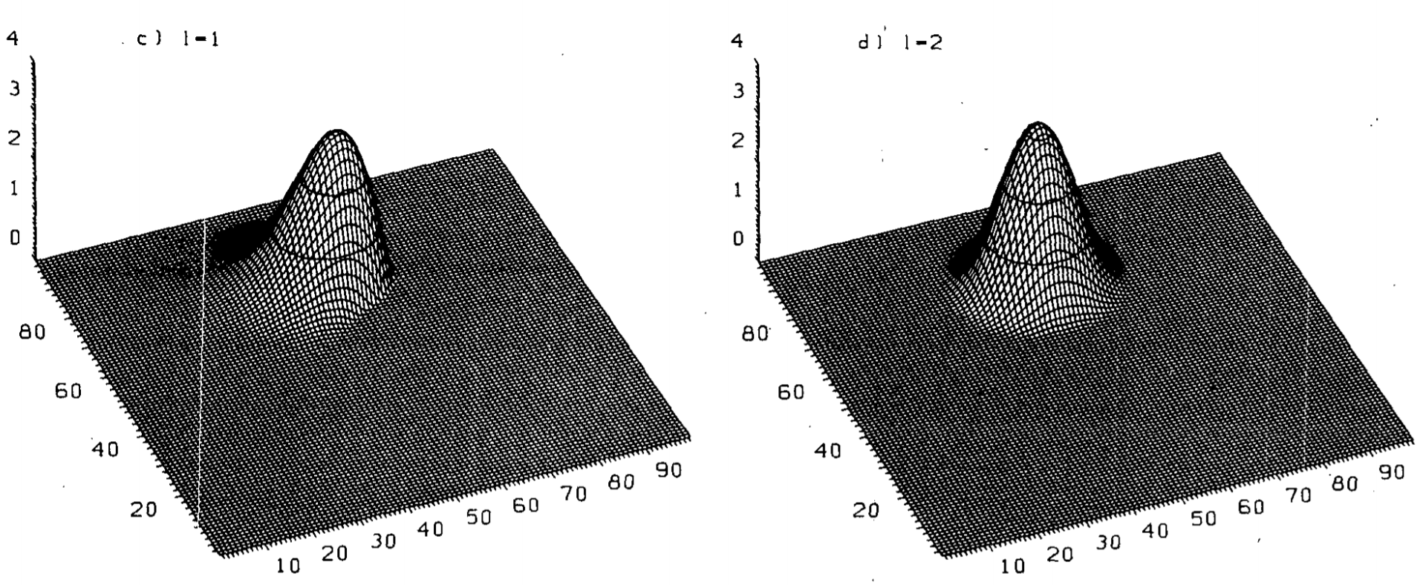
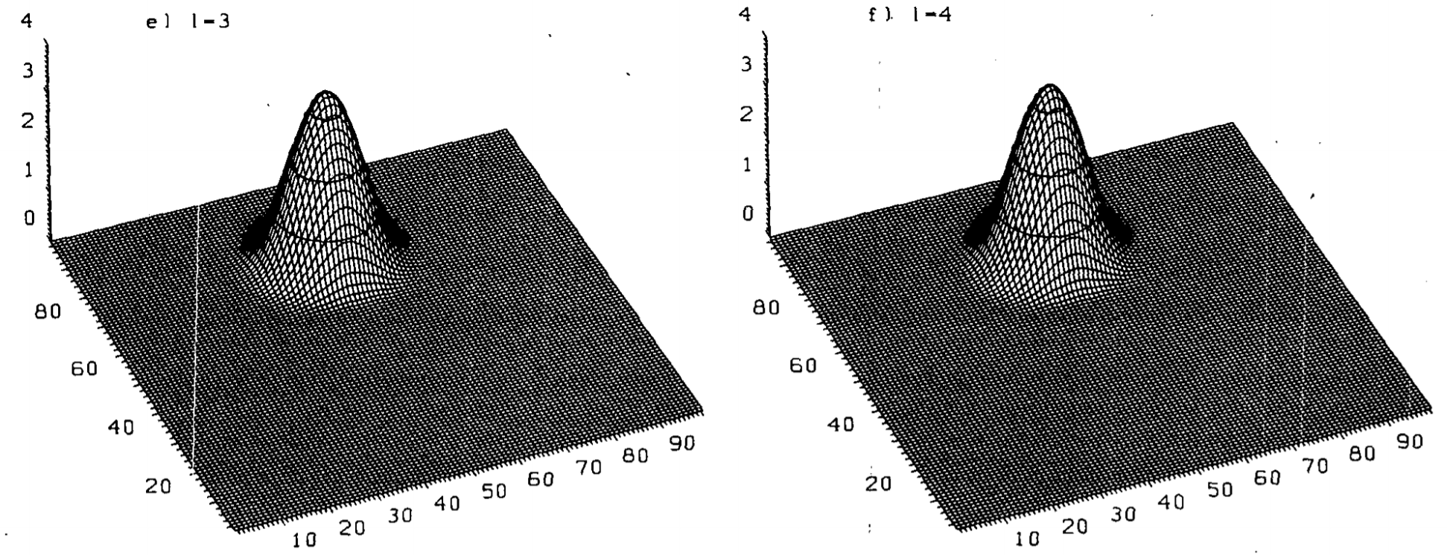
Bott Scheme

Slide 13
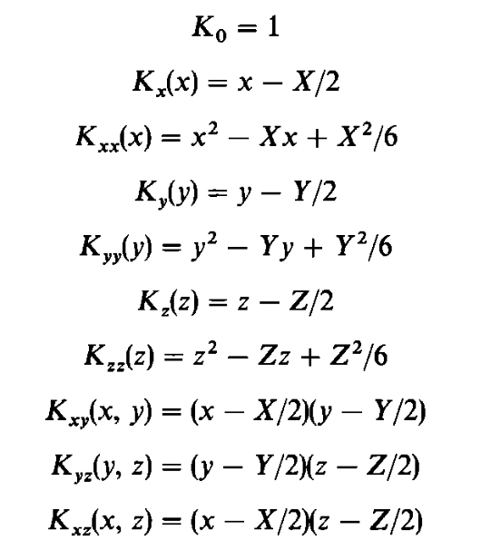
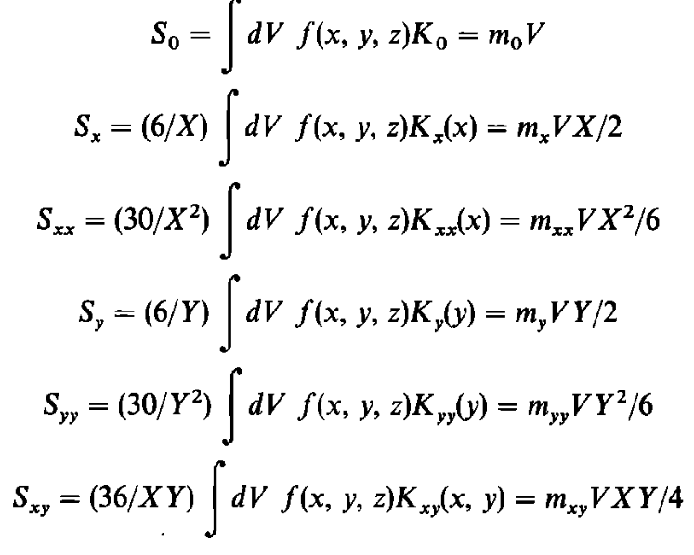
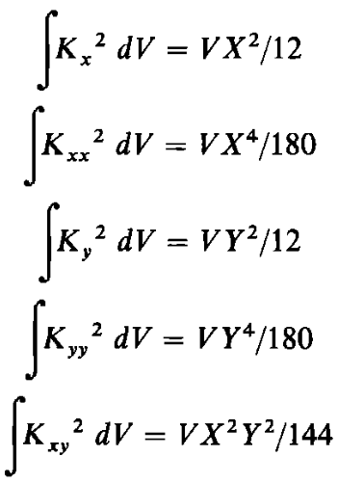
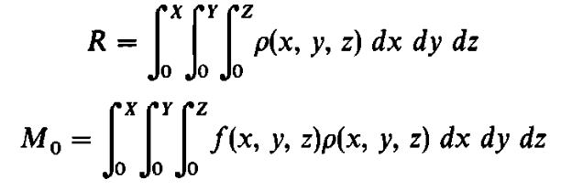
Prather Scheme
Quadratic form

Slide 14
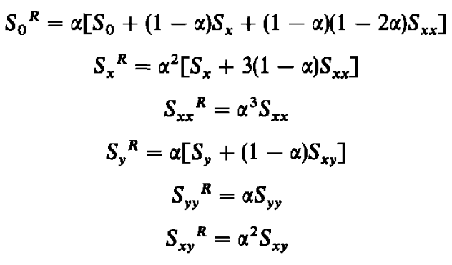
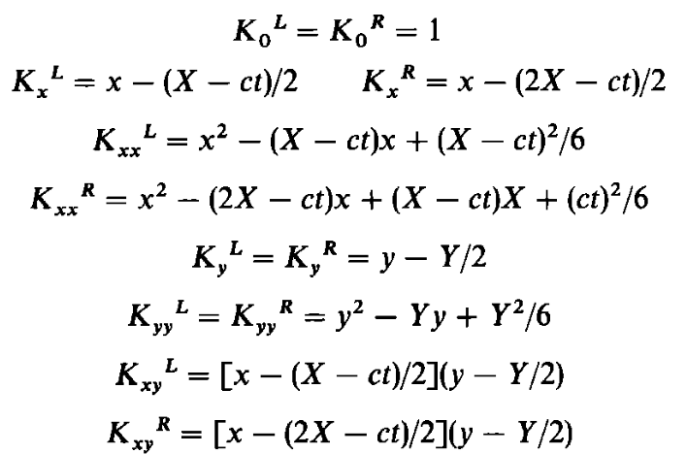
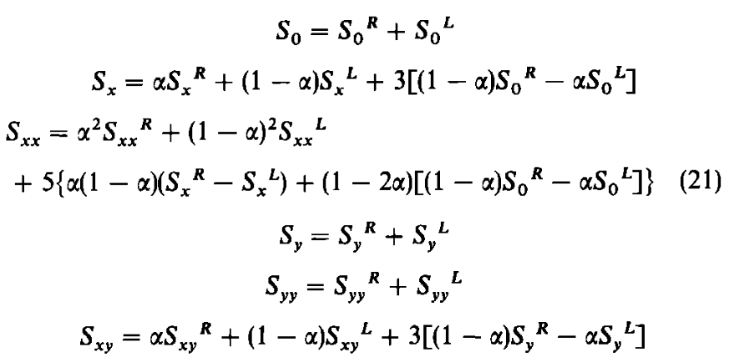
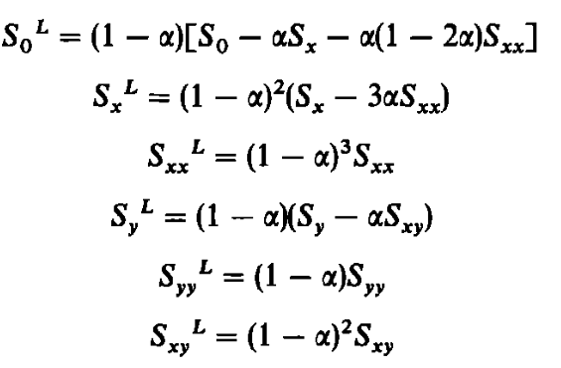
Prather Scheme

Slide 15
Prather Scheme
Step 1. Define moments of original boxes
Step 2. Calculate the moments for appropriate subboxes
Step 3. Designate components of new grid box
Step 4. Combine subboxes into grid box

Slide 16
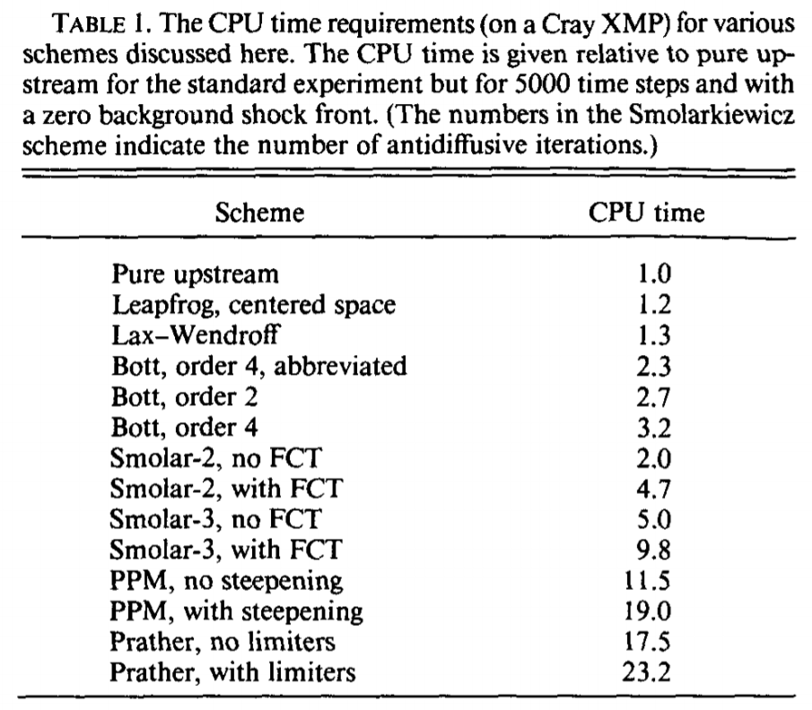
Comparison
Muller 1991

Slide 17
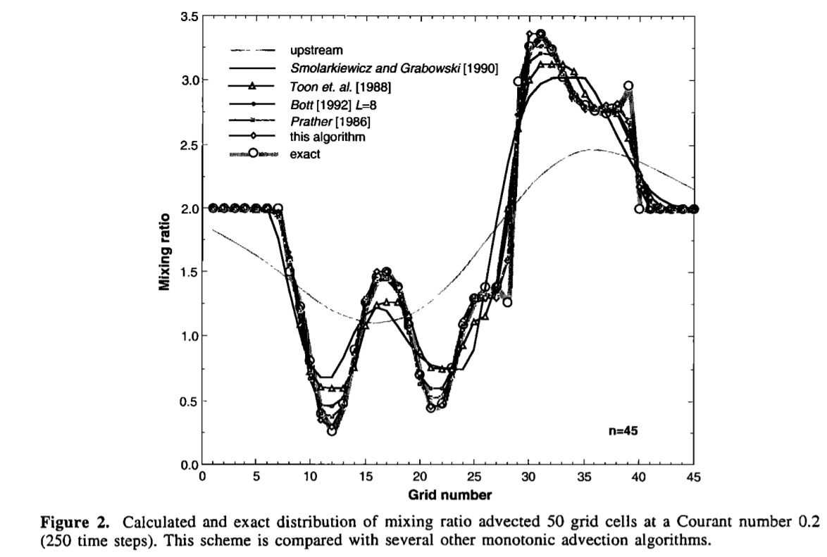
Comparison
Walcek 2000

Slide 18
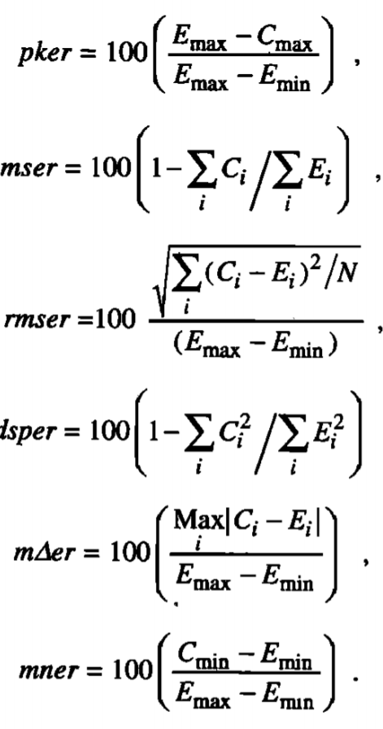
Comparison
Walcek 2000
Walcek 2000

Slide 19
Future
AI PDE solver
Reconfigurable computing & Edge computing

Slide 20
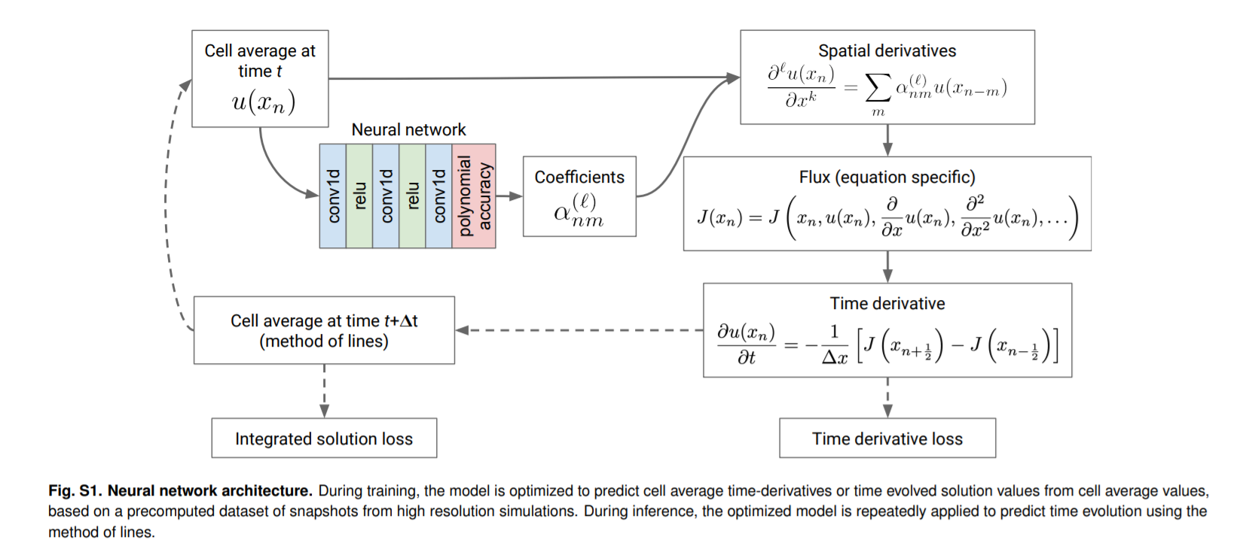
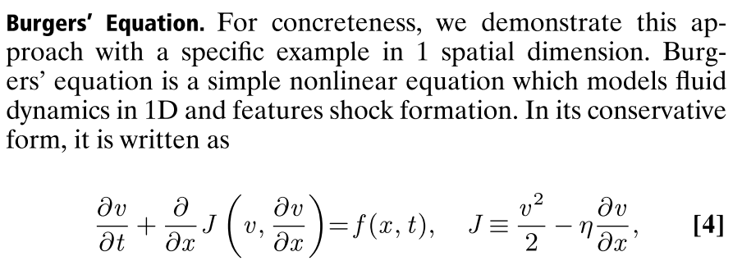
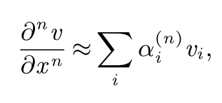
AI PDE solver

Slide 21
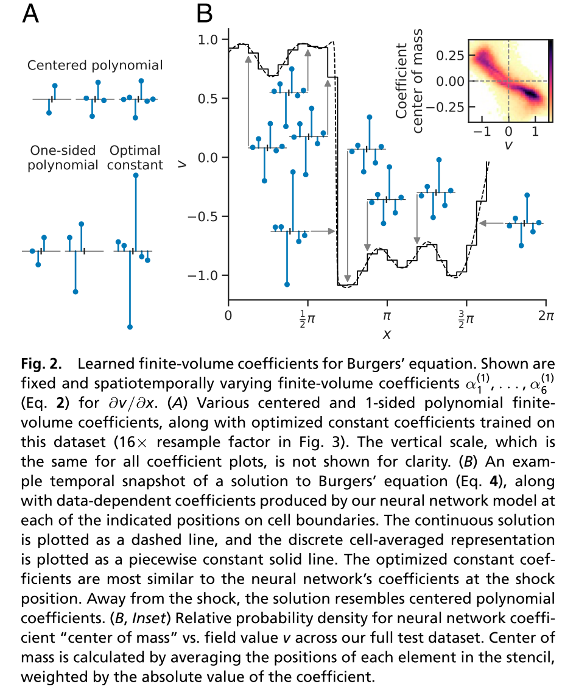
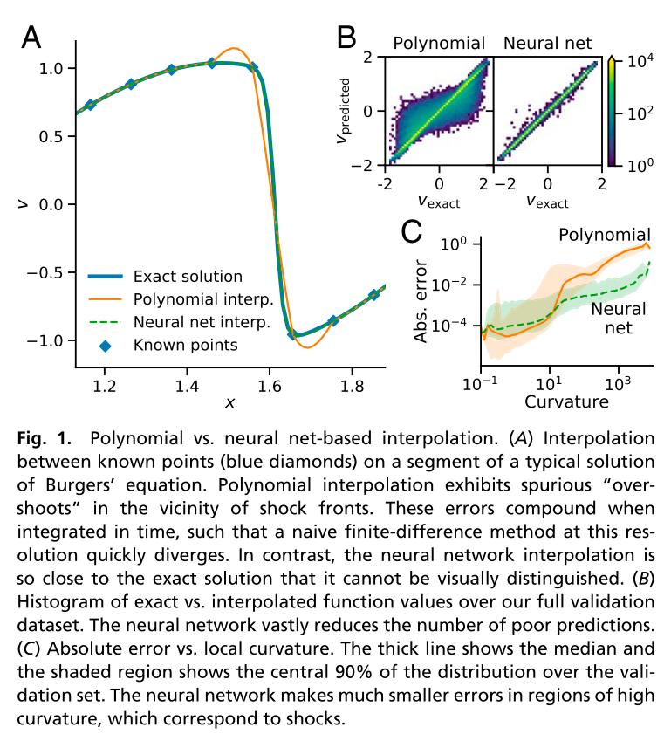
AI PDE solver

Slide 22
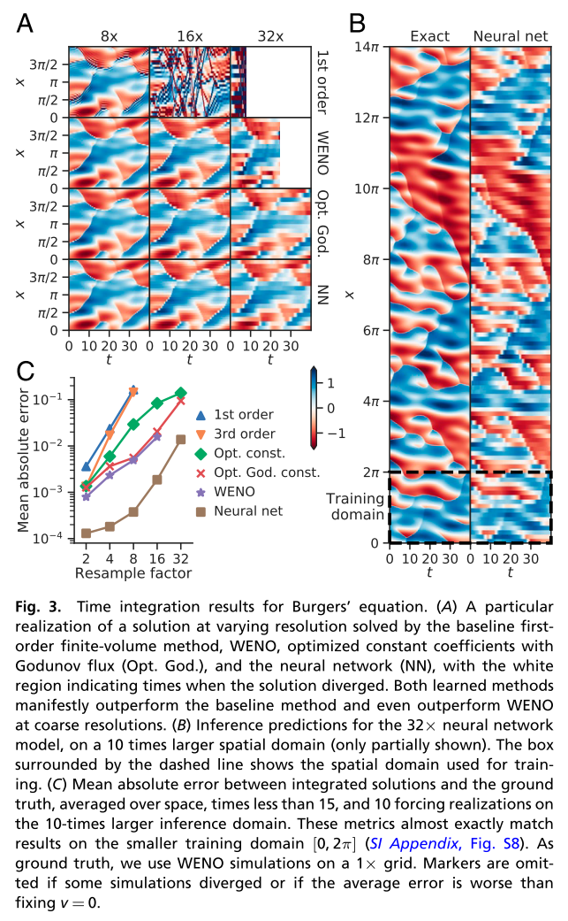
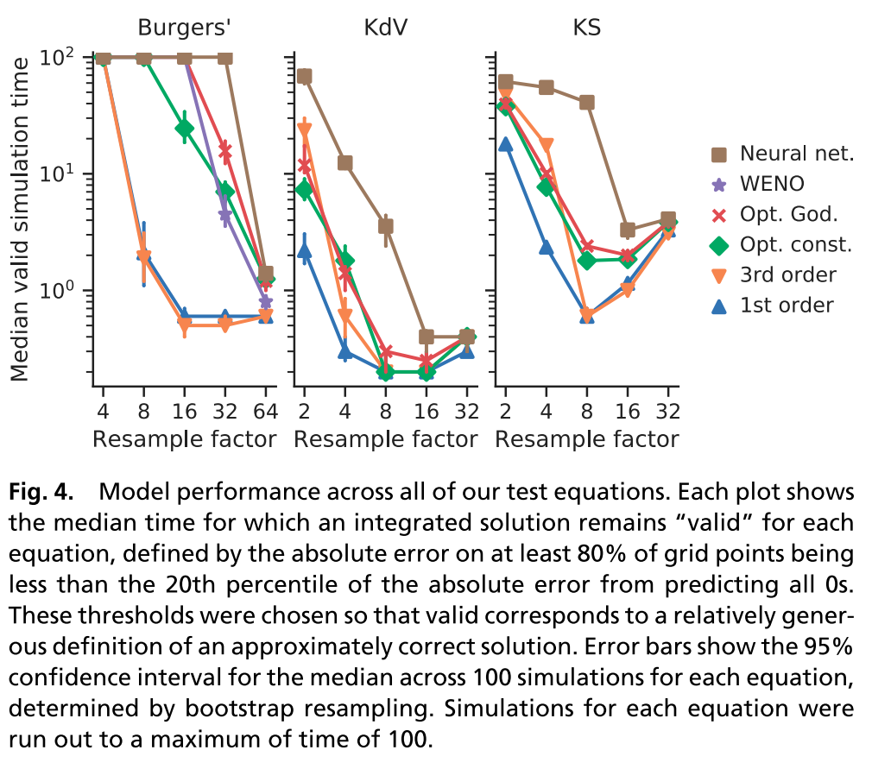
AI PDE solver

Slide 23
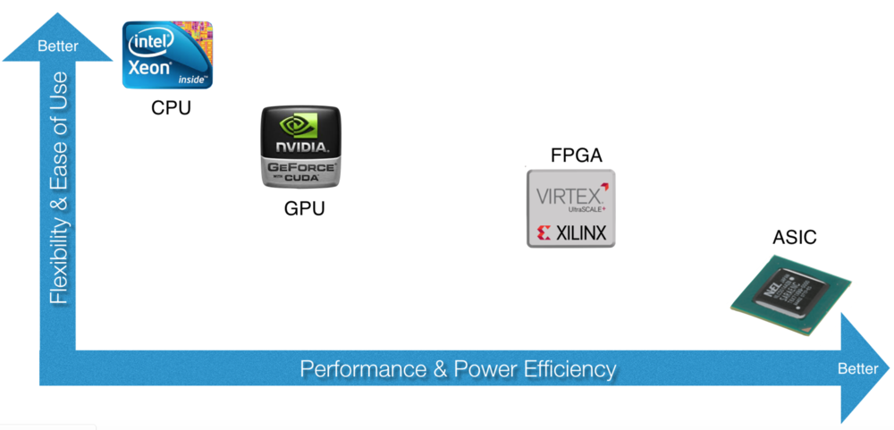
Reconfigurable computing & Edge computing
Field-programmable gate array
Application-specific integrated circuit

Slide 24
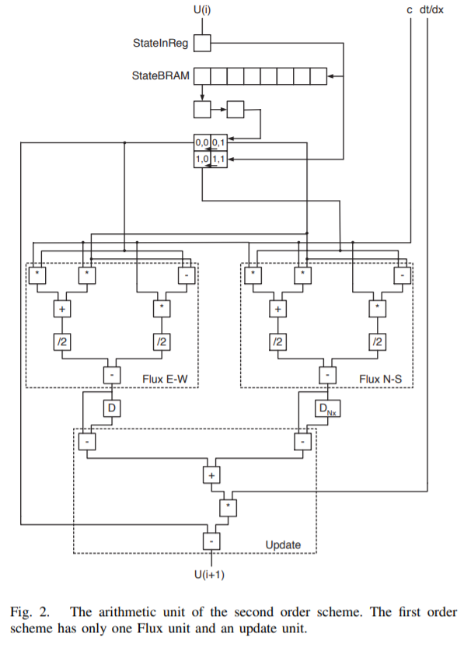
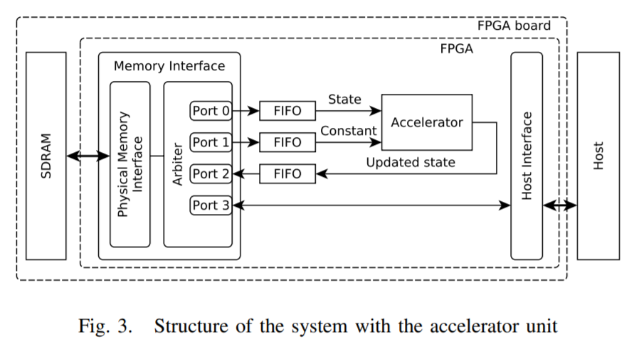
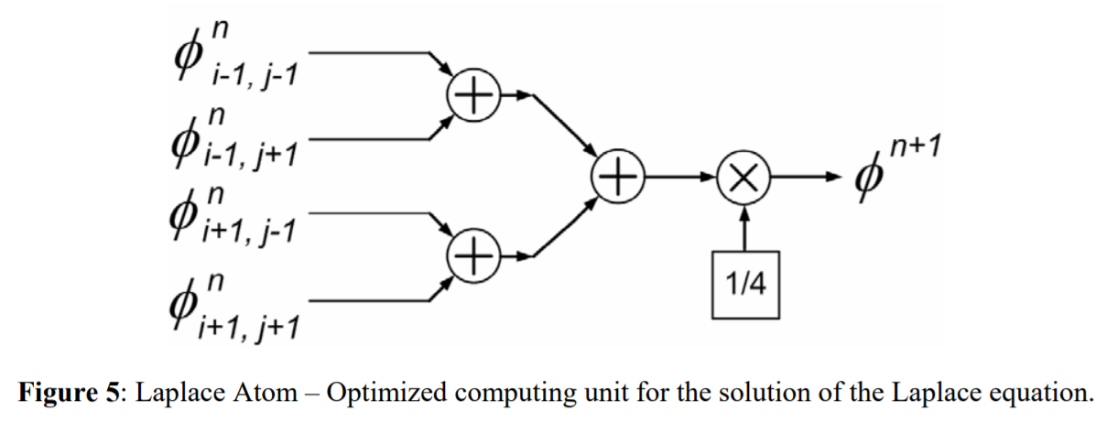
Reconfigurable computing & Edge computing

Slide 25
Thanks

Slide 26
Reference
Yamartino, R. J. 1993. “Nonnegative, Conserved Scalar Transport Using Grid-Cell-Centered, Spectrally Constrained Blackman Cubics for Applications on a Variable-Thickness Mesh.” Monthly Weather Review 121 (3): 753–63. https://doi.org/10.1175/1520-0493(1993)121<0753:NCSTUG>2.0.CO;2.
Colella, Philup, and Paul R Woodward. 1984. “The Piecewise Parabolic Method (PPM) for Gas-Dynamical Simulations.” JOURNAL OF COMPUTATIONAL PHYSICS. Vol. 54.
Kiss, András, Zoltán Nagy, Árpád Csík, and Péter Szolgay. 2012. “Examining the Accuracy and the Precision of PDEs for FPGA Computations.” In International Workshop on Cellular Nanoscale Networks and Their Applications. https://doi.org/10.1109/CNNA.2012.6331439.
Núñez, Rafael C, Juan G Gonzalez, and José A Camberos. n.d. “Large-Scale Numerical Solution of Partial Differential Equations with Reconfigurable Computing.” Accessed April 7, 2021. www.accelogic.com,AIAA.
Mojtabi, Abdelkader, Michel Deville, and Michel O Deville. 2015. “One-Dimensional Linear Advection-Diffusion Equation: Analytical and Finite Element Solutions Open Archive TOULOUSE Archive Ouverte (OATAO) One-Dimensional Linear Advection-Diffusion Equation: Analytical and Finite Element Solutions.” Computers and Fluids 107: 189–95. https://doi.org/10.1016/j.compfluid.2014.11.006ï.
Thuburn, John. 1995. “Dissipation and Cascades to Small Scales in Numerical Models Using a Shape-Preserving Advection Scheme.” Monthly Weather Review 123 (6): 1888–1903. https://doi.org/10.1175/1520-0493(1995)123<1888:dactss>2.0.co;2.
Odman, M Talat. 1998. “Research on Numerical Transport Algorithms for Air Quality Simulation Models Project Summary.”
Byun, Daewon W, Jeffrey Young, Jonathan Pleim, M Talat Odman, and Kiran Alapaty. n.d. “Chapter 7 NUMERICAL TRANSPORT ALGORITHMS FOR THE COMMUNITY MULTISCALE AIR QUALITY (CMAQ) CHEMICAL TRANSPORT MODEL IN GENERALIZED COORDINATES.”
Ge, Xiaozhen, Feng Li, and Ming Ge. 1997. “Meteorology, and Atmospheric Physics Numerical Analysis and Case Experiment for Forecasting Capability by Using High Accuracy Moisture Advectional Algorithm.” Meteorol. Atmos. Phys. Vol. 63.
Muller, R. 1992. “The Performance of Classical versus Modern Finite-Volume Advection Schemes for Atmospheric Modeling in a One-Dimensional Test-Bed.” Monthly Weather Review 120 (7): 1407–15. https://doi.org/10.1175/1520-0493(1992)120<1407:tpocvm>2.0.co;2.
Petrova, Silvia, Hristina Kirova, Dimiter Syrakov, and Maria Prodanova. 2008. “Some Fast Variants of TRAP Scheme for Solving Advection Equation - Comparison with Other Schemes.” Computers and Mathematics with Applications 55 (10): 2363–80. https://doi.org/10.1016/j.camwa.2007.11.001.
Bott, A. 1989. “A Positive Definite Advection Scheme Obtained by Nonlinear Renormalization of the Advective Fluxes.” Monthly Weather Review 117 (5): 1006–15. https://doi.org/10.1175/1520-0493(1989)117<1006:apdaso>2.0.co;2.
Prather, Michael J. 1986. “Numerical Advection by Conservation of Second-Order Moments.” Journal of Geophysical Research 91 (D6): 6671. https://doi.org/10.1029/JD091iD06p06671.
Bar-Sinai, Yohai, Stephan Hoyer, Jason Hickey, and Michael P. Brenner. 2019. “Learning Data-Driven Discretizations for Partial Differential Equations.” Proceedings of the National Academy of Sciences of the United States of America 116 (31): 15344–49. https://doi.org/10.1073/pnas.1814058116.
Han, Jiequn, and Arnulf Jentzen. 2018. “Solving High-Dimensional Partial Differential Equations Using Deep Learning.” PNAS 115. https://doi.org/10.1073/pnas.1718942115.

