Slide 1
Atmospheric Mercury: From emission to deposition
Shannon Capps
April 22, 2008

Slide 2
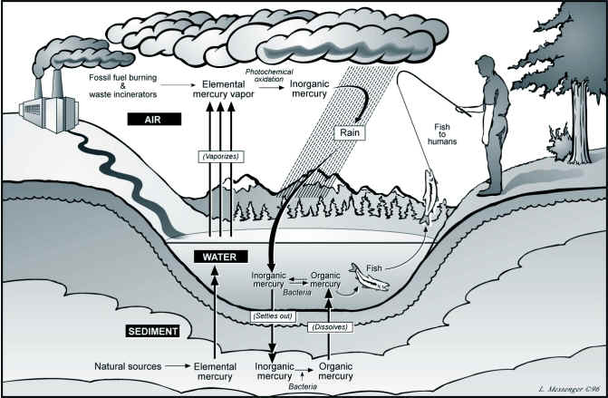
Mercury cycling
From http://people.uwec.edu/piercech/Hg/mercury_water/cycling.htm

Slide 3
Model Components
125 x 125 km domain
Chemistry
Gaseous and aqueous chemical mechanisms
Chemical kinetic constants
Losses
Dry deposition schemes
Wet deposition estimations
Production
Anthropogenic Emissions
Natural (Re)emissions

Slide 4
Chemical Species
Gaseous elemental mercury (Hg(0)) (GEM)
Atmospheric lifetime, τ, of 0.5 to 2 years due to dry deposition and chemical reactions (Lin et al., 2006)
Reactive gaseous mercury (Hg(II)) (RGM)
Produced by oxidation of GEM, this species’ atmospheric lifetime is governed by wet and dry deposition
Particulate mercury (PHg)
Nonreactive species whose atmospheric lifetime is governed by wet and dry deposition

Slide 5
Chemical Reactions
Gaseous reduction of Hg(0)
Aqueous reactions of Hg(II)
Oxidation
Reduction

Slide 6
Gaseous Hg(0) Oxidation
Continental troposphere
O₃
OH
Marine boundary layer and upper troposphere
Cl
Br
Alternate oxidants
H₂O₂, Cl₂, Br₂, BrO, I, I₂

Slide 7
Aqueous Hg(II) Reactions
Oxidation
OH
O₃
Cl
Br

Slide 8
Aqueous Hg(II) Reactions
Reduction
SO₃
HO₂•
Light

Slide 9
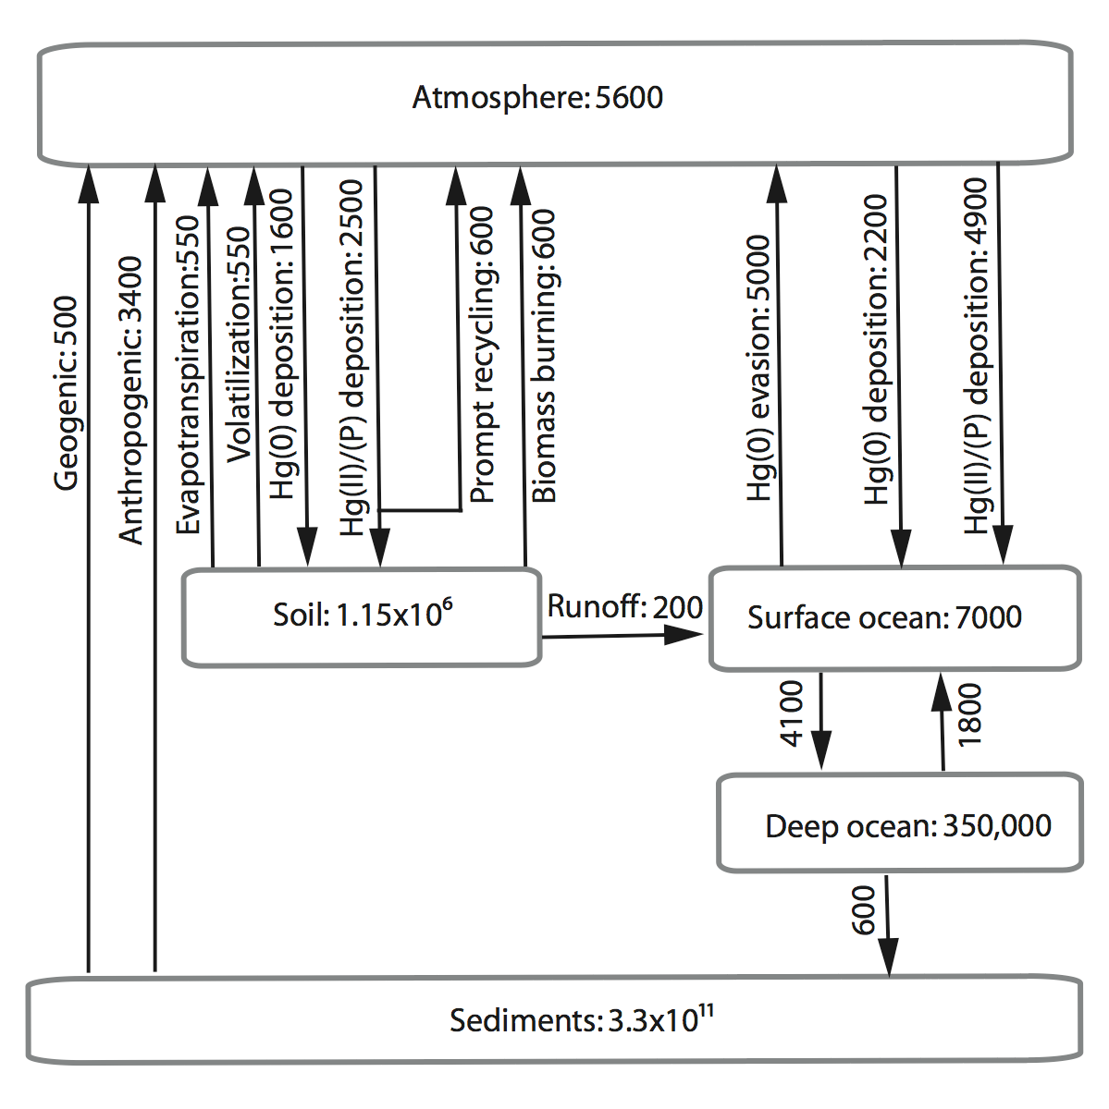
Sources and Sinks
Compared to 1970 in preindustrial times.
As with any other chemical we have studied, a budget is as simple or complex as a flow diagram.
Inventories are in 10⁶ g and rates are in 10⁶ g y⁻¹
from Selin et al., 2008

Slide 10
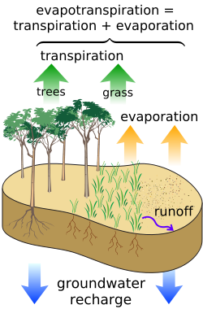
Natural (Re)emissions
Evapotranspiration
The combination of transpiration from vegetation and evaporation from land surfaces
Volatilization
Reduction-oxidation reactions occur within the soil and due to heat, the Hg(II) is released from the soil pool into the atmosphere

Slide 11
Immediate recycling
Fast return into atmosphere
Freshly deposited mercury has a reemission lifetime of days to months after deposition
After a few months, the reemission lifetime is identical to the mercury strongly bound to the soil already
~20% of wet deposition of Hg(II) results in quick release of Hg(0) into the atmosphere

Slide 12
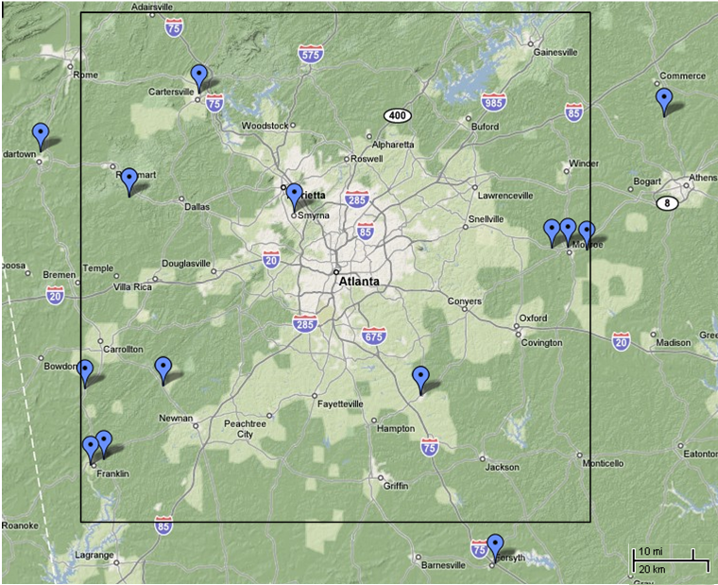
Fossil fuel combustion
Points represent gas turbine power generation sites
Yorkville MDN site
(rking’s public Google map)

Slide 13
Anthropogenic Emissions

Slide 14
Atlanta in April Scenario
Sources | (kg/day)
Anthropogenic Emissions¹ | 1.29
Evapotranspiration² | 0.099
Volatilization² | 0.090
Prompt Recycling | f(deposition)
Sinks | (cm/day)
Dry Deposition, V_{d}³ | 864
Wet Deposition, P ⁴ | 0.432
Flux = [Hg_{i}]* V_{d}
Flux = [Hg²⁺]* P
EPA NEI 1999, http://www.epa.gov/air/data/reports.html
Selin et al., 2008, submitted, http://www-as.harvard.edu/chemistry/trop/
Lin et al., 2006
National Weather Service, http://www.weather.gov/climate/index.php?wfo=ffc

Slide 15
Checking Results
Similar studies have been carried out (Selin et al., 2008, Lin et al., 2006, etc.)
Data from these will be useful for verifying that the programming has been done correctly
Measurements of wet deposition (Mercury Deposition Network) has extensive data
Checking against actual measurements will provide verification for the model inputs and resulting values

Slide 16
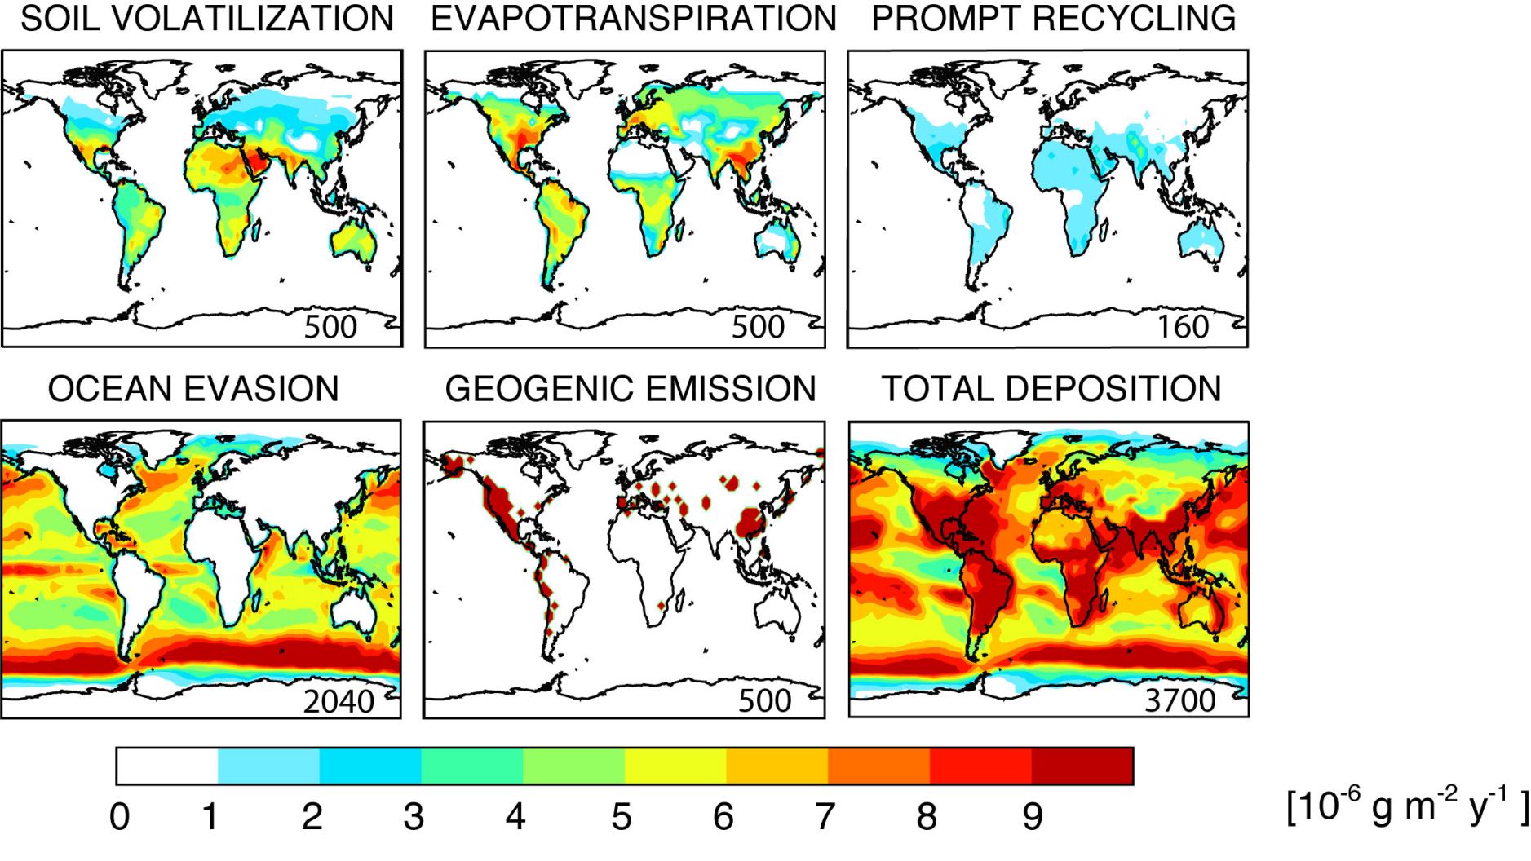
Modeled estimates
(Selin et al., 2008), submitted

Slide 17
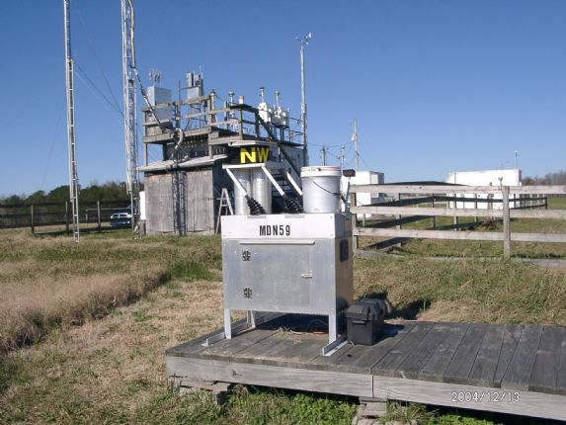
Measurements
Mercury Deposition Network
Weekly measurements of wet deposition of mercury
Yorkville, GA in Paulding County
April 2006, 0.75 kg/day

Slide 18
Conclusions
Expected challenges
Difficulty finding stable initial conditions for the Runge-Kutta fourth order solver
Comparisons of the wet depositions rates
Anticipated findings
Similar results to the Selin et al. findings due to simplicity
Gain range of the impact of the thermodynamics (gas-liquid-solid partitioning)
Notes:
Ill-conditioned matrices
Poor knowledge of conditions

Slide 19
Natural Occurrences of Mercury
Sources
Natural
Anthropogenic
Relevance
Human health impacts
Ecosystem impact
Cycling
Air
Surface/water
Transfer
Wet/dry deposition
Etc.
Chemistry
General – species of Hg
Atmospheric reactions – photochemistry/oxidation

