Slide 1
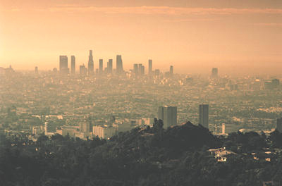
Long Term Trends of Surface Ozone Level
Lu Xu
Xiaoxi Liu
Benjamin Sheyko

Slide 2
Overview
1. Introduction
2. Long-term changes in surface O3 of global scale
- N.H. and S.H.
3. Long-term changes in surface O3 levels in the United States (1980-2005)
4. Effect of Asian emissions on surface O3 in the US
5. Conclusions

Slide 3
1. Introduction
Ozone in the troposphere is a key ingredient in many atmospheric physical and chemical processes
-Radiative forcing
-Precursor to the formation of OH
-Photochemical ozone production: human health, terrestrial ecosystems
Tropospheric Ozone:
- Near ground level: air quality concerns
- Entire depth of the troposphere: the climatic and oxidizing impacts of O3
A lifetime of several days to several weeks, ozone is not a globally or hemispherically well-mixed constituent

Slide 4
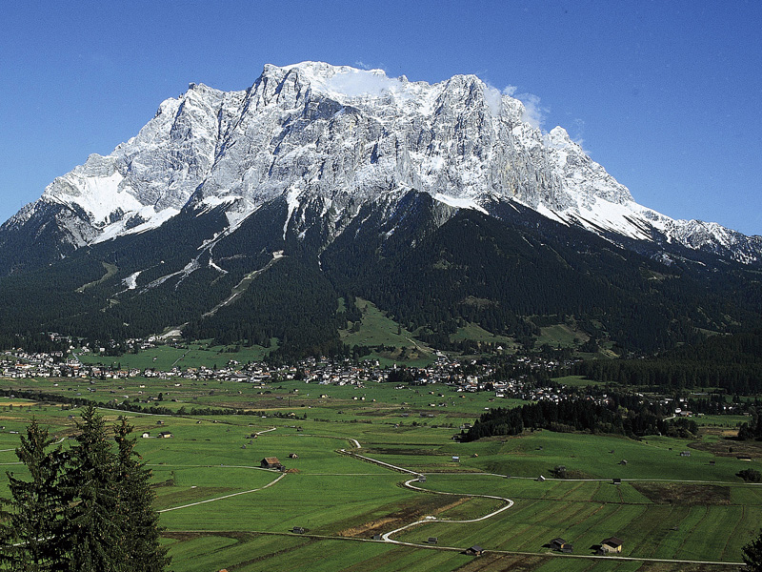
2. Global long term surface O3 trends
Approach:
- Long records (>15 years)
“Background” sites away from
precursor sources
Surface observations
To highlight the decadal changes:
1975–1984, 1985–1994 and 1995–2004
Zugspitze, Germany

Slide 5
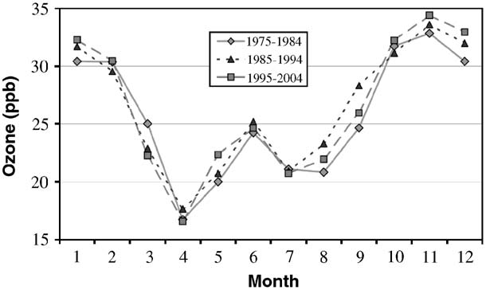
Changes in the northern hemisphere-High Latitudes
Barrow(70N): a significant 4.8 (±1.7)%/decade increase
Springtime ozone depletion related to bromine chemistry
Periods of both declining and increasing ozone amounts, varying patterns of change on multi-decadal time scales.
Average monthly surface ozone
at Barrow, Alaska

Slide 6
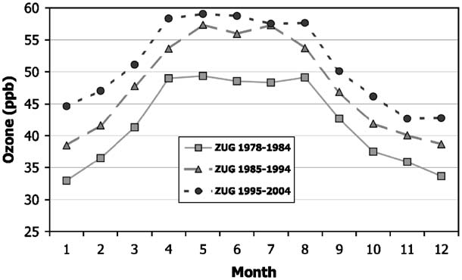
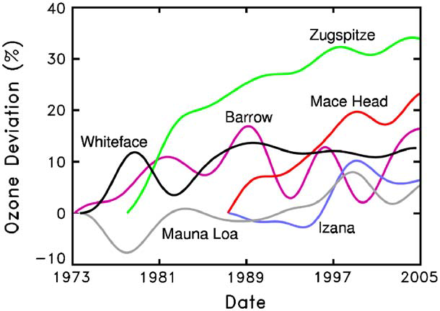
Changes in the northern hemisphere-Mid Latitudes
Continental Europe showed significant increases in the 1970s and 1980s:
Zugspitze, 12.6 (±0.8)%/decade increase
Over North America rises in the 1970s are less than those seen in Europe, suggesting significant regional differences.
44.4N, New York
53.2N, Ireland
28.3N, Spain
19.5N, Hawaii
Average monthly surface ozone at Zugspitze, peak of the Wetterstein Mountains, Germany
Ozone trend curves in percent deviation at six N.H. surface ozone sites

Slide 7
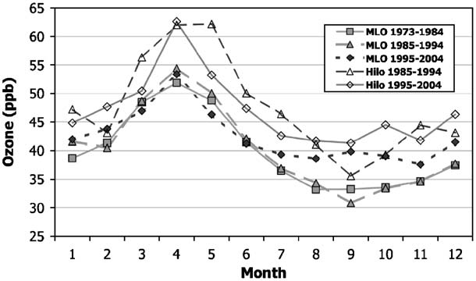
Changes in the northern hemisphere-Tropics
In the N.H. tropics the surface record in Hawaii show a significant increase (3.5±1.5%/decade) in the autumn months in the most recent decade .
The Hawaiian location sees transport events that may have their origin in East Asia.
Seasonal variation in surface ozone (filled symbols) at
Mauna Loa Observatory (MLO) and in the 700–500 hPa layer
ozone (open symbols) at Hilo, Hawaii

Slide 8
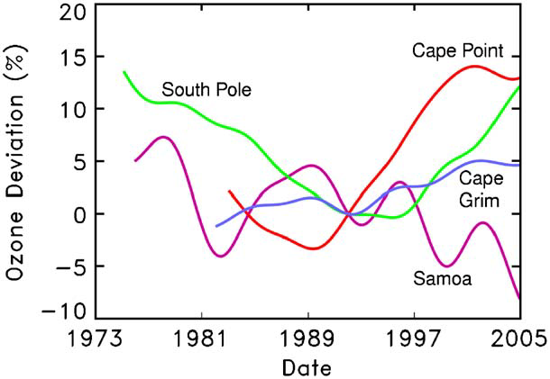
Changes in the southern hemisphere
Ozone trend curves in percent deviation
at four selected S.H. surface ozone sites:
South Pole (90S), Antarctica
Cape Point (34.4S), South Africa
Cape Grim (40.7S), Australia
Samoa (14S)
Ozone trend curves in percent deviation at four selected S.H. surface ozone sites

Slide 9
3. Assessing Surface Ozone Trends in the U.S. From 1980-2005

Slide 10
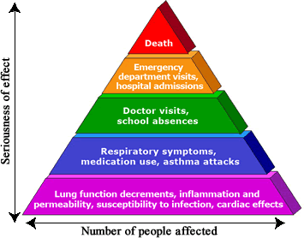
Background
Breathing ground-level ozone can result in a number of health problems observed in broad segments of the population. Some of these effects and symptoms include:
Induction of respiratory symptoms
Inflammation of airways
Chest tightness, wheezing, or shortness of breath
Throat irritation
Ground-level ozone causes more damage to
plants than all other air pollutants combined.
"Health Effects of Ozone in the General Population." EPA. Environmental Protection Agency. Web. 10 Apr. 2012. <http://www.epa.gov/apti/ozonehealth/population.html>.
"Plant Science Research : Ozone Effects on Plants." Web. 18 Apr. 2012. <http://www.ars.usda.gov/Main/docs.htm?docid=12462>.

Slide 11
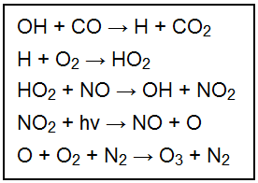
Control of U.S. NOx Emission
NOx in the presence of VOC and sunlight can produce Ozone
In 1975 the U.S. was the first to mandate the widespread use of catalytic converters, reducing NOx emissions and the production rate of low level Ozone
To understand the overall trends of Ozone in the U.S., the EPA has made Ozone measurements since before 1980 (286 Sites)
Considering both health and vegetation exposure index can provide the statistical significance of trends as well as quantify the effects anthropogenic behavior.

Slide 12
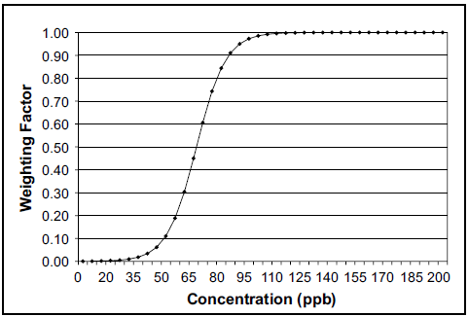
Ozone Trend Indices/Database
Using several indices are useful for studying the importance of Ozone trends:
Human Health Effects
2nd highest 1-hour average concentration (1)
4th highest 8-hour concentration (2)
Vegetation Effects
24- hour W126 Cumulative Exposure Index (3)
EPA’s Air Quality System database
Validation steps used to sort the 286 monitoring sites
Two data sets were analyzed: (1980 -2005) and (1990 - 2005)
Lefohn, A., D. Shadwick, and S. Oltmans. "Characterizing Long-term Changes in Surface Ozone Levels in the United States (1980–2005)." Atmospheric Environment 42.35 (2008): 8252-262. Print.

Slide 13
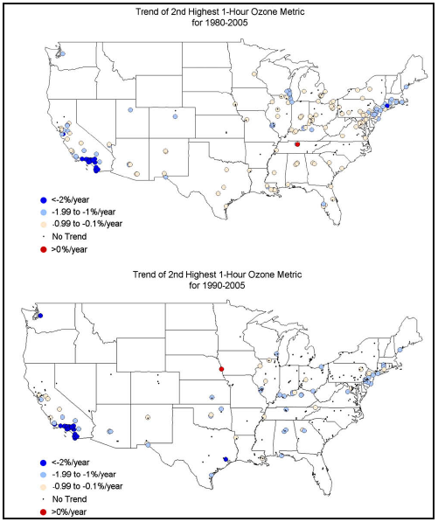
Trends – Index 1

Slide 14
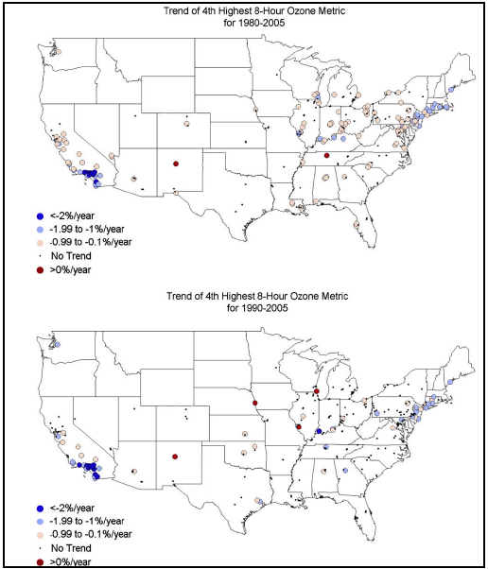
Trends – Index 2

Slide 15
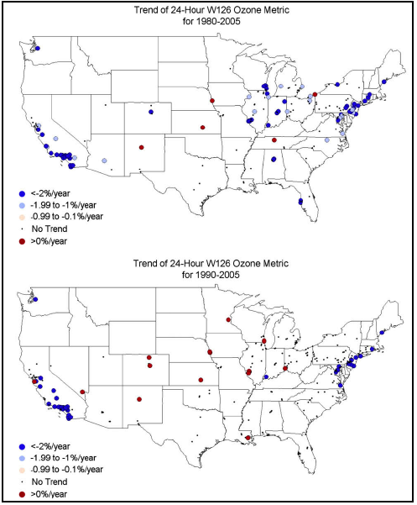
Trends – Index 3

Slide 16
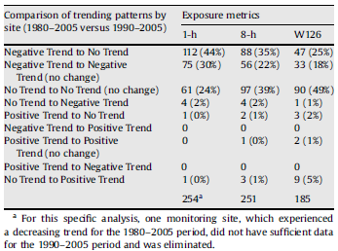
US Trend Summary

Slide 17
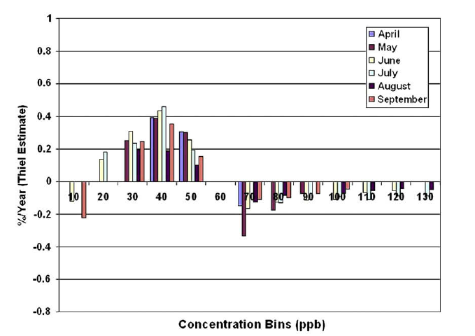
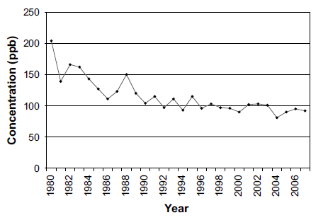
Monotonic Trend of Surface Ozone
Four cities around the US were chosen and their composite trends were plotted as a function of time
A general slowing downward trend was observed with some noise
Large scale circulation variations
Biomass burning

Slide 18
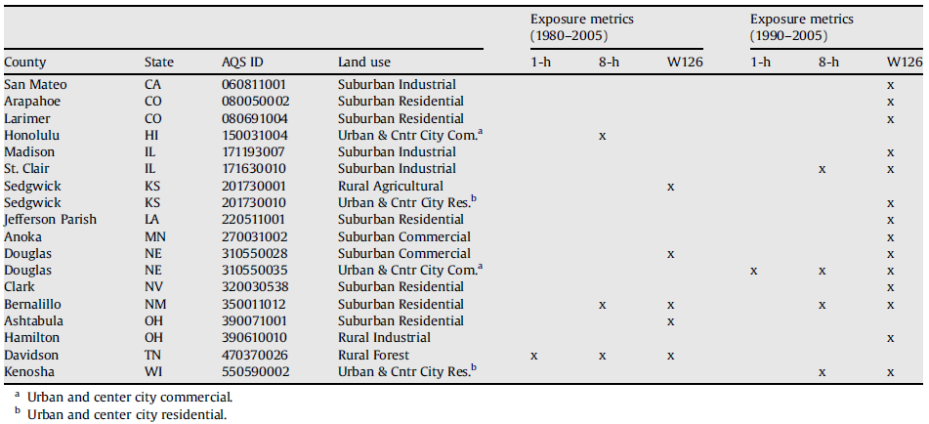
Cities with Increased Ozone Trends

Slide 19
Summary for US Trends
Nearly all locations experienced a significant downward trend in ozone mixing ratio between 1980 and 2005 and no change between 1990 and 2005
Some sites experienced increased ozone trends over the study period
Mostly rural or industrial locations
U.S. regulation on emissions has been effective in reducing surface ozone concentrations

Slide 20
4. Effect of Asian emissions on surface ozone in the US

Slide 21
Background and Approach
Harvard GISS global three-dimensional model of tropospheric chemistry
1-year archive of meteorological
Horizontal resolution 4°×5°
Meteorological information is updated every 4 hours
Too coarse to revolve urban plumes
Includes 80 species (24 chemical tracers)

Slide 22
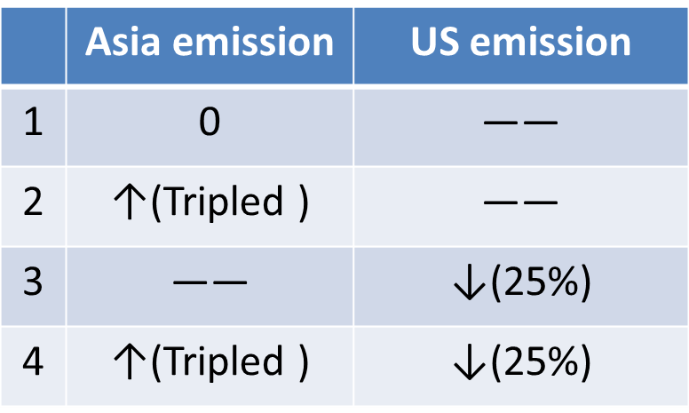
Experiments
Compare changes of O3 concentration relative to 1985 values
Note: emission means anthropogenic emissions, such as NOx, VOC, etc

Slide 23
west
east
maximum

Slide 24
Asia——, US ↓25%
Asia tripled ↑, US ↓25%

Slide 25
Summary for Effects of Asian Emissions
Tripling of Asian anthropogenic emissions from 1985 is expected to increase monthly mean O3 concentrations by 2-6 ppb in the western United States and by 1-3 ppb in the eastern United States
The maximum effect being in April-June
This increase would more than offset the benefits of 25% domestic reductions in anthropogenic emissions of NOx and VOC in the western United States.

Slide 26
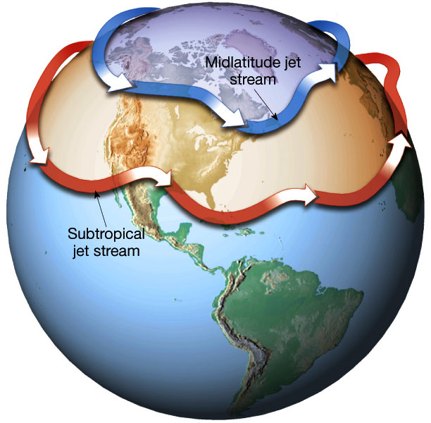
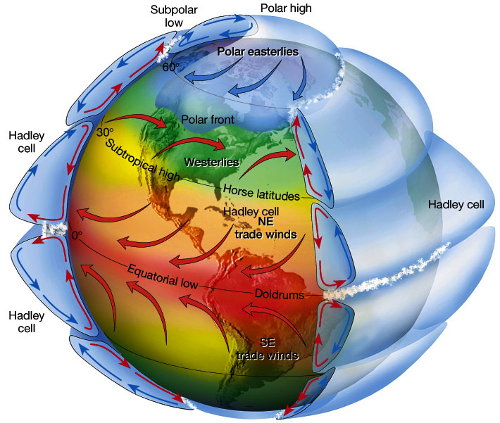
A global perspective is necessary when designing a strategy to meet regional O3 air quality objectives

Slide 27
Future work
Effect of US emissions on surface ozone in the Asia
 | Asia emission | US emission
1 | —— | 0
2 | —— | ↑(Tripled)
3 | ↓(25%) | ——
4 | ↓(25%) | ↑(Tripled)

Slide 28
5. Conclusions
Data collected around the globe showed that tropospheric ozone increased significantly during the 1970s and 1980s in the mid-latitudes of Europe and North America, but appeared to have leveled off and in some places declined in the more recent decades
Nearly all locations experienced a significant downward trend in ozone mixing ratio between 1980 and 2005 and no change between 1990 and 2005
U.S. regulation on emissions has been effective in reducing surface ozone concentrations
Asian anthropogenic emissions have great effect on US surface ozone concentrations

Slide 29
References
1. Oltmans, S. J., Lefohn, A. S., Harris, J. M., Galbal ly, I., Scheel, H. E., Bodeker, G., Brunke, E.,Claude, H., Tarasick, D., Johnson, B. J., Simmonds, P., Shadwick, D., Anlauf, K., Hayden, K., Schmidlin, F., Fujimoto, T., Akagi, K., Meyer, C., Nichol, S., Davies, J., Redondas, A., and Cuevas, E.: Long-term changes in tropospheric ozone, Atmos. Environ., 40, 3156–3173, 2006.
2. Jacob, D. J., Logan, J. A., and Murti, P. P.: Effect of rising emissions on surface ozone in the United States, Geophys. Res. Lett., 26, 2175–2178, 1999.
3. "Health Effects of Ozone in the General Population." EPA. Environmental Protection Agency. Web. 10 Apr. 2012. <http://www.epa.gov/apti/ozonehealth/population.html>.
4."Plant Science Research : Ozone Effects on Plants." Web. 18 Apr. 2012. <http://www.ars.usda.gov/Main/docs.htm?docid=12462>.
5. Lefohn, A., D. Shadwick, and S. Oltmans. "Characterizing Long-term Changes in Surface Ozone Levels in the United States (1980–2005)." Atmospheric Environment 42.35 (2008): 8252-262. Print.

