Slide 1
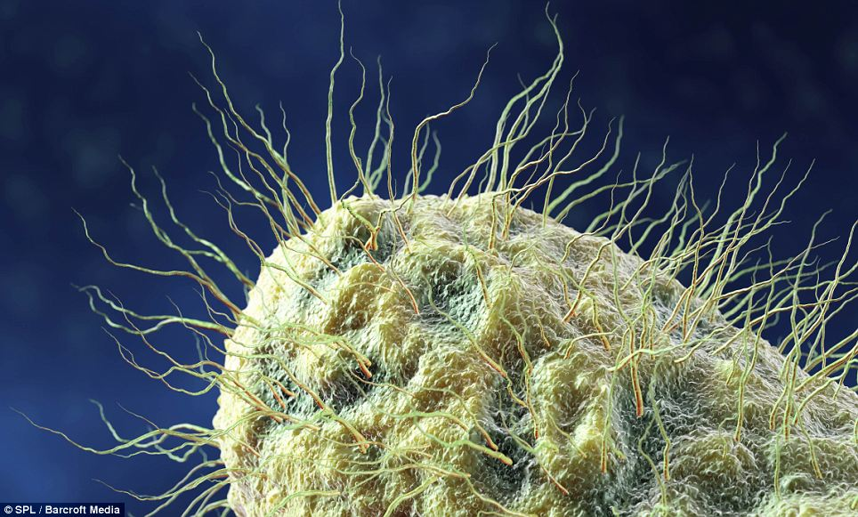
Biological Aerosol’s Role as Ice Nuclei: Assessing Upper Tropospheric Bacteria Concentrations and Genus
Benjamin Sheyko
EAS 6410
4/26/2012

Slide 2
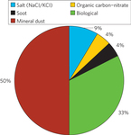
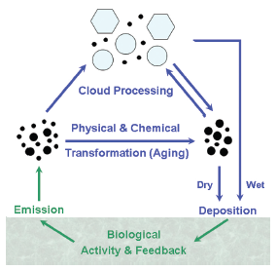
Biological Aerosols
Bacteria
Fungi
Pollen
Viruses
Algae
Lichens
More than 10^24 biological cells inhabit leaf surfaces on Earth alone

Slide 3
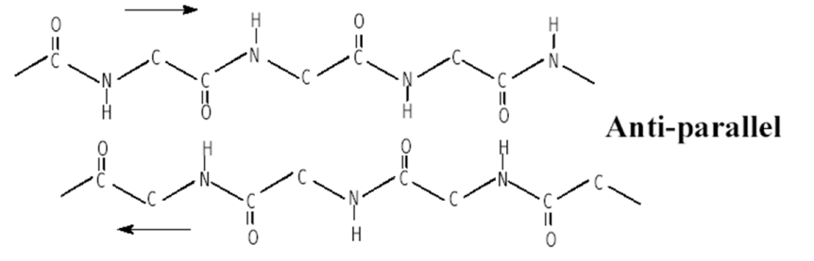
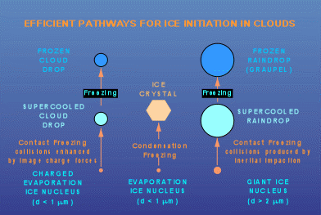
Ice Nuclei (IN)
As an air parcel rises it cools, water condenses on particles creating water/ice droplets, and clouds are formed.
  Precipitation and the radiative balance of earth is affected
  The most effective nucleation cites are larger particles (>.1 um)
Without an effective ice nucleation site, ice cannot form at temperatures above -40 Deg. C.
Some bacteria are highly effective IN (ICE+ Bacteria)
  ICE+’s Beta protein sheets mimic the H-bonding of ice
  Ice can form in the presence of these bacteria at higher temps. (-5 Deg. C.)

Slide 4
Current Understanding of Atmospheric Bacteria
Systematic low tropospheric bacteria abundance and composition are lacking
  1E4 cells/m^3 over land (10-1000 times less over water)
  Crude biological identification techniques
Little data on high atmosphere abundance and compositions exists
  Concentrations were thought to be negligible
Little data on upper tropospheric "Big Particle” makeup exists
  The potential for bacteria to play a significant role as CCN/IN has not been extensively investigated
Reasons
  No standardization of air sampling
  More abundant biological aerosols have been the focus

Slide 5
Significance of Project
Experimentally constraint a low end estimate on upper Tropospheric (in and out of storms):
  Bacteria concentrations
  “Big Particle” compositions
Identify upper tropospheric bacterial species
  Potentially novel species
Progress the understanding of the potential signifigance bacteria could have on:
  Precipitation
  Radiative forcing

Slide 6
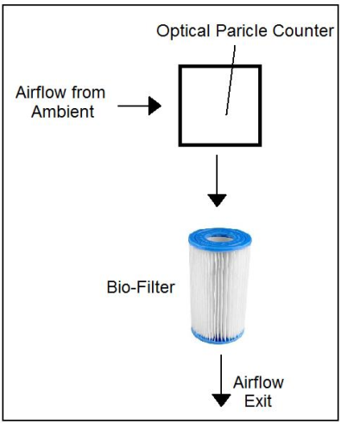
GRIP NASA Hurricane Mission
NASA mission with multiple measurements (in and out of storms)
  Total particle number distribution
  High altitude (>30,000 ft.) particle filtering (>.2 um)
  Volume ambient air processed through filter
Four flights used in total

Slide 7
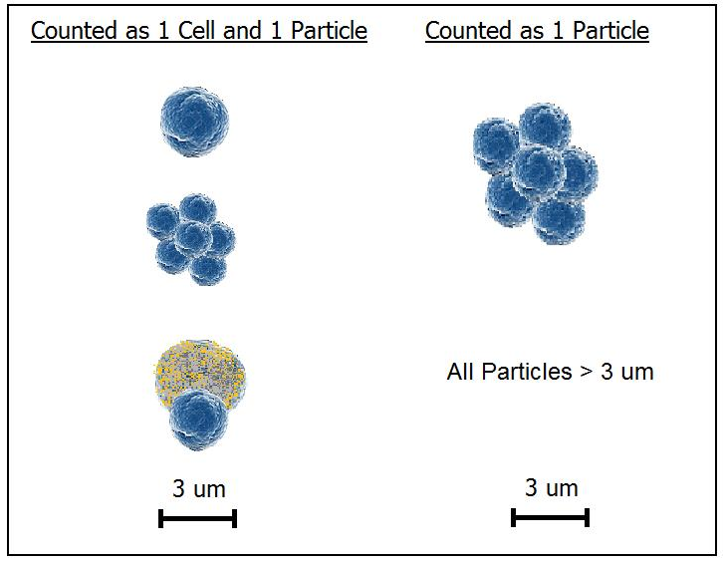
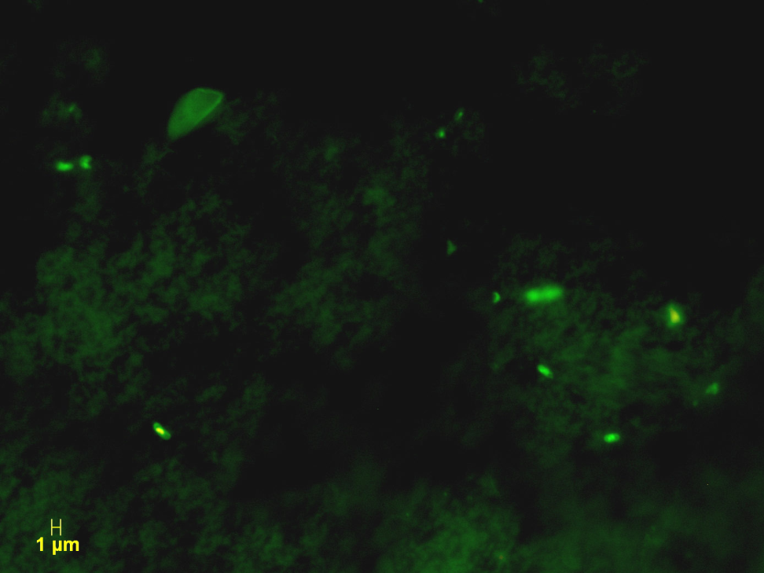
Cell/Particle Data
Bacteria cells range from [.2,3] um
Particle fragmenting after OPC not common (see cell picture)
Cell count provides an absolute low end estimate
  100X fluorescence microscopy

Slide 8
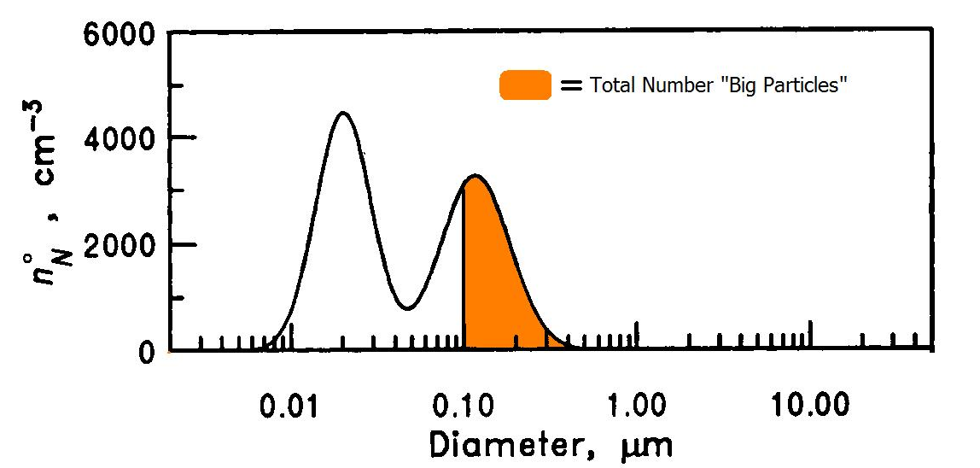
Cell/Particle Results
Total high altitude cell count was determined for each flight
  All cell species were identified through PCR
Mean total “Big Particle” count was determined for each flight

Slide 9
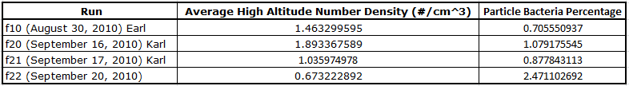
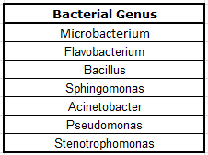

Calculations/Results
High Altitude Bacteria Densit$y =$ Total number of cells/volume air processed
% of “Big Particles” from bacteria cells = ND Bacteria/Total ND “Big Particles”
288 Genus Identified in Total!

Slide 10
Conclusions
High altitude bacteria concentration can be higher than previously thought
  Both in and out of hurricanes
Bacteria cells could make up a significant percentage/exist on a significant percentage of “Big Particles” in the upper Troposphere
Several (ICE+) bacteria were successfully identified in the high altitude regions of study. Many genus and potential species identified
Much more quantitative research is needed to understand the magnitude of the impact biological emissions have on precipitation and radiative forcing

Slide 11
References
Beard. "Ken Beard - Professor of Meteorology." 302 Found. University of Illinois. Web. 26 Apr. 2012. <http://www.atmos.illinois.edu/~beard/>.
"In Situ Detection of Biological Particles in Cloud Ice-crystals." Nature Geoscience. Web. 21 Apr. 2012. <www.nature.com>.
Seinfeld, John H., and Spyros N. Pandis. Atmospheric Chemistry and Physics: From Air Pollution to Climate Change. New York: Wiley, 1998. Print.
Bowers, R. M., C. L. Lauber, C. Wiedinmyer, M. Hamady, A. G. Hallar, R. Fall, R. Knight, and N. Fierer. "Characterization of Airborne Microbial Communities at a High-Elevation Site and Their Potential To Act as Atmospheric Ice Nuclei." Applied and Environmental Microbiology 75.15 (2009): 5121-130. Print.
Smorodin, V.Ye. "The Temperature Activation Spectrum of Atmospheric Ice Nuclei and Mechanisms of Heterogeneous Ice Nucleation in Supercooled Clouds." Journal of Aerosol Science 22 (1991): S553-555. Print.
Primary biological aerosol particles in the atmosphere: a review

Slide 12

Questions

