Slide 1
Characterization of Aerosols at Fire Station 8, Atlanta, GA
Matt Kollman

Slide 2
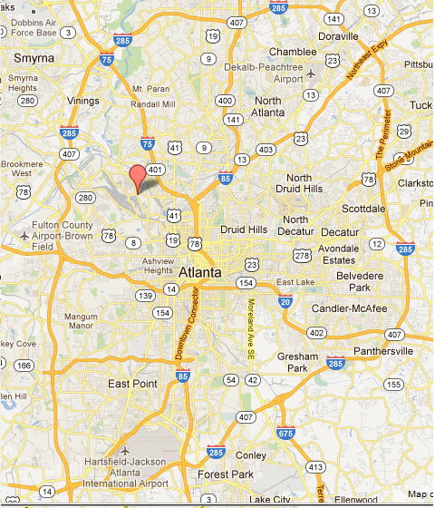
Location
FS8

Slide 3
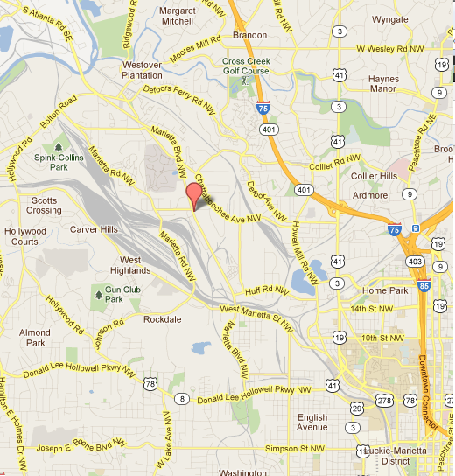
Location
Railyard
FS8
“most polluted area in Atlanta”

Slide 4
Measurements
Aerosol mass spectra using an Ambient Chemical Speciation Monitor (ACSM) on 30 minute saves
TEOM for PM2.5 mass concentrations
Black carbon concentrations
Aerosol light scattering data
Met data

Slide 5
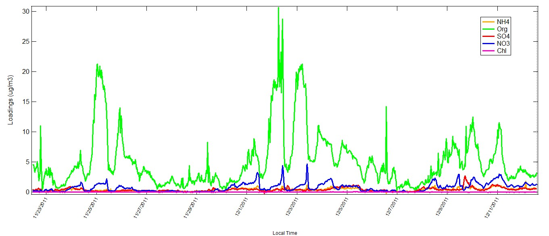
Aerosol composition over time

Slide 6
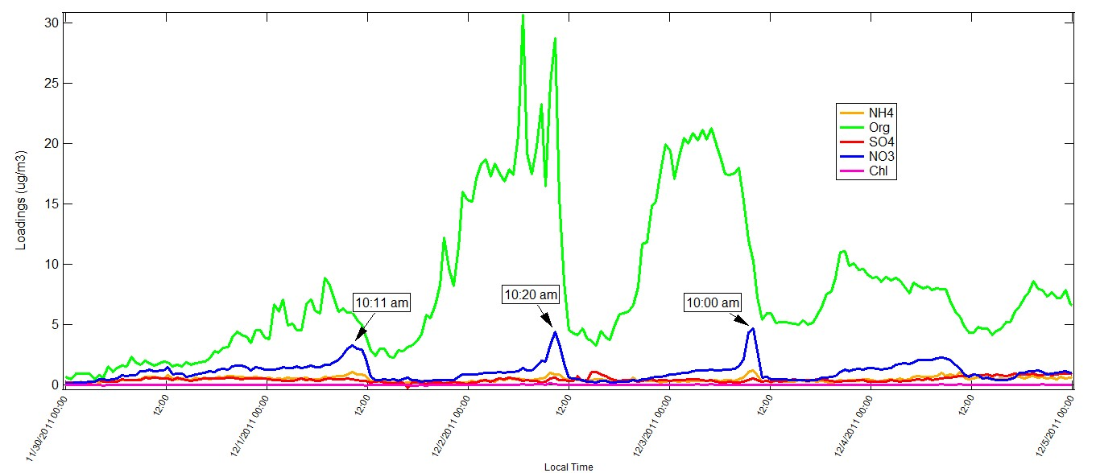

Slide 7
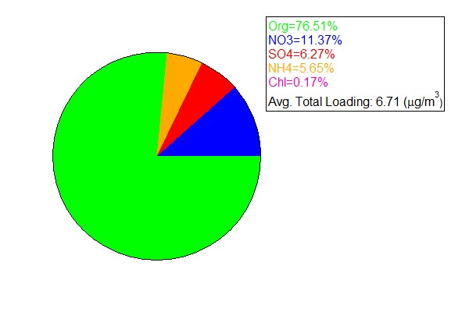
Average composition
Sulfate is a much lower proportion of aerosol than expected
Total loading over whole period is typical of Atlanta

Slide 8
Positive Matrix Factorization (PMF)
Mathematical model that identifies similarities across a dataset and groups into factors
Does not require a priori information
Useful for source apportionment

Slide 9
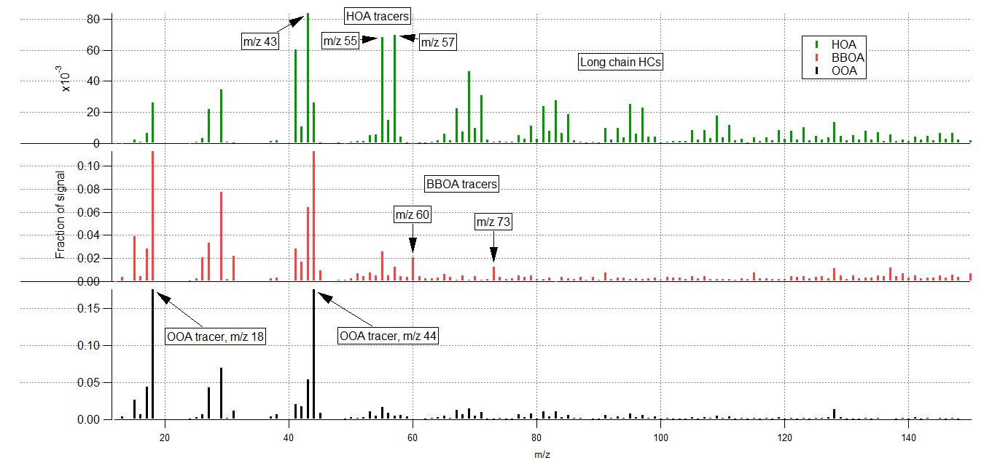
Identification of factors

Slide 11
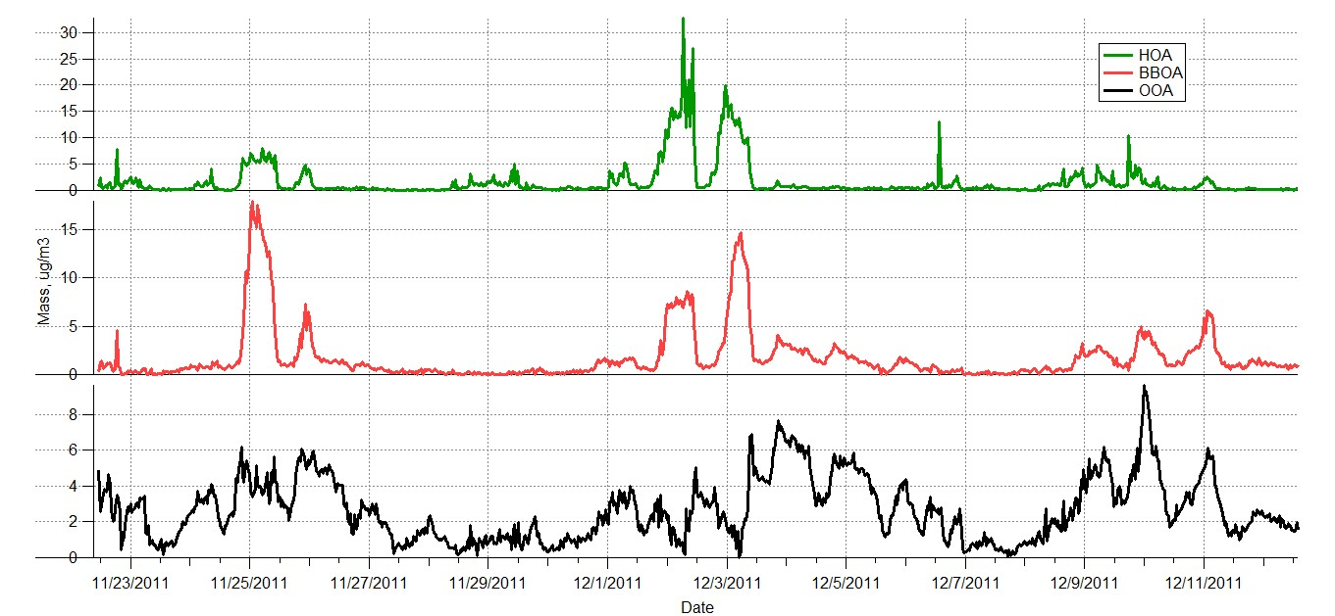
Time series for three factor solution

Slide 12
Discussion
Organic plumes that contain nitrate peaks at the end all come from the same source
Constant background of aged aerosol in Atlanta
Biomass burning signal may be due to prescribed burning outside Atlanta
Huge plumes in beginning of December equally due to BBOA and HOA

Slide 13
Correlation with external data
Ions
Elemental and organic carbon
Wind speed, direction
Rain events

