Slide 1
Simulate the vertical profile of methanesulfonic acid (MSA) over tropical Pacific
Yuzhong Zhang

Slide 2
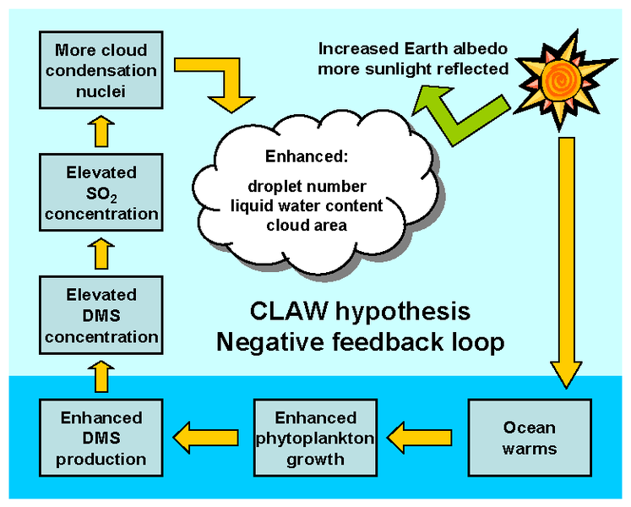
CLAW hypothesis
Figure from en.wikipedia.org/wiki/CLAW_hypothesis
Charlson et al., 1987

Slide 3
CLAW hypothesis
Figure from en.wikipedia.org/wiki/CLAW_hypothesis
Charlson et al., 1987

Slide 4
CLAW hypothesis
Figure from en.wikipedia.org/wiki/CLAW_hypothesis
Charlson et al., 1987

Slide 5
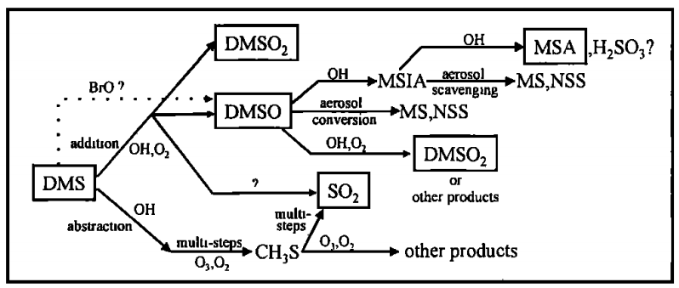
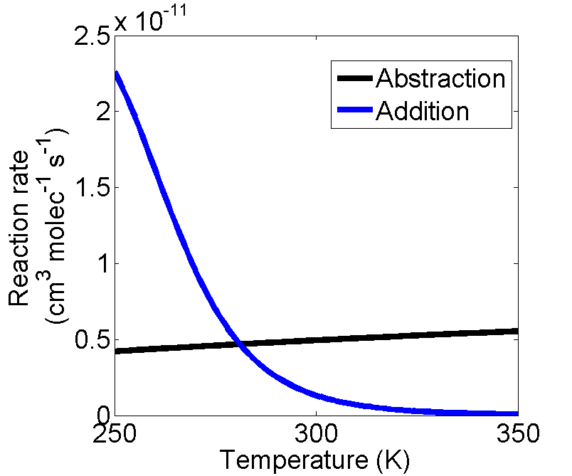
Marine sulfur chemistry
Dimethyl sulfide (DMS)
CH₃SCH₃
Methanesulfonic
acid
Nowak, et al., 2001
Gray, et al., 2010

Slide 6
Model description
1 dimensional model
Meteorology data from WRF
Chemistry
Aerosol scavenging
Dry deposition
Convection & turbulence
5 minute time step.
Run 30 days for steady state solution

Slide 7
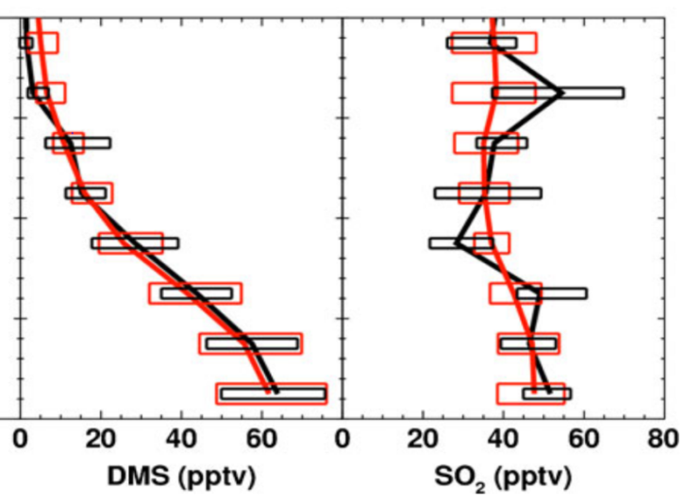
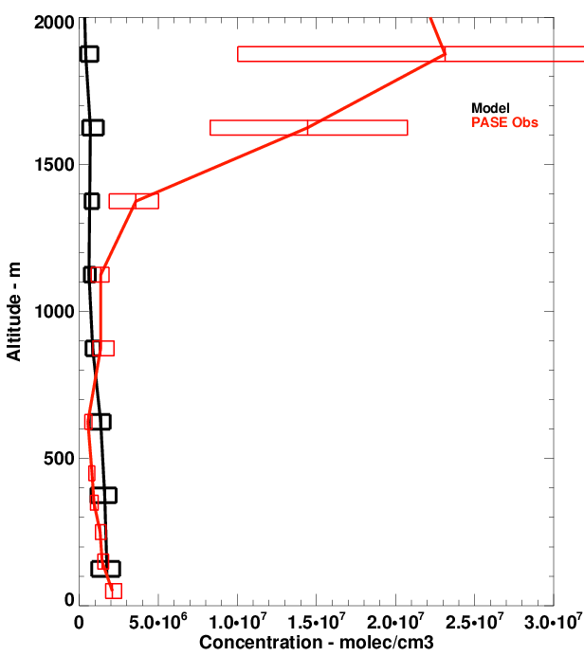
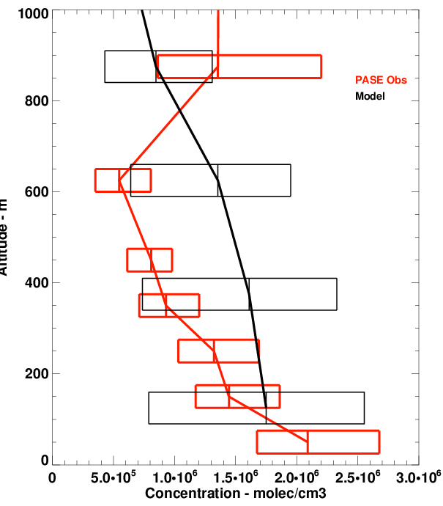
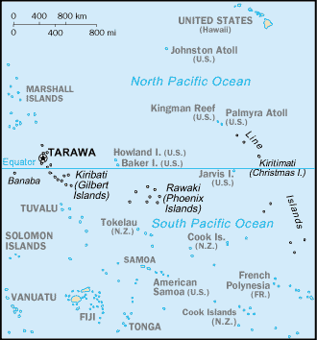
PASE campaign
Aug-Sep. 2007
Gray, et al, 2010

Slide 8
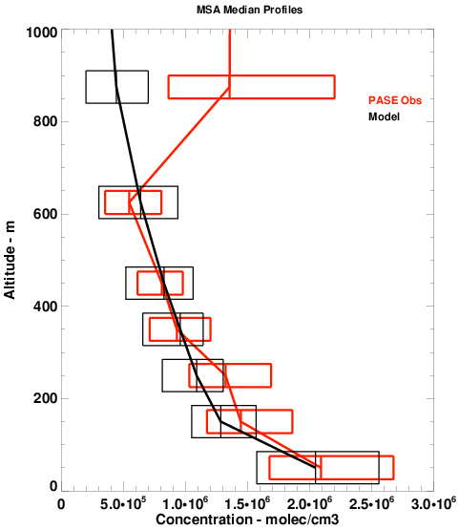
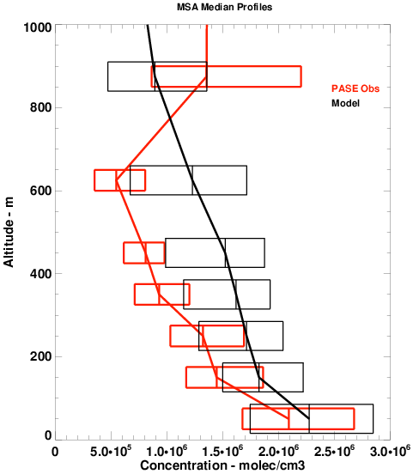
Unknown source from the surface
Aerosol scavenging
0.5x
Unit: 10^6 molecule/cm2/s

Slide 9
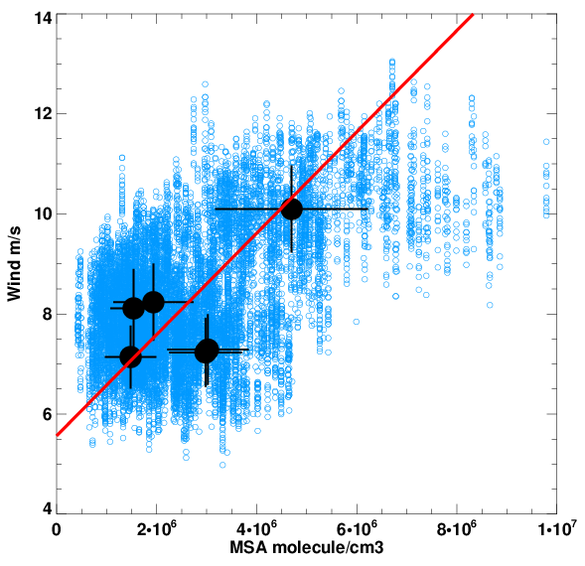
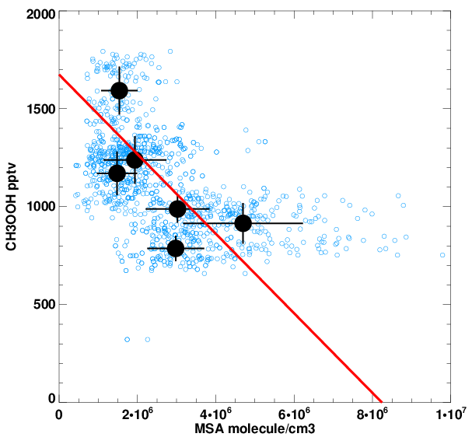
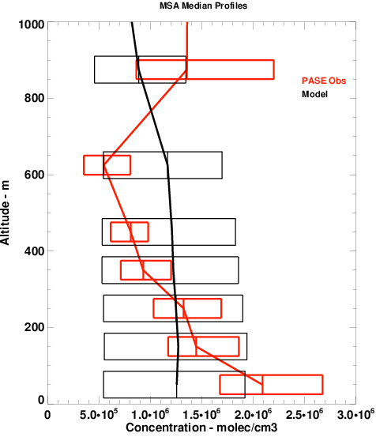
BrO influence & sensitivity to aerosol
Unit: 10^6 molecule/cm2/s
Surface emission
No aerosol 13
w/ aerosol 2
1pptv BrO at 1st layer
?
BrO oxidation scheme
DMS + BrO ➔ DMSO + …
DMSO + OH ➔ MSIA + DMSO2
MSIA + OH ➔ SO2 +MSA

Slide 10
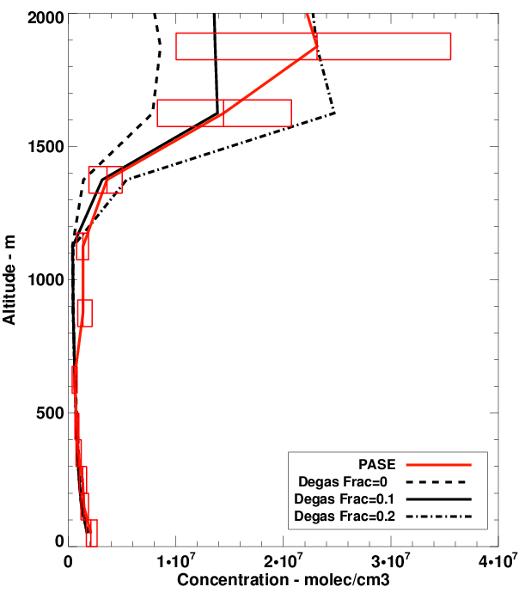
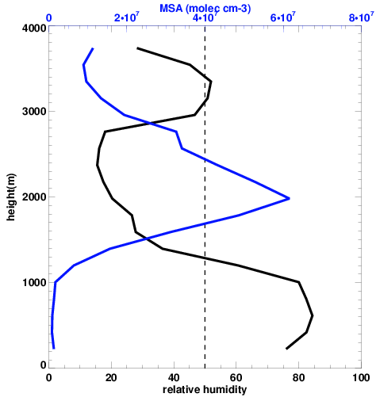
RH dependence and MSA degassing in FT
Abrupt change of liquid water under efflorescence point (EP), e.g. NaCl ~40%
Hypothesis:
Aerosol cannot take up MSA any more
MSA degases from aerosol phase, when RH < EP

Slide 11
MSA budget in tropical pacific marine atmosphere

Slide 12
Thank you!

