Slide 1
Aerosol composition at a rural site southeast of London measured by high resolution mass spectrometry
Lu Xu

Slide 2
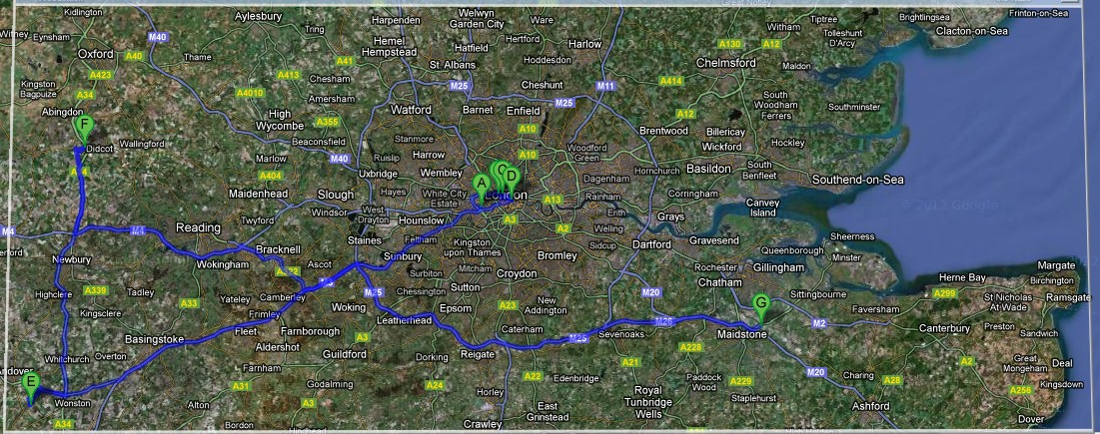
ClearfLo (Clean Air for London) Project
collaborative multidisciplinary project to study boundary layer pollution across London
detling

Slide 3
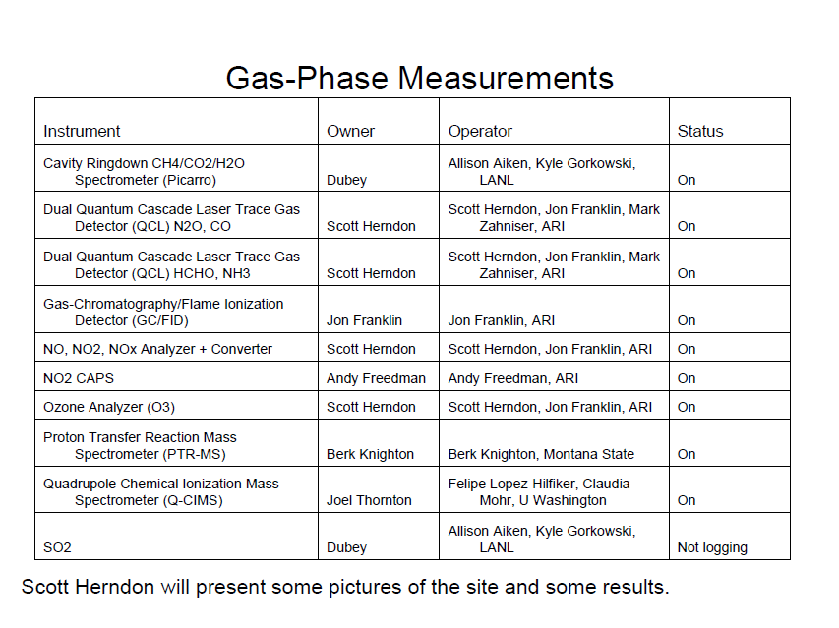

Slide 4
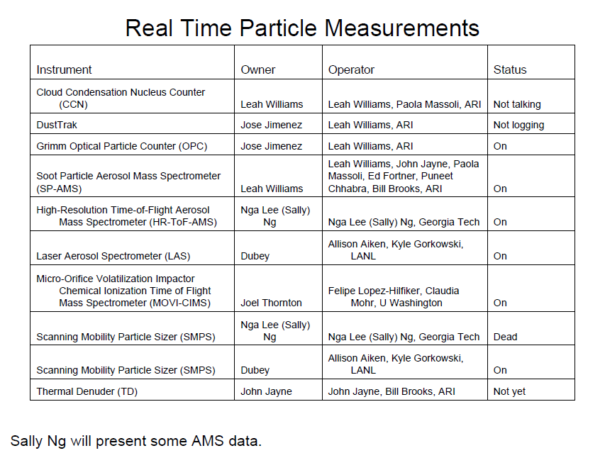

Slide 5
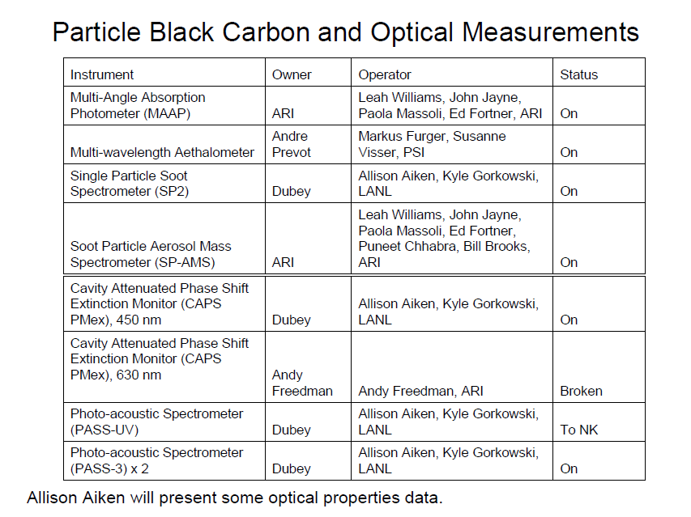

Slide 6
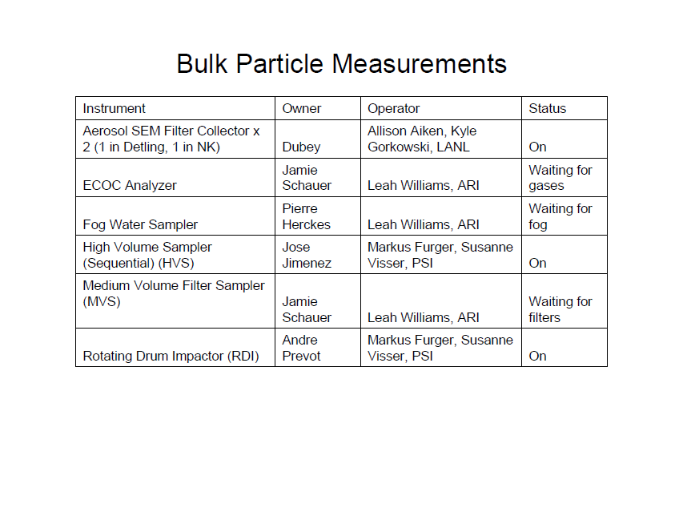

Slide 7
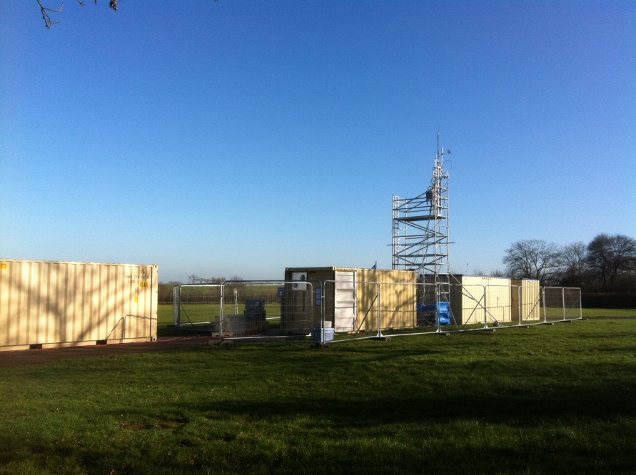
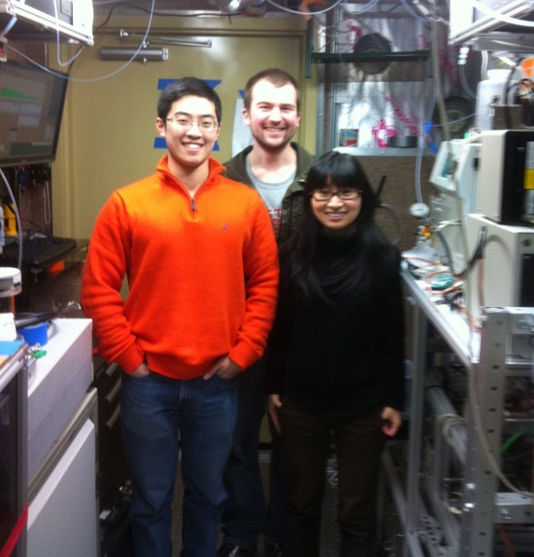
Data collection
Good data: 1/18/2012 to 2/14/2102 (27 days)
Bypass and Thermal Denuder
Thermal Denuder
inlet
valve
AMS

Slide 8
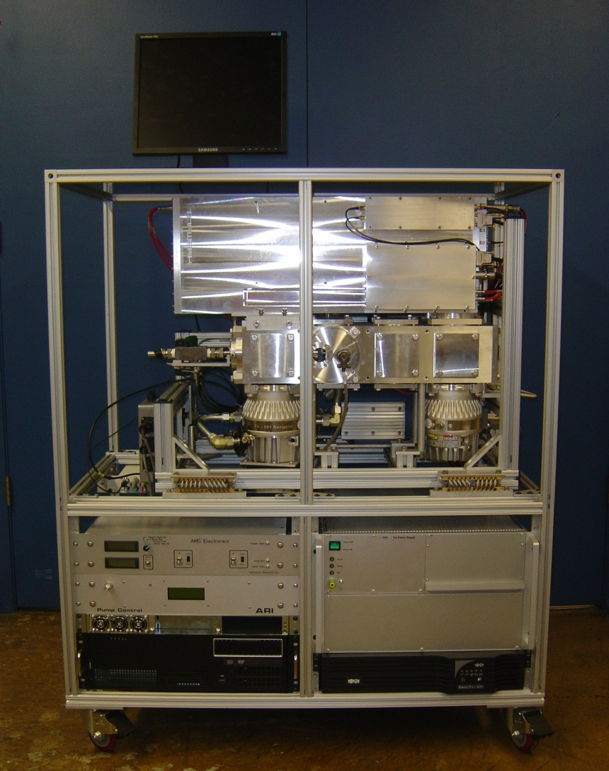
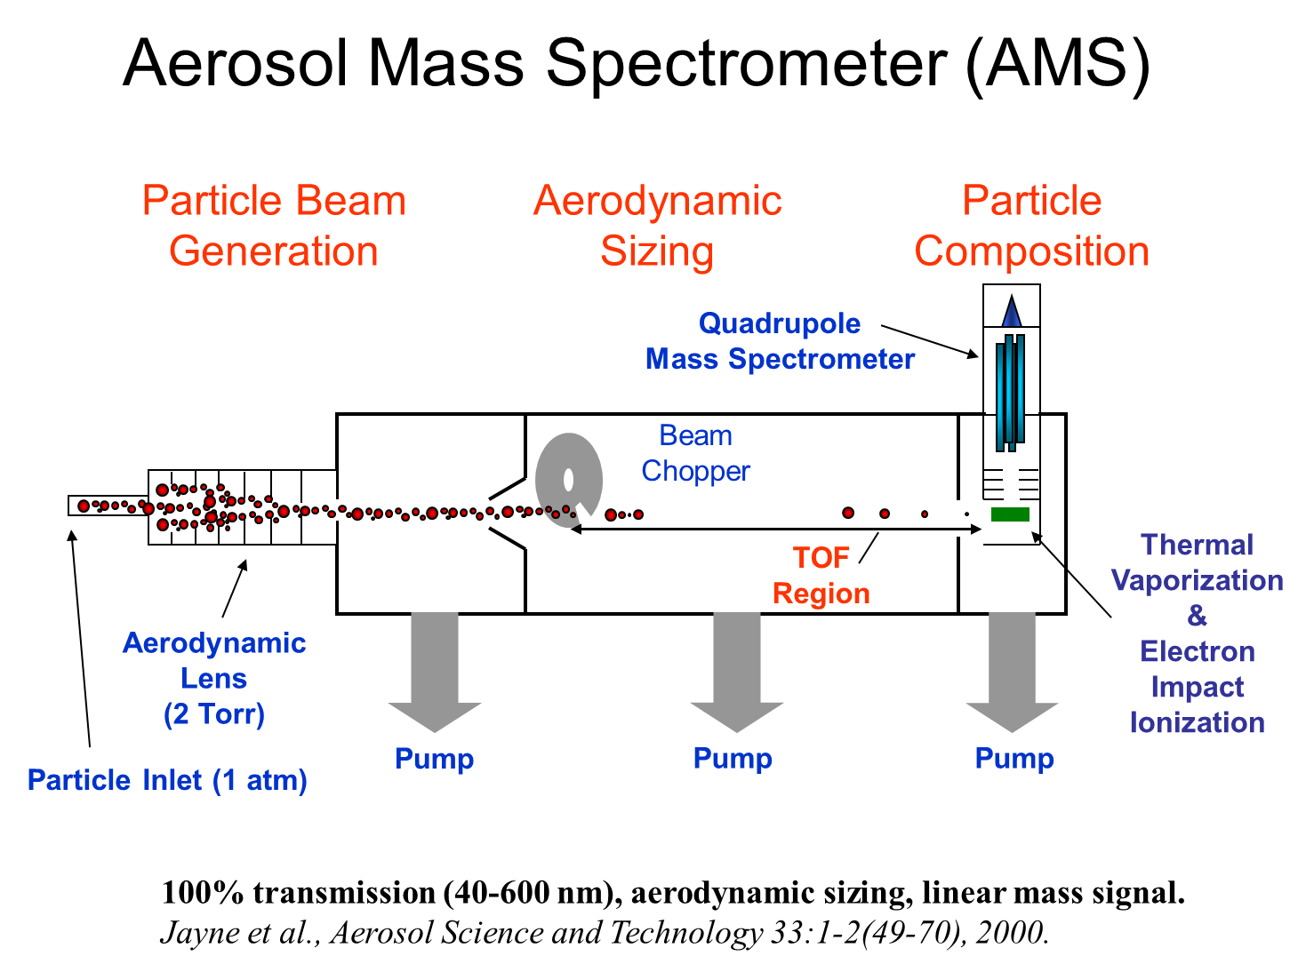
AMS

Slide 9
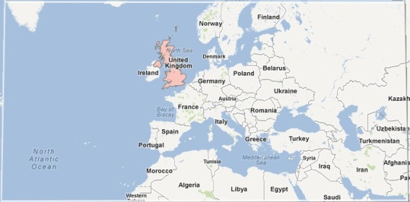
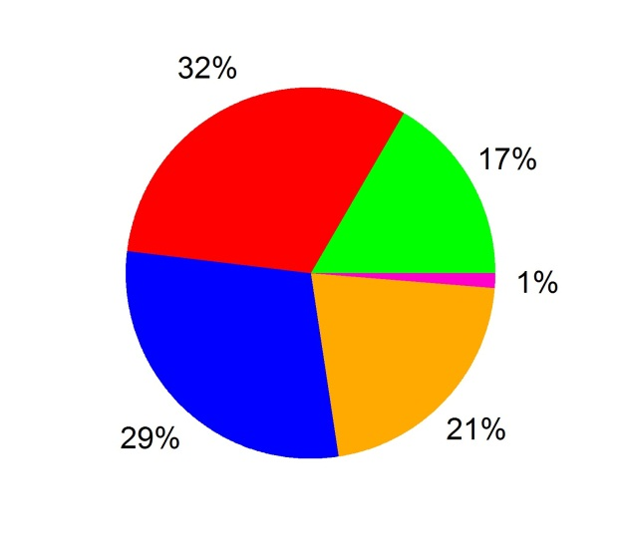
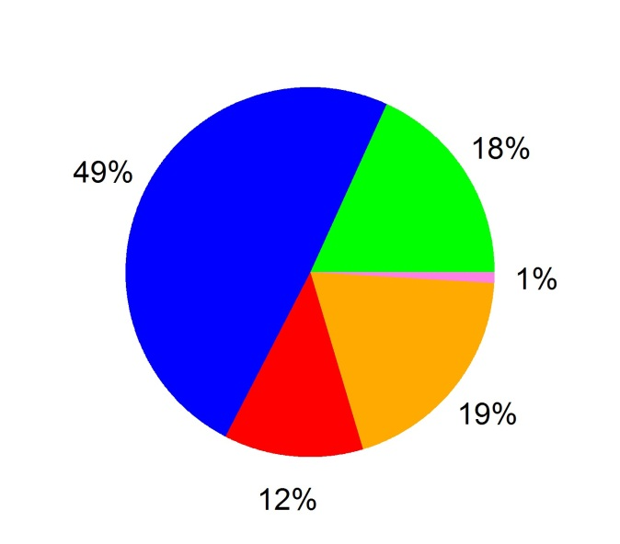
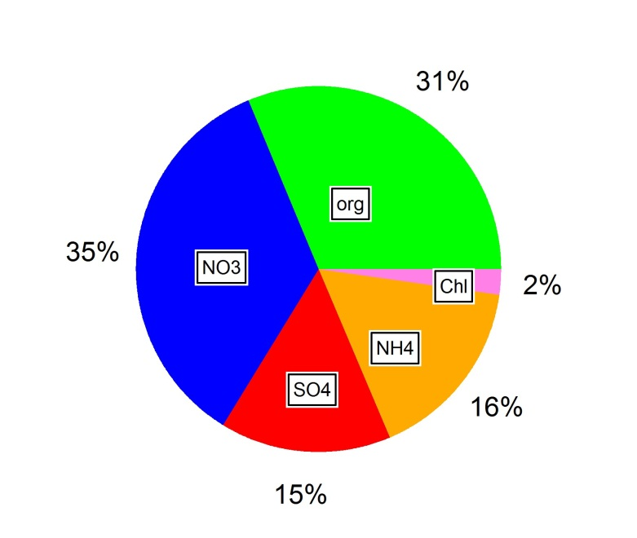
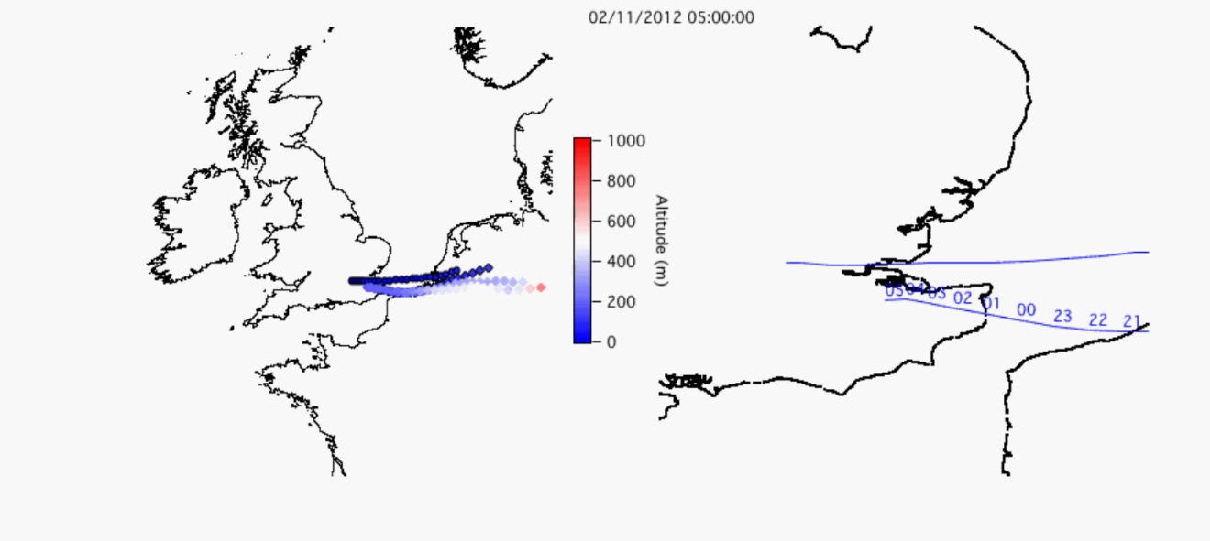
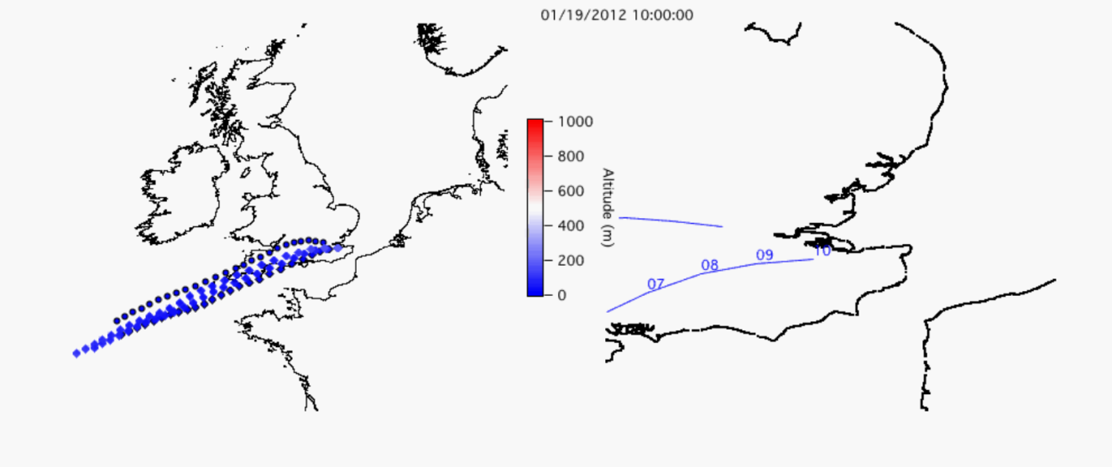
Bypass data: time series
Average loading:
4.88 μg/m³
From East
(highest loading,
very high nitrate)
From ocean
(cleanest air mass)

Slide 10
Bypass data: Average mass spectra
NH+(17)
NH+(16)
NO+(30)
NO2+(46)
CO+(28)
CO2+(44)
Org44/Org = 0.12
(O/C = 0.54, Aiken et al, 2008)
BBOA: 0.3 – 0.4
HOA: 0.06 – 0.1
COOH→CO+ and CO2+

Slide 11
Deconvolution of organics spectra
Positive Matrix Factorization (PMF) (Lanz et al., 2007; Ulbrich et al., 2009)
Mass
Spectrum
Mass
Spectrum,
Source 1
Mass
Spectrum,
Source 2
Mass
Spectrum,
Source 3
x
x
x
Time
. . .
=
+
+
+ …
Contribution (ug/m³), Source 1
Contribution (ug/m³), Source 2
Contribution (ug/m³), Source 3

Slide 12
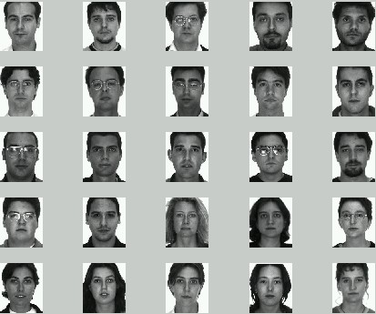
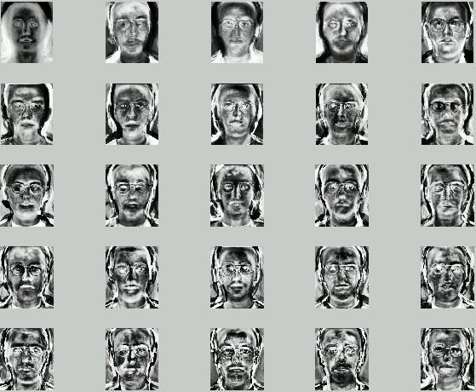




0.5
+
0.4
+
0.2
=
0.99
Characteristic nose and eye
Characteristic ear
Characteristic mouse

Slide 13
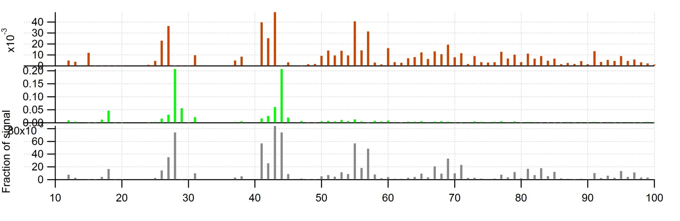
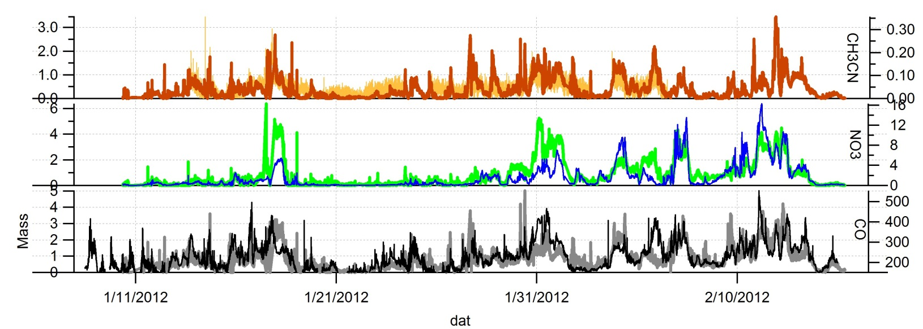
UMR three factor solution
C2H4O2+(60)
C3H5O2+(73)
Biomass burning orangic aerosol (BBOA)
Oxygenated organic aerosol (OOA)
Hydrocarbon-like organic aerosol (HOA)
Biomass burning
SOA
OOA
BBOA
HOA
POA
OOA is surrogate for SOA
HOA is surrogate for POA
OOA: correlates better with nitrate
HOA: correlates with CO
BBOA: fresh OA, correlates with CH3CN

Slide 14
Bypass vs. denuded data
Org
NO3
SO4
NH4
Chl

Slide 15
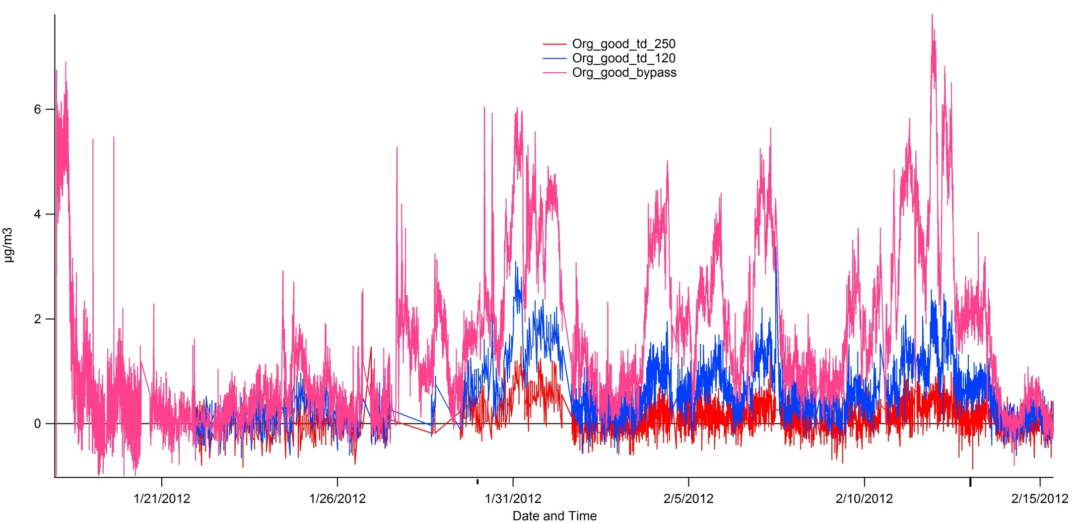
Different TD temperature

Slide 16
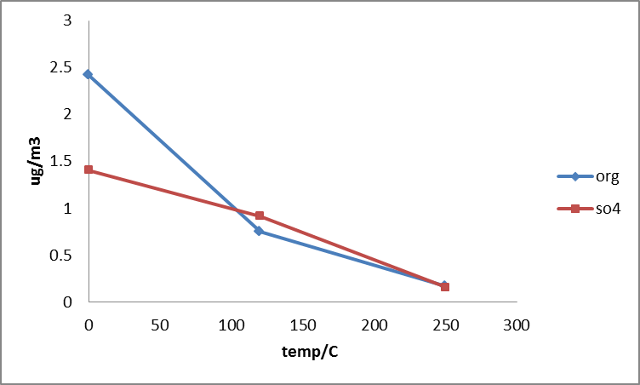

Slide 17
Summary
Cleanest air mass comes from the ocean
Air mass from the East : characterized by high loadings, especially high nitrate
PMF resolved three factors: HOA, OOA, BBOA
Nitrate and ammonia are more volatile

Slide 18
Future work
High resolution analysis
Thermal denuder data
Comparison with other measurements at the Detling site as well as other sites (especially London site)

Slide 19
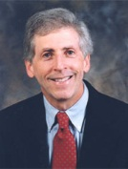
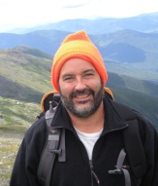
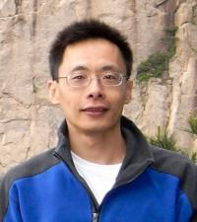
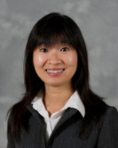


Acknowledgement
Knowledge
age

Slide 20
QUESTIONS?
Please Don’t Ask……

