Slide 1
Oceanic Biogenic Volatile Organic Compounds (BVOCs): formation processes and ocean-atmosphere exchange
Hang Qu
Ruixiong Zhang
April 16 2014

Slide 2
Outline
Introduction
OVOCs formation processes
Ocean-atmosphere exchange

Slide 3
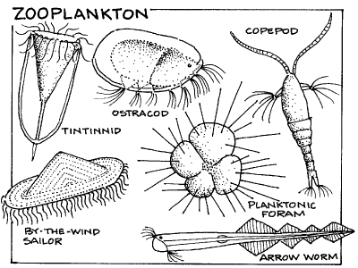
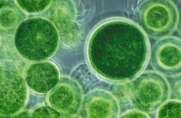
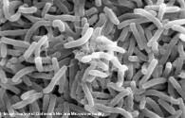
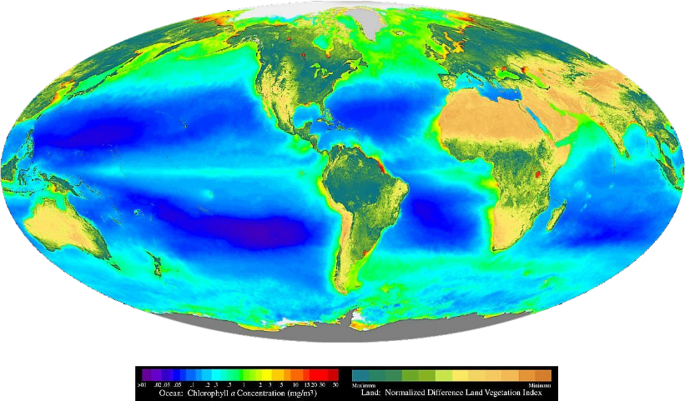
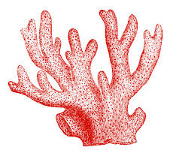
What is inside the oceans?
Antioxidant/metabolite/...
Notes:
We have a lot of fish, coral. And they are feeding on a lot more algae and planktons. The metabolism of which is really fast.

Slide 4
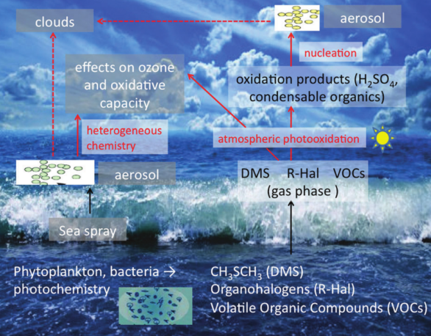
What does the ocean emit?
Dimethyl sulfide (DMS)
Nitrogen-containing gases:N₂O, ammonia and amines
Carbon Monoxide
VOCs
Methane
Non-methane VOCs (NMVOCs)
Terpenes: Isoprene, monoterpene
Halocarbons: CHBr₃, CHBr₂, CHCl₃, CH₃Cl...
Oxygenated VOCs (OVOCs)
Methanol, ethanol, propanol
Acetaldehyde
Acetone
Aerosol
GHG, aerosol
Atmospheric chemistry
GHG
SOA precursors
Atmospheric chemistry
SOA precursors

Slide 5
Chemical depletion of OVOCs
CH₃OH
OH
CH₃O
CH₄+CO
CH₃CHO
hν
OH
O₂
10%
90%
CH₃+HCO
CO
OH
O₂
5%
95%
O₂
CH₂OH
O₂
HCHO
CH₃O₂
hν
CH₂CHO
CH₃CO
CH₃C(O)CH₃
CH₃+CH₃CO
23%
40%
OH
O₂
CH₃C(O)O₂
O₂
HC(O)CHO
CH₃C(O)CH₂
HCHO+CO
CH₂CO
M
CH₂O₂CHO
O₂
Almost 100%
CH₃C(O)CH₂O₂

Slide 6
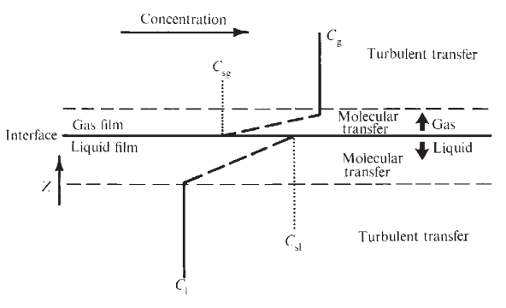
Ocean-atmosphere exchange: two-file resistance model
Henry law constant:
$H=\frac{C_{g}}{C_{w}}$ if equilibrium
C_{g}
$$Flux=k_{t}(C_{w}−\frac{C_{g}}{H})$$
C_{w}
Total mass transfer coefficient
Problem: how to determine$k_{t}$ ?
(Liss and Slater et al., 1974)
Notes:
You can see that, if the right term in the bracket is equal to zero, there will be no flux at all.

Slide 7
$$\frac{1}{k_{t}}=\frac{1}{k_{w}}+\frac{1}{Hk_{a}}$$
$\frac{1}{k_{w}}$,$\frac{1}{Hk_{a}}$water and air side resistance (series mode)
For water soluble molecules:
$k_{w}≫Hk_{a}→\frac{1}{k_{w}}≈$0
$$k_{t}≈Hk_{a}$$
For less soluble molecules:
$Hk_{a}≫k_{w}→\frac{1}{Hk_{a}}≈$0
$$k_{t}≈k_{w}$$

Slide 8
Water-side transfer velocity, k_{w}
Evaporation
(cooling effect)
Disturbing molecular diffusion layer
will increase sea-atmosphere transfer
IMPORTANT when wind is weak
cooler
Notes:
Opposite to atmosphere, the cooler surface water will generate instability.

Slide 9
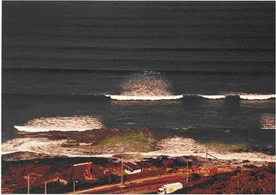
Water-side transfer velocity, k_{w}
White capping bubbles
breaking waves would bring:
transfer of gases through bubble wall
increase instability
IMPORTANT for less soluble gases when wind
is strong
(Wanninkhof et al., 2009)
Notes:
Actually for soluble gases the water-side transfer velocity is not important...

Slide 10
Air-side transfer velocity, k_{a}
Lack of measurement/ validation
Large uncertainty (especially for soluble gases)
(Johnson et al., 2010)

Slide 11
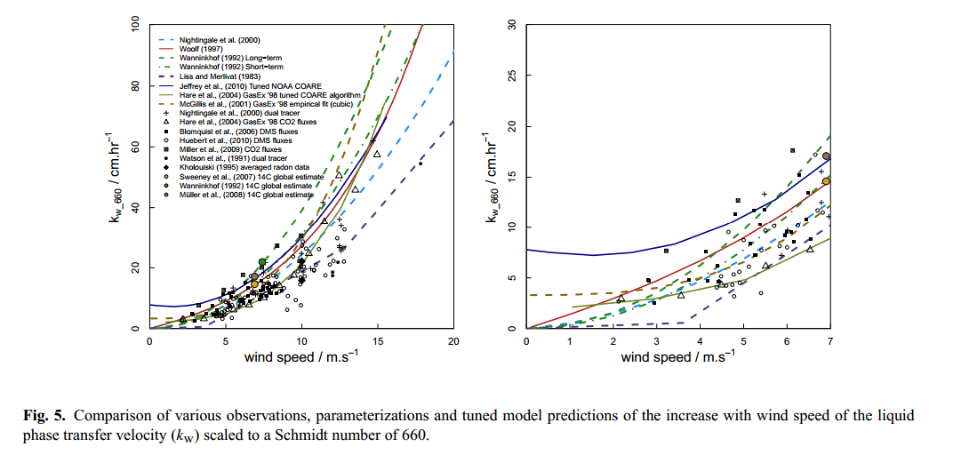
NOAA COARE gas transfer algorithm
$$k_{w}=\frac{u_{∗}}{r_{w}},k_{a}=\frac{u_{∗}}{r_{a}}$$
(molecular turbulence)
(Johnson et al., 2010; Fairall et al., 2011)

Slide 12
Spatial Distribution
Beale et al. (2013)

Slide 13
Oligotrophic Northern Atlantic Gyre
Latitude | Methanol | Acetaldehyde | Acetone
30N to 50N | 128 | 6 | 9
10N to 30N | 237 | 5 | 14
10S to 10N | 137 | 5 | 5
40S to 10S | 121 | 5 | 7
Light Depth | Methanol | Acetaldehyde | Acetone
97%(5m) | 48-361 | 3-9 | 2-24
33%(10-30m) | 45-398 | 3-7 | 2-20
14%(20-60m) | 43-420 | 3-11 | 2-19
1%(50-150m) | 42-387 | 3-12 | 1-7
0%(200m) | <27-277 | 3-16 | <0.3-7
Decrease with light strength
Increase with light strength

Slide 14
Concentrations of OVOCs following a phytoplankton bloom
V. Sinha et al. (2007)

Slide 15
Air-Sea Fluxes of OVOCs
Tg/yr | Methanol | Acetaldehyde | Acetone
Sea. | -9 | 36.5 | -2
Glob. | 206 (Jacob, 2005) | 213 (Millet, 2010) | 82 (Fischer 2012)
Perc. | 4.4% | 17.1% | 2.4%

Slide 16
Thank you!

Slide 17
Reference
Liss, P. S. and Slater, P. G.: Flux of Gases across the Air-Sea Interface, Nature, 247, 181–184, doi:10.1038/247181a0, 1974. 253, 268, 284
Carpenter, L. J., Archer, S. D., and Beale, R.: Ocean-atmosphere trace gas exchange, Chemical Society Reviews, 41, 6473-6506, 10.1039/c2cs35121h, 2012.
Wanninkhof, R., Asher, W. E., Ho, D. T., Sweeney, C. S., and
McGillis, W. R.: Advances in quantifying air-sea gas exchange and environmental forcing, Ann. Rev. Mar. Sci., 1, 213–244, doi:10.1146/annurev.marine.010908.163742, 2009.
Fairall, C. W., Yang, M., Bariteau, L., Edson, J. B., Helmig, D., McGillis, W., Pezoa, S., Hare, J. E., Huebert, B., and Blomquist, B.: Implementation of the Coupled Ocean-Atmosphere Response Experiment flux algorithm with CO2, dimethyl sulfide, and O3, Journal of Geophysical Research: Oceans, 116, C00F09, 10.1029/2010JC006884, 2011.
Johnson, M. T.: A numerical scheme to calculate temperature and salinity dependent air-water transfer velocities for any gas, Ocean Sci., 6, 913–932, doi:10.5194/os-6-913-2010, 2010.

Slide 18
Reference
V. Sinha et al., Air-sea fluxes of methanol, acetone, acetaldehyde, isoprene and DMS from a Norwegian fjord following a phytoplankton bloom in a mesocosm experiment, Atmos. Chem. Phys., 7, 739-755, 2007.
D. B. Millet et al., Clobla atmospheric budget of acetaldehyde: 2-D model analysis and constraints from in-situ and satellite observations, Atmos. Chem. Phys., 10, 3405-3425, 2010
L. J. Carpenter et al., Ocean-atmosphere trace gas exchange, Chem. Soc. Rev., 41, 6473-6506, 2012
E. V. Fischer et al., The role of the ocean in the global atmospheric budget of acetone, Geophys. Res. Lett., 39, L01807, 2012
J. L. Dixon et al., Production of methanol, acetaldehyde, and acetone in the Atlantic Ocean, Geophys. Res. Lett., 40, 4700-4705, 2013
D. J. Jacob et al., Global budget of methanol: Constraints from atmospheric observations, J. Geophys. Res., 110, D08303, 2005
R. Beale et al., Methanol, acetaldehyde, and acetone in the surface waters of the Atlantic Ocean, J. Geophys. Res., 118, 5412-5425, 2013

