Slide 1
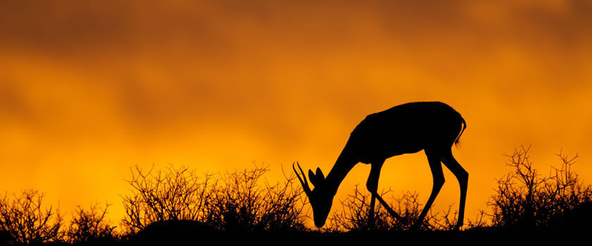
The Link between Wildfires and Precipitation in Africa
Ziming Ke

Slide 2
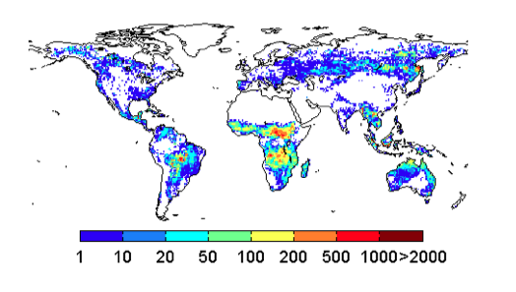
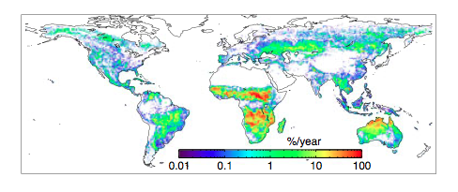
1. Introduction: Why Important
Significant emission amount
Mean annual fire emissions (g C m-2 year−1)
(Van der Werf et al., 2006)
Vast amounts of Area Burned
Mean annual are burned
(Giglio et al., 2013)

Slide 3
1.Introduction: Background
Little research focuses on Africa
African emissions accounted for 49% of the total southern hemisphere and South America contributed another 13% (Van der Werf et al., 2006)
With respect to burned area, A gradual decrease trend in NHAF and a gradual increase in SHAF. Most burned area is Savanna (Giglio et al., 2013)
The Peak months of burning and emissions is different in NHAF and SHAF (Liousse et al, 2010)

Slide 4
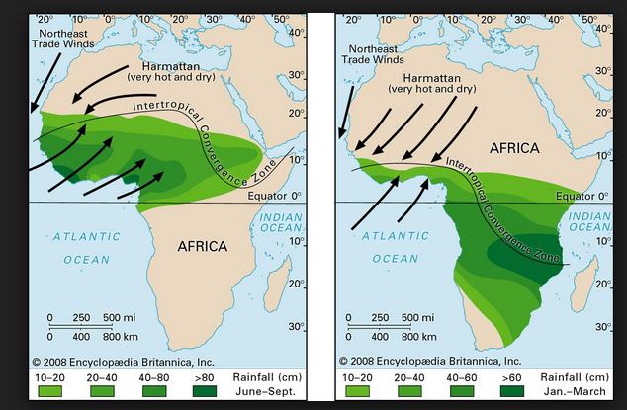
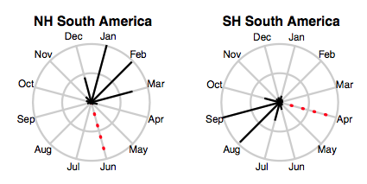
Monsoon System and Fire Season

Slide 5
2. Method and Data
Purpose: find a link between regional climate parameter and Africa wild fires. And there is a bridge between climate and fires.
Data: GFED burned area and CSFR total precipitation data
Method: Separate Africa into NHAF and SHAF; Separate the fire variability into trends and interannual parts. The link between

Slide 6
3. Results: fire season

Slide 7
3. Results: fire trends

Slide 8
Precipitation and Fire climatology

Slide 9
Precipitation and Fire trends
Averaged precipitation at the first three month of fire season, which can suppress the fire
A plausible link at NHAF : the blue lines
No clear link in SHAF

Slide 10
Whether this link between precipitation and fires in NHAF still exits in interannual variability band ?

Slide 11
First EOF Spatial Pattern
Trends are removed before analysis

Slide 12

Two blue lines are similar but with different frequencies.
Precipitation has higher frequency than fire data
Fire first PCs
AR1 model can link them together

Slide 13
3. Results: AR1 model

Slide 14
4. conclusion
Precipitation is a primary force to drive NHAF fires and lead one year
The bridge to link the two is AR1 model

