Slide 1
AMS Characterization of β-pinene Nighttime Oxidation
Javier Sanchez
EAS6410
April 23rd , 2014

Slide 2
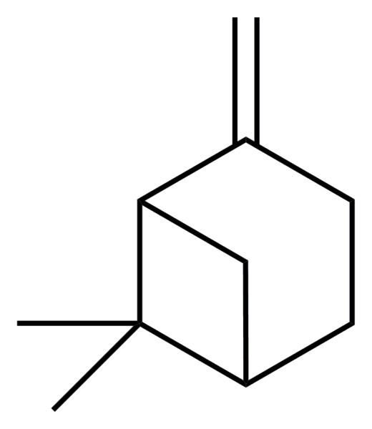
Work to be presented
β-pinene oxidation
9, 12, and 15 ppb concentrations
NO₃ as primary oxidant
AMS analysis of oxidation and composition of products

Slide 3
Aerosol Mass Spectrometer
AMS can provide:
Time series and average mass spectra
Fragments
Organic mass
Elemental composition : C, H, O
Notes:
AMS data is meaningful across a dataset, not just one.

Slide 4
Organic mass loadings
9 ppb
12 ppb
15 ppb
Notes:
Fast reaction. First generation products.

Slide 5
Fragment 29 increases due to reaction
Fragments C3H5 and C4H7 decrease over time

Slide 6
Elemental composition
12 ppb

Slide 7
f₄₄ vs f₄₃
9 ppb
15 ppb
12 ppb

Slide 8
Organic nitrates
Significant product of nighttime oxidation
Fairly high volatility
Less partitioning into aerosol phase
Difficult to quantify
Can be present in a number of fragments

Slide 9
Β-pinene ON fragmentation

Slide 10
Take-aways
AMS can be a powerful instrument but has limitations
AMS data is relevant across datasets
Mass loading influences aerosol composition
Organic nitrates are important night time products but difficult to quantify

Slide 11
Appendix

Slide 12
12 ppb

Slide 13
9 ppb

Slide 14
15 ppb

Slide 20
01/24

Slide 21
02/01

Slide 24
Notes:
Top is closer look at reaction region. C3H5/C4H7 are unoxidized fragments. CHO is f29 which represents organics.

