Slide 1
Haze in China
Aoxing Zhang, Linghan Zeng, Ting Fang

Slide 2
Outlines
Characteristics of haze in China
Sources and formation mechanisms
Current challenges and policies

Slide 3
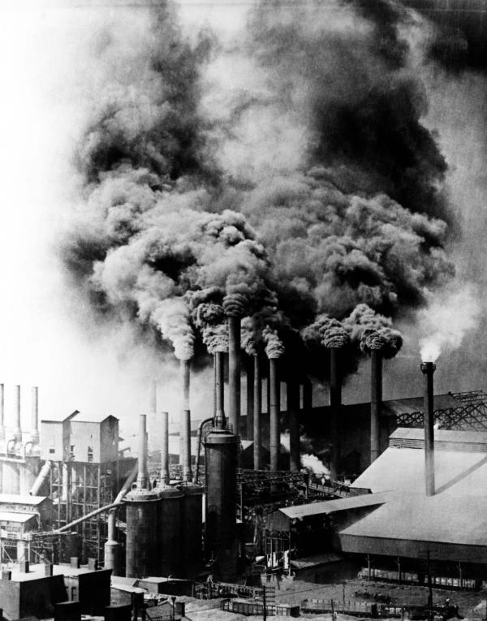
Old days - City’s prosperity
Nowadays – Climate change & Health impacts
A Pittsburgh steel mill (in 1906)

Slide 4


Haze in China
River Bank, Shanghai
River Bank, Shanghai (Dec 8th 2013)

Slide 5
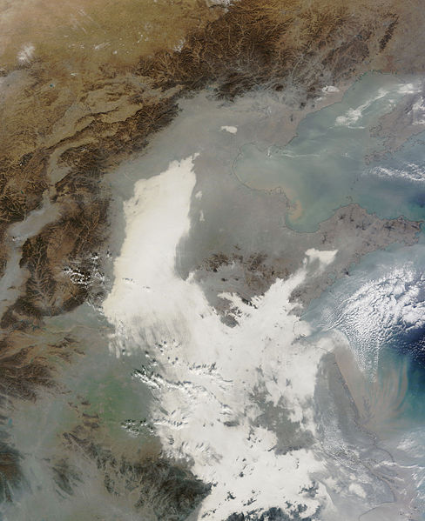
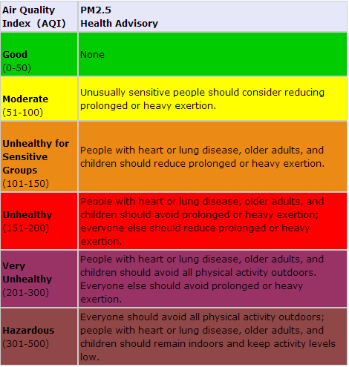
2013 Eastern China Smog
Shanghai (Dec 8th) Air Quality Index = 155
Shanghai
Image acquired by NASA’s MODIS
(Dec 7th 2013)

Slide 6
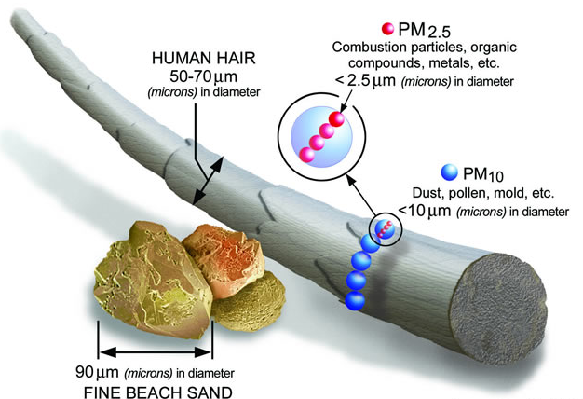
Particulate matter (PM) (aerosol)
Primary PM – directly emitted into the air
Secondary PM – formed from gaseous precursors (SO₂, NOx, NH₃, VOCs…)
Adapted from EPA

Slide 7
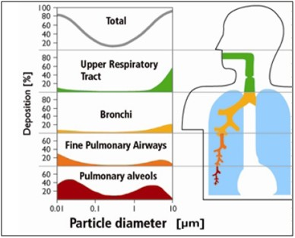
Health Effect of PM
Fraction of PM deposit in respiratory system
Asthma
Irregular heartbeat
Airways inflammation, coughing or difficulty breathing
Cardiopulmonary mortality increases by 6-13% per 10 µg/m³ of PM_{2.5} [Beelen R et al. 2008; Krewski D et al 2009]
BBC News – linked air pollution to 7 million deaths globally (WHO, March 25th)
From: www.icao.int/environmental-protection/PublishingImages/HealthEffects_2.jpg

Slide 8
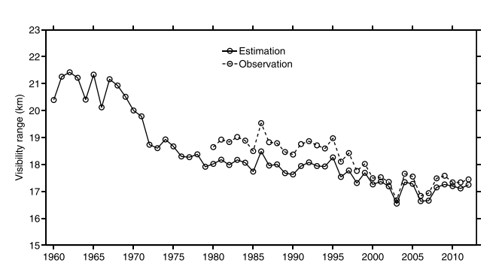
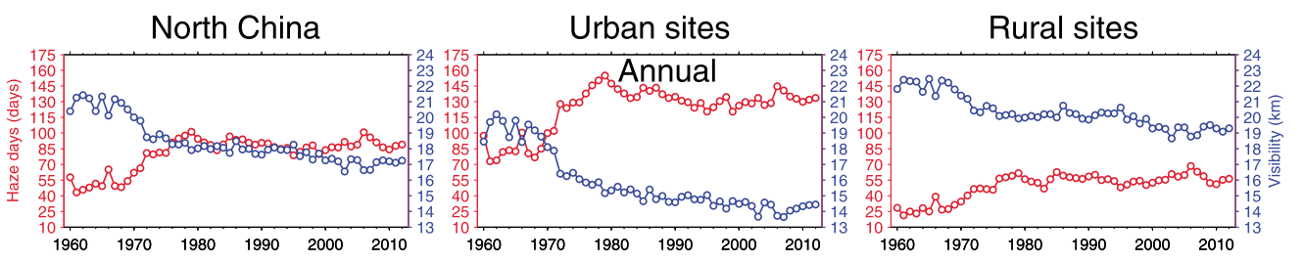
Characteristics – reduced visibility
[Chen and Wang, 2015]

Slide 9
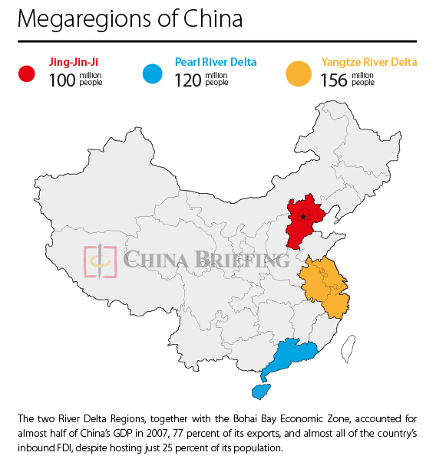
Wei K. et al., 2016
Zhao X. et al., 2013
Huang R. et al., 2014
Wang Y. et al., 2014
Han B. et al., 2016
Ho K. et al., 2016
Wang L. et al., 2014
Zhang X. et al., 2016
Huang R. et al., 2014
Huang W. et al., 2016
Huang R. et al., 2014

Slide 10
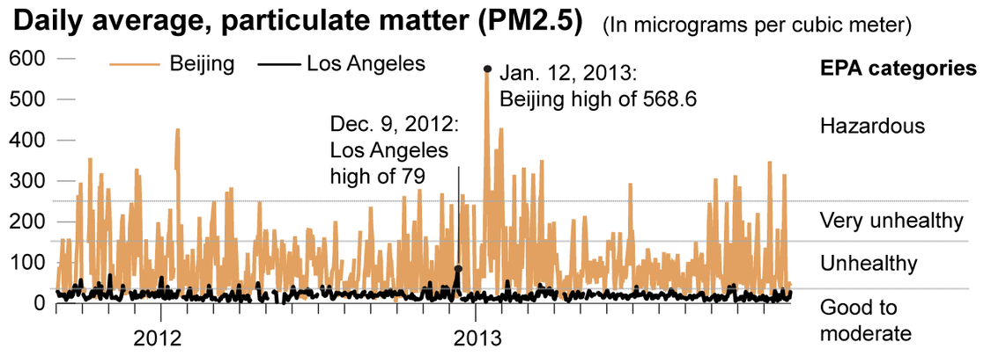
Characteristics – high PM_{2.5} concentration
China annual standard 35 µg/m³
China daily standard: 75 µg/m³ (ambient air quality standards which is to be implemented in 2016: GB3095-2012)
EPA annual standard: 15 µg/m³
EPA daily standard: 35 µg/m³

Slide 11
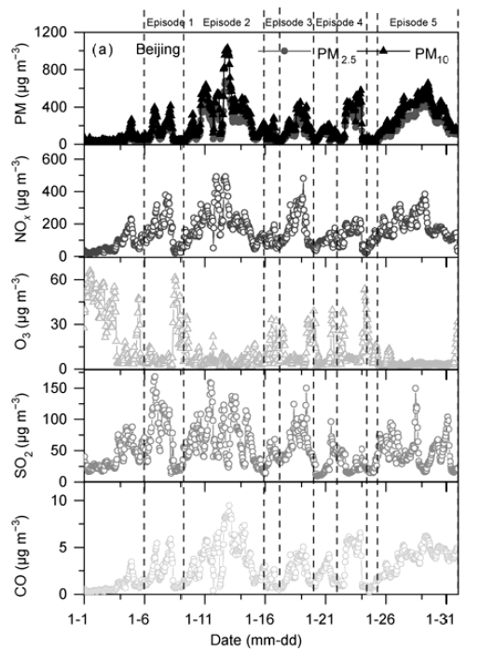
Characteristics – high PM_{2.5} concentration
[Wang et al., 2014]

Slide 12
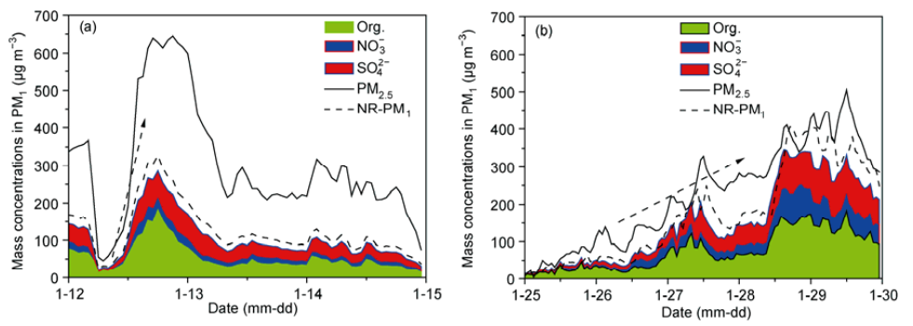
Characteristics – rapid growth
Explosive growth
Sustained growth
Concentration of PM_{2.5} increased rapidly from around 35 µg m⁻³ to around 650 µg m⁻³ with in 8 hours;
The rapid growth of PM₁ is mainly attributed by organics, SO4 and NO3. The growth rates of these three aerosols were 19, 12, and 6 µg m⁻³ h⁻¹, respectively.

Slide 13
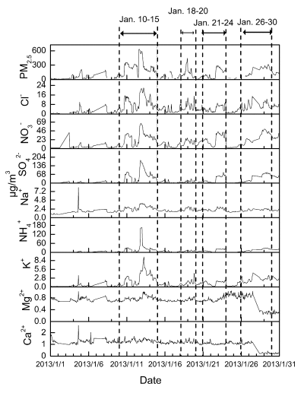
Characteristics – ions
[Han et al., 2016]

Slide 14
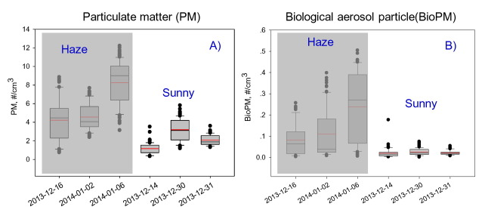
Characteristics – bioaerosols
bacteria, fungi, viruses, endotoxin and allergens
[Wei et al., 2016]

Slide 15
Source and Formation
Why haze is the most severe in China, especially North China?
Why haze is happening in China JUST NOW, not past or future(hopefully☺)?

Slide 16

Source and Formation for Haze in China
Power Plants
Industrial
Primary
Domestic
Secondary
Agriculture
NOx->Nitrate
SO₂->Sulfate
Transportation
Organic
Landform
Gas phase pollutants
Meteorology Condition
Notes:
The external cause of the severe haze episodes was the unusual atmospheric circulation, the depression
of strong cold air activities and the very unfavorable dispersion due to geographical and meteorological conditions. However,
the internal cause was the quick secondary transformation of primary gaseous pollutants to secondary aerosols, which
contributed to the “explosive growth” and “sustained growth” of PM2.5. Particularly, the abnormally high amount of nitric oxide
(NOx) in the haze episodes, produced by fossil fuel combustion and vehicle emissions, played a direct or indirect role in the
quick secondary transformation of coal-burning sulphur dioxide (SO2) to sulphate aerosols. Furthermore, gaseous pollutants
were transformed into secondary aerosols through heterogeneous reactions on the surface of fine particles, which can change
the particle’s size and chemical composition. Consequently, the proportion of secondary inorganic ions, such as sulphate and
nitrate, gradually increased, which enhances particle hygroscopicity and thereby accelerating formation of the haze pollution.

Slide 17
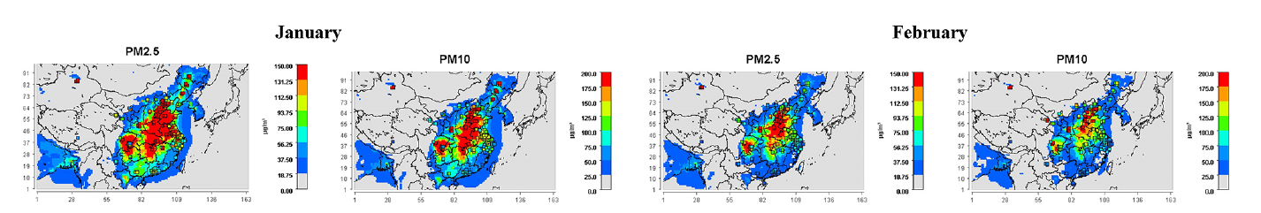
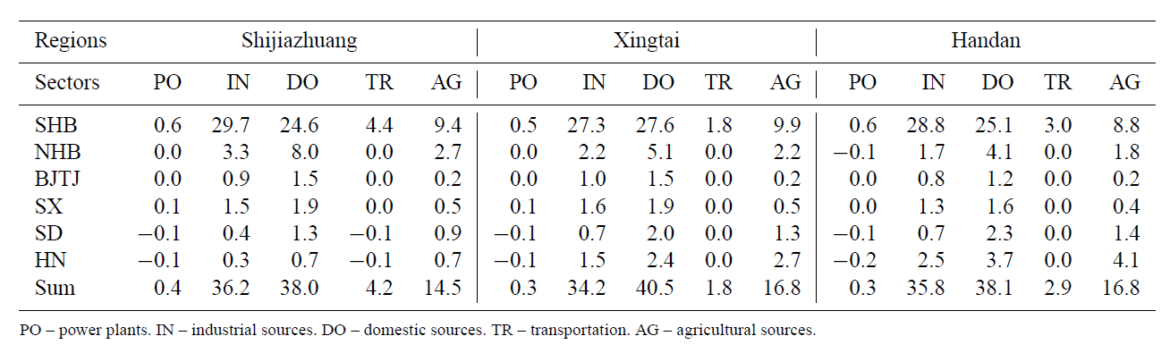
The 2013 severe haze over southern Hebei, China: model evaluation, source apportionment, and policy implications
L. T. Wang, et. Al. ACP, 2013
Overlay with CMAQ output and observations

Slide 18

Ratio of Source
Southern Hebei
Nouthern Hebei
Beijing&Tianjin
Shanxi
Shandong
Henan
Source contributions by region and sector to the PM2.5 concentrations in (a) Shijiazhuang, (b) Xingtai, and (c) Handan from 14 January to February 2013. Dot signs indicate the maximum and minimum, and square signs indicate the average value.
(Wang, et al., 2013)

Slide 19
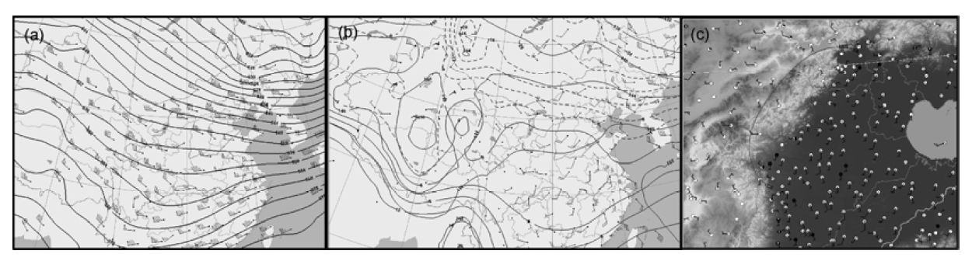
Meteorological Conditions
Spatial distributions of simulated PBL height (m) in Domain 2 in December 2007, and 1–13 and 14–31 January, and February, 2013.
(Wang, et al., 2013)
Synoptic maps on 12th January, 2013 for 500 hPa at 08 LT (a), 850 hPa at 20 LT (b), and surface at 08 LT (c).
(Wang, et al., 2014)

Slide 20
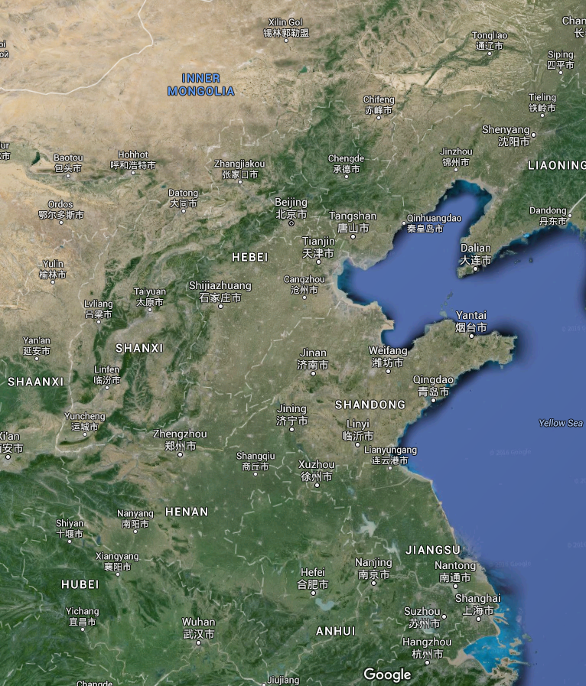
Meteorological Conditions
CRAZY SEVERE HAZE!
(Wang, et al., 2013)
Very severe haze
Xingtai
Handan

Slide 21
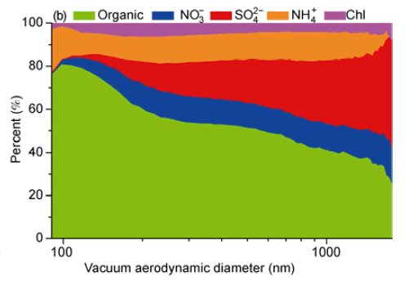
Species in China Haze
(Han, et al., 2016)
(Wang, et al., 2014)
Notes:
Right figure has different inorganic species ratio(more NH4, less NO3 SO4),because right one is a single measurement, in 7-9am, peak hour. Left one is also Jan 2013, but don’t know its exactly time period.

Slide 22
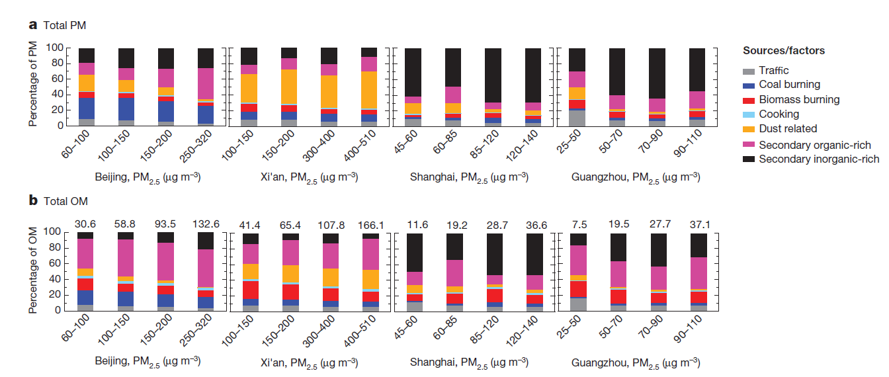
Species in China Haze
(Huang, et al., 2014)

Slide 23
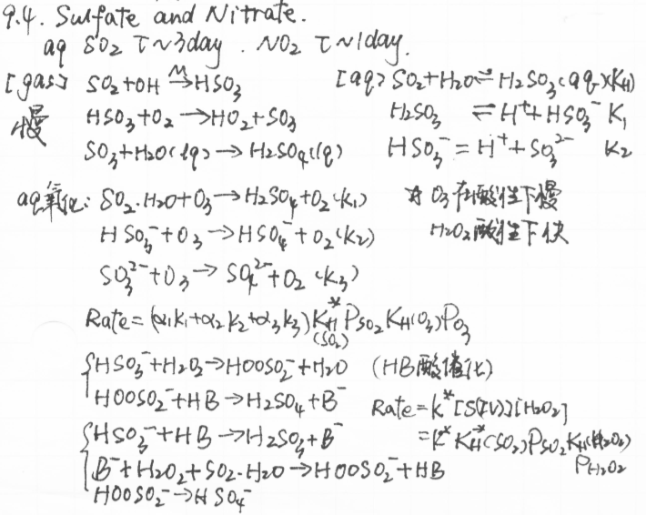
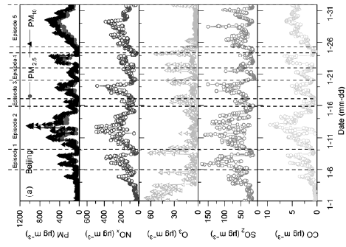
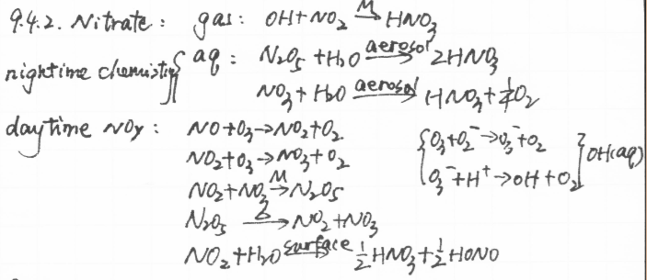
Secondary Source of Haze
Sulfate
Nitrate
Variation of particle matter and gaseous pollutants in Beijing in January 2013. The five haze episodes are marked between the dote lines.

Slide 24
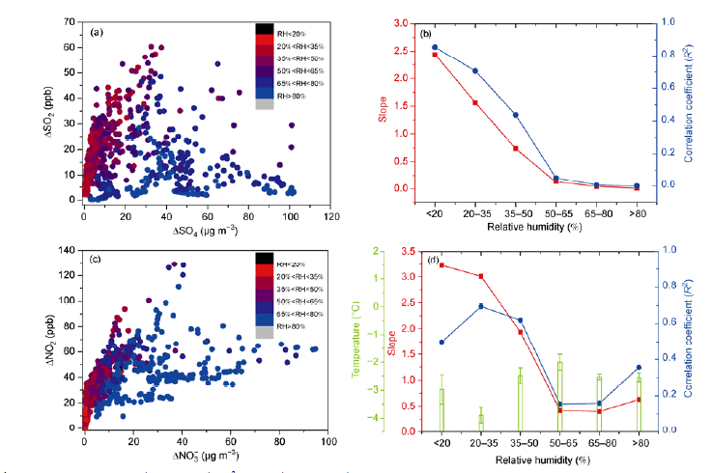
Scatter plots of (a) ΔSO₄ versus ΔSO₄²⁻ and (c) ΔNO₂ versus ΔNO₃⁻ at different RH ranges and (b) and (d) show the linear regression coefficient and slope as a function of RH.

Slide 25
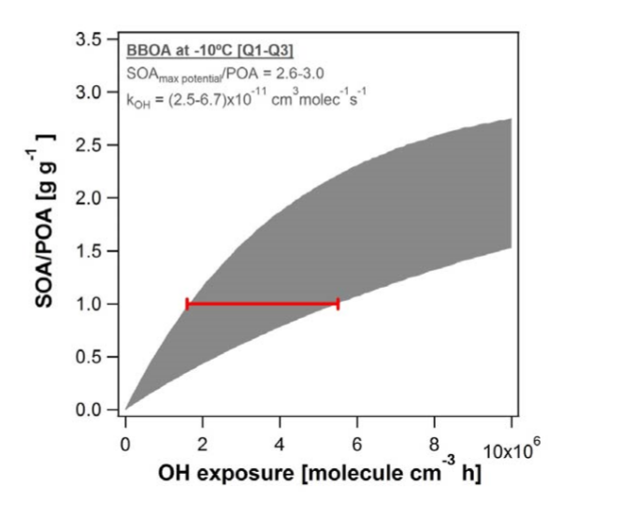
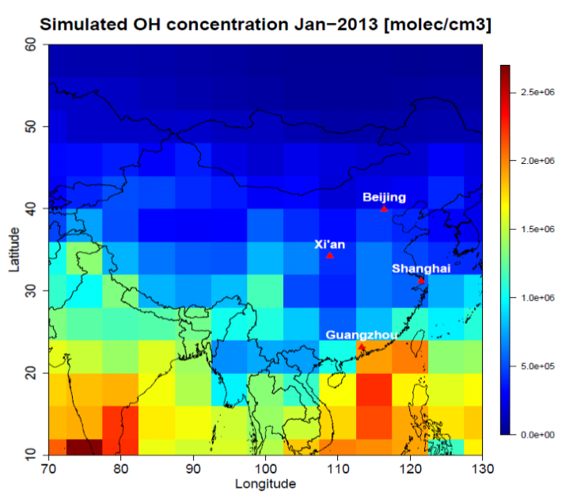
Wintertime SOA Formation
(Huang, et al., 2014)
Aging of biomass burning emissions performed at wintertime temperature (-10 oC) using a novel setup. The SOA/POA ratio is shown as a function of OH exposure (i.e., [OH] × time). SOAmax potential/POA is the maximum SOA potential normalized by POA; k_{OH} is the SOA production rate via OH chemistry. The interquartile range [Q1-Q3] from 5 experiments is represented by the grey area and the OH exposures necessary to produce SOA equal to POA is represented by the red bar (i.e. at OH exposures of 1.6-5.5 × 106 molecules cm-3 h). The SOAmax_potential/POA represents the asymptotic values reached by Q1 and Q3.
Notes:
We
show that low temperature does not significantly reduce SOA formation
rates of biomass burningemissions
At OHN concentrations typical of wintertime China
(.0.43106 molecules cm23, 24 h average, for the cities of this study),
these exposures are reachable in 4–14 h, which is fast with respect to
atmospheric transport especially during stagnant conditions.

Slide 26
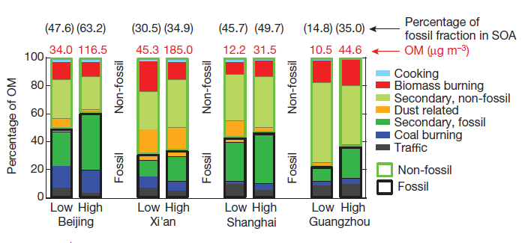
SOA Sources
Still highly uncertain
Fossil fuel and no-fossil fuel sources
Fossil and non-fossil fractional contributions of each source
during low and highPM2.5 levels observed in different cities.

Slide 27
Current Policies and Challenges

Slide 28
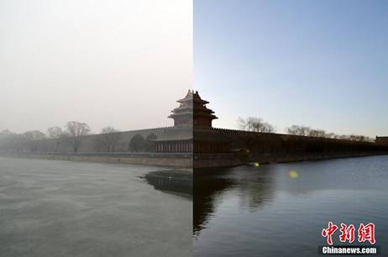
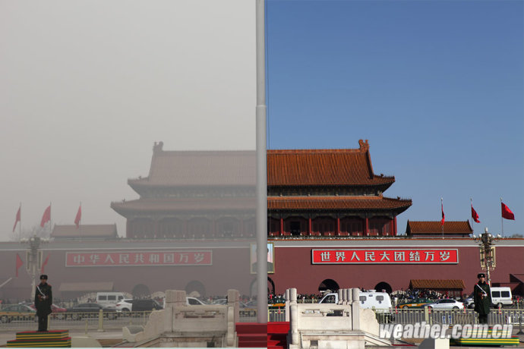
Haze vs “APEC-Blue”

Slide 30
Action been taken
Replacing coal fuel to natural gas.
Moving out heavily polluting factories.
More rigid traffic restriction.
All construction activities were halted.
Some polluting factories were ordered to reduce activities or even shut down.

Slide 31
Current Policies
13th Five-Year Plan
Air Pollution Prevention and Control Law
Vehicle emission Standards (states I II III…)
Fuel Quality Standards
Vehicle Restriction Rule (even and odd plate restriction)
License plate lottery and encourage new energy vehicles

Slide 32
Challenges
How to reduce pollution and keep development simultaneously.
Non-road vehicle (agriculture vehicle),burning corps privately.
Some vehicles, especially for high-duty truck, exceed emission standards several times even with a tag to show they pass the emission test (Corruption of some departments).
Although emission standards keep to be updated, the fuel for both gasoline and diesel do not reach the quality to achieve that standard.
Who should pay for the cost of refining oil: Oil company? Government? Consumer?

Slide 33
Diurnal variation of absorption coefficient in summer and 2. Diurnal variation of absorption coefficient in summer and winter.
winter. (He, et al.,2009)
Diurnal variations of PM2.5 concentration in a typical urban site in Beijing in 2014. (Lv, et al., 2015 )
Time series of hourly OC and EC concentrations and precipitation. (Lin, et al., 2009)
Maximum value of PM and BC appears at night due to 1) lower BLH at night
2) High Duty Truck

Slide 34
High duty diesel engine
Pros
  High efficiency
  High power
Cons
  High NOx
  High PM (Diesel Particulate Filter)
  High EC/OC
How to control?
Enforce to install DPF
Diesel Quality
Non-road diesel engine regulation

Slide 36
Future Perspective
Air pollution is controllable.
  e.g. APEC blue, LA
Energy transition nationwide: from coal to natural gas.
More strict punishment for enterprises, factories and vehicles exceed emission standards.
Improvement of supply fuel, and fuel quality standard should be ahead of emission standard.
Enterprises should take more social responsibility.

Slide 37
References
Wang, Y.; Yao, L.; Wang, L.; Liu, Z.; Ji, D.; Tang, G.; Zhang, J.; Sun, Y.; Hu, B.; Xin, J., Mechanism for the formation of the January 2013 heavy haze pollution episode over central and eastern China. Sci. China Earth Sci. 2014, 57 (1), 14-25.
Huang, R. J.; Zhang, Y.; Bozzetti, C.; Ho, K. F.; Cao, J. J.; Han, Y.; Daellenbach, K. R.; Slowik, J. G.; Platt, S. M.; Canonaco, F.; Zotter, P.; Wolf, R.; Pieber, S. M.; Bruns, E. A.; Crippa, M.; Ciarelli, G.; Piazzalunga, A.; Schwikowski, M.; Abbaszade, G.; Schnelle-Kreis, J.; Zimmermann, R.; An, Z.; Szidat, S.; Baltensperger, U.; El Haddad, I.; Prevot, A. S., High secondary aerosol contribution to particulate pollution during haze events in China. Nature 2014, 514 (7521), 218-22.
Wang, L. T.; Wei, Z.; Yang, J.; Zhang, Y.; Zhang, F. F.; Su, J.; Meng, C. C.; Zhang, Q., The 2013 severe haze over southern Hebei, China: model evaluation, source apportionment, and policy implications. Atmospheric Chemistry and Physics 2014, 14 (6), 3151-3173.
Zhao, X. J.; Zhao, P. S.; Xu, J.; Meng, W.; Pu, W. W.; Dong, F.; He, D.; Shi, Q. F., Analysis of a winter regional haze event and its formation mechanism in the North China Plain. Atmospheric Chemistry and Physics 2013, 13 (11), 5685-5696.
Han, B.; Zhang, R.; Yang, W.; Bai, Z.; Ma, Z.; Zhang, W., Heavy haze episodes in Beijing during January 2013: Inorganic ion chemistry and source analysis using highly time-resolved measurements from an urban site. Sci Total Environ 2016, 544, 319-29.
Wei, K.; Zou, Z.; Zheng, Y.; Li, J.; Shen, F.; Wu, C. Y.; Wu, Y.; Hu, M.; Yao, M., Ambient bioaerosol particle dynamics observed during haze and sunny days in Beijing. Sci Total Environ 2016, 550, 751-9.
Lv, B.; Zhang, B.; Bai, Y., A systematic analysis of PM2.5 in Beijing and its sources from 2000 to 2012. Atmospheric Environment 2016, 124, 98-108.
He, X.; Li, C. C.; Lau, A. K. H.; Deng, Z. Z.; Mao, J. T.; Wang, M. H.; Liu, X. Y., An intensive study of aerosol optical properties in Beijing urban area. Atmos. Chem. Phys. 2009, 9 (22), 8903-8915.
Yue, X.; Wu, Y.; Hao, J.; Pang, Y.; Ma, Y.; Li, Y.; Li, B.; Bao, X., Fuel quality management versus vehicle emission control in China, status quo and future perspectives. Energy Policy 2015, 79, 87-98.
Huang, W.; Fan, H.; Qiu, Y.; Cheng, Z.; Xu, P.; Qian, Y., Causation mechanism analysis for haze pollution related to vehicle emission in Guangzhou, China by employing the fault tree approach. Chemosphere 2016, 151, 9-16.

