Slide 1
The Impacts of Land Use/Cover Change on Air Quality and Climate
Authors: Jianfeng Li, Ye Cheng, Yunle Chen

Slide 2
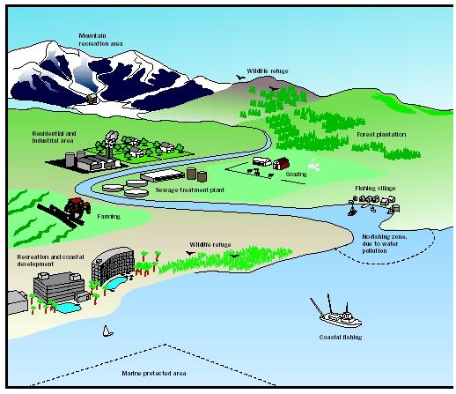
What is land use and land cover?
Land use is characterized by the arrangements, activities and inputs people undertake in a certain land cover type to produce, change or maintain it. (http://www.fao.org/nr/land/use/en/)
Land cover is the physical material at the surface of the earth. (https://en.wikipedia.org/wiki/Land_cover)
Land use ≠ Land cover; However, these two terms are used interchangeably and in confusion [Pete Fisher et al., 2005].
LULCC
http://www.waterencyclopedia.com/La-Mi/Land-Use-Planning.html

Slide 3
The relationship between land use/cover and earth systems
Land use/cover and Energy and Radiation
Land use/cover and hydrology systems
Land use/cover and biogeochemical cycles
Land use/cover and socioeconomic systems
[David Lawrence et al., 2012]

Slide 4
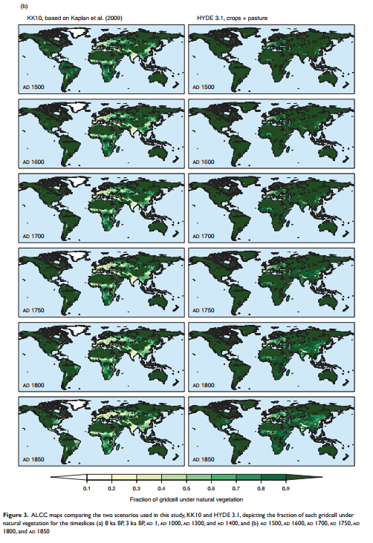
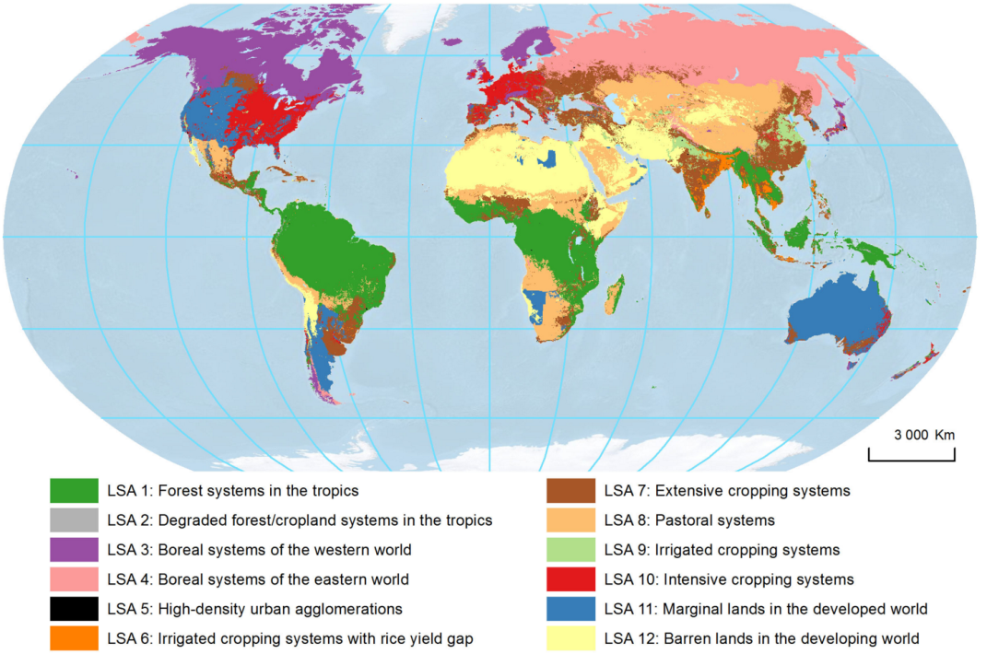
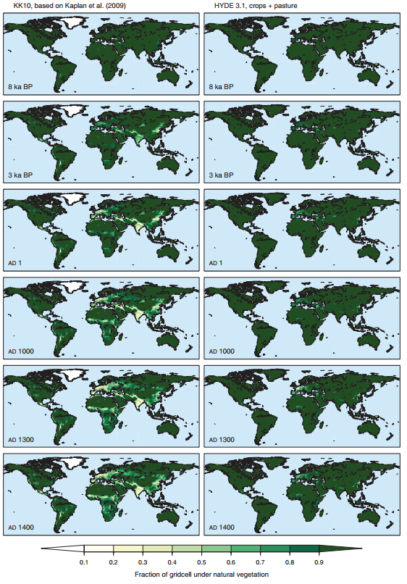
Current Land use/cover Changes are greater than ever in history
(http://phys.org/news/2013-11-global-insights.html)
Global land cover change from 8000 BP to -50 BP
Border relationships between land use/cover change and food security, energy supply, biodiversity, atmospheric composition, air quality, climate change, etc., makes related researches important. [Coletter Heald et al., 2015]
[Jed Kaplan et al., 2010]

Slide 5
Figure 1. A schematic illustration of the climate impacts of land use and land cover change.
(D. S. Ward et al. 2014)

Slide 6
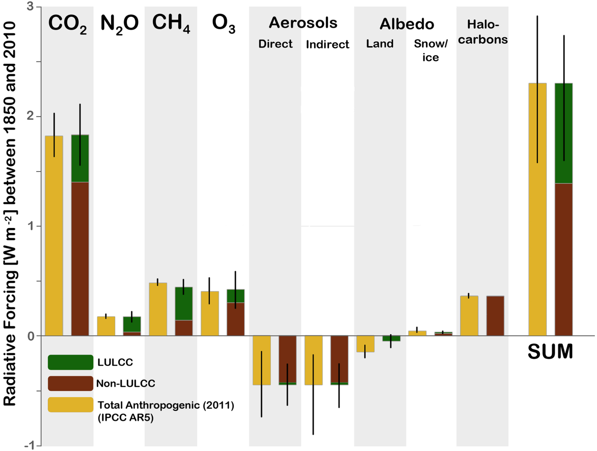
Figure 3. RFs for LULCC and other anthropogenic impacts estimated by this study for the year 2010 referenced to the year 1850.

Slide 7
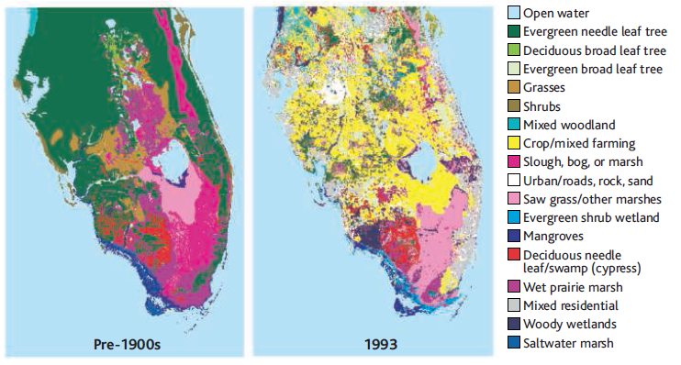
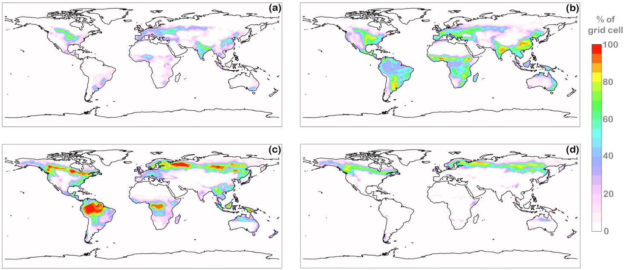
1. Forest -> Cropland
(Roger A. Pielke Sr, 2005)
Figure 2. Percent of grid box area consisting of (a) year 2010 crops, (b) potential crops based on climate and soil suitability, (c) year 2010 forests, and (d) year 2100 forests in the theoretical extreme case.
(D. S. Ward et al. 2014)

Slide 8
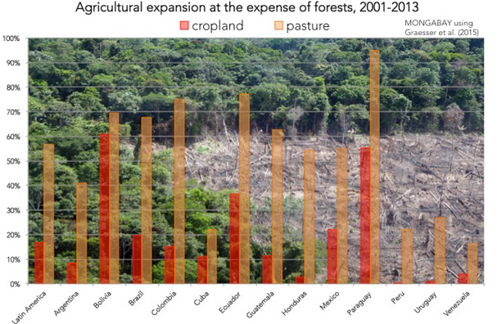
No irrigation:
less evaporation of water from leaves leading to warmer temperatures in that area.
Irrigation:
more water is transpired and evaporated from moist soils, which cools and moistens the atmosphere

Slide 9
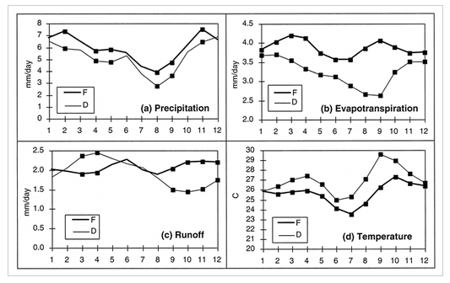
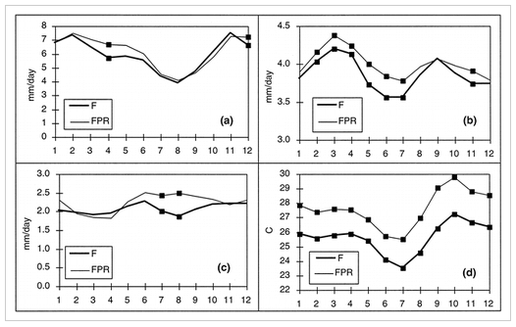
Effects of deforestation
Effects of double CO2
(Marcos Heil Costa, 2010)
The impact of land use change on temperature was found to be comparable to that of GHG accumulation.

Slide 10
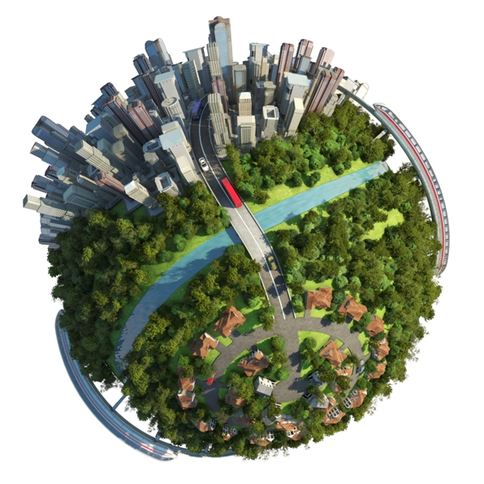
2. Urbanization
Local climates tend to be warmer due to the increased amount of
heat released within a densely populated area.
density of construction materials.
Concrete: absorption
Roofing: reflection.
(www.learnatunitar.org)
Urban heat island effect

Slide 11
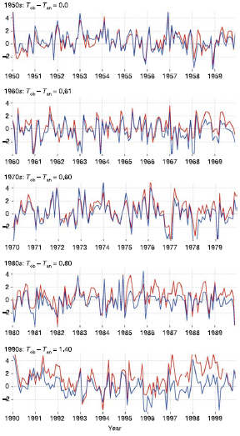
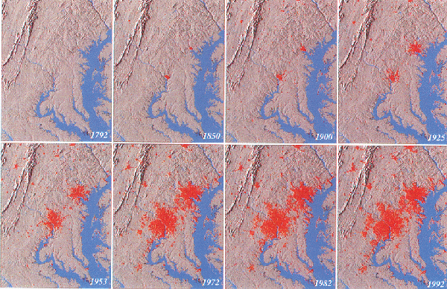
Fig. 5-2. Two hundred years of urban growth for the Baltimore-Washington region. Red pixels denote urban land use as defined by both the USGS and the Bureau of the Census. (Timothy W. Foresman, 2012)
(Eugenia Kalnay, 2003)

Slide 12
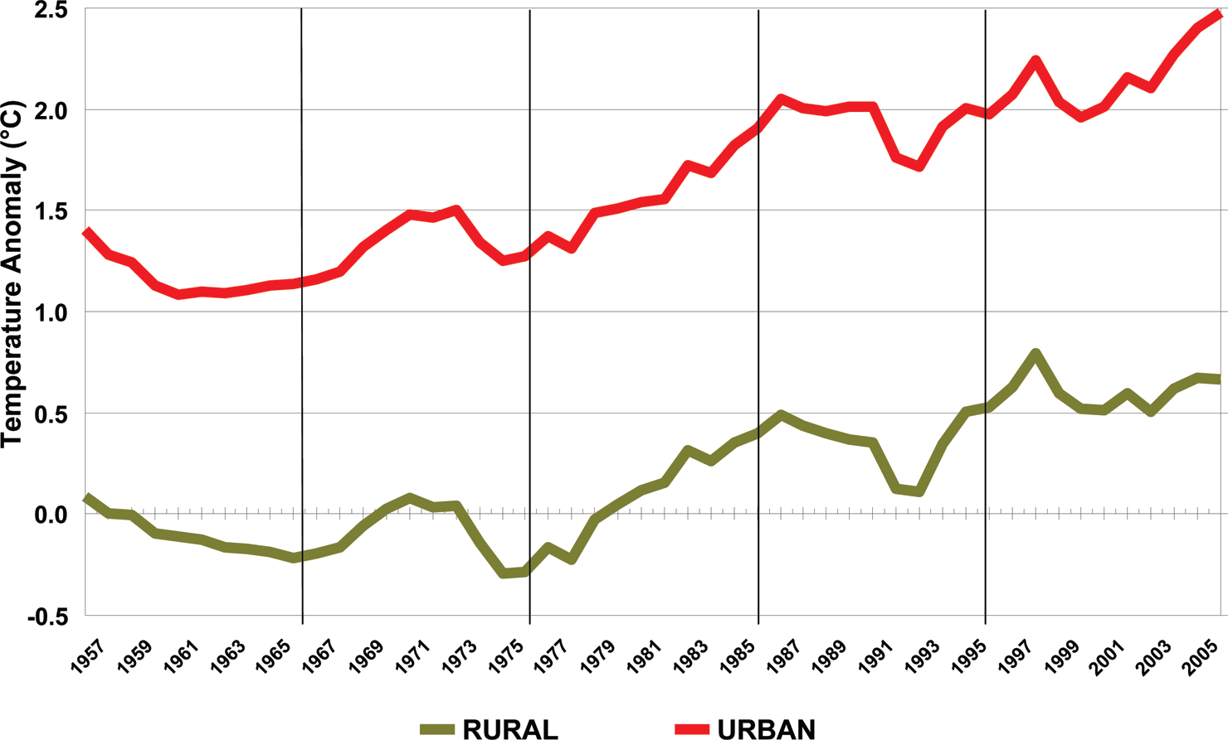
FIGURE 1. Urban and rural temperature anomalies (5 year means) for 50 large U.S. metropolitan regions over the period of 1957-2006. (BRIANSTONE ,JR 2009).

Slide 13
Land use/cover changes effects on Air quality 1. N-based gases emissions – Natural land use/cover change
NO, NO2, N2O, NH3….
Agricultural development -> soil emissions
Fire-> fire emissions
Urbanization -> traffic emissions

Slide 14
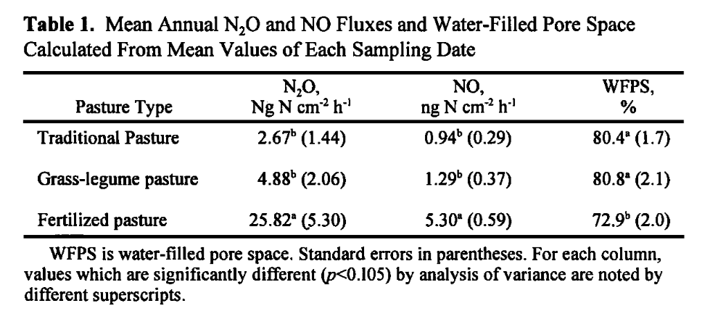
Land use/cover changes effects on Air quality 1. N-based gases emissions – Natural land use/cover change
Effects of pasture management on N2O and NO emissions from soils in the humid tropics of Costa Rica
EdzoVeldkamp, MichaelKeller, MarvinNufiez
Global Biogeochemical Cycles (1998), 12, 71.
Monthly measurements of N2O and NO emissions from pastures with three different management systems on volcanic soils
Tropical humid climate

Slide 15
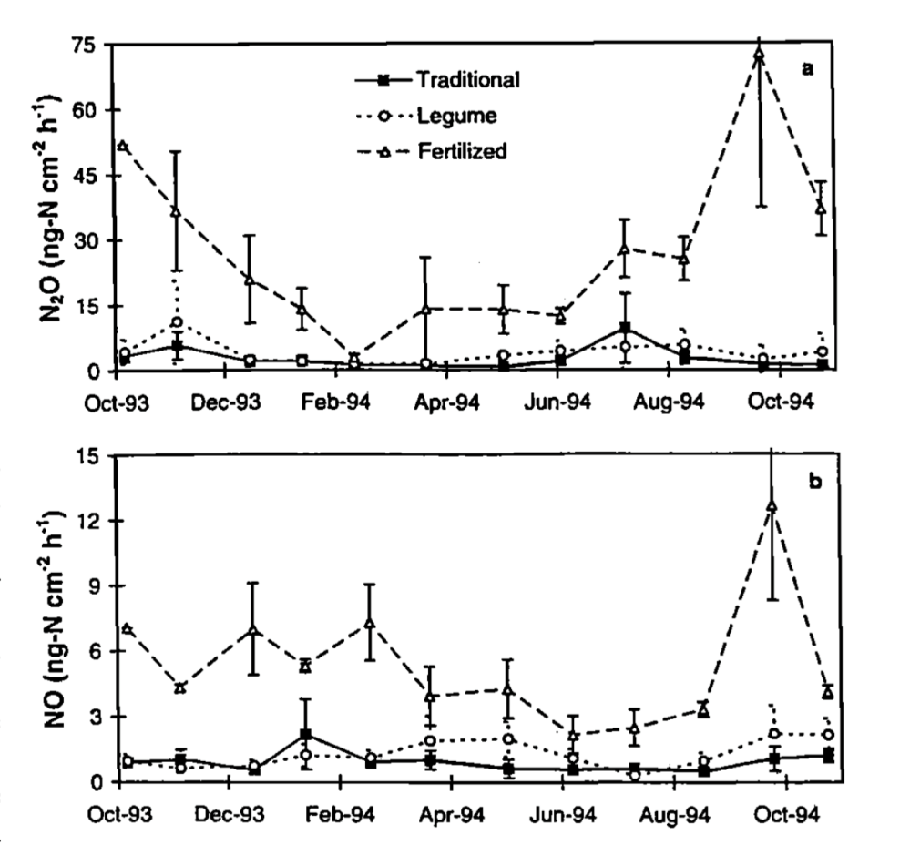
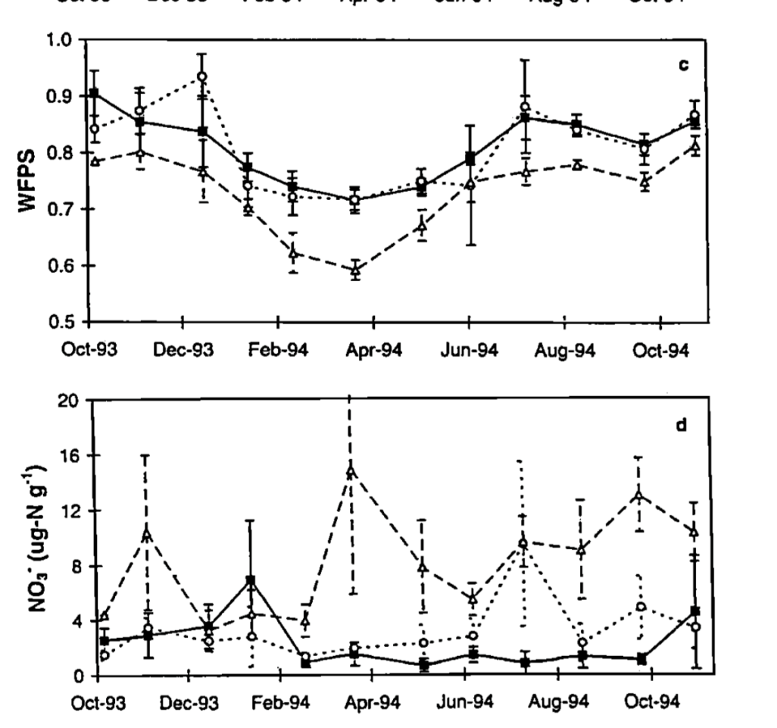
N2O fluxes in the fertilized pastures exhibit seasonal pattern with the greatest fluxes for a given nitrogen management corresponding to the months with highest soil-water filled pore spaces (WFPS)
High NO fluxes corresponding to the months with low WFPS
N2O, NO loss from the fertilized pastures were significantly higher than grass-legume and conditional pastures

Slide 16
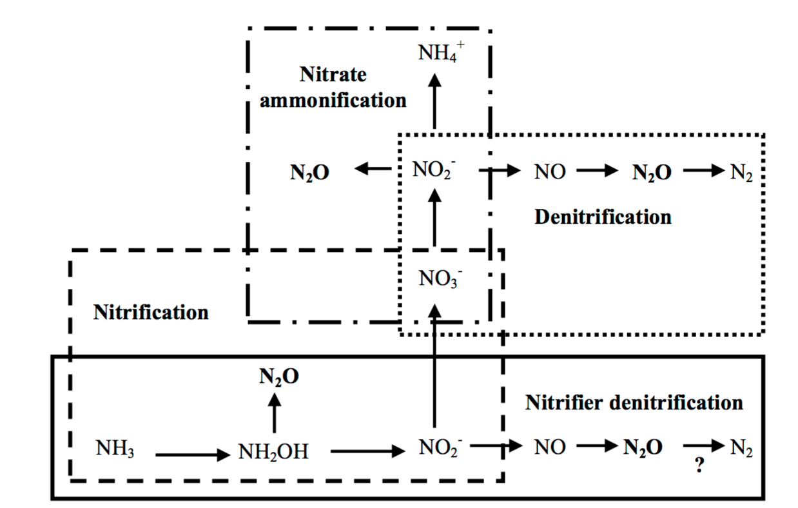
N2O: product of denitrification
NO: product of nitrification
Water present in soil fills the pore space, decreasing the oxygen concentration and creating anoxic conditions that favor reductive processes. Dry soil allows for higher oxygen levels, resulting in
an increase in oxidative processes.
Baggs, et al. 2010

Slide 17
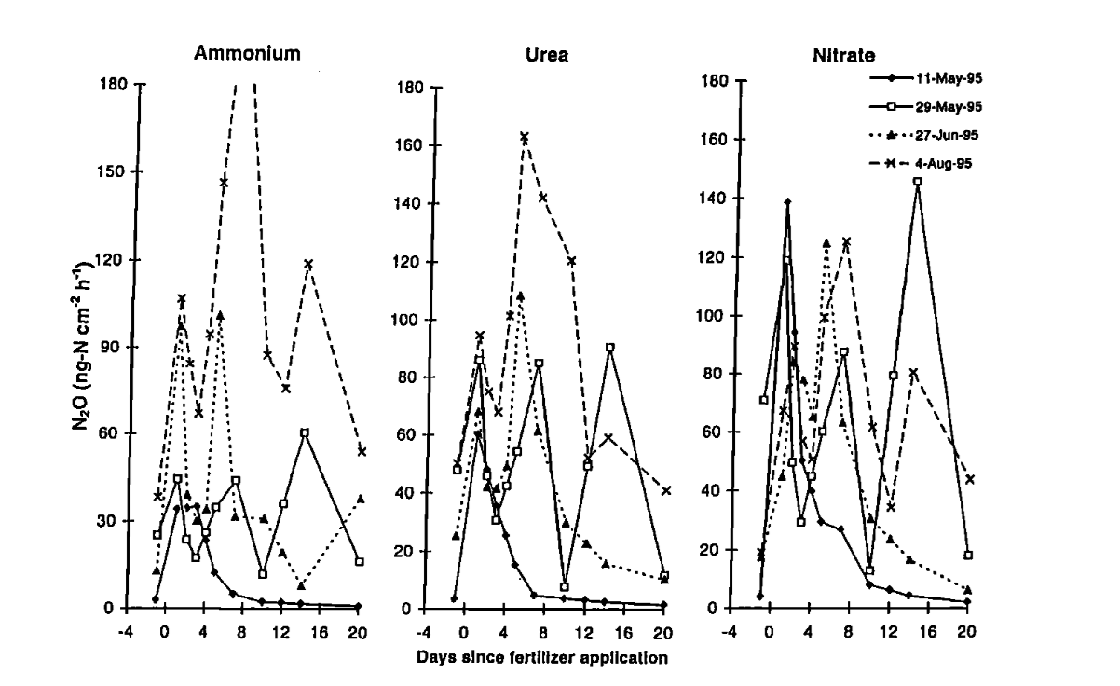
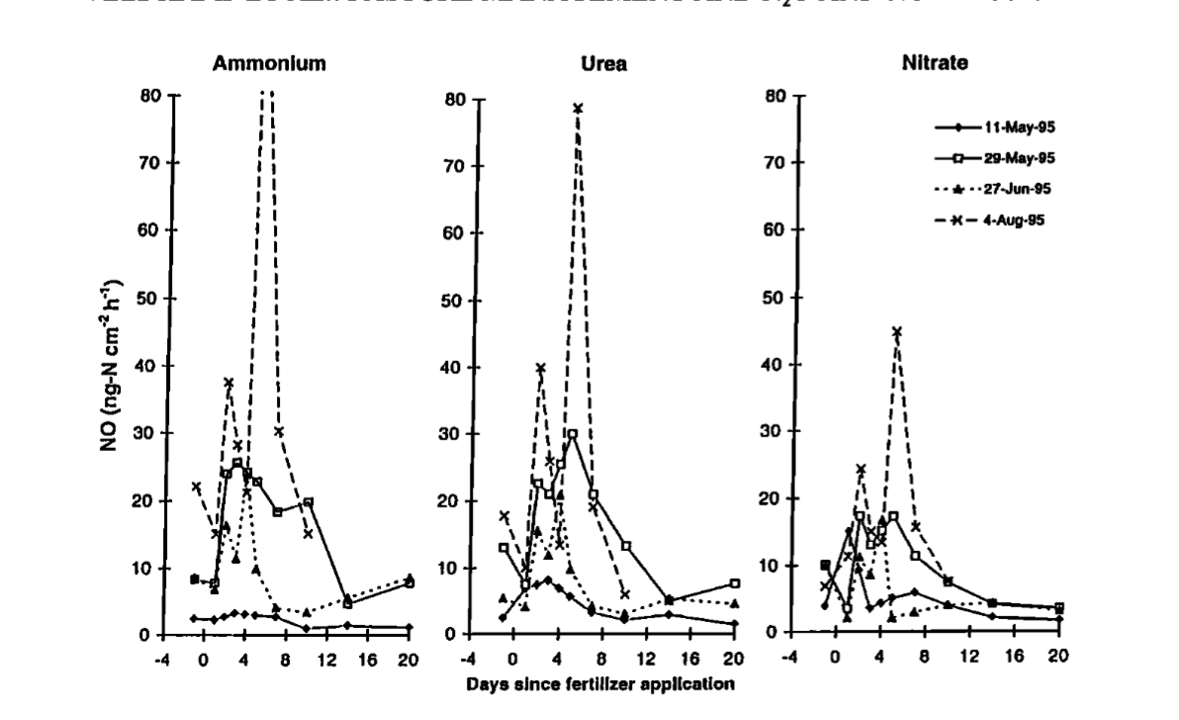
The timing of the highest NO and N2O emissions is not influenced by the fertilizer composition
The highest fluxes were always measrued after 2 to 6 days following fertilization
N2O fluxes are always higher than NO fluxes for all fertilizer type

Slide 18
Land use/cover changes effects on Air quality 1. N-based gases emissions – Natural land use/cover change
Satellite observations indicate substantial spatiotemporal variability in biomass burning NOx emission factors for South America
P. Castellanos, K. F. Boersma, and G. R. van der Werf
Atmospheric Chemistry and Physics, (2014), 14, 3929–3943.
Monthly NOx emission factors for four fire types are calculated:
deforestation
savanna/grassland
Woodland
agricultural waste burning
South America, dry season (July – October)

Slide 19
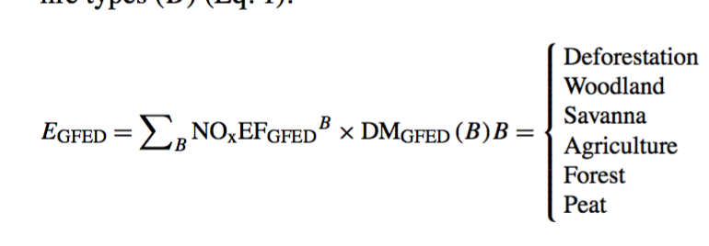
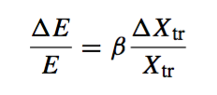
E_{GFED}: total fire NOx emissions in a model grid cell
NOxEF_{GFED}^{B}: GFED v3 NO emission fac- x
tor for the fire type B
DM_{GFED}(B): the mass of dry matter consumed by the fire type B in the model grid cell
Xtr: NO2 columns
E: surface NOx emissions
β: sensitivity factor
E_{OMI}: estimate fire NOx emissions in a model grid cell (EOMI)
NOxEF_{OMI}^{B} : fire-type-specific OMI-constrained NOx emission factor

Slide 20
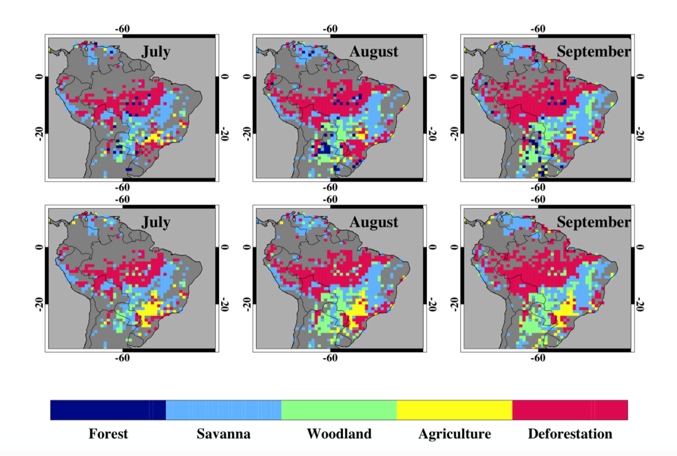

Slide 21
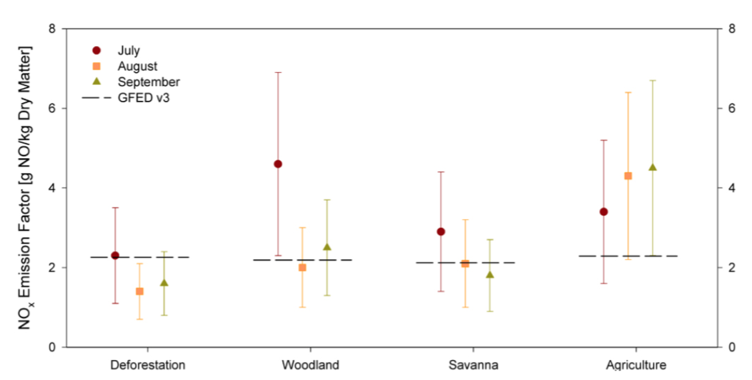
deforestation fires have the lowest NOx emission factors, while agricultural fire NOx emission factors were the highest
NOx emission factors for woodland and savanna burning are comparable on average and fall in in the middle of the calculated range

Slide 22
Land use/cover changes effects on Air quality 2. BVOC emissions – Natural land use/cover change
The impact of bark beetle infestations on monoterpene emissions and secondary organic aerosol formation in western North America
O. J. Squire, A. T. Archibald, N. L. Abraham, D. J. Beerling, C. N. Hewitt, J. Lathiere, R. C. Pike, P. J. Telford, and J. A. Pyle
Atmospheric Chemistry and Physics, (2014), 14, 1011-1024.
1. In the last decade, western North America has experienced the largest bark beetle outbreaks in recorded history.
2. Bark beetle attack can promote elevated monoterpene emissions in trees due to the likely defense mechanism of the trees.
3. This study is to quantify the monoterpene emission change and related air quality effects.
4. NACAR CESM (Community Earth System Model) v 1.1, 1.9°×2.5°, from 1997 to 2010; CLM4 (Community Land Model), CAM4 (Community Atmosphere Model), MEGAN 2.1； SOA calculation

Slide 23
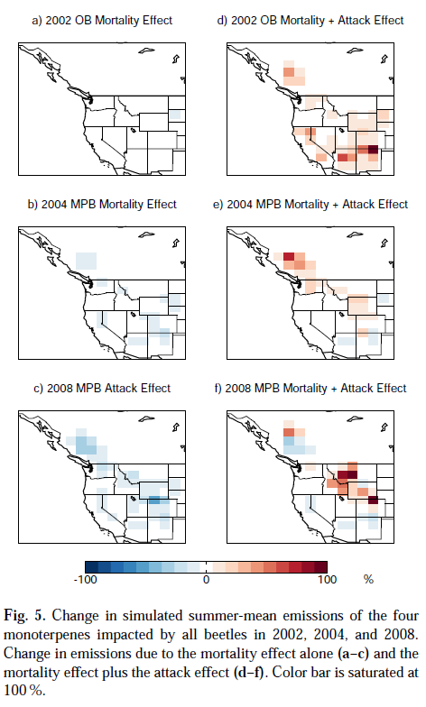
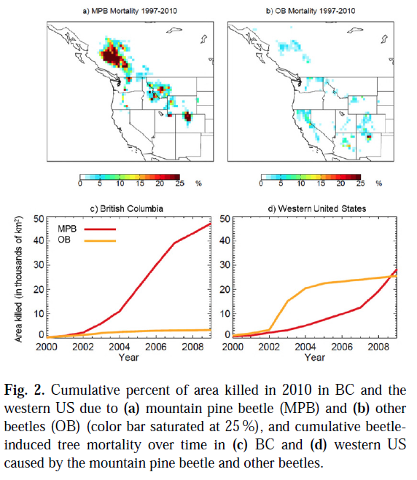
With all four monoterpene emissions included, the largest local increase above baseline is 111% in 2002, 70% in 2004, and 104% in 2008. The majority of the impact is from the MPB, except in 2002.

Slide 24
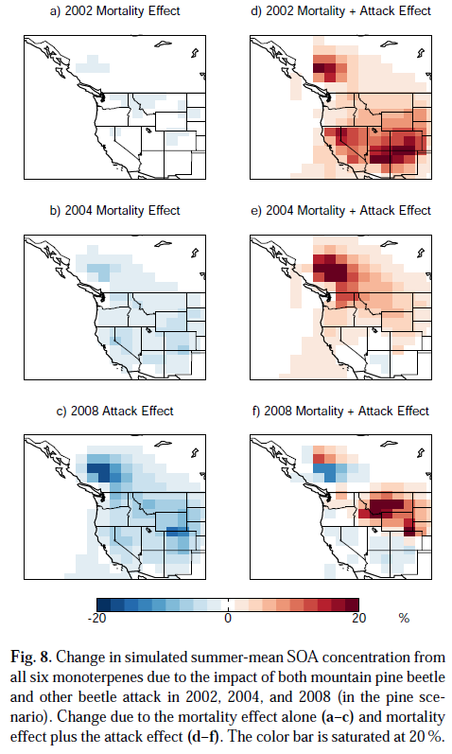
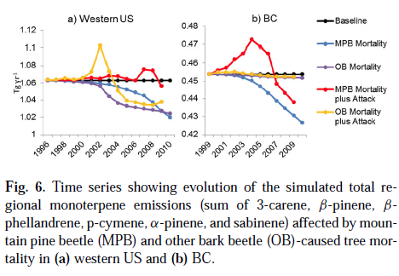
During this year, the mortality effect causes widespread decreases in SOA from 1–5 %. Including the attack effect, specific areas see increases above a baseline of up to 37% with a widespread increase
above a baseline of 10 %. The year with the smallest overall attack effect impact is in 2009, likely a combination of decreasing infestation of MPB in BC and a decreasing infestation of the OB in the western US, allowing the mortality effect to overcome the attack effect in this year.
In a given year, the more trees under attack, the stronger the attack effect; however, increasing cumulative mortality in later years offsets more of the attack effect. For BC, the maximum increase in total emissions of these four compounds is 7% above baseline in 2004. For the US, the maximum increase in total emissions of these four compounds is 3% above baseline in 2008. Although total monoterpene emissions are not significantly perturbed by bark beetle kill, Fig. 5 shows that local effects can be substantially larger.

Slide 25
Organic aerosol typically makes up 15–70% of total fine particulate matter (PM2.5) measured in summertime in the western US. Simulated SOA makes up only a fraction of total simulated OA in the western United States, typically 15–50% in winter and 40–90% in summer, with large primary emissions due to wildfires.
These sites are examples of areas that saw some of the highest increases in total SOA concentrations above baseline in the western US in our simulation. However, the simulated increase in SOA under the pine scenario (maximum increase of 0.2 μgm−3) is dwarfed by the seasonal and interannual variability in observed OA which is largely driven by wildfire activity.

Slide 26
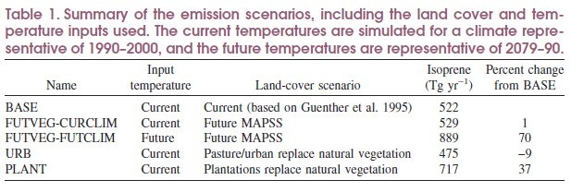
Land use/cover changes effects on Air quality 2. BVOC emissions – Anthropogenic land use/cover change
Future Changes in Biogenic Isoprene Emissions: How Might They Affect Regional and Global Atmospheric Chemistry?
Christine Wiedinmyer, Xuexi Tie, and Alex Guenther
Earth Interactions, (2006).
The authors used the output from one MAPSS model run for our study: a future run, which used a mean climate for 2070–99 predicted by the Hadley HADCM2SU global circulation model (GCM) with a resolution of 0.5°×0.5°. The HADCM2SUL GCM simulation has a global temperature increase of 1.7°C at the time of CO2 doubling, with the largest increases in temperatures at latitudes between −20° and 20°N and at latitudes greater than 50°N. MOZART -2 model with a resolution of 2.8°×2.8°.

Slide 27
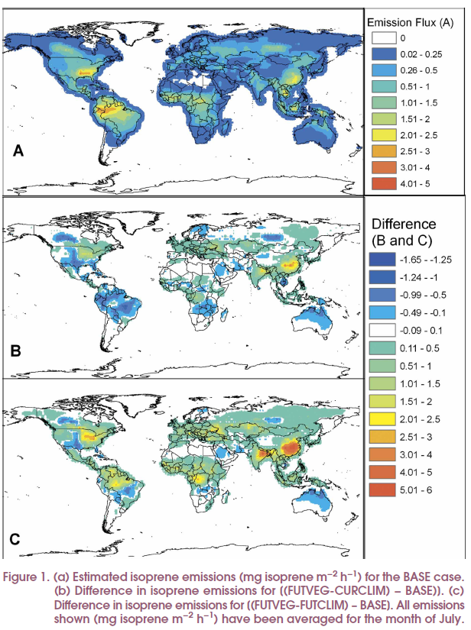
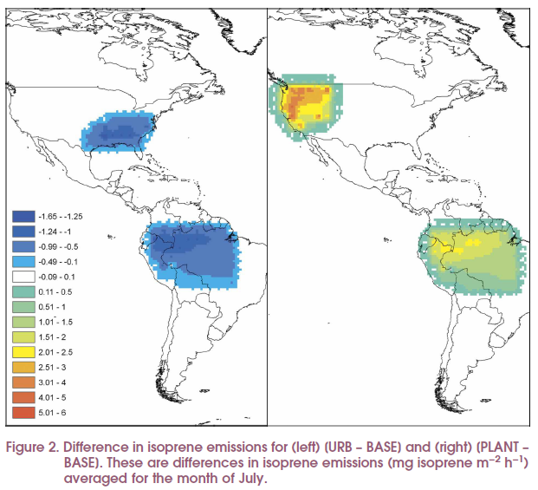
B – A: The largest decreases in isoprene emissions were in South America, northern Australia, India, and the south-central United States where natural forests that have high isoprene emissions were replaced by shrubs, savannas, and grasslands, which have much lower emissions. Small increases in isoprene emissions were simulated in China, India, Europe, and the northeastern United States, where forested vegetation types replaced areas with low-emitting vegetation.
C – A: biogenic isoprene emissions were increased in most regions, with the exception of northern Australia, central South America, and the central United States.

Slide 28
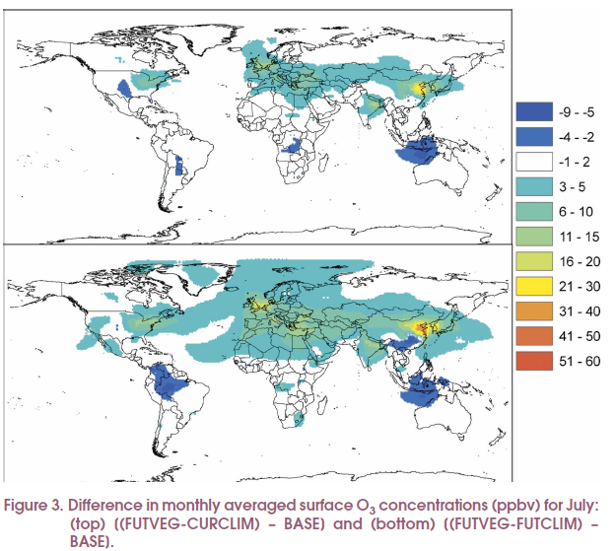
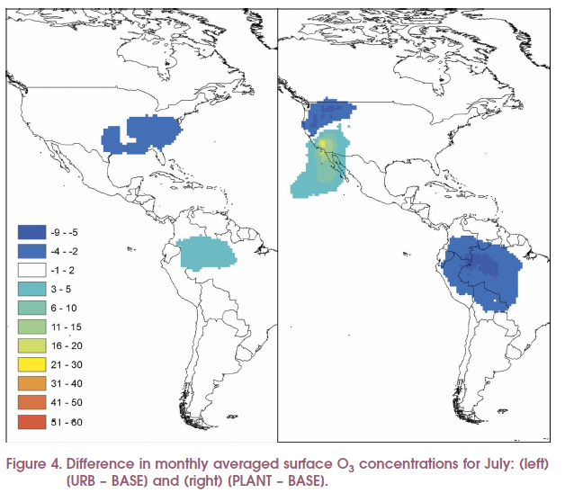
B – A: For July, the differences in monthly averaged surface O3 concentrations ranged from −9 ppb to 52 ppbv. In this case, monthly averaged O3 concentrations for July were decreased as much as 25% in some areas (southern China, Indonesia, central Africa, and Brazil) and increased as much as 95% in other areas (Europe and northeastern China).
C – A: The FUTVEG-FUTCLIM scenario included large increases in isoprene emissions in the Amazon and central Africa and a subsequent reduction of O3 concentrations.

Slide 29
Conclusion
Land use/Land cover change (LULCC) are much faster than ever in the history along with the processes of urbanization and deforestation.
In global scale, LULCC affects the climate by GHGs storage change; In regional scale, LULCC affects the climate by the change of albedo and heat flux.
LULCC has large effect on the emissions of N-based gases and BVOC. Both of them will effect regional air quality such as O3 and aerosols.

Slide 30
References
Fisher P F, et al. "Land use and Land cover: Contradiction or Complement". In Peter Fisher, David Unwin. Re-Presenting GIS (2005). Chichester: Wiley. pp. 85–98.
Lawrence, David M., et al. "The CCSM4 land simulation, 1850-2005: Assessment of surface climate and new capabilities." Journal of Climate25.7 (2012): 2240-2260.
Kaplan, Jed O., et al. "Holocene carbon emissions as a result of anthropogenic land cover change." The Holocene (2010): 0959683610386983.
Heald, Colette L., and Dominick V. Spracklen. "Land use change impacts on air quality and climate." Chemical Reviews 115.10 (2015): 4476-4496.
Squire, O. J., et al. "Influence of future climate and cropland expansion on isoprene emissions and tropospheric ozone." Atmospheric Chemistry and Physics 14 (2014): 1011-1024.
Wiedinmyer, Christine, et al. "Future changes in biogenic isoprene emissions: how might they affect regional and global atmospheric chemistry?." Earth Interactions 10.3 (2006): 1-19.

Slide 31
D. S. Ward, N. M. Mahowald, and S. Kloster. Potential climate forcing of land use and land cover change. Atmos. Chem. Phys., 14, 12701–12724, 2014
Timothy W. Foresman . The Baltimore-Washington Regional Collaboratory Land-Use History Research Program. http://landcover.usgs.gov/luhna/chap5.php
Eugenia Kalnay and Ming Cai. Impact of urbanization and land-use change on climate. NATURE, VOL 423, 2003.
Marcos Heil Costa * and Jonathan A. Foley , 2010: Combined Effects of Deforestation and Doubled Atmospheric CO₂Concentrations on the Climate of Amazonia. Journal of Climate, 13, 18–34, doi: 10.1175/1520-0442(2000)013<0018:CEODAD>2.0.CO;2.

