Slide 1
Source Apportionment of Water Soluble Elements, EC/OC, and BrC by PMF
Linghan Zeng
04/21/2016

Slide 2
Introduction
Why do I focus on water soluble elements?
Why do the source apportionment?

Slide 3
Positive Matrix Factorization (PMF)
Receptor Model
A model for pollutant source identification contributing to the observed chemical concentrations at a receptor site.
Receptor modeling utilizes composition data collected at the receptor site to determine the source attributions.

Slide 4
PMF Equation
X = GF + E
Samples
(n×m)
Source Contributions
(n×p)
Source Profiles
(p×m)
Residuals
(n×m)

Slide 5
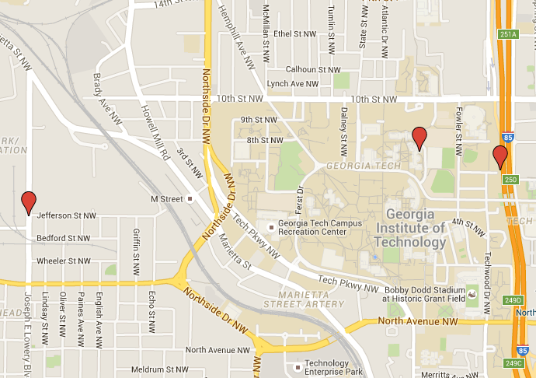
Sample Description
Sites
Jefferson Street (JST)
Georgia Tech (GT)
Road Side (RS)

Slide 6
Sample Description
Site | Year | Season | Number
JST | 2012 | Summer (Jun, Jul, Aug) | 57
 |  | Fall (Sep, Oct) | 22
 |  | Winter (Dec, Feb2013) | 51
 | 2013 | Spring (Mar) | 21
RS | 2012 | Fall (Sep, Oct) | 29
 | 2013 | Winter (Feb) | 29
GT | 2012 | Summer (Aug) | 37
 | 2013 | Spring (Mar) | 21
Total |  |  | 267

Slide 7
Data used in PMF
S, K, Ca, Ti, Mn, Fe, Cu, Zn, As, Se, Br, Sr, Ba, Pb were measured by XRF
EC/OC
BrC
Missing values are replaced by species median with 400% uncertainties.
Values below limit of detection are replaced by half of LOD with 5/6 uncertainties.

Slide 8
Data Summary
Species | S | K | Ca | Ti | Mn | Fe | Cu | Zn | Se
LOD (ngm⁻³) | 6.19 | 16.45 | 29.64 | 0.09 | 0.11 | 3.11 | 0.91 | 1.87 | 0.02
Overall Uncertainty (%) | 8.13 | 11.63 | 15.87 | 28.22 | 10.74 | 19.83 | 25.38 | 12.90 | 9.62
Species | Br | Sr | Ba | As | Pb | EC | OC | BrC
LOD (ngm⁻³) | 0.03 | 0.11 | 1.13 | N.A. | 0.14 | N.A. | N.A. | N.A.
Overall Uncertainty (%) | 9.62 | 25.46 | 17.73 | 10.77 | 11.85 | 6.29 | 15.8 | 20

Slide 9
Concentration Seasonal Variation

Slide 11
Result
Four factors solution is the optimal.
Transportation: Cu, Fe, Ba，EC
Biomass Burning: K, BrC
Mineral Dust: Ca, Mn
Secondary Formation: S

Slide 12
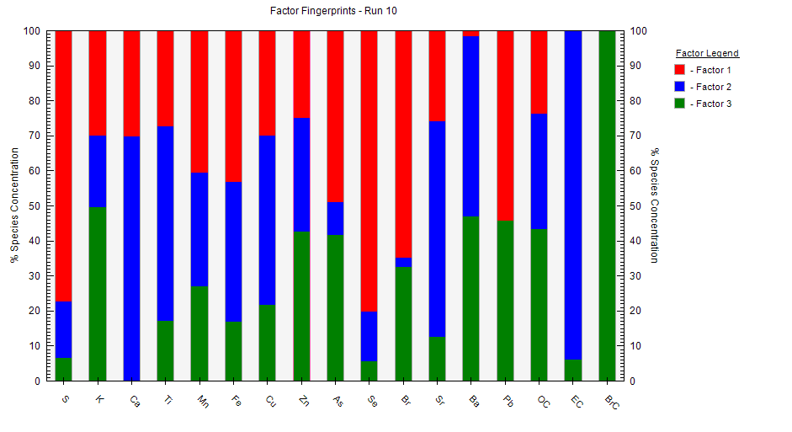
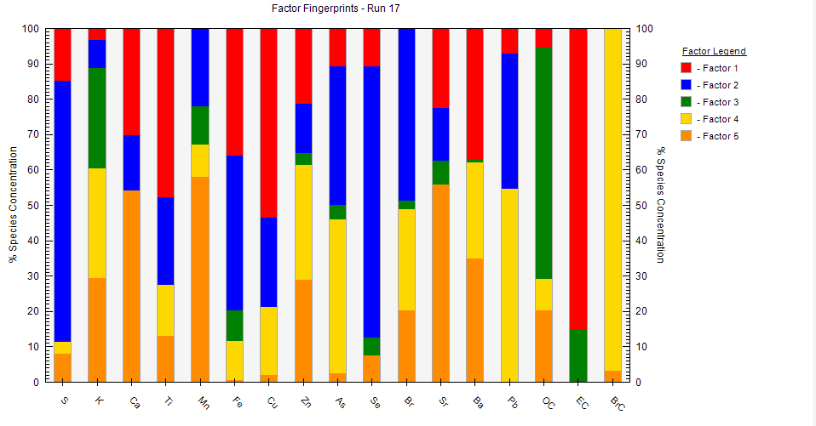
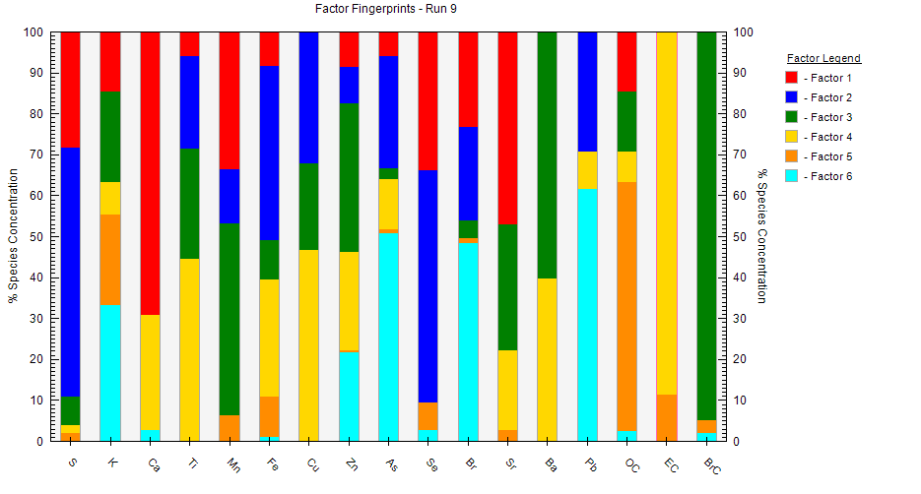
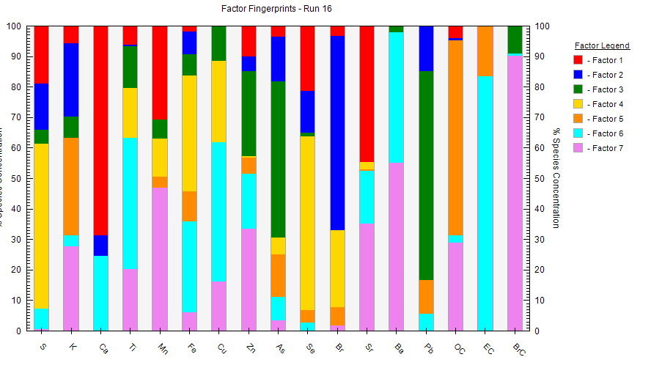
Other Results

Slide 13
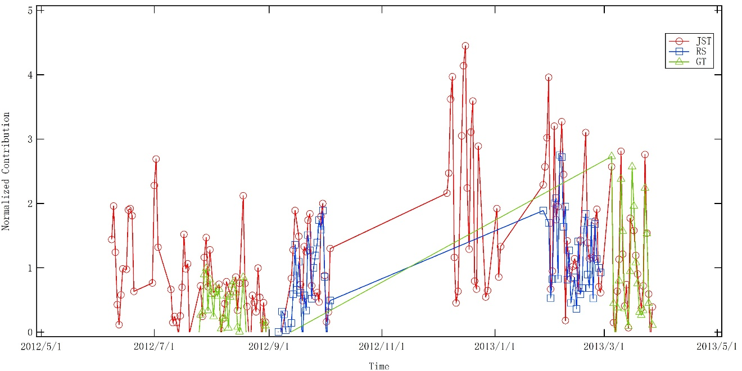
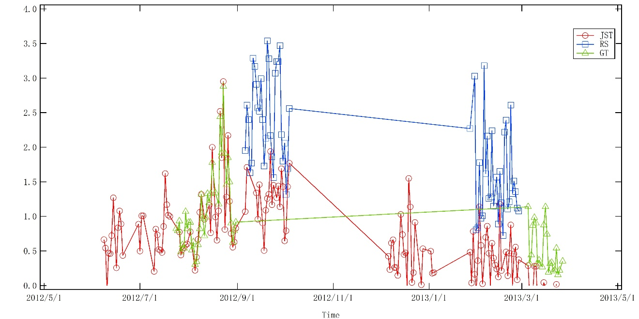
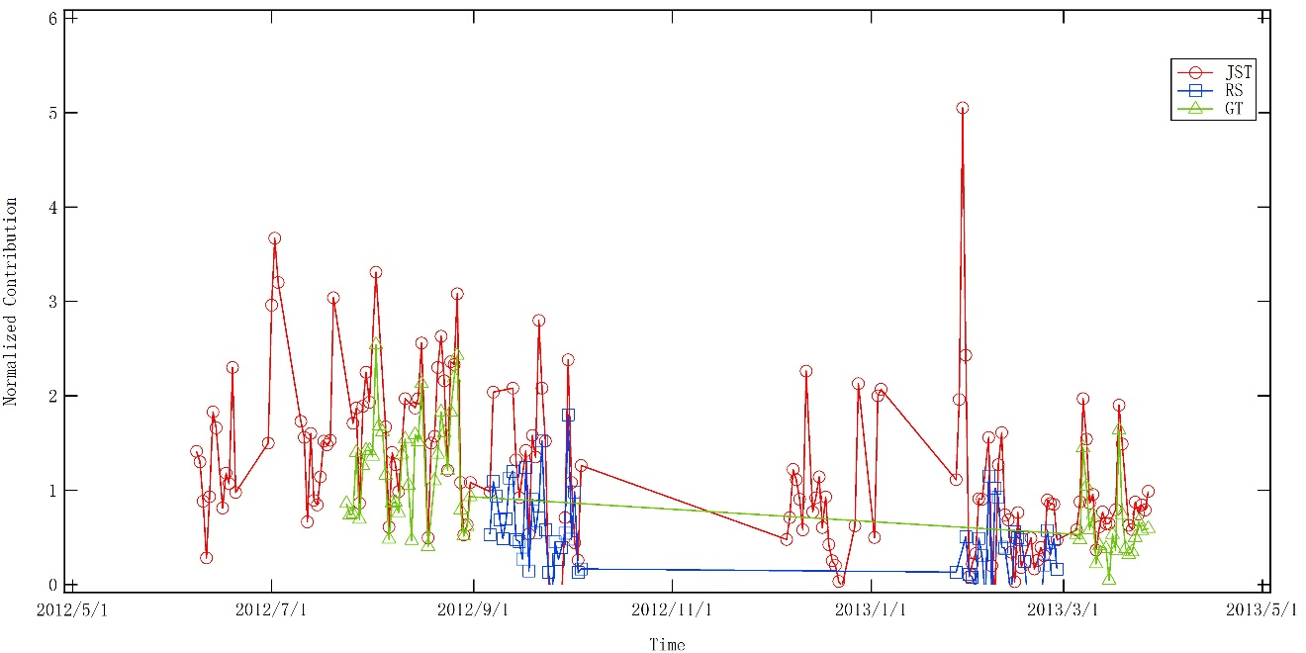
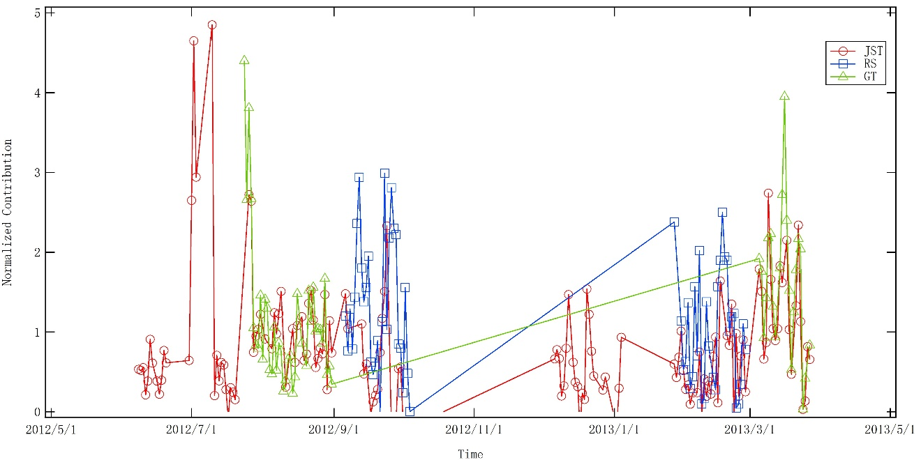
Biomass Burning
Transportation
Secondary Formation
Mineral Dust

Slide 14
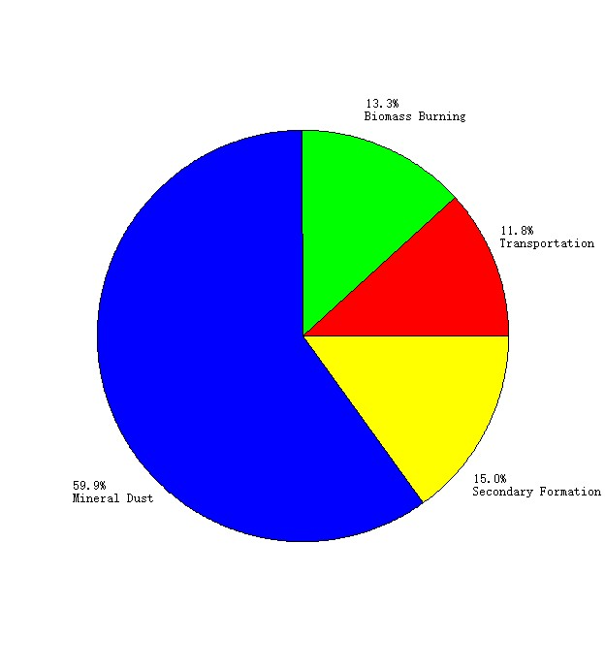
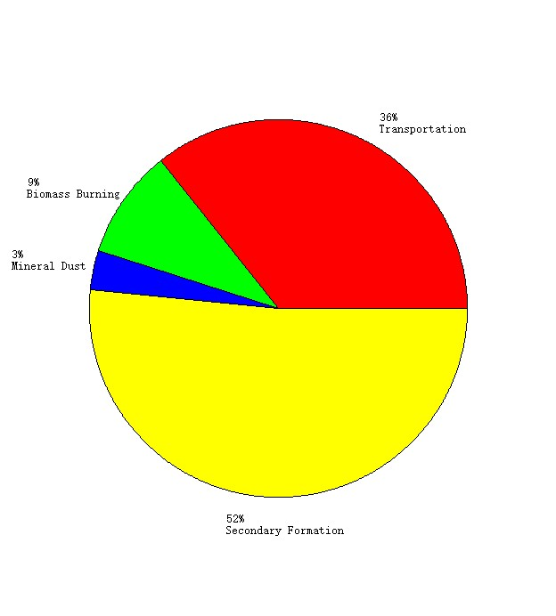
Factor Contribution for Mn, Fe, Cu
Mn
Fe
Cu

Slide 15
Limitation
Require large sample number
Hard to distinguish sources with similar profiles.
No physical or chemical mechanism to support the results
Factor explanation depends on users

Slide 16
Future Work (if needed)
Uncertainty Analysis
Oxidative potential vs redox-active elements
Compare source apportionment with other models

Slide 17
Thank you!

