Slide 1
Quantification of Organic Sulfur Compounds with
HR-ToF-AMS
Yunle Chen
04/21/2016

Slide 2
Background
Why we’re interested in organic sulfur compounds?
  Organic sulfur compounds have been observed in chamber experiments and in ambient aerosols globally
  Organic sulfur compounds can act as surfactants
Most abundant organic sulfur species in atmosphere
  Organosulfates: R-O-SO₃⁻
  Sulfonates: R-SO₃⁻

Slide 3
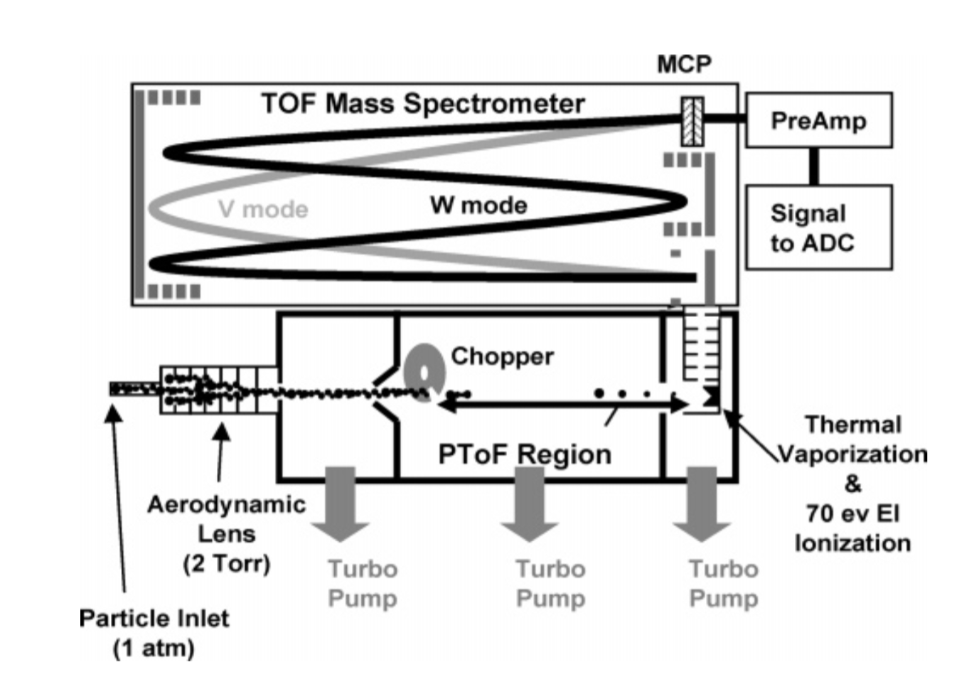
HR-ToF-AMS
Ambient air is sampled through a critical orifice
particles ranging from ∼35 nm to 1.5 μm in size are focused into a narrow beam in an aerodynamic lens
Particle size is determined by measuring flight time across a fixed distance in sizing region
Particles are vaporized by impaction on vaporizer surface (~600 ºC) and ionized by electron ionization (70 eV)
DeCarlo et al., 2006

Slide 4
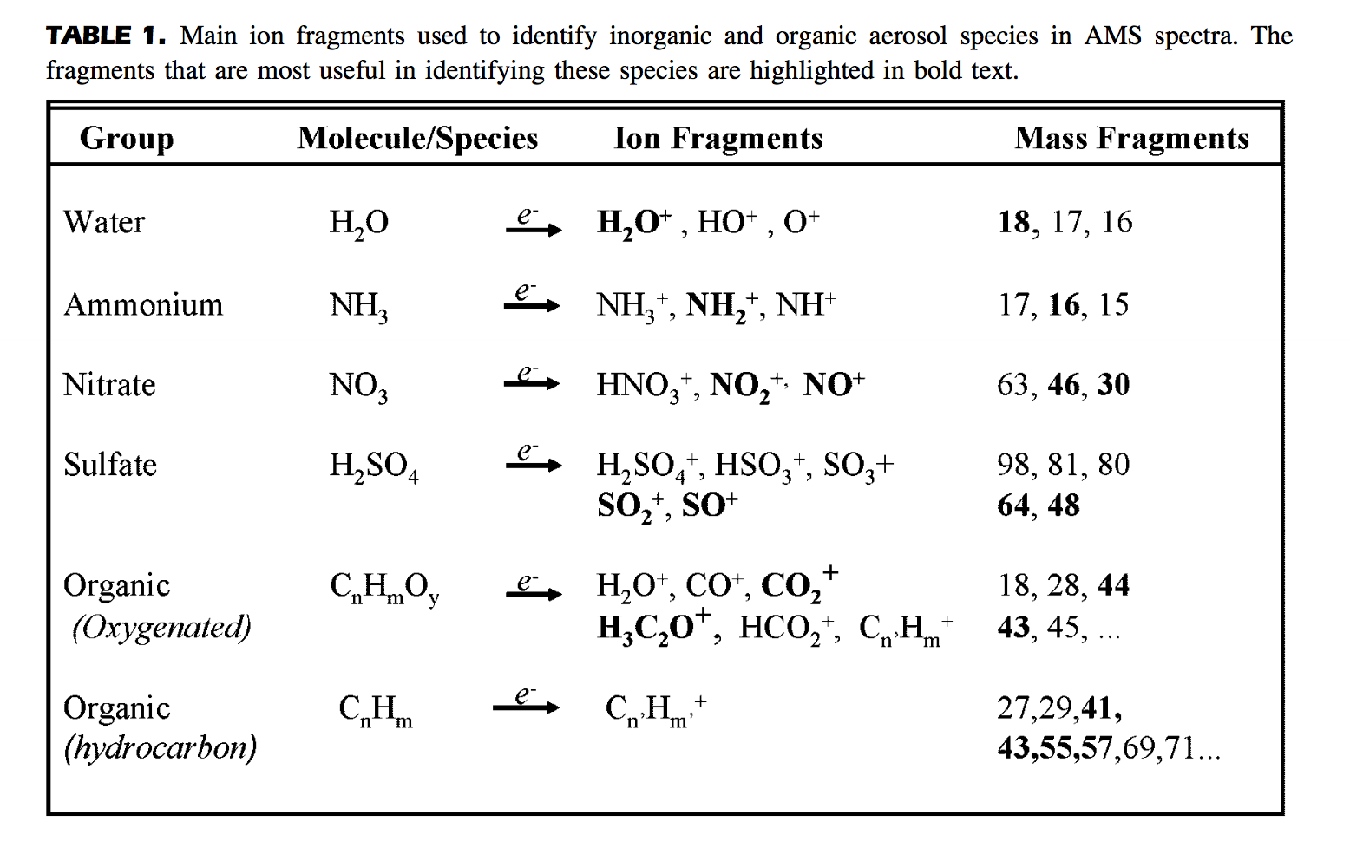
AMS Species
Canagaratna et al., 2007

Slide 5
AMS Species
AMS assigned all sulfate fragments to inorganic sulfate group. However, organic sulfur compounds can also produce “inorganic sulfate” fragments.
Canagaratna et al., 2007

Slide 6
Motivation
Organic sulfur compounds (organosulfates and sulfonates studied here) can produce “inorganic sulfate” fragments
Organic sulfur compounds and inorganic sulfates may have different sulfate fragment patterns
The difference in fragment patterns can be used to quantify organic sulfur compounds in aerosols

Slide 7
Sulfate fragments: pure compounds

Slide 8
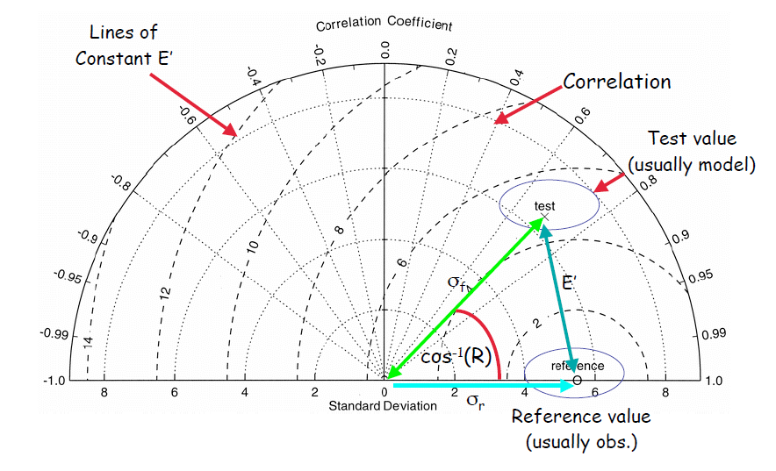
Taylor Plot

Slide 9
Sulfate fragments: pure compounds & ambient data

Slide 10
Sulfate fragments: pure compounds & ambient data

Slide 11
Conclusion & Future Work
Inorganic sulfates and organic sulfur compounds both produce sulfate fragments in AMS
Inorganic sulfates and organic sulfur compounds have different sulfate fragment patterns
Combination of pure inorganic sulfates and organic sulfur compounds can’t represent ambient sulfate behavior
pH may affect organic sulfur compounds’ fragment patterns

Slide 12
Thank you

