Slide 1
Ship emission effect on Houston Ship Channel CH2O concentration ——study with high resolution model
Ye Cheng

Slide 2
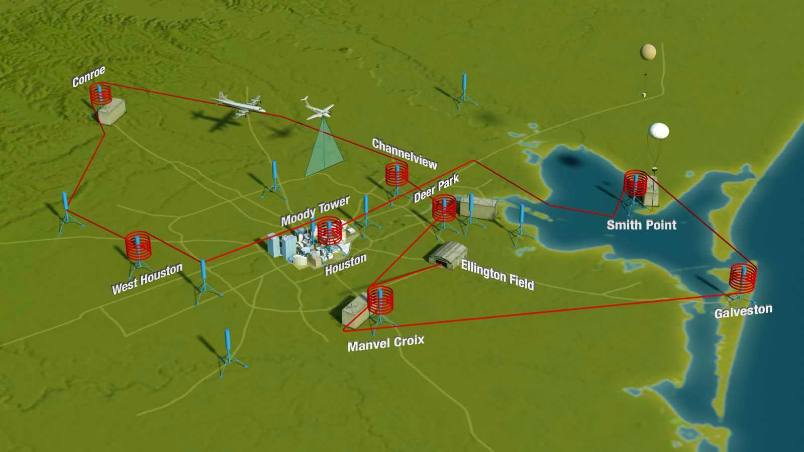
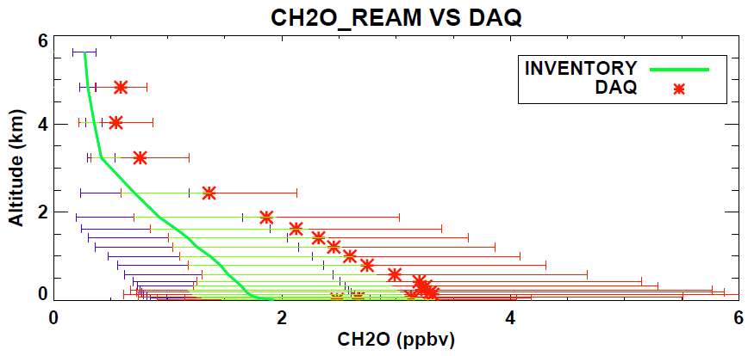
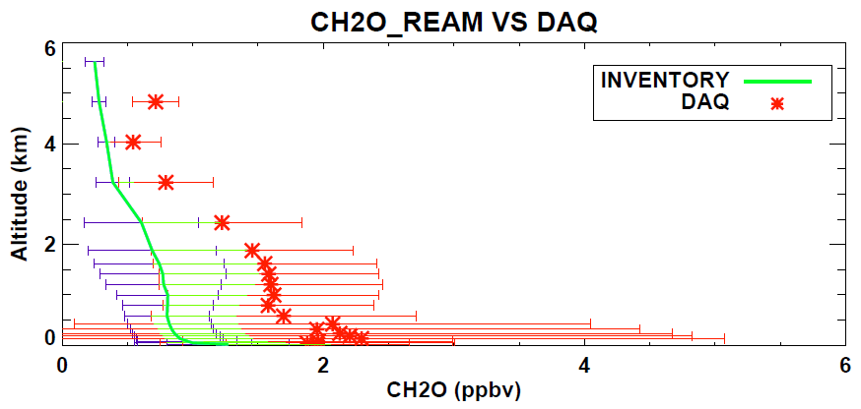
Introduction and Backgrounds
Data sets
2013 Houston, Texas Campaign Flights: September 2013
NASA P-3B over 8 observation sites
Altitude: Surface to 5km
Observation time: 7:00 am to 15:00pm
(NASA website)
All Sites
REAM model
Regional chEmical trAnsport Model (REAM)
Resolution: 36km × 36km
Emission inventory: NEI 2011
Chemistry boundary conditions: GEOSCHEM
Meteorology fields: WRF v3.6
Biogenic emission: MEGAN v2.10
HSC

Slide 3
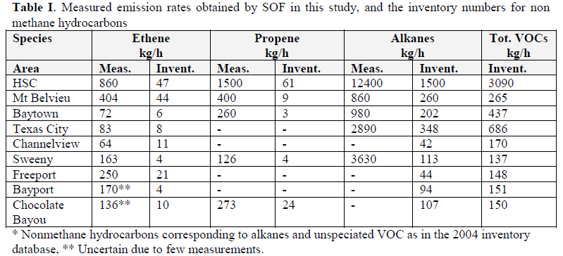
Introduction and Backgrounds
Solar Occultation Flux (SOF) measurement (Johan Mellqvist, 2006) which is part of the extensive summer campaign TexAQS 2006, included in the Second Texas Air Quality Study (TexAQS II), revealed extremely higher values of VOCs (70%-80% of which is alkanes) at HSC areas.
(Johan Mellqvist, 2013)

Slide 4
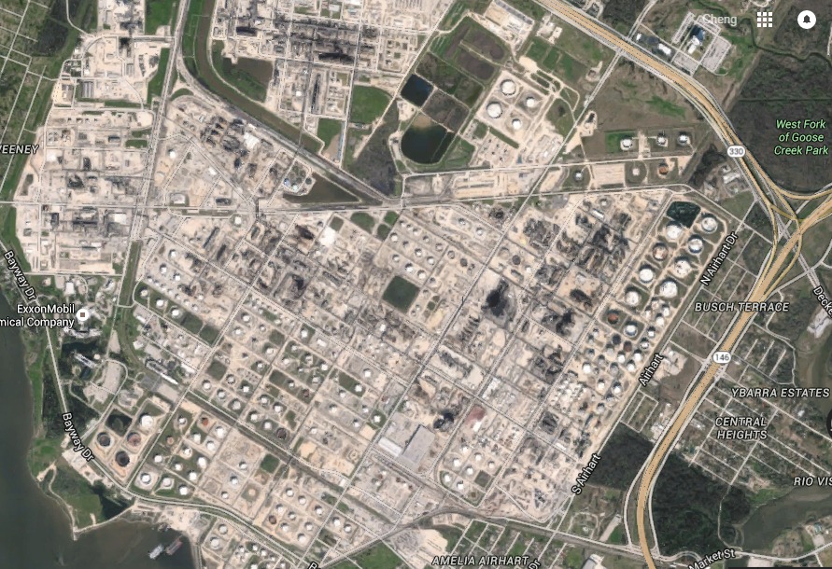
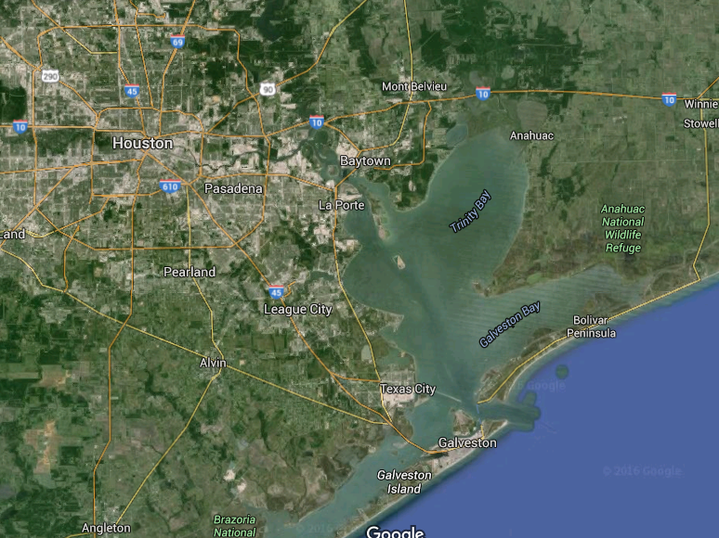
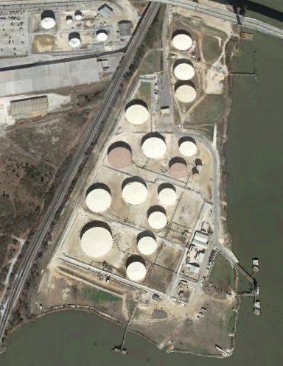
Introduction and Backgrounds
The major sources are attributed to oil leakage evaporation from crude oil tanks and loading process in oil industrial areas.
(Google Earth)

Slide 5
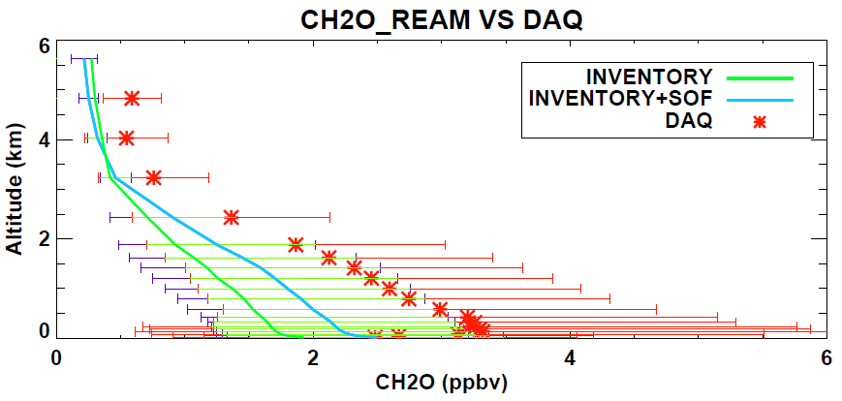
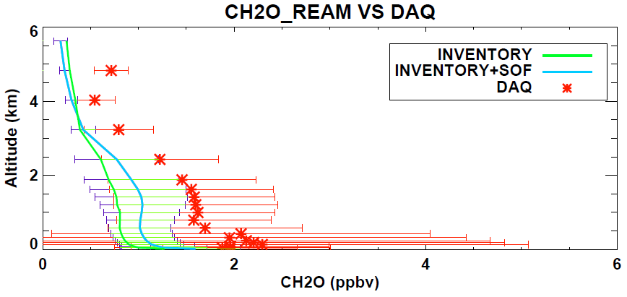
Recent progress
Concentration profiles simulation
(a)
All Sites
Emission was multiplied 8.7 on all the grids having oil industries
(b)
HSC
Figure 16. Mean concentrations vertical profiles comparison of CH₂O in September 2013 at (a) all Texas’s DISCOVER AQ sites and (b) ship channel sites between observation (DAQ: stand for DISCOVER AQ), and model simulation (INVENTORY: stand for the REAM model result using NEI emission inventory 2011; INVENTORY+SOF: stand for the REAM model result with inventory corrected based on SOF).

Slide 6
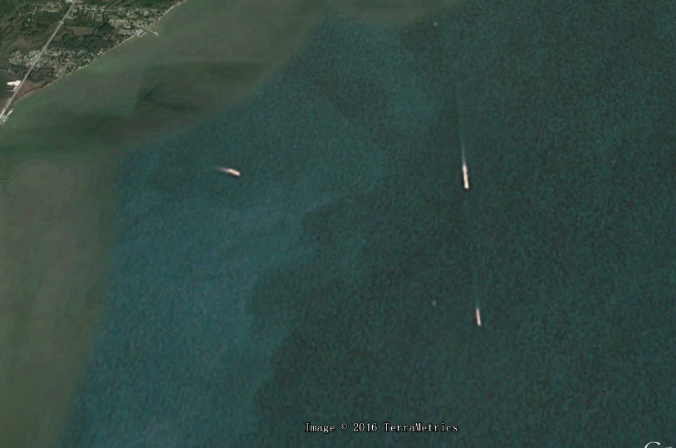
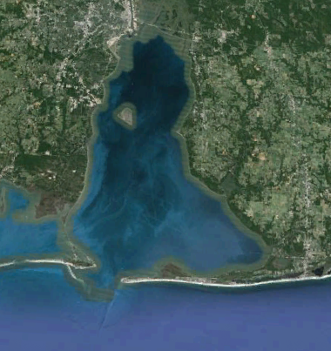
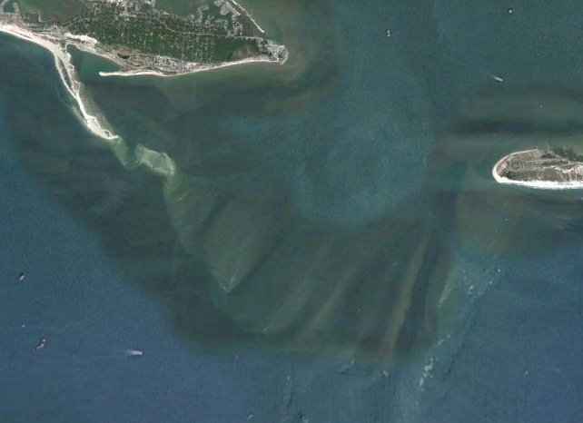
Recent progress
Ship transport
Crude oil transported by ships will also have VOCs evaporation
(Google Earth)

Slide 7
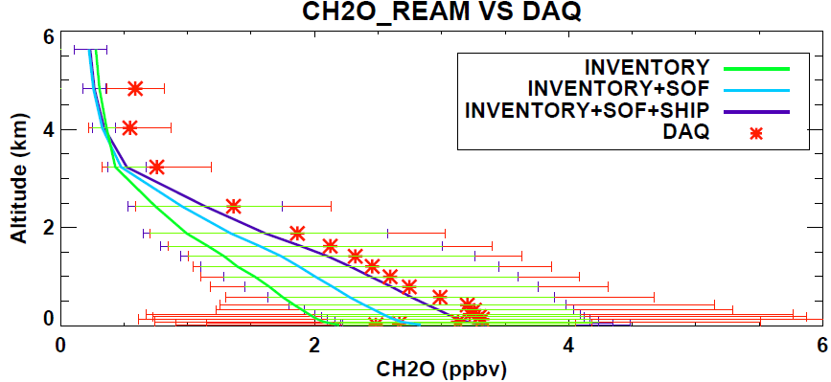
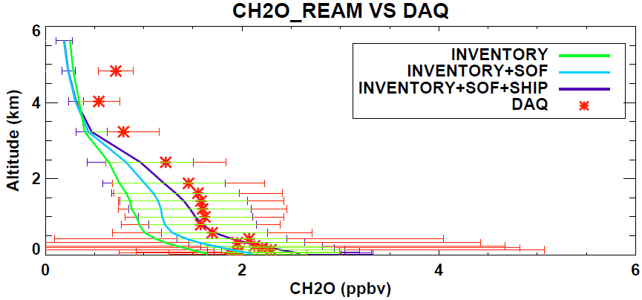
Recent progress
Concentration profiles simulation
(a)
All Sites
Emission was multiplied 100 on the ocean grids
(b)
HSC
Figure 17. Mean concentrations vertical profiles comparison of CH₂O in September 2013 at (a) all Texas’s DISCOVER AQ sites and (b) ship channel sites between observation (DAQ: stand for DISCOVER AQ), and model simulation (INVENTORY: stand for the REAM model result using NEI emission inventory 2011; INVENTORY+SOF: stand for the REAM model result with inventory corrected based on SOF; INVENTORY+SOF+SHIP: stand for the REAM model result with 100 times of alkanes emissions on the ocean in addition to SOF correction).

Slide 8
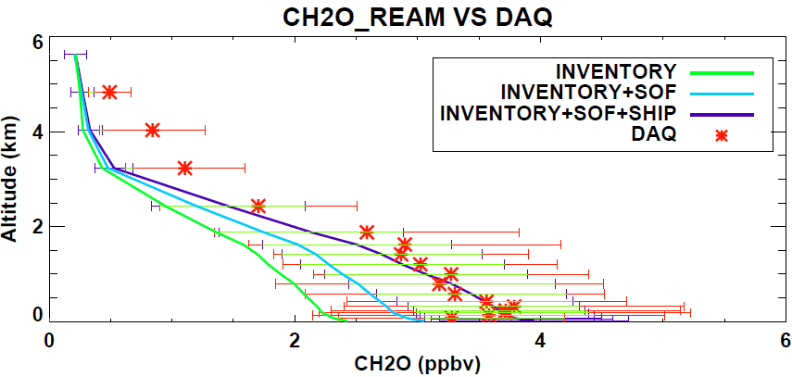
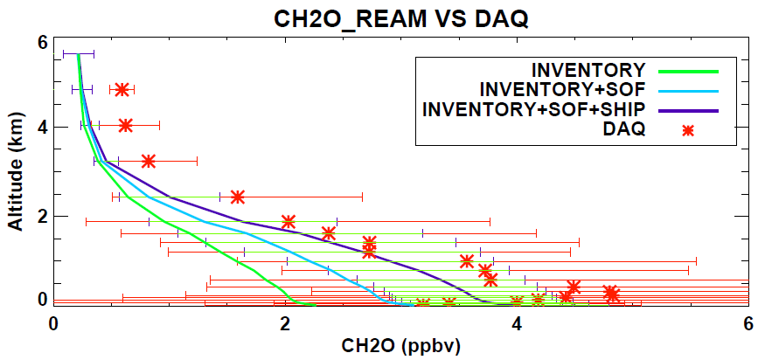
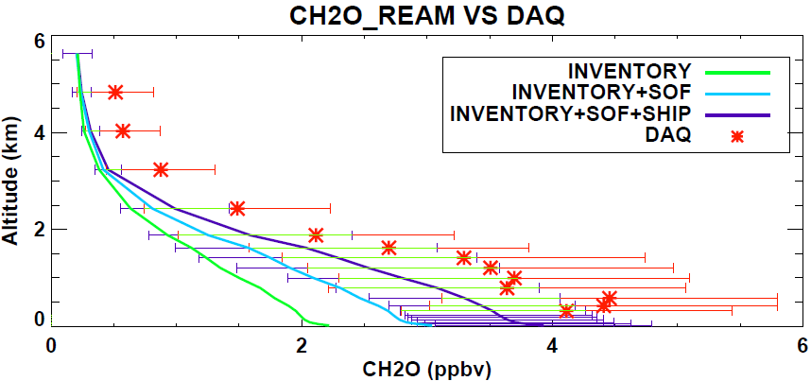
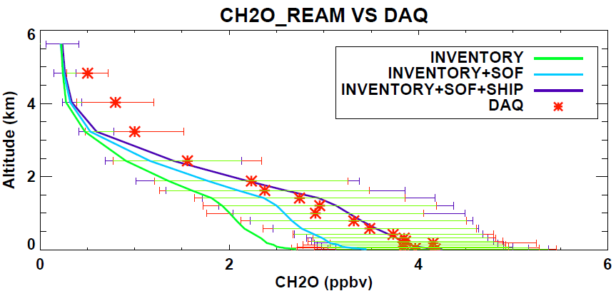
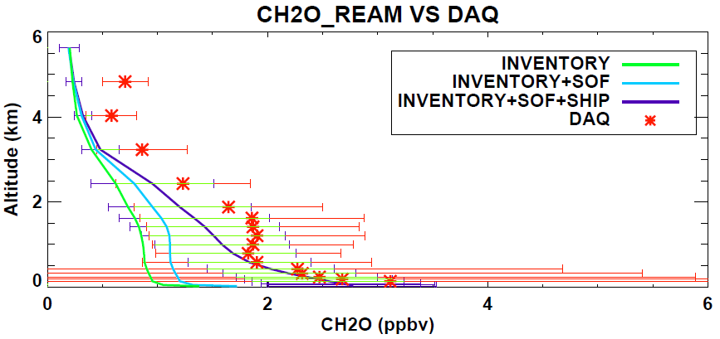
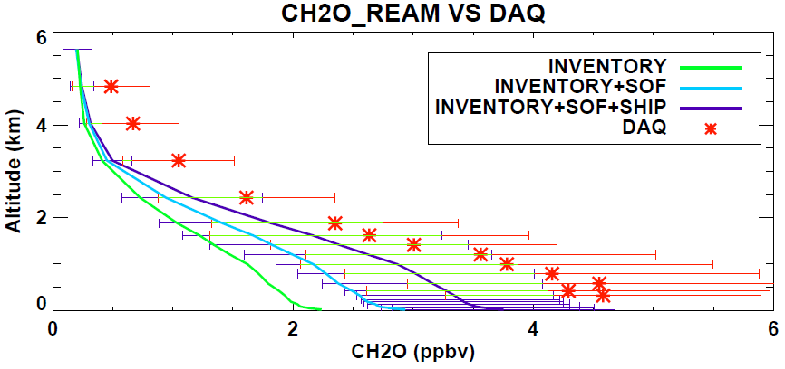
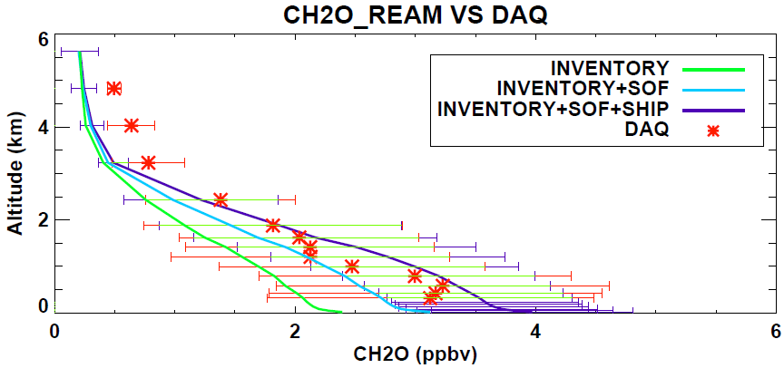
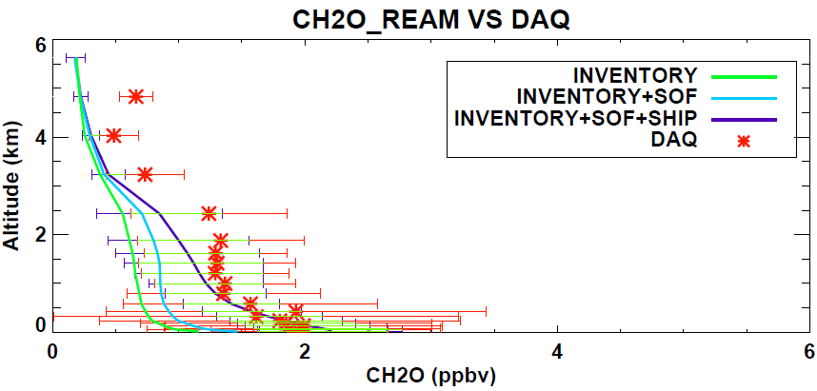
(1)
(2)
(3)
(8)
(4)
(7)
(6)
(5)

Slide 9
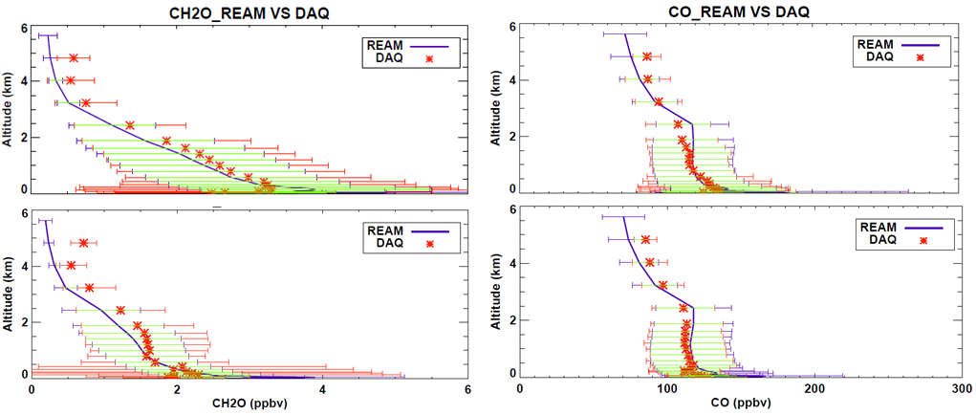
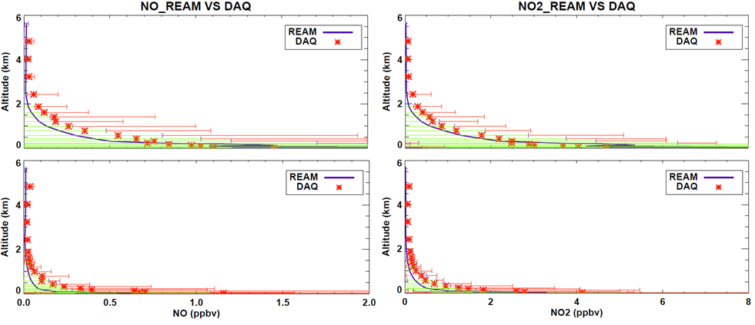
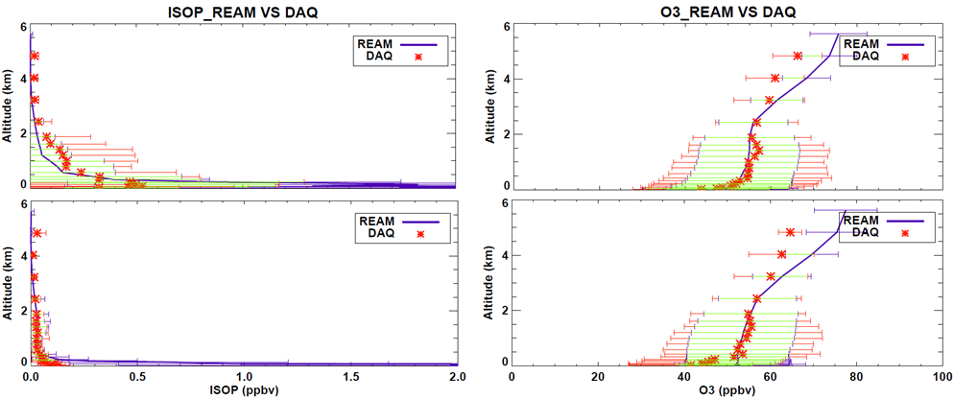
Recent progress
(a)
(b)
All Sites
All Sites
Concentration profiles simulation for different tracers
HSC
HSC
(c)
(d)
All Sites
All Sites
HSC
HSC
(e)
(f)
All Sites
All Sites
HSC
HSC
Figure 18. Mean concentrations vertical profiles of (a) CH₂O, (b) CO, (c) NO, (d) NO₂, (e) ISOPRENE and (f) O₃ in September 2013 at Texas’s DISCOVER AQ sites from observation (DAQ: stand for DISCOVER AQ) and model (REAM) simulation. The mark “All Sites” and “HSC” represent the data for all measurement sites and that for Houston ship channel, respectively. The blue error bars indicate the REAM model mean results’ standard deviations and the red error bars indicate those of DISCOVER AQ. The green horizontal lines present above two’s common parts.

Slide 10
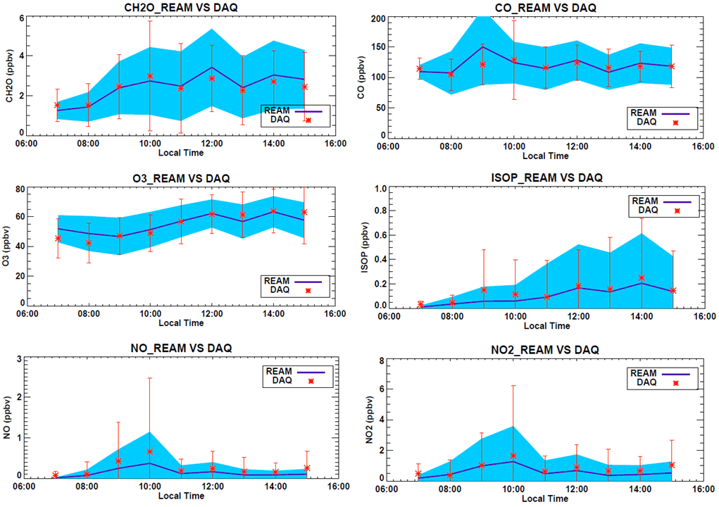
Recent progress
Concentration diurnal circle simulation
(a)
(b)
(c)
(d)
(e)
(f)
Figure 19 Mean concentrations vertical profiles of (a) CH₂O, (b) CO, (c) NO, (d) NO₂, (e) ISOPRENE and (f) O₃ in September 2013 at Texas’s DISCOVER AQ sites from observation (DAQ: stand for DISCOVER AQ) and model (REAM) simulation. The blue error areas indicate the REAM model mean results’ standard deviations and the red error bars indicate those of DISCOVER AQ.

Slide 11
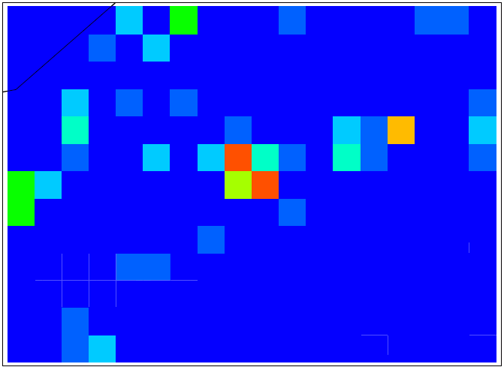
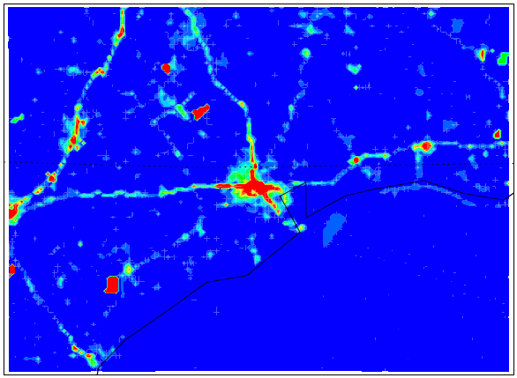
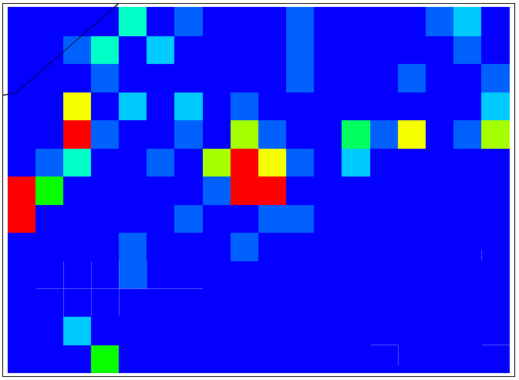
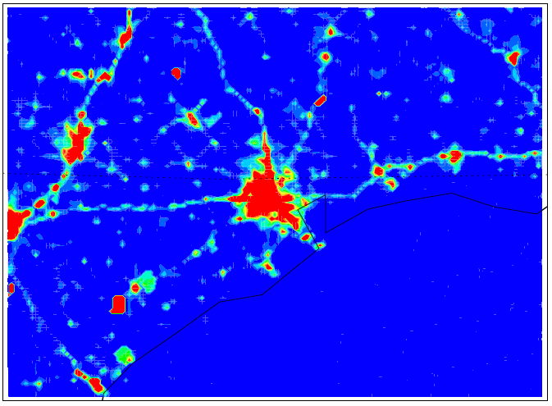
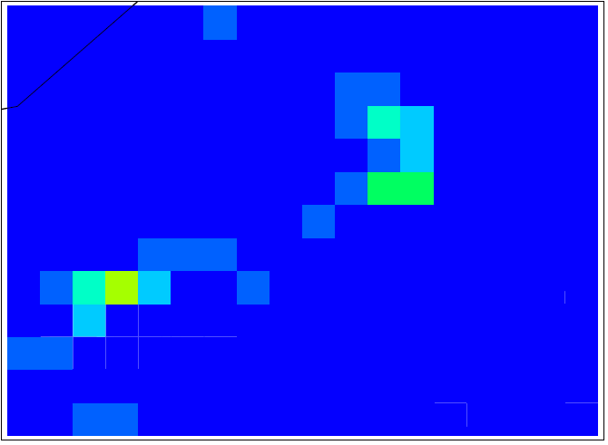
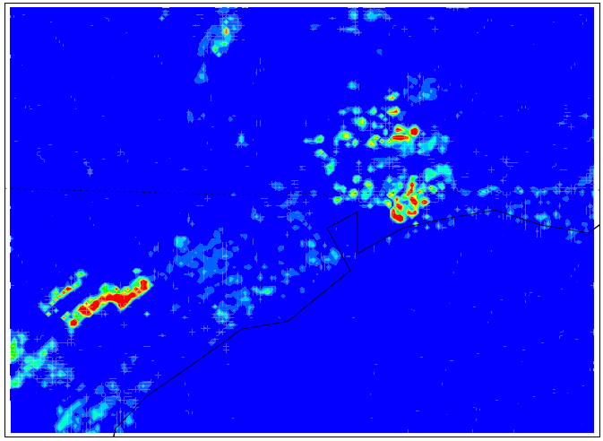
Recent progress
36km*36km
4km*4km
High Resolution Emissions Inventory
NOx
(10^22 molec/s/grid)
1 Better for a small region study
2 Potential to find more evidence
CO
(10^22 molec/s/grid)
HCHO
(10^22 molec/s/grid)

Slide 12
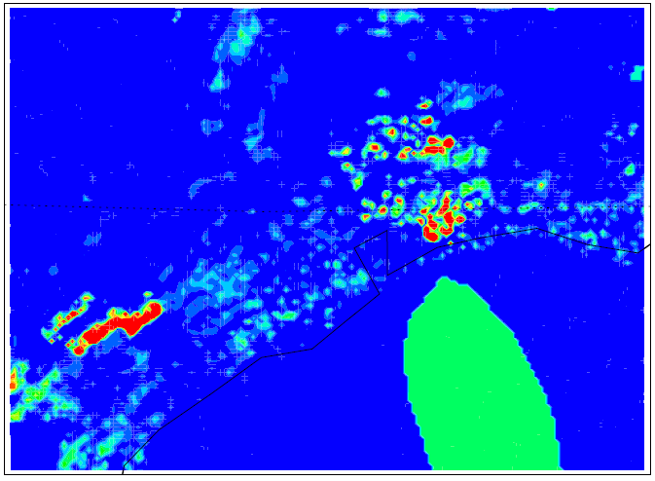
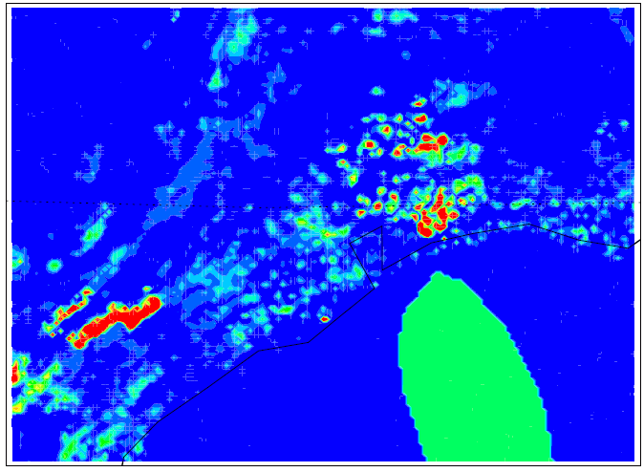
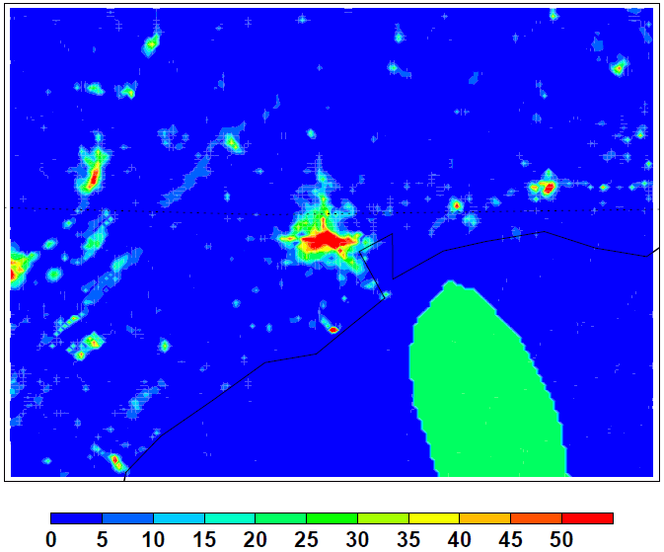
Recent progress
Alkanes emissions distribution
Ship emissions along the routes?
(10^22 molec/s/grid)

Slide 13
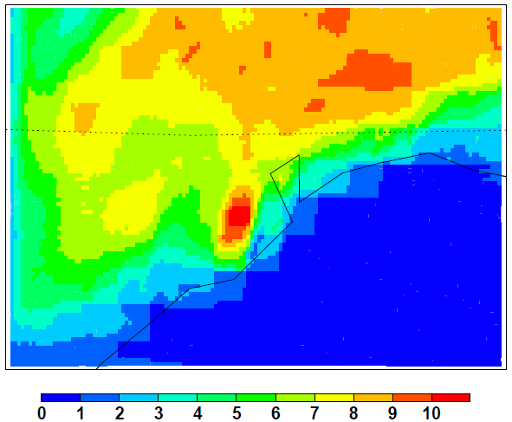
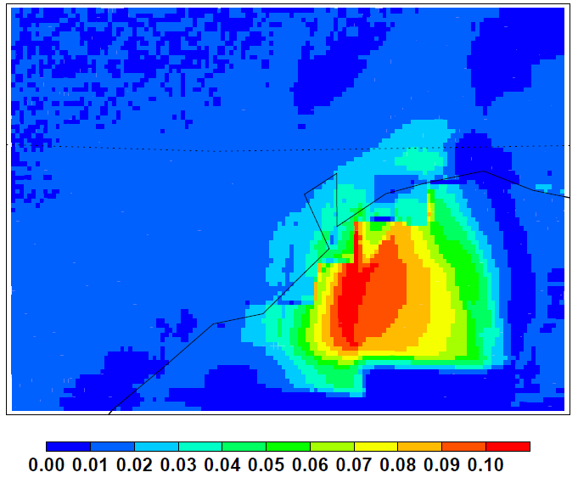
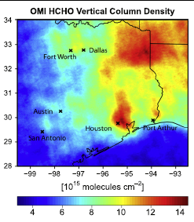
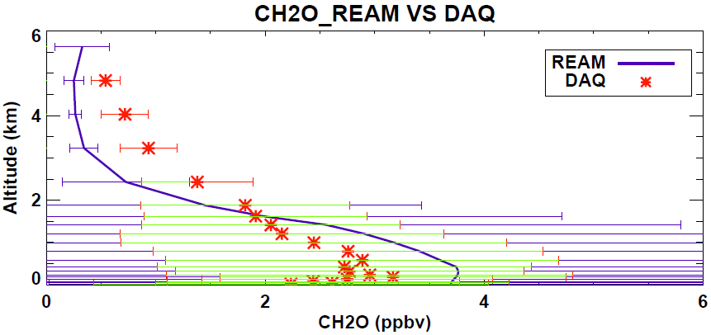
Recent progress
CH2O distributions
CH2O concentration distribution
CH2O enhancement by 100 times oceans emission

Slide 14
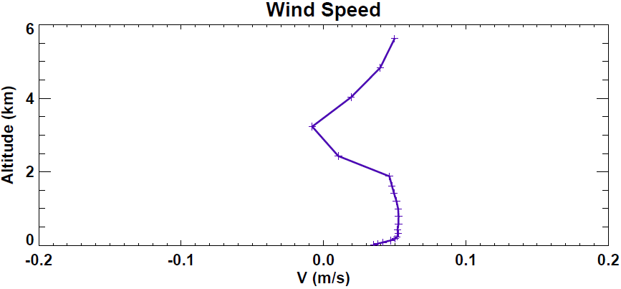
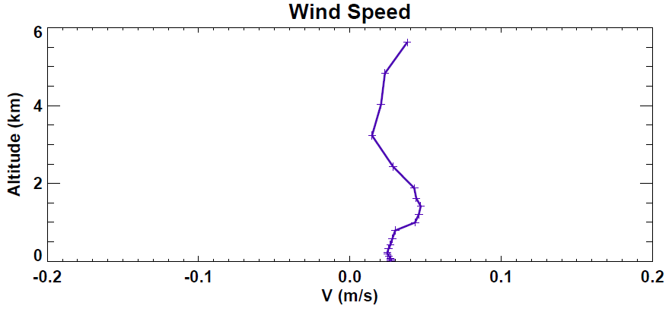
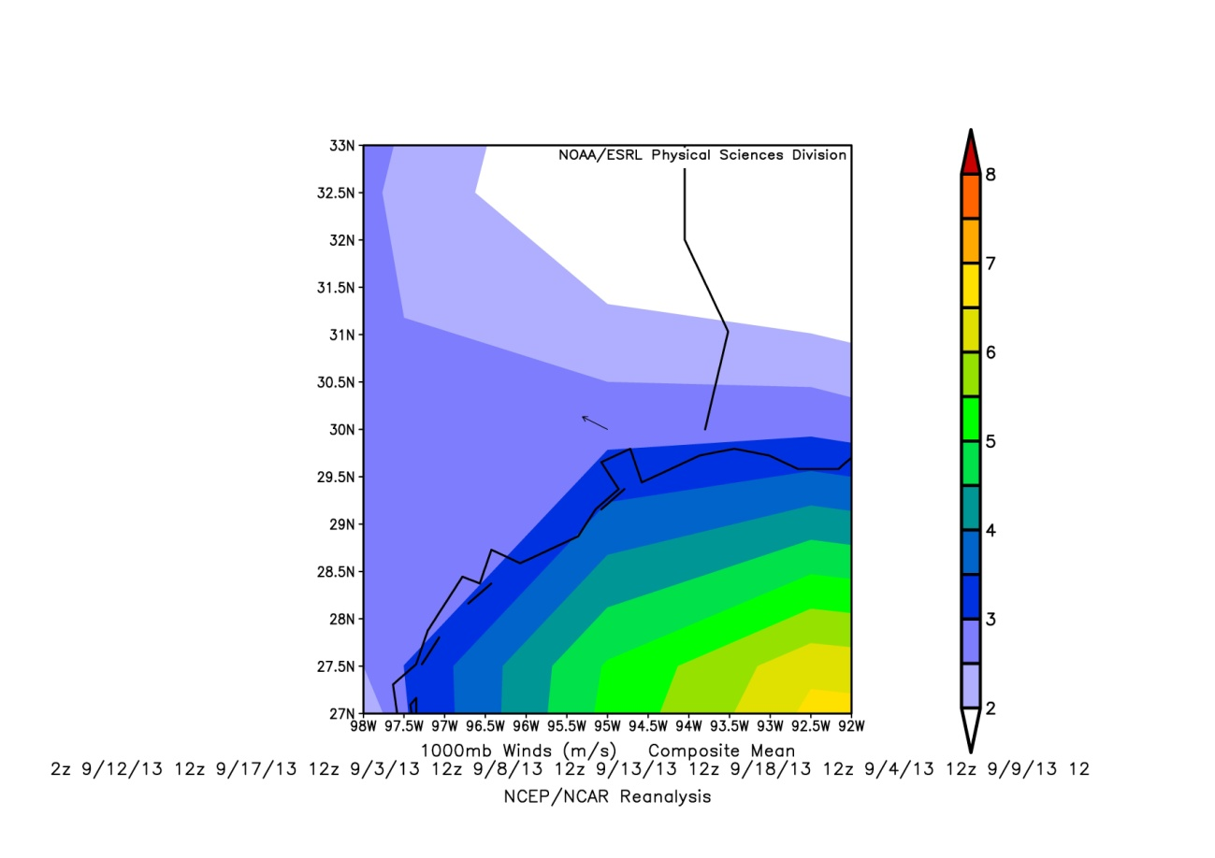
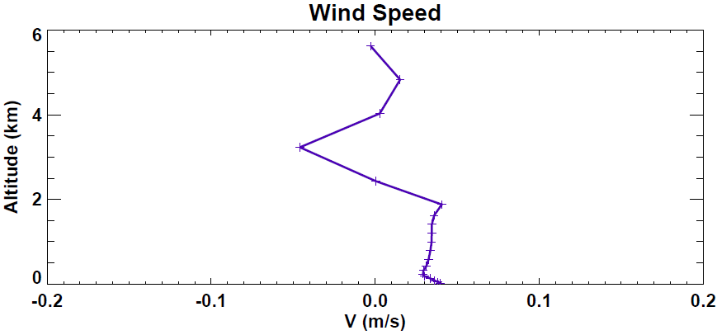
Recent progress
Sea breeze?
Ocean to Land wind speeds

Slide 15
Recent progress
Wind speed and concentration
Work before deadline
1 Finish the model running
2 Derive the correlation between wind speed and CH2O concentration based on model results
3 Make satellite comparison

