Slide 1
Association between PM-induced Reactive Oxygen Species and water-soluble elements of samples collected in Bucaramanga, Colombia
Gabriela Saavedra, Kento T. Mágara-Gomez
Final Project
Atmospheric Chemistry
April 24, 2018

Slide 2
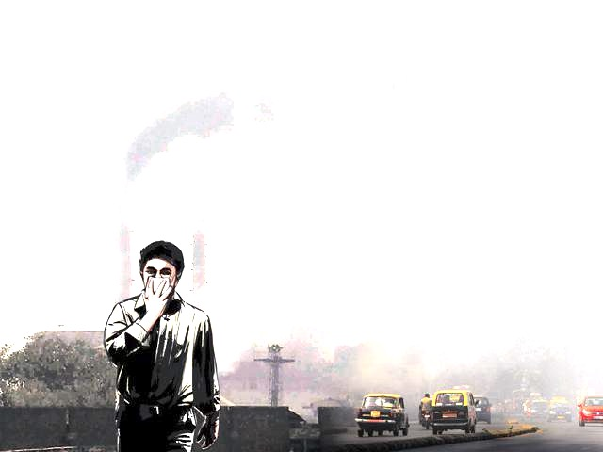
Particulate Matter (PM) adverse health effects
PM
Myocardial infarction
Arrhythmia
Asthma
Lung cancer
Chronic obstructive pulmonary disease
Exposure to ambient particulate matter caused 4.2 million deaths in 2015 (Landrigan et al., 2017).
(Tuet et al., 2016b)
https://goo.gl/DHbix8

Slide 3
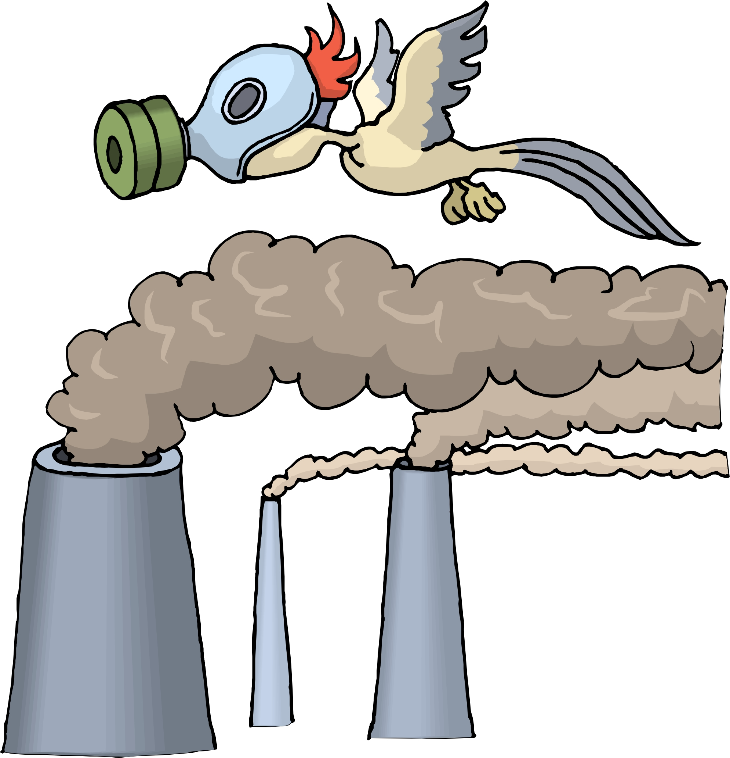
PM-induced ROS formation
Reactive Species
ROS/RNS
Produced by physiological processes
Cell signaling, gene transcription and immune response.
Oxygen homeostasis (Seifried et al., 2007)
https://goo.gl/DHw5TW
https://goo.gl/DHw5TW
Alteration of gene expression
Damage to biological macromolecules
Oxidative stress
Inflammation
https://goo.gl/3dpqwJ
Chronic degenerative diseases
Modified from: (Marcadenti and Lopes Assis Coelho, 2015)

Slide 4
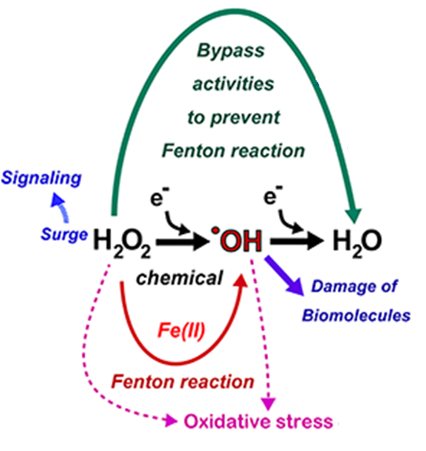
Metals associations to ROS production
Metals contribute to ROS production via Fenton-Like reactions
Well-established link between metal-containing samples and mortality (T. Burnett et al., 2000)
Verma et al., 2014 found strong and moderate correlations between specific metals (K, Mn, Fe, Cu, Zn) and the oxidative potential of PM samples
https://goo.gl/DEevSM
Vary depending on source emissions

Slide 5
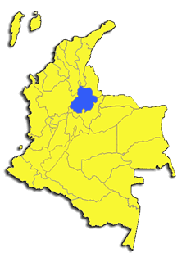
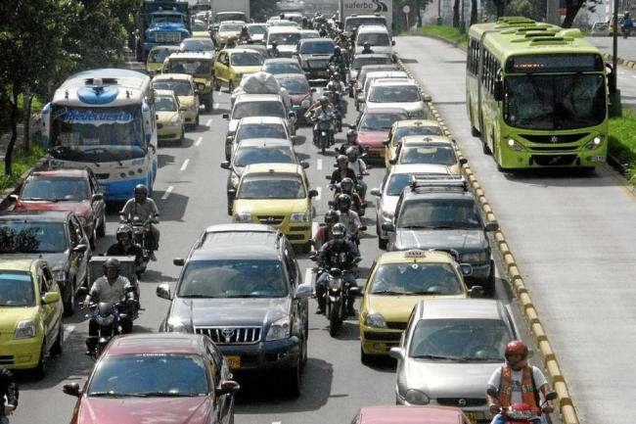
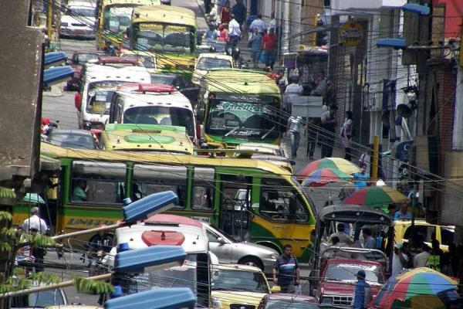
PM exposure in Bucaramanga, Colombia
Developing countries are addressing high levels of exposure at much earlier levels of economic development than the present developed countries (Ochieng, Vardoulakis and Tonne, 2016).
https://goo.gl/FCWLyh
https://goo.gl/RneHkX
63% Vehicle fleet (UPME, 2010)
Uncontrolled transport
planning
Limited air quality
management capacity

Slide 6
Aims of the study
Main objective: Correlate PM-induced oxidant production with water-soluble elements from samples collected in Bucaramanga, Colombia
Specific aims:
Compare two sites of Bucaramanga with High and Low PM₁₀ concentration records.
Determine the elemental composition of the samples collected.
Calculate the correlation coefficients between the metal concentrations and the ROS produced.

Slide 7
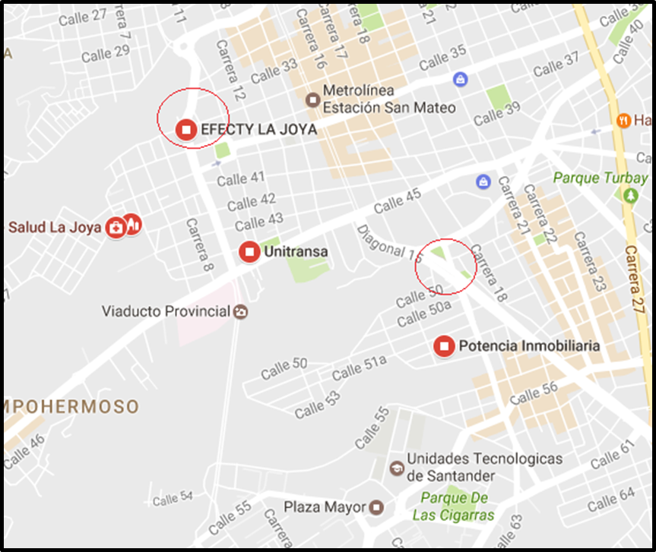
Methods: Filters collection
Medium Volume particulate sampler (URG-3000ABC)
The filters was collected every five days during one year.
¼ 47 mm Teflon filters
La Joya
Transito

Slide 8
Methods: Composite samples
2 Punches of 1.5 m² per Teflon filter
Chemical Composition
Water soluble ions: Ion chromatography
Total elements: ICP-MS (Thermo-Finnigan Element 2)
Total Organic Carbon (TOC): Standard method for TOC (ASTM D 7573-09)
https://goo.gl/jWRz2x
UW-Madison & Wisconsin State Laboratory of Hygiene Trace Element Research Group

Slide 9
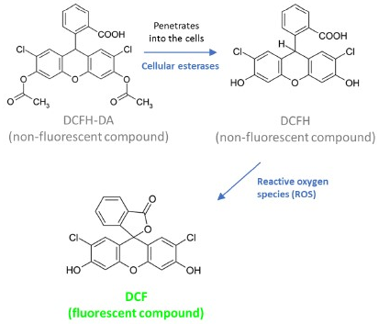
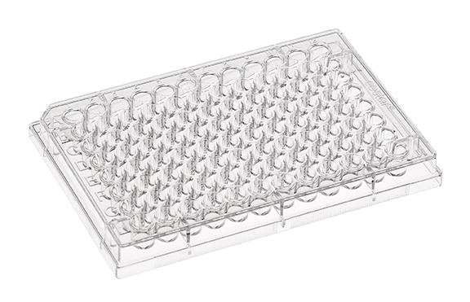
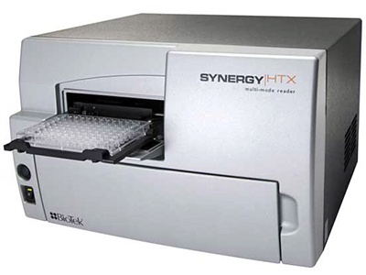
Methods: ROS produced
Rat alveolar cell line NR8383
Incubated in a 96-well plate
Exposed to probe
Exposed to filter extracts
https://goo.gl/MPnEno
Measure fluorescence intensity

Slide 10
Results: PM_{2.5} concentrations
Composite sample | Date
1 | 20-Oct-14
2 | 25-Nov-14
3 | 19-Jan-15
4 | 12-Feb-15
5 | 20-Mar-15
6 | 13-Apr-15
7 | 13-May-15
8 | 12-Jun-15
9 | 12-Jul-15
10 | 17-Aug-15
11 | 16-Sep-15
12 | 22-Oct-15
13 | 21-Nov-15
14 | 21-Dec-15
15 | 2-Feb-16
22.9 µg/m³
16.9 µg/m³
Vehicular emissions = 85% of incidence

Slide 11
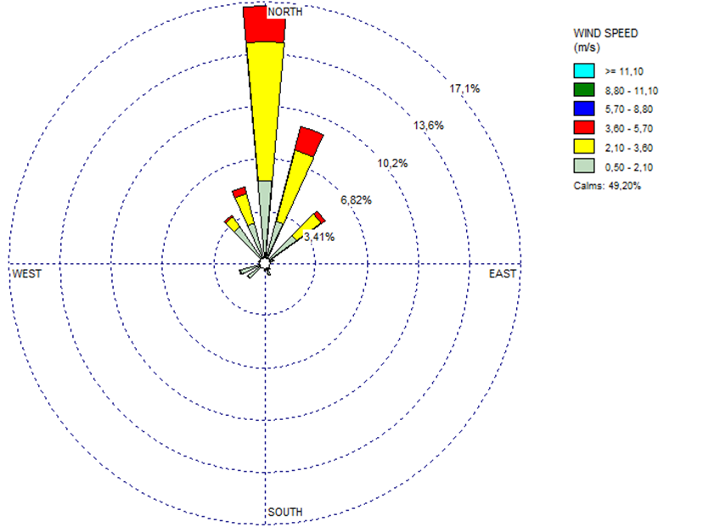
Results: PM_{2.5} concentrations
Wind rose plot from October 2014 to Marzo 2016
WRPLOT view
PM_{2.5} concentrations in La Joya were influenced by transport from Transito site.

Slide 12
Results: Total metal concentrations

Slide 13
Results: Elemental composition

Slide 14
Results: ROS produced

Slide 15
Results: Correlations to ROS activity
Variables | Correlation coefficients Transito | Correlation coefficients La Joya
PM2.5 | 0.19 | 0.36
Fe | 0.46 | 0.18
Ni | 0.64 | 0.38
Cu | 0.07 | 0.18
Pb | 0.47 | 0.25
Cr | 0.56 | 0.13
V | 0.35 | 0.34
S | 0.40 | 0.45
Mn | 0.65 | 0.08
K | 0.52 | 0.43
Total water soluble elements | 0.54 | 0.41
BC | 0.23 | 0.002
TOC | 0.21 | 0.23
Correlations:
Moderate
Weak
(Accordance with T. Burnett et al., 2000)
* P <0.05

Slide 16
Results: Correlations
Variables | Correlation coefficients Transito | Correlation coefficients La Joya
PM2.5 | 0.19 | 0.36
Fe | 0.46 | 0.18
Ni | 0.64 | 0.38
Cu | 0.07 | 0.18
Pb | 0.47 | 0.25
Cr | 0.56 | 0.13
V | 0.35 | 0.34
S | 0.40 | 0.45
Mn | 0.65 | 0.08
K | 0.52 | 0.43
Total water soluble elements | 0.54 | 0.41
BC | 0.23 | 0.002
TOC | 0.21 | 0.23
(Deonarine, Kolker and Doughten, 2015)
https://goo.gl/YhQqLG
https://goo.gl/NC5LxA
(Sullivan, 1969)
https://goo.gl/XCzG1V
(Verma et al., 2014)
https://goo.gl/8fGiam

Slide 17
Conclusions
Total water soluble elements had better correlations to ROS activity than PM_{2.5}, BC and TOC in both Transito and La Joya sites (Accordance with T. Burnett et al., 2000).
In Transito: Ni, Mn and K presented moderate correlations with ROS activity. Ni, Mn and K are mainly emitted by coal combustion, blast furnaces and biomass burning, respectively. (These sources are not major contributors according to PMF analysis).
In La Joya: Ni, V, K presented weak correlations with ROS activity.
Pb, Cr, V and S concentrations may be associated to poor fuel quality.
The correlations between ROS activity and specific metals were stronger in Transito site than in La Joya (proximity to sources).
This study highlights the importance of regulating minor sources, which have greater contributions to PM induced cytotoxicity and oxidative stress than major sources.

Slide 18
Thank you!
Questions?

Slide 19
Methods: PM Source apportionment
40%
21%
45%
19%
24%
22%
(López, Zapata and Mágara-Gomez, 2016)
Wind rose plot from October 2014 to Marzo 2016
WRPLOT view
(Camacho, Saavedra and Mágara-Gomez, 2016)

Slide 20
Results: Elemental composition

Slide 21
Results: Elemental composition

