Slide 1
Investigating the Impact of atmospheric aerosol acidity on aerosol constituent transport fluxes EAS 6410 Final presentation April 24th, 2018
By: Ifayoyinsola Ibikunle
Advised by: Athanasios nenes
Acknowledgements: Rodney Weber,
Hongyu Guo
Notes:
Be consistent and use black as the color of text in the presentation
Change color of title to black or make bigger if they are going to be in yellow

Slide 2
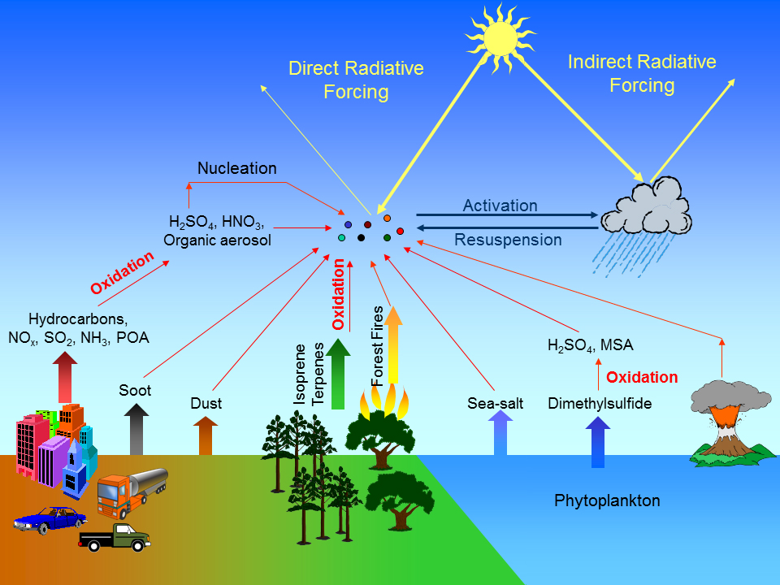
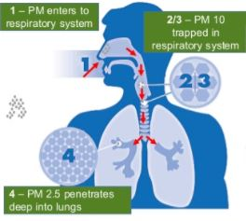
Atmospheric aerosols are important because they effect human & ecosystem health and climate
https://phys.org/news/2016-03-scientists-discuss-complexities-tiny-particles.html#jCp
https://www.slideshare.net/AhmadMubin2/aerosol-retrieval-using-modis-data-amp-rt-code
https://www.cnn.com/2015/03/08/asia/china-bans-smog-doc/index.html
Notes:
Aerosols are suspensions of tiny particles in the atmosphere, and have both anthropogenic (i.e., man-made) sources such as industrial processes and car emissions, and natural sources such as forest fires, volcanoes, and wave-breaking in the ocean. Aerosol particles affect Earth's climate, both individually and by serving as the nuclei around which cloud drops form, by influencing how much solar energy is absorbed by Earth (including the oceans, atmosphere, and land) or is reflected back into space. Collecting accurate data and achieving better understanding of the roles in which aerosols participate is thus crucial to understanding how chemical transformations in the atmosphere effect fluxes of chemical species to ecosystems.
quality of life Read more at: https://phys.org/news/2016-03-scientists-discuss-complexities-tiny-particles.html#jCp
https://www.slideshare.net/AhmadMubin2/aerosol-retrieval-using-modis-data-amp-rt-code (respiratory issues such as asthma, cardiovascular disease)
pollutants concentrate and form a usually low-hanging shroud that impairs visibility and may become a respiratory health threat.

Slide 3
Research Objective: Quantify the importance of aerosol acidity in global chemical transport models
Atmospheric transport and deposition of minerals represent a major source of Fe, N, and P for remote marine ecosystems
These nutrients are needed by phytoplankton to photosynthesize and hence, play a major role in oceanic carbon storage
Phytoplankton are used to predict ecosystem responses to anthropogenic and natural perturbations
Acid processing of aerosols increases the bioavailability of nutrients in dust
Aerosol acidity is not currently parametrized in chemical transport models
Notes:
My research will focus on minerals in dust containing P and reactive N because these minerals have not been investigated extensively.
Phytoplankton photosynthetic activity is responsible for approximately half of annual CO₂ exchange with the deep ocean which contains nearly 85 % of Earth’s mobile carbon
Acid processing occurs when anthropogenic emissions (such as Sox and NOx) mix and interact with dust.
To fully understand these impacts, it is critical to elucidate these dissolution processes in models to quantify aerosol constituent concentrations prior to land and ocean deposition. Aerosol acidity in models, however, is not constrained to date, hence processes sensitive to acidity (such as micronutrient solubility) therefore, are poorly constrained.
However, previous approaches do not include acidity constraints.
Why is pH important? Look at current limitations
pH is a direct measure of aerosol acidity, but there are limitations to measuring pH:
1. no available fine particle pH measurement techniques
2. pH proxies (ion balances and molar ratios) have limitations (hennigan et. al 2015)

Slide 4
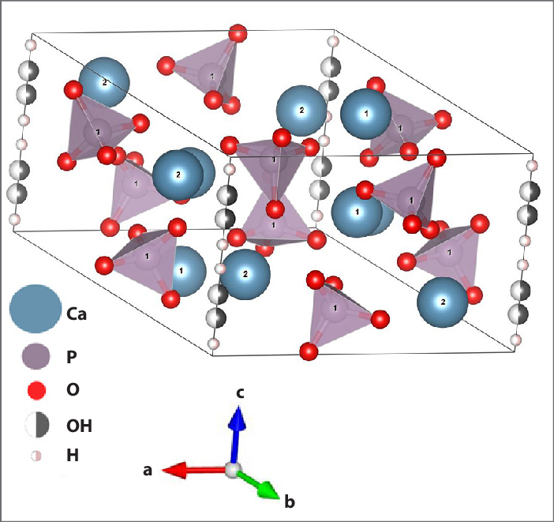
Importance of acidity: Particle acidity enhances the bioavailability of micronutrients in dust
DUST +
ACID PROCESSING
SOLUBLE MICRONUTRIENTS
https://www.researchgate.net/figure/Fabrication-of-structure-model-of-hydroxyapatite-HA-in-VESTA-program-visualization-is_fig4_303826926
Notes:
Sox and Nox from anthropogenic emissions acidify aerosol during atmospheric transport. This acidification process causes dissolution of micronutrients in dust. for my research, I focus on P dissolution from apatite.
Figure on the left shows the hydroxyapatite structure. Myriokefalitakis et. al (2016) hypothesizes that H⁺ from dissolved sulfate and nitrate aerosol react with ligands in mineral dust (e.g. PO₄³⁻), weakening the bond to the metal (e.g. Ca²⁺), and therefore allow the micronutrient to be mobilized to a soluble form. It is through this interaction that once originally insoluble apatite is then made soluble.
Talk about specific area (e.g. An area to study where aerosol acidity is pertinent is the Mediterranean, which is at the nexus of Europe, Asia, and Africa. In this environment, dust from the Sahara gets transported and interacts with polluted air masses from Europe and Asia minor. It is important to note that this ecosystem is limited by phosphorus, so deposition of bioavailable P is important for marine ecosystem productivity. and acid processing of dust provides nutrients for organisms in the ocean to photosynthesize. pH varied from 0.5 to 2.8 during study-- Bougiatioti et. al 2016), so aerosols were highly acidic, enough to solubilize P.
Figure on the right is a diagram that depicts the sources and fates of P. Could either be terrestrial or marine. My research focus is marine.

Slide 5
Ph is predicted through thermodynamic model, ISORROPIA II
$$pH=−\log_{10}(\frac{1000∗[H+]}{W_{i}})$$
Where [H⁺] is the hydronium ion concentration and W_{i} is the particle water concentration
pH predictions are evaluated using the approach of Guo et.al (2015)
Input: Total nitrate (HNO₃+NO₃⁻) → Output: HNO₃, NO₃⁻
Input: Total ammonium (NH₃+NH₄⁺) → Output: NH₃, NH₄⁺
Notes:
First step in quantifying the impacts of micronutrient dissolution is to obtain predictions of pH, as it is a direct measure of particle acidity
_{Limitation of pH}
No available direct fine particle pH measurement technique.
pH proxies (ion balance and molar ratio) have limitations [Hennigan et al., 2015].
Partitioning is used to validate pH predictions from ISORROPIA
H+ and Wi are outputs from ISORROPIA II
ISORROPIA II (Fountoukis and Nenes, ACP, 2007) is one of the most computationally efficient and comprehensive inorganic thermodynamic modules available.
Can treat dust, sulfate, nitrate, ammonium and seasalt mixtures. (crustals are important! Not all models include treatment of these species)
It has been evaluated against in-situ data from numerous campaigns (e.g., Atlanta, Mexico City).
How do we ensure pH predictions are good estimates?
We look at how observed partitioning (ε) of semi volatile gas sensitive to pH is compared against the predictions

Slide 6
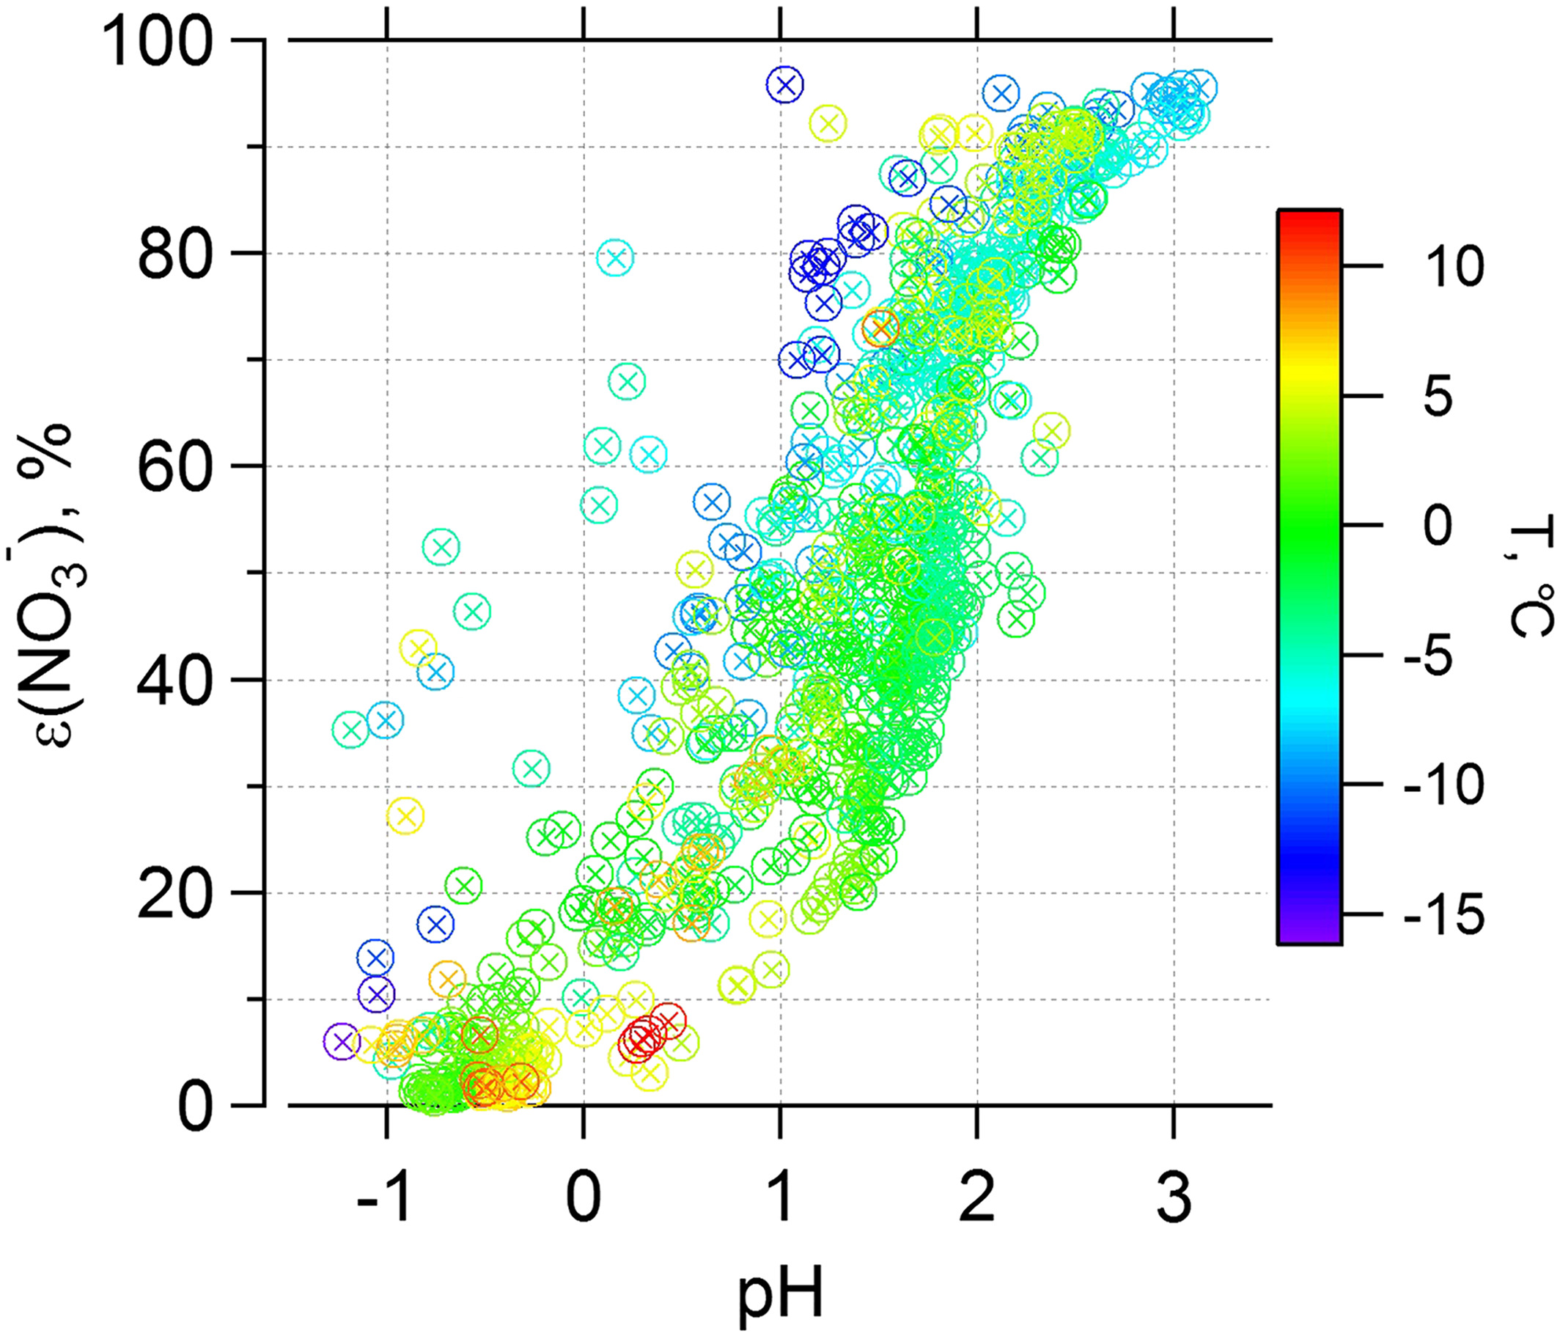
acidity estimates are validated through partitioning of SEMi-Volatile species in aerosols
$$ε\left(X\right)= \frac{{\left[X\right]}_{aerosol}}{{\left[X\right]}_{gas}+{\left[X\right]}_{aerosol}}=f(pH)$$
Where [x] denotes the concentration of NO3-, NH4+, or Cl-
e.g. nitrate and nitric acid
HNO3 (g) HNO3
HNO3 NO3- + H+
Guo, et. al, JGR, 2016
Notes:
Partitioning from Winter study (remember to cite)
Partitioning is defined as the amount of species X in the aerosol phase over the total amount of species X present. The figure on the right shows how the partitioning of nitrate varies as a function of pH. This figure was taken from the WINTER study conducted in the NE US in 2015. Aerosol acidity was determined to be 0.77+-0.96.
Look at NO3, NH4, and Cl because these can be measured and are required as input for ISORROPIA.
We compare observed and partitioning values to determine how well ISORROPIA predicts pH for given observational data.

Slide 7
Outline
Aerosol acidity studies
Utah Winter Fine Particulate Study (UWFPS)
Temperature inversions cause PM2.5 buildup
Korea‐United States Air Quality Study (KORUS‐ AQ)
Long range transport of pollution and soil dust into southern half of Korean peninsula
Europe
Dust from the Sahara interacts with polluted air masses from Europe, Russia, and Asia
Notes:
Emissions from Asia include a mix of fossil fuel combustion, other industrial activities, biomass burning, vegetation sources, and soil dust. The downwind of China allows for evaluation of long-range transport of pollution into the peninsula.
European sites will be most impacted by my

Slide 8
UTAH

Slide 9
UTAH: LOGan cache valley
Kuprov, et al. 2014
Notes:
Why investigate these sites? And what questions do we intend to answer?
Don’t know what is causing heat deficits in Utah
Cache valley is a rural site (in comparison to salt lake city) in northern Utah. Site where complete set of aerosol measurements were available for input into ISORROPIA. AMS was used to measure NO3, Cl, SO4, and NH4. CIMS measured HNO3 and ammonia QCL spectrometer measured NH3.
The middle portion of the nocturnal atmospheric boundary layer characterized by weak sporadic turbulence and initially uniformly mixed potential temperature and pollutants remaining from the mixed layer of the previous day.
Below the statically neutral residual layer is the stable boundary layer in contact with the radiatively cooled ground, and above it is the capping inversion that separates boundary layer air from free-atmosphere air.
During inversion and non-inversion periods, PM mass is primarily composed of NH4NO3 (pic is of jan and feb 2009 for Salt lake city), but this trend is also observed for Cache Valley. How could this be?
In-situ measurements PM1 measurements to determine aerosol composition. Cache valley is an agricultural valley in northern Utah, so its strange that we would see elevated levels of Nox in this area. Expected in urban areas where industrial emissions, transportation, cooking, heating, the burning of vegetation are more prevalent. This could suggest that residual layer chemistry, together with high speeds in the residual layer could transport soluble nitrate over wide geographic area. Or there could have been a number of agricultural fires that took place?

Slide 10
Observed ammonium partitioning is in good agreement with Model predictions
Notes:
Explain other figures? How do they relate to the partitioning of semi-volatile species? Why observations are off?
Expand figure. Make sure to explain and reference the different plots
First 4 plots from the left show the relationship between observed and predicted concentration values. If the agreement is good, then points should fall on the 1:1 line. Generally, there is good agreement, however, HNO3 correlation is weak. We attribute these discrepancies to instrument bias since ISORROPIA is able to efficiently predict the concentration of NH4 and NH3, for instance, which were measured from different instruments.
Weak agreement in NO3 partitioning is a result of HNO3 measurement bias (particle evaporation during sampling at night and vapor condensation during the day?– CalNex). This propagation of bias is present in e(NO3) plots, which also exhibit a lot of scatter. We go ahead with pH estimates from ISORROPIA II because NH4 partitioning agreement is strong. Cl- partitioning not shown here because HCl was not measured in this study.
Based on this, we move forward with the pH predictions.
Add units for observed and predicted values

Slide 11
Acidity levels for PM1 aerosols in Utah are high compared to other areas within the us
Campaign | UWFPS | CalNex | SOAS | SENEX | WINTER
Type of measurement | Ground | Ground | Ground | Air | Air
Year | 2017 | 2010 | 2013 | 2013 | 2015
Season | Winter | Early summer | Summer | Summer | Winter
Location | Western U.S. | SW U.S. | SE U.S. | SE U. S. | NE U.S.
pH | 4.45±1.05 | 1.9±0.5 | 0.9±0.6 | 1.1 ±0.4 | 0.8±1.0
Table modified from Guo et. al, ACP, 2017
Notes:
Show pH in different regions of the US. Add question I want to answer.
Because there is so much nitrate in comparison to ammonium (as shown in previous slide), we would expect the acidity levels to be higher in this region, which is corroborated when we compare the pH in Utah to that of other areas within the U.S. pH will allow us to determine if there are significant levels of soluble nitrite that would allow for long range transport of nitrite to other geographic areas.
More soluble forms of nitrogen at high pH, so to this end, are acidity levels in UTAH to produce nonnegligible amounts of soluble nitrite?

Slide 12
Ph levels in Utah are not high enough to condense nitrite
Average pH=4.45±1.05
Average T=270.78 ± 7.36
http://people.atmos.ucla.edu/jochen/research/hono/hono.html
$$H_{2}O+2NO_{2} →HNO_{3}+HONO$$
$$HONO+hv →OH+NO$$
$$ε\left(NO2−\right)=\frac{H_{HONO}^{∗}∗W_{i}∗R∗T∗0.987∗10^−14}{γ_{NO2−}∗γ_{H+}∗10^−pH+H_{HONO}^{∗}∗W_{i}∗R∗T∗0.987∗10^−14}$$
Where $H_{HONO}^{∗}$=$K_{a}∗H_{HONO}$and $γ_{x}$is the activity coefficient of species X
Notes:
HONO is mainly formed heterogeneously on surfaces in the presence of water and NO_{2..} NO2 condenses to form …. HONO then goes on to photolyze to product OH. Overall reaction mechanisms are shown here, but essentially we would have gaseous NO2 condense in water. It reacts with an H+ ion to form HONO. HONO is then undergoes photolysis during the day to form OH.
.987*10^-14 is just conversion factor
pH levels are not high enough to condense nitrite so that it can act as storage for HONO during the study
Presence of nitrite in residual boundary layer would allow for transport to other geographical areas. During the day, HONO would serve as the primary source of OH formation in the atmosphere. OH is an important oxidizing agent.

Slide 13
Future work/NEXT Steps: EUROPE
Create a pH datasets for sites in Europe where in-situ measurements are available
Parametrize pH as a constraint in global chemical transport models to obtain more accurate predictions of P and N deposition fluxes to remote ecosystems
Address the following scientific questions:
What are the levels of acidity in atmospheric aerosols?
How does atmospheric processing alter the bioavailability of nutrients in aerosols?
How do models capture the observed levels of acidity, and how can biases affect nutrient bioavailability and deposition patterns?
Notes:
Use ACTRIS database to obtain measurements
dissolution mechanisms that consider aerosol acid processing will reduce uncertainties associated with the complex interplay of atmospheric inputs on biogeochemical cycles.
Focus on P and N because considerable work on iron has already been investigated

Slide 14
QUESTions?

Slide 15
Measurement Bias in CIMS measurement of HNO3

Slide 16
Solution procedure for ISORROPIA II
C. Fountoukis and A. Nenes, ACP, 2007
Notes:
Other model limitations and advantages of using ISORROPIA II
ISORROPIA II is computationally superior to other thermodynamic models
-treats crustals
-algorithm for solving for equilibrium concentration is much faster than other thermodynamic models.

