Slide 1
Analysis of Gas Flaring and Its Impact on Carbon Dioxide Emissions in Nigeria
Ayanna Jones | Atmospheric Chemistry

Slide 2
Introduction
Hypothesis
Methods
Data/Results
Analysis
Conclusion
Presentation Outline

Slide 3
Introduction

Slide 4
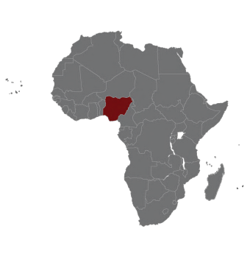
Introduction
Nigeria is Africa’s most populous country with diverse energy resources.
Globally, Nigeria’s gas reserves (including crude oil with and without natural gas) are ranked as the 9th largest.
In recent years, Nigeria has attracted researchers as concern for increased contribution to greenhouse gas production due to the use of gas flaring has been observed.

Slide 5
What is ‘‘Gas Flaring’’?
‘‘Flaring is the controlled burning of natural gas and a common practice in oil/gas exploration, production and processing operations. A flare system consists of a flare stack and pipes that feed gas to the stack. Flare size and brightness are related to the type and amount of gas or liquids in the flare stack. Flares generate heat and noise. Large flares can be quite noisy because of the volume and velocity of the gas going through the flare stack.’’
U.S. Environmental Protection Agency (EPA), 2014
https://www.youtube.com/watch?v=pXrCaXO9uq0

Slide 6
What is ‘‘Gas Flaring’’?
According to the EPA, benefits of gas flaring include…
Allowing proper testing of drilled oil well using temporary flares
A safety device decreasing risk of fires and explosions at oil and gas plants
Managing waste gas that cannot be efficiently captured and returned for processing
- U.S. Environmental Protection Agency (EPA), 2014

Slide 7
Gas Flaring is NOT Beneficial
Flaring emits toxic substances
Flaring is likely to cause early deaths and leukemia
Flairing causes acid rain
Flairing is a violation of human rights
Flairing is against the law

Slide 8
Gas Flaring Contributes to Climate Change
Flaring produces the primary greenhouse gases (GHGs), carbon dioxide (CO₂) and methane (CH₄).
Also, flaring of gas rich in liquids can produce smoke, with aerosol effects that can also contribute to global warming.
Notes:
One of the key problems in assessing the impact of flaring on GHG accumulation is the lack of information not only about the quantities involved but also about the types of gases emitted. Issues in
The ratio of gas vented to gas flared is crucial because the impact of methane on global warming is about 21 times greater than that of CO2, so a small change in the ratio of flaring to venting makes a disproportionate change in the impact on the global environment. For example, if 90 percent of the associated gas volume is flared and 10 percent is vented, the amount vented would have approximately twice the global warming effect as the amount flared.
Gas flares vary greatly in the efficiency with which they burn methane and thus convert it into CO2. The least efficient flares still frequently used may convert only 90 percent of the methane to CO2, while the most efficient flares convert 98 percent. The global warming impact of the least efficient flares is twice that of the most efficient.
Thecompositionofthegasbeingflaredcanvarygreatly.Somegasisrichinhydrocarbonsheavierthan methane (propane, butane, pentanes plus) and thus produces more carbon, as well as smoke and aerosols. In other cases, gas may contain significant proportions of inert gases (nitrogen, helium) and sulfur compounds (H2S), as well as CO2. Incineration of such “impure” natural gas will have a different impact on the climate change than that of pure hydrocarbons.
Because of these uncertainties, the impact of flaring on global warming could be larger than normally assumed. A possible means of reducing uncertainty would be to measure a representative sample of flaring sites and assess the likely range of average characteristics of flaring on a regional basis, using improved figures on flaring volumes to arrive at a global estimate of the impact of flaring on global warming.

Slide 9
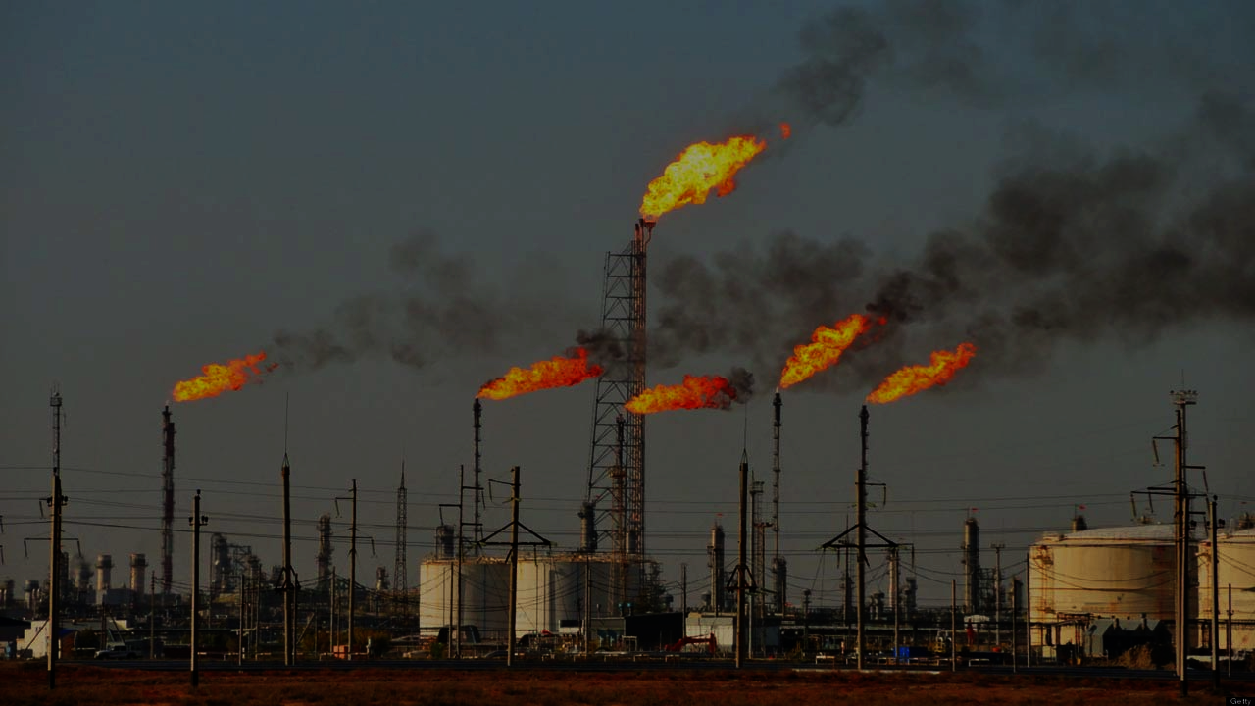
Hypothesis:
I hypothesize that there will be more than a 15% increase in CO2 emissions by 2030.
Is the information valid? What are the implications of the information’s validity?

Slide 10
Methods
In 2016, Turkish scientists Samuel Asumadu-Sarkodie & Phebe Asantewaa Owusu published findings which showed an increase of roughly 15% in carbon dioxide emissions in Nigeria by 2030.
The scientists used statistical methods and employed time-series data spanning from 1971 to 2012. They utilized a linear regression analysis to examine the causal relationship among the study variables and subsequently forecasted Nigeria’s energy use with the ARIMA and ETS models.

Slide 11
Methods
The Turkish scientists employed four main components to their study which they used to analyze overall carbon dioxide increases by 2030. These four variables include:
Energy Use (kg of oil equivalent per capita)
Carbon Dioxide Emissions (kt)
Economic Growth ($US)
Urban Population

Slide 12
Methods
Utilizing data from TheGlobalEconomy.com, to create new graphs to compare to previous graphs on connection between gas flaring and carbon dioxide production.
Comparing previous work on carbon dioxide emissions to my own data.

Slide 13
Methods
TheGlobalEconomy.com presents over 300 carefully selected indicators from multiple official sources such as the World Bank, the International Monetary Fund, the United Nations, and the World Economic Forum to keep track of economic developments in foreign countries.
Microsoft Excel used to create graphs.

Slide 14
Data

Slide 15
Data

Slide 16
Data

Slide 17
y = 1607.9x + 9953
By plugging in the corresponding year to ‘x’, I will be able to attain the appropriate prospective CO2 emission data.
For instance,
y = 1607.9(55) + 9953
= 98,387.5 kt

Slide 18
y = 1607.9x + 9953
YEAR | NUMBER OF YEARS AFTER 1960 | CO2 EMISSIONS (KT)
2015 | 55 | 98387.5
2016 | 56 | 99995.4
2017 | 57 | 101603.3
2018 | 58 | 103211.2
2019 | 59 | 104819.1
2020 | 60 | 106427.0
2021 | 61 | 108034.9
2022 | 62 | 109642.8
2023 | 63 | 111250.7
2024 | 64 | 112858.6
2025 | 65 | 114466.5
2026 | 66 | 116074.4
2027 | 67 | 117682.3
2028 | 68 | 119290.2
2029 | 69 | 120898.1
2030 | 70 | 122506.0

Slide 19
Results

Slide 20
Results

Slide 21
Analysis
A global initiative has been launched to cease routine flaring by 2030.
If gas flaring continues, by 2030, CO2 emissions will be greater than 120000 kt

Slide 22
Analysis
Samuel & Phebe’s Anlysis
My Analysis
15% increase from 2012 to 2030
Took into acount carbon dioxide emissions, oil production, etc.
Utilized more statistical methods and softwares
24% increase from 2012 to 2030
Took into acount only carbon dioxide emissions
Utilized limited statistical methods and software
Increase in CO2 Emissios by 2030 is observed

Slide 23
Conclusions

Slide 24
Conclusions
A global initiative has been launched to cease routine flaring by 2030.
By the data collected, routine flaring must be decreased.
Claims of decreasing CO2 emissions are false as data shows.
Flaring must stop immediately.
The continuation of flaring is not only humanly and environmentally harmful, but constitutes a large source of revenue loss to the people and government of Nigeria.

Slide 25
References
Asumadu-Sarkodie, S., and Owusu, P. A., 2016i. Forecasting Nigeria’s energy use by 2030, an econometric approach. Energ. Source. B 11:990–997.
‘‘Gas flaring in Nigeria.’’ (2005)
Otene IJJ, Murray P, Enongene KE (2016) The potential reduction of carbon dioxide (CO2) emissions from gas flaring in Nigeria’s oil and gas industry through alternative productive use. Environments 3(4):31. doi: 10.3390/environments3040031
‘‘Understanding the basics of gas flaring.’’ (2014) Division of Air Pollution Control. U.S. Environmental Protection Agency

Slide 26
Thank You!
Questions?

