Slide 1
pH of Atmospheric Particles
Atmospheric Chemistry
EAS 6410
Rime El Asmar
April 16th, 2020

Slide 2
Table of Content
Introduction
Drivers of pH alterations
Effects of pH on the atmosphere:
Dry deposition of inorganic reactive nitrogen species
Gas–particle partitioning of toxic organic pollutants
Visibility, and climate
Human Health

Slide 3
Acidity of Atmospheric Particles and Clouds
Pye et al, Atmospheric Chemistry and Physics, EGU

Slide 4
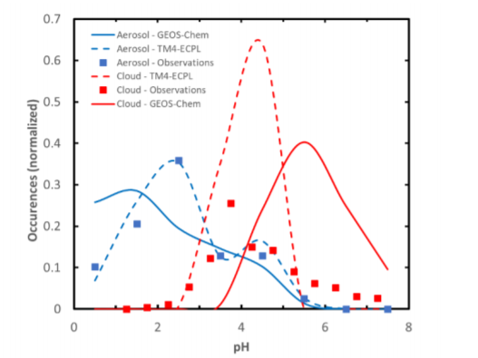
Aerosol and Cloud pH
Pye et al, Atmospheric Chemistry and Physics, 2019 EGU

Slide 5
Chemical Species
Degree of acidity or basicity
Volatility
Based on the dissociation constants
Volatile eg. VOCs
Semi-Volatile eg. NH_{3 ,}HNO₃
Non-Volatile eg. H₂SO₄

Slide 6
Effects of Aerosol pH
Aerosol acidity governs dry deposition of inorganic reactive nitrogen species
It affects the magnitude and spatial patterns of inorganic N deposition to terrestrial and aquatic ecosystems.
total nitrate (TNO₃ = HNO₃ + NO₃⁻ )
It affects the partitioning between gas and aerosol phases of
total ammonium (TNH₄ = NH₃ + NH₄⁺ )

Slide 7
How ?
Lower aerosol pH favors partitioning of TNO₃ toward gaseous HNO₃ rather than aerosol NO₃⁻ thus shortening its lifetime
Higher aerosol pH favors partitioning of TNH₄ toward gaseous NH₃ rather than NH₄⁺.
Conditions of aerosol pH that promote a short residence time and local dry deposition of TNO₃ may conversely result in longer range transport of TNH₄ and a more spatially extensive pattern of deposition and influence from source regions.

Slide 8
In some regions, such as the western US in Winter, reducing aerosol ammonium nitrate concentrations may lead to substantial reductions in overall PM_{2.5} mass.
Reduction of the level of nitrate occurs by several scenarios other than only reducing precursor emissions that lead to lower nitric acid that partitions to the aerosol .
Taking pH as a key variable having important role, reductions in ammonia to lower the particle pH can shift both nitrate and ammonium to gas phase nitric acid and ammonia.
Weagle et al ES&T 2018: SPARTAN

Slide 9
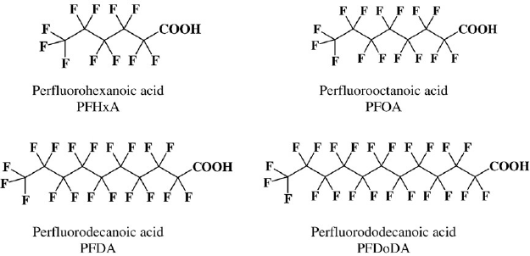
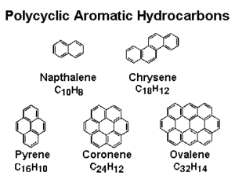
Aerosol acidity affects gas–particle partitioning of toxic organic pollutants
It affects their environmental fate and pathways for exposure
Tebes-Stevens et al., 2017
Liang et al., 1997

Slide 10
3. Aerosol Acidity affects Optical Properties of particles
It affects visibility, and climate
mass and chemical composition of atmospheric aerosols
Scattering and absorbing radiation
Water Uptake Properties (Hygroscopicity)
Visibility and Climate
Turnock et al., 2019

Slide 11
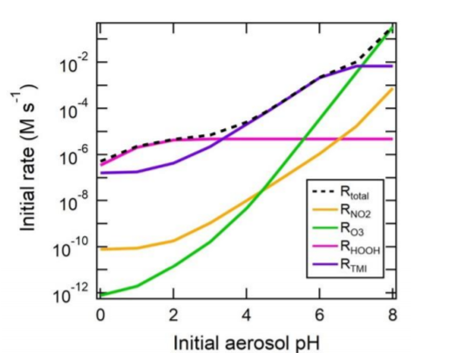
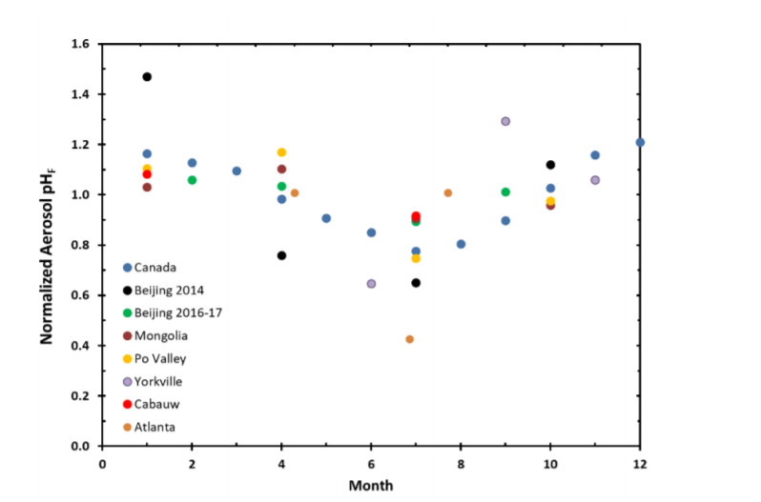
Pye et al, Atmospheric Chemistry and Physics, EGU

Slide 12
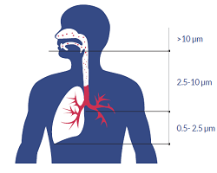
4. Aerosol acidity is associated with health effects of air pollution
Particles in the PM_{2.5} size range are able to travel deeply into the respiratory tract, reaching the lungs.
So
Composition of PM_{2.5} is associated with adverse human health effects including premature mortality, in addition to pulmonary and cardiovascular diseases.
What exactly pH does?
The pH of aerosol influences solubility of toxic forms of trace species, such as transition and heavy metals, that have been linked to negative health effects.
Induce oxidant production, known as Reactive Oxygen and Nitrogen Species that initiates inflammatory cascades leading to oxidative stress and cellular damage.
Lindsay & Xu, 2018

Slide 13
Conclusion
Aerosol and cloud acidity are key drivers of atmospheric chemistry which explains how emissions impact air quality, human health, ecosystems, and climate.
More information should exists on the spatial and temporal distribution of atmospheric acidity, its drivers and influences.
More data should become available about atmospheric particles pH that can be used for model evaluation and improvement.

Slide 15
References
Havala O. T. Pye, Athanasios Nenes, ,Becky Alexander, Andrew P. Ault, Mary C. Barth, Simon L. Clegg , Jeffrey L. Collett, Jr. , Kathleen M. Fahey , Christopher J. Hennigan , Hartmut Herrmann , Maria Kanakidou, James T. Kelly, I-Ting Ku , V. Faye McNeill, Nicole Riemer, Thomas Schaefer, Guoliang Shi, Andreas Tilgner, John T. Walker, Tao Wang, Rodney Weber ,Jia Xing , Rahul A. Zaveri, Andreas Zuend :The Acidity of Atmospheric Particles and Clouds, Atmospheric Chemistry and Physics, 18 October 2019.
Tebes-Stevens, C., Patel, J., Jones, W., and Weber, E.: Prediction of Hydrolysis Products of Organic Chemicals under Environmental pH Conditions, Environ. Sci. Technol., 51, 5008-5016, https://doi.org/10.1021/acs.est.6b05412, 2017.
Philip, S., Martin, R., Snider, G., Weagle, C., van Donkelaar, A., Brauer, M., Henze, D., Klimont, Z., Venkataraman, C., 25 Guttikunda, S., and Zhang, Q.: Anthropogenic fugitive, combustion and industrial dust is a significant, underrepresented fine particulate matter source in global atmospheric models, Environ. Res. Lett., 12, https://doi.org/10.1088/1748-9326/aa65a4, 2017.
Turnock, S. T., Mann, G. W., Woodhouse, M. T., Dalvi, M., O’Connor, F. M., Carslaw, K. S., and Spracklen, D. V.: The Impact of Changes in Cloud-Water pH on Aerosol Radiative Forcing, Geophys. Res. Lett., in press, https://doi.org/10.1029/2019GL082067, 2019.
Lindsay Miller and Xiaohong Xu: Ambient PM2.5 Human Health Effects—Findings in China and Research Directions. (http://creativecommons.org/licenses/by/4.0/).

