Slide 1
Biomass Burning Impact on New Delhi Pollution
EAS 6410 Individual Project Katie Kicklighter

Slide 2
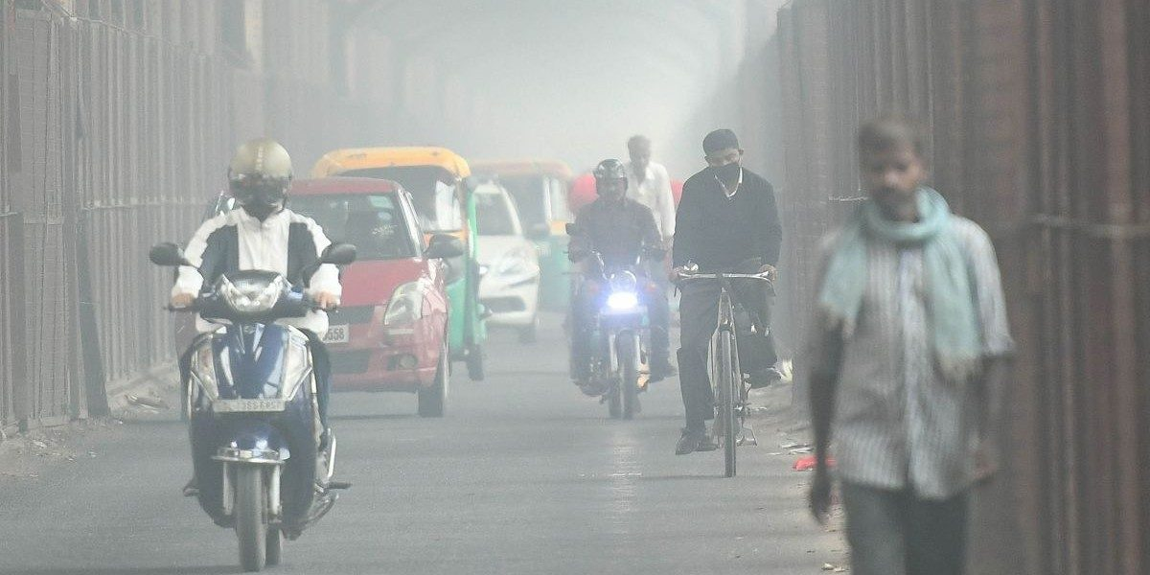
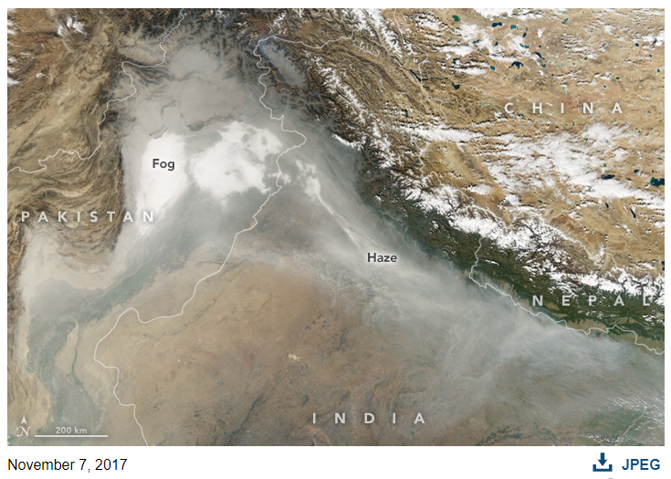
New Delhi Pollution Problem
New Delhi is a megacity in the northern section of India and is one of the most populated cities in the world
Winter PM_{2.5} concentrations range around 100–200 μg m⁻³, occasionally reaching 1,000 μg m⁻³; (WHO safety guidelines are 25 μg m⁻³/24 h)
In Nov. 2019, pollution in New Delhi warranted declaration of a health emergency
Top: Street view of pollution in New Delhi in Nov. 2019, when the city declared a health emergency due to pollution (1)
Right: NASA imagery of pollution in the IGP in 2017 (2)
https://electrek.co/2019/11/04/new-delhi-suffers-pollution-crisis/
https://earthobservatory.nasa.gov/images/91240/haze-blankets-northern-india

Slide 3
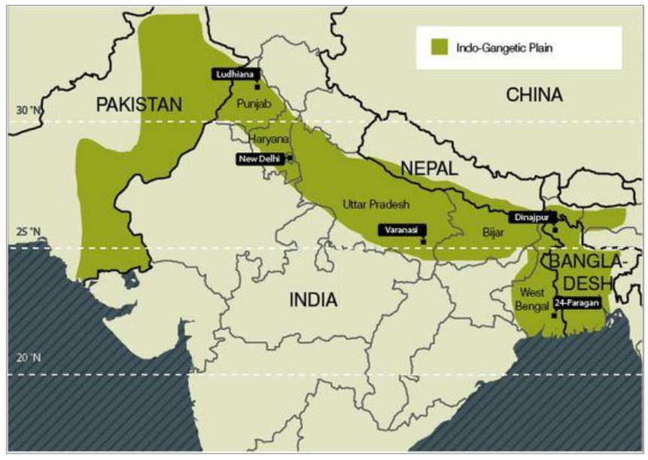
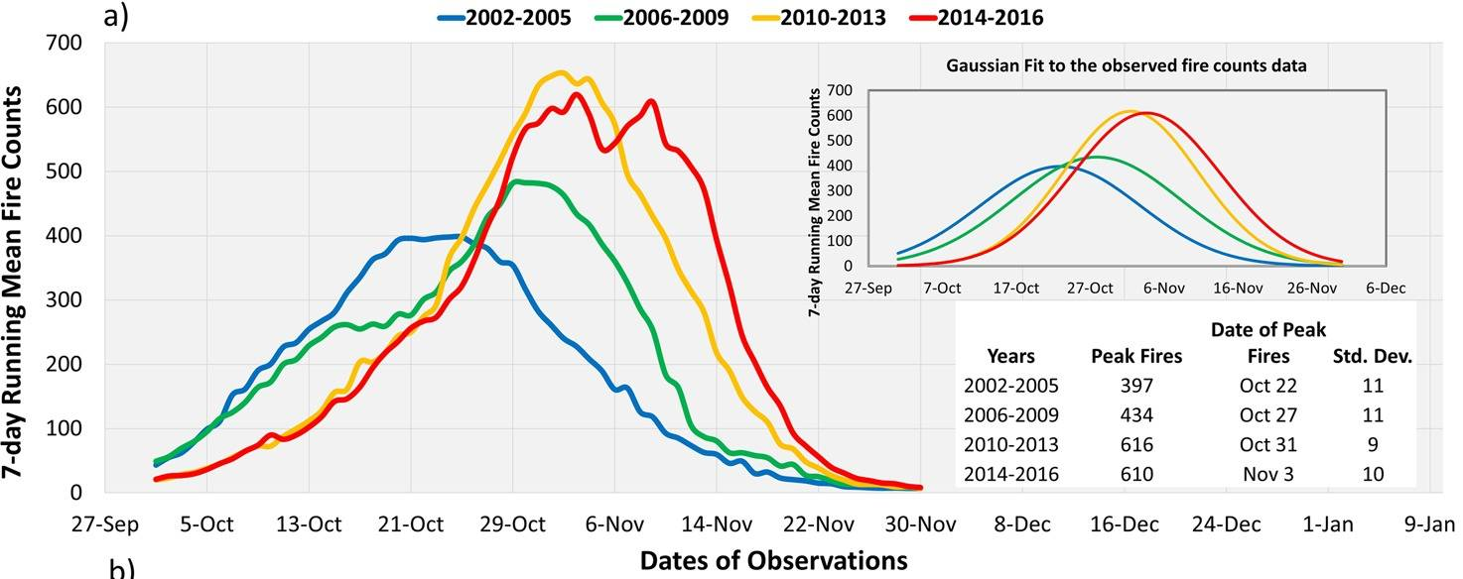
Indo-Gangetic Plain Agriculture
New Delhi is located in the Indo-Gangetic Plain, which is a primary source of food for the region
Rice and wheat are the predominant crops of the IGP
Burning crop residue is a common practice to stave off diseases in future crop yields
Crop burning peaks in the pre-monsoon season (Apr-May) and the post-monsoon season (Oct-Nov)
Punjab Preservation of Subsoil Water Act, 2009
Caused a shift in post-monsoon burning dates
[Jethva, 2019]

Slide 4
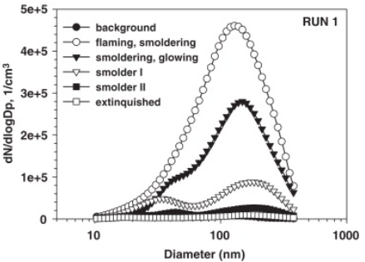
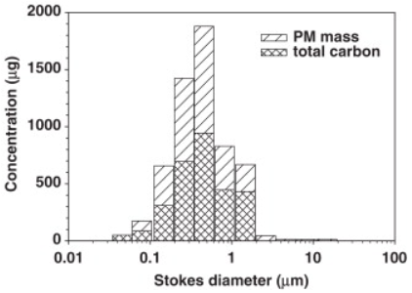
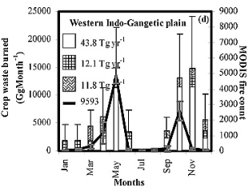
Impact of biomass burning
Rice and wheat (cereal) remnants are the primary crop wastes burned
Wheat burning produced a bimodal distribution of particle diameters, rice had a unimodal distribution of ~0.5 μm diameter
Rice has a much larger emission factor for PM_{2.5} and black carbon
[Venkataraman, 2006]
[Hays, 2005]

Slide 5
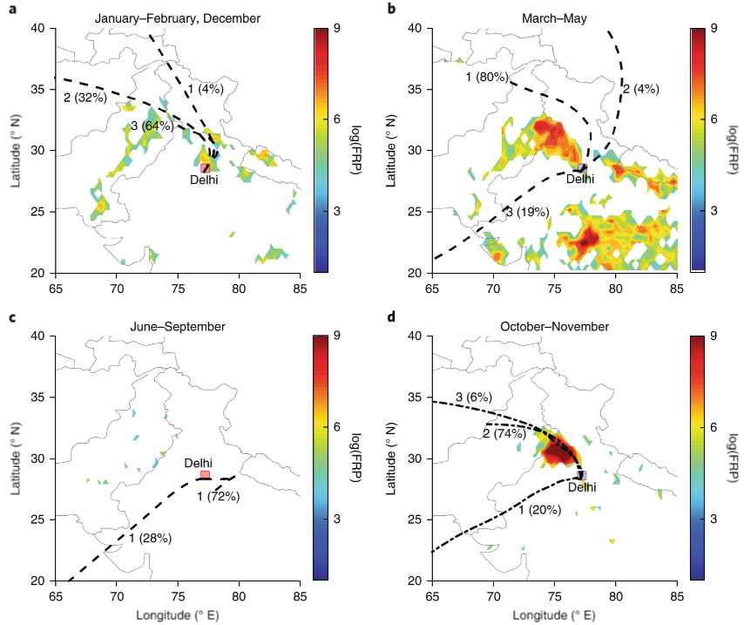
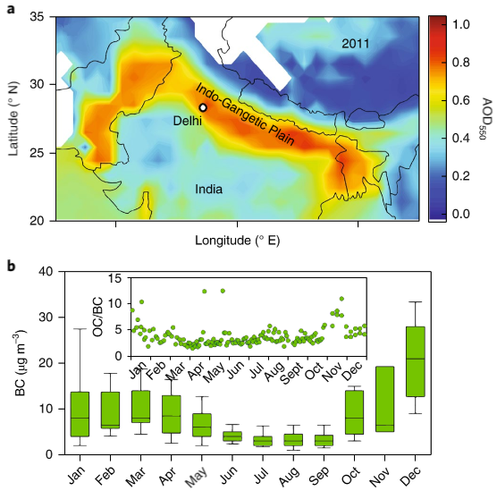
Seasonal Biomass Burning and BC Levels
[Bikkina, 2019]
Aerosol Optical Depth (AOP) is at a maximum in the IGP
Fire Radiative Power (FRP) shows sources of burning-related pollution

Slide 6
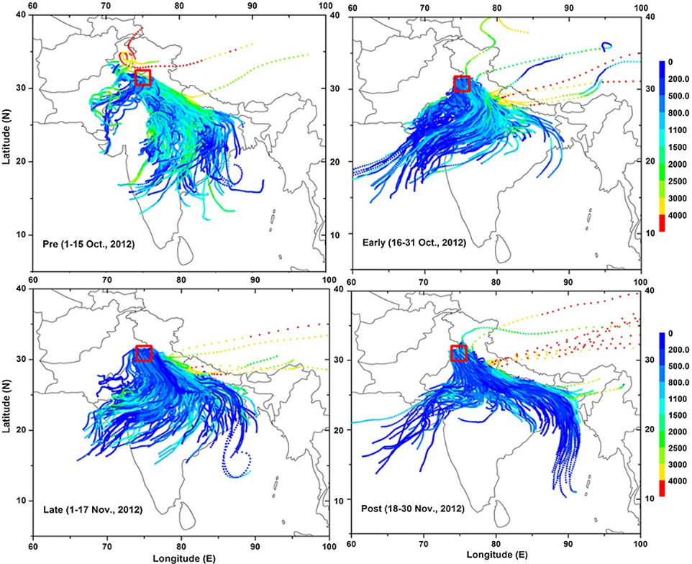
Plume and Long-Range Transport
During post-monsoon season, low altitude winds develop through the IGP
These southeasterly winds carry pollution from burning biomass through the IGP to cities such as New Delhi
[Kaskaoutis, 2014]
[Vijayakumar, 2016]

Slide 7
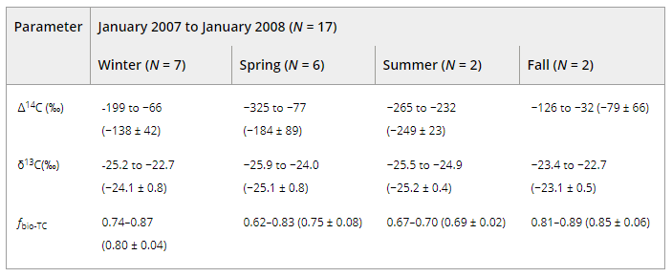
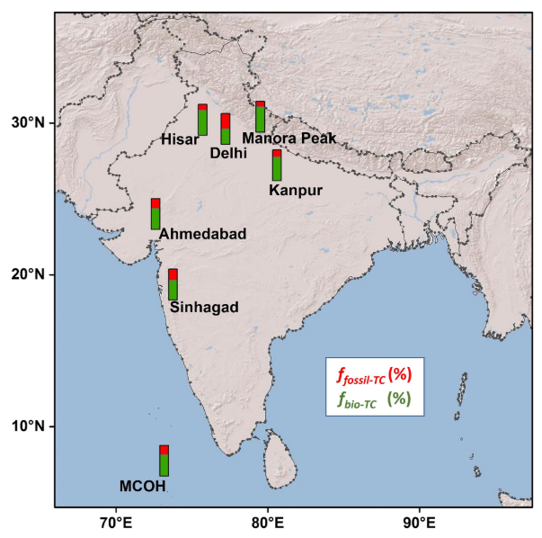
Aerosol sources
[Bikkina, 2017]
[Bikkina, 2019]
[Bikkina, 2017]
Total carbon increases are evident in Kanpur in the postmonsoon season
Black carbon follows a similar trend in Delhi, also on the Indo-Gangetic plain

Slide 8
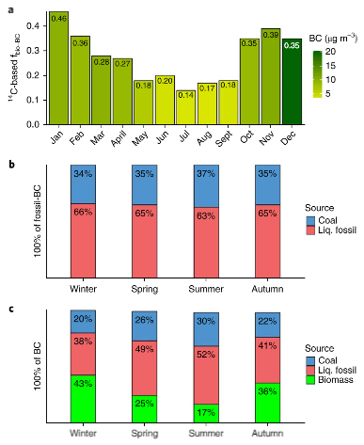
Aerosol sources
[Tripathi, 2019]
[Bikkina, 2019]
In Delhi, pollution from industries and transportation takes a larger role, but the biomass burning creates a substantial contribution starting in autumn months.

Slide 9
conclusion
New Delhi’s pollution problem is seasonally exacerbated by biomass burning in India’s Punjab state
The burning of rice and wheat crop residues in late Oct. and early Nov. result in smoke plumes that pollute the surrounding area
The shallow boundary layer effectively traps the emissions, and the low altitude winds carry them to the southeast down the IGP
In Autumn and Winter, this results in over 1/3 of New Delhi’s black carbon pollution to be biomass-based
As the pollution continues, the PM2.5 concentrations will continue to have an impact on the health of New Delhi resident and on the radiative forcing

Slide 10
References
Bikkina, S., Andersson, A., Ram, K., Sarin, M. M., Sheesley, R. J., Kirillova, E. N., Rengarajan, R., Sudheer, A. K. and Gustafsson, Ö.: Carbon isotope-constrained seasonality of carbonaceous aerosol sources from an urban location (Kanpur) in the Indo-Gangetic Plain, Journal of Geophysical Research: Atmospheres, 122(9), 4903–4923, doi:10.1002/2016jd025634, 2017.
Bikkina, S., Andersson, A., Kirillova, E. N., Holmstrand, H., Tiwari, S., Srivastava, A. K., Bisht, D. S. and Gustafsson, Ö.: Air quality in megacity Delhi affected by countryside biomass burning, Nature Sustainability, 2(3), 200–205, doi:10.1038/s41893-019-0219-0, 2019.
Gadde, B., Bonnet, S., Menke, C. and Garivait, S.: Air pollutant emissions from rice straw open field burning in India, Thailand and the Philippines, Environmental Pollution, 157(5), 1554–1558, doi:10.1016/j.envpol.2009.01.004, 2009.
Hays, M. D., Fine, P. M., Geron, C. D., Kleeman, M. J. and Gullett, B. K.: Open burning of agricultural biomass: Physical and chemical properties of particle-phase emissions, Atmospheric Environment, 39(36), 6747–6764, doi:10.1016/j.atmosenv.2005.07.072, 2005.
Jethva, H., Torres, O., Field, R. D., Lyapustin, A., Gautam, R. and Kayetha, V.: Connecting Crop Productivity, Residue Fires, and Air Quality over Northern India, Scientific Reports, 9(1), doi:10.1038/s41598-019-52799-x, 2019.

Slide 11
References
Kaskaoutis, D. G., Kumar, S., Sharma, D., Singh, R. P., Kharol, S. K., Sharma, M., Singh, A. K., Singh, S., Singh, A. and Singh, D.: Effects of crop residue burning on aerosol properties, plume characteristics, and long-range transport over northern India, Journal of Geophysical Research: Atmospheres, 119(9), 5424–5444, doi:10.1002/2013jd021357, 2014.
Liu, T., Marlier, M. E., Defries, R. S., Westervelt, D. M., Xia, K. R., Fiore, A. M., Mickley, L. J., Cusworth, D. H. and Milly, G.: Seasonal impact of regional outdoor biomass burning on air pollution in three Indian cities: Delhi, Bengaluru, and Pune, Atmospheric Environment, 172, 83–92, doi:10.1016/j.atmosenv.2017.10.024, 2018.
Tripathi, C. B., Baredar, P. and Tripathi, L.: Air Pollution in Delhi:Biomass Energy and Suitable Environmental Policies are Sustainable Pathways for Health Safety, Current Science, 117(7), 1153, doi:10.18520/cs/v117/i7/1153-1160, 2019.
Venkataraman, C., Habib, G., Kadamba, D., Shrivastava, M., Leon, J.-F., Crouzille, B., Boucher, O. and Streets, D. G.: Emissions from open biomass burning in India: Integrating the inventory approach with high-resolution Moderate Resolution Imaging Spectroradiometer (MODIS) active-fire and land cover data, Global Biogeochemical Cycles, 20(2), doi:10.1029/2005gb002547, 2006.
Vijayakumar, K., Safai, P., Devara, P., Rao, S. V. B. and Jayasankar, C.: Effects of agriculture crop residue burning on aerosol properties and long-range transport over northern India: A study using satellite data and model simulations, Atmospheric Research, 178-179, 155–163, doi:10.1016/j.atmosres.2016.04.003, 2016.

Slide 12
Questions?

