Slide 1
Antarctic Ozone Hole Recovery
Seungchan Kim (Patrick)
April 16th, 2020
EAS 6410

Slide 2
Antarctic Ozone Hole
Depletion of stratospheric ozone layer by chlorine in spring (Farman et al., 1985)
Ozone-Depleting Substances (ODSs) were phased out since Montreal Protocol (1987), lowering abundance of anthropogenic ODSs in the troposphere since 1994 (Carpenter et al., 2014)

Slide 3
Decrease in chlorine / Ozone recovery
Decrease of chlorine in the stratosphere has been observed in the past years (Kohlhepp et al., 2012)
Both chemistry-climate models (CCM) and observations confirmed the recovery of ozone in the polar region (e.g. Chipperfield et al., 2017, Weber et al., 2018)
Dhomse et al. (2018) predicted October column ozone in Antarctica would return to 1980 value by 2060 (1σ: 2055 – 2066) using 20 coupled CCMs

Slide 4
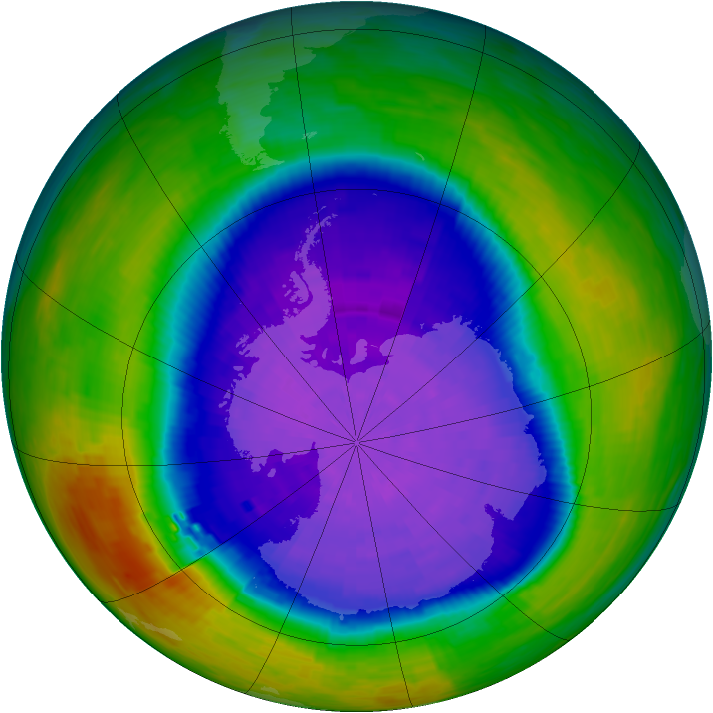
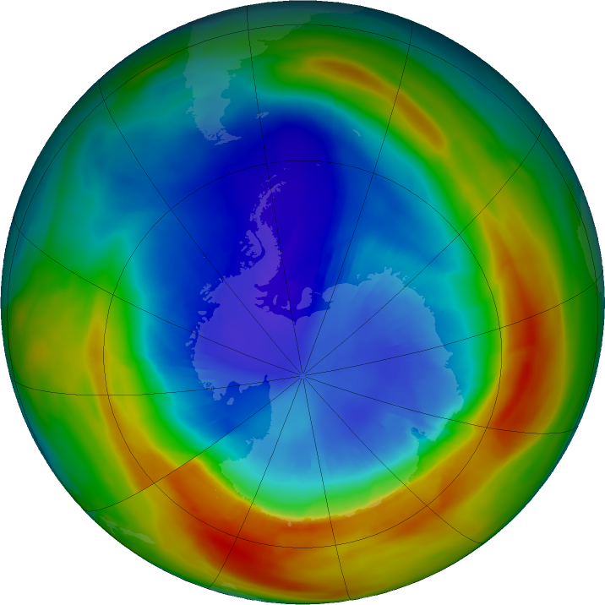
September 30, 1994
September 04, 2019
Retrieved from NASA Ozone Watch
Notes:
2019: smallest ozone hole on record (due to unusual weather pattern in the stratosphere over south pole)

Slide 5
Decline of CFC-11
Rate of decrease of atmospheric CFC-11 concentrations slowed by ~50% since 2012 (Montzka et al., 2018)
Rate was constant from 2002 – 2012
Montzka et al. (2018)
Notes:
Graph: observation data (not model)

Slide 6
Decline of CFC-11
Montzka et al. (2018)
Notes:
Left: global rate of change of CFC-11
Right: hemispheric mole fraction difference (NH-SH)
E1: emission scenario (spatial distribution) CE: constant emission
M: MERRA
FD(fixed dynamics)
Red: observation – agrees well with emission-scenario (on both plots) = CFC emission did increase

Slide 7
Very Short-Lived Substance (VSLS)
CH2Cl2 (dichloromethane): an industrial solvent also used as a feedstock in the production of other chemicals (e.g. Simmonds, P. G. et al., 2006)
It is a VSLS
Although short-lived, both natural and anthropogenic VSLS have been detected in the lower stratosphere (Carpenter et al., 2014)
Notes:
CFC-11 still contributes about one-quarter of anthropogenic Cl (1/5 of all Cl) – significant effect
VSLS: NOT controlled by Montreal Protocol

Slide 8
CH2Cl2 Trend
Increase in atmospheric abundance of VSLS chloroform (CHCl3) also reported (Fang et al., 2019)
Both increase may delay recovery, depending on its rate
Hossaini et al. (2017)
Notes:
NOAA surface measurement (estimation of ~1 Tg emission CH2Cl2 to sustain) note: short lifetime, so less impact compared to ODS
Scenario 1: increase rate = 2004 – 2014 period (2.85 ppt/yr mid-lat NH) S2: 2012 – 2014 period (6.1 ppt/yr) S3: no growth (fixed at 2016 level)
Cl entering stratosphere
Using Chemical Transport Model (CTM)

Slide 9
Dhomse et al. (2019)
Notes:
(CTM) R2000 = control model run with 2000-2018 meteorology
R2000_CFC11_B = additional CFC-11 emission based on assumptions post-2010 use was for non-emissive foam blowing with steady decrease in 2010-2020
(delayed ~2 years)
R2000_CFC11_67 = constant 67 Tg/yr of CFC-11 (delayed ~ 18 years) (unrealistic)
R2000_NoVSLS = 0 injection of chlorine due to VSLS (forward ~ 7 years)

Slide 10
Future work & Conclusion
Ozone recovery is happening, but at a slower rate
Accurately quantifying the amount of increase of chlorine, and tracing the sources (to limit) is necessary
Further studies on the impacts of VSLS (not controlled yet)

Slide 11
References
Carpenter, L. J. et al., Scientific Assessment of Ozone Depletion: 2014. Global Ozone Research and Monitoring Project—Report No. 55, Ch. 1, 1.1–1.101, (World Meteorological Organization, Geneva, 2014)
Chipperfield, M. P., Bekki, S., Dhomse, S., Harris, N. R. P., Hassler, B., Hossaini, R., . . . Weber, M. (2017). Detecting recovery of the stratospheric ozone layer. Nature, 549(7671), 211-218. doi:10.1038/nature23681
Dhomse, S. S., Kinnison, D., Chipperfield, M. P., Salawitch, R. J., Cionni, I., Hegglin, M. I., . . . Zeng, G. (2018). Estimates of ozone return dates from Chemistry-Climate Model Initiative simulations. Atmospheric Chemistry and Physics, 18(11), 8409-8438. doi:10.5194/acp-18-8409-2018
Dhomse, S. S., Feng, W., Montzka, S. A., Hossaini, R., Keeble, J., Pyle, J. A., . . . Chipperfield, M. P. (2019). Delay in recovery of the Antarctic ozone hole from unexpected CFC-11 emissions. Nat Commun, 10(1), 5781. doi:10.1038/s41467-019-13717-x
Fang, X., Park, S., Saito, T., Tunnicliffe, R., Ganesan, A. L., Rigby, M., . . . Prinn, R. G. (2018). Rapid increase in ozone-depleting chloroform emissions from China. Nature Geoscience, 12(2), 89-93. doi:10.1038/s41561-018-0278-2
Farman, J. C., Gardiner, B. G., & Shanklin, J. D. (1985). Large losses of total ozone in Antarctica reveal seasonal ClOx/NOx interaction. Nature, 315(6016), 207-210. doi:10.1038/315207a0
Hossaini, R., Chipperfield, M. P., Montzka, S. A., Leeson, A. A., Dhomse, S. S., & Pyle, J. A. (2017). The increasing threat to stratospheric ozone from dichloromethane. Nat Commun, 8, 15962. doi:10.1038/ncomms15962

Slide 12
References
Kohlhepp, R., Ruhnke, R., Chipperfield, M. P., De Mazière, M., Notholt, J., Barthlott, S., . . . Wood, S. W. (2012). Observed and simulated time evolution of HCl, ClONO2, and HF total column abundances. Atmospheric Chemistry and Physics, 12(7), 3527-3556. doi:10.5194/acp-12-3527-2012
Montzka, S. A., Dutton, G. S., Yu, P., Ray, E., Portmann, R. W., Daniel, J. S., . . . Elkins, J. W. (2018). An unexpected and persistent increase in global emissions of ozone-depleting CFC-11. Nature, 557(7705), 413-417. doi:10.1038/s41586-018-0106-2
NASA Ozone Watch, retrieved on 14 April 2020. https://ozonewatch.gsfc.nasa.gov/SH.html
Simmonds, P. G., Manning, A. J., Cunnold, D. M., McCulloch, A., O'Doherty, S., Derwent, R. G., . . . Prinn, R. G. (2006). Global trends, seasonal cycles, and European emissions of dichloromethane, trichloroethene, and tetrachloroethene from the AGAGE observations at Mace Head, Ireland, and Cape Grim, Tasmania. Journal of Geophysical Research, 111(D18). doi:10.1029/2006jd007082
Weber, M., Coldewey-Egbers, M., Fioletov, V. E., Frith, S. M., Wild, J. D., Burrows, J. P., . . . Loyola, D. (2018). Total ozone trends from 1979 to 2016 derived from five merged observational datasets – the emergence into ozone recovery. Atmospheric Chemistry and Physics, 18(3), 2097-2117. doi:10.5194/acp-18-2097-2018

