Slide 1
Project EAS-6410
Priyansh Sharma

Slide 2
The Journey
I believe, all forms of research, have journey to the research question itself?
Raman had why is the colour of the ocean blue?
Newton had why has the apple fallen?
Mine was why can’t I use what Dr. Wang gave us as an example? So I decided to look into the oxidation of Methane.

Slide 3
The Journey
What if CH₄ oxidation is done not by OH⁻ radical but by Cl⁻ present in NaCl, which is a dominant part of the sea-salt composition, but not as important as nitrates and sulphates in aerosol.
Alternate oxidation Pathway
What about areas far away from sea? So I started looking into Chlorine Chemistry?
CFCs are gone and HCFCs will be removed entirely soon. But chlorine is too interesting an element to not have any effects in the atmosphere.
Abundantly present (in the form of sea-salt)
Highest electron Affinity
Has already proven to be troublesome

Slide 4
Research Questions
Where does Chloride come from?
Where does it go?
Not a part of the aerosol composition
What impact do Chlorides (and Halides) have in the troposphere?

Slide 5
Where does it come from?
Organic
Need not be worried about mostly, as majority are decomposed to simpler forms with Chlorine becoming a part of an inorganic compound.
Exceptions
CFCs
CCl₄
CH₃Cl
CH₃CCl₃
Inorganic
Acidification of Sea-Salt to form HCl
Burning of biomass and solid waste (plastics)
Landfills sites

Slide 6
Where does it go?
Here’s where things get interesting
The Chlorine in HCl forms a few compounds due to both two-phase chemistry and multiphase chemistry
ClNO₃ (PSCs)
ClNO₂ (More important)
ClNO
ClO_{x}

Slide 7
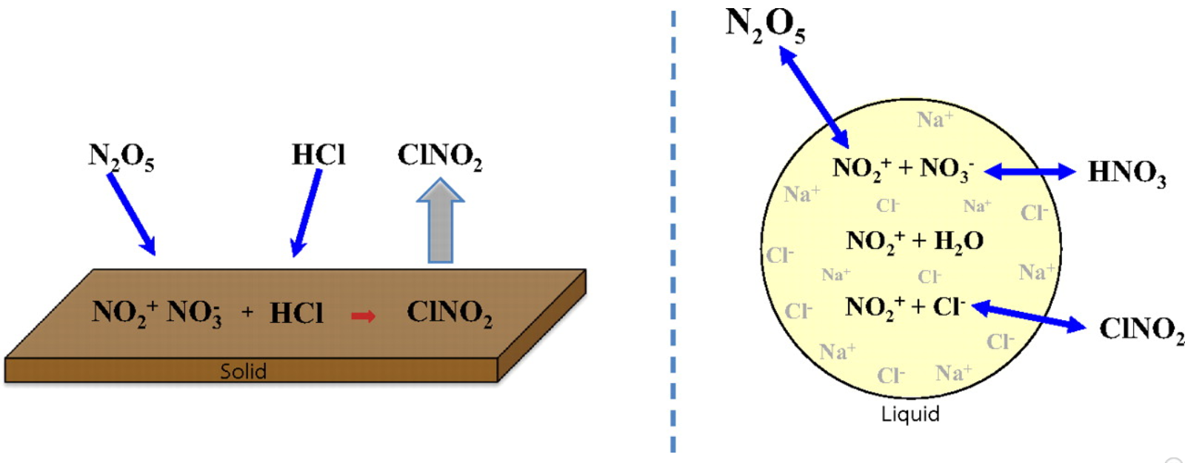
Multiphase and Two-phase chemistry

Slide 8
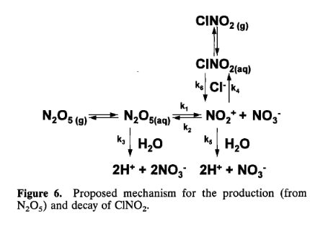

Slide 9
Why are these important
These are important as an additional reactive species might change the concentrations of
Ozone
OH radical
Subsequently, Particulate Matter
Reconsider current chemical models

Slide 10
Let’s step outside the States for a few slides

Slide 11
Europe: Dichotomy of Chlorine
ClNO₂ increases the concentration of tropo Ozone
ClO_{x} (and Iodine O_{x}) reduce the concentrations of tropo Ozone

Slide 12
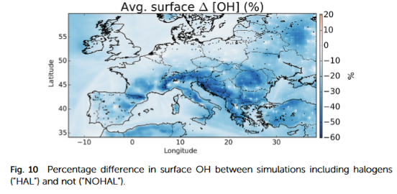
Effect on OH radical
Average of 16%
Removal of NO_{x} and O₃
Conversion from Halide oxides not enough to compensate

Slide 13
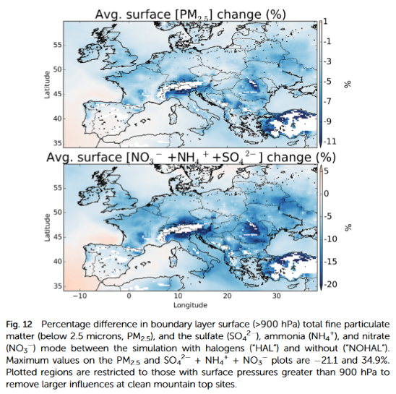
Particulate Matter
PM_{2.5} goes down by 1.7%
Nitrates, ammonium and sulphates go down by 4.3%

Slide 14
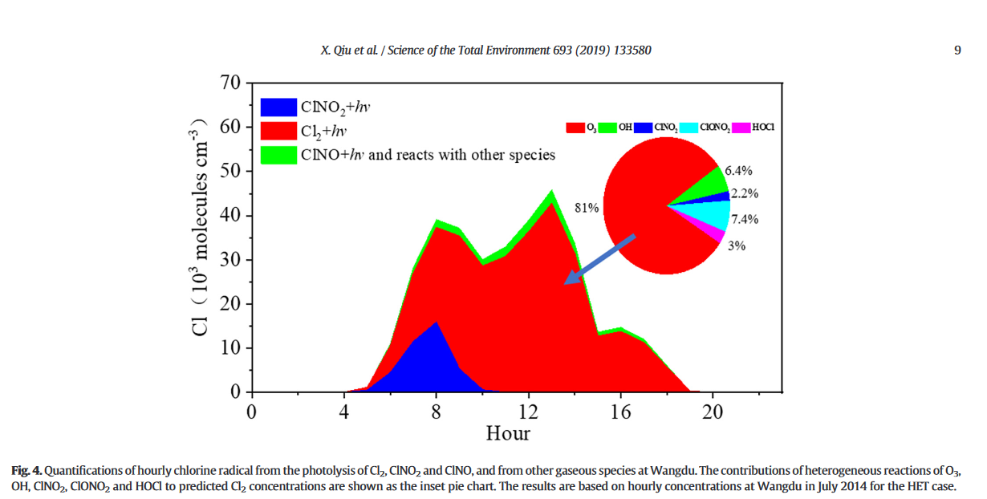
China
It all brought me back to Dr. Wang.
The research in China is in direct opposition to the results shown in Europe.
This (and a few other studies) displayed that the addition of Chlorine radical leads to direct increase in O₃,OH,HO₂ and RO₂ concentrations by up to 20%, 28%, 36% and 48% in areas with high No_{x} and low VOCs

Slide 15
Let’s leave land altogether

Slide 16
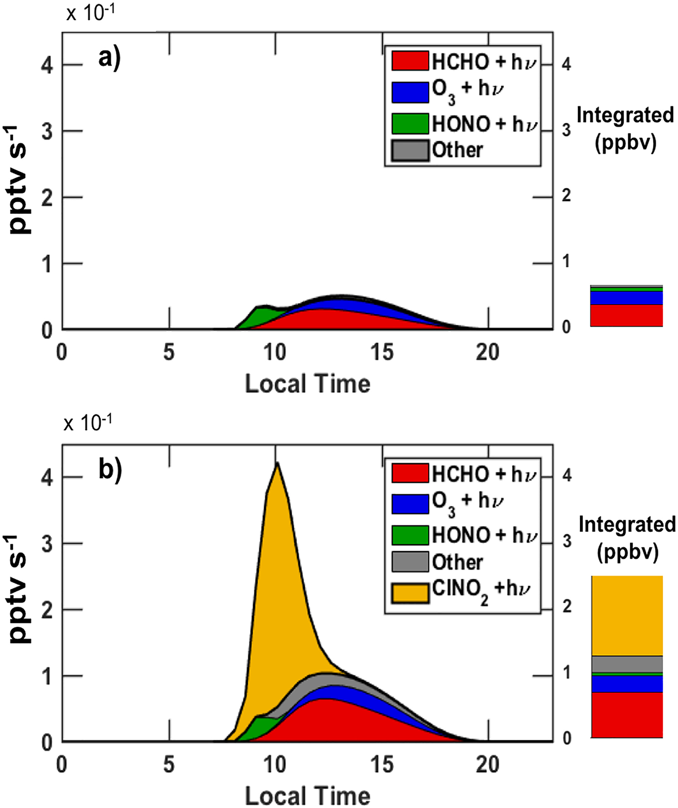
Over the ocean
One of the most important oxidants over the Marine boundary layer

Slide 17
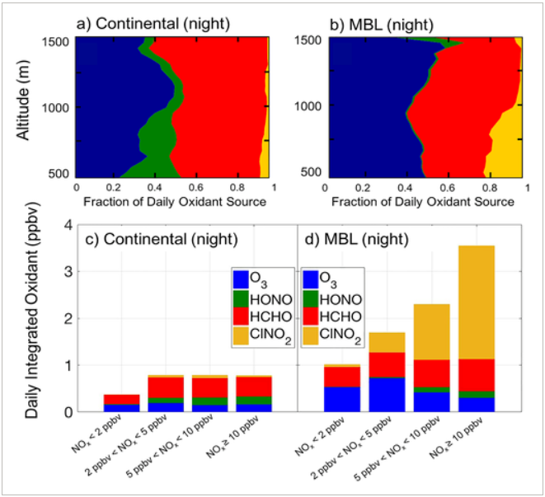
MBL vs CBL
It can be seen (during wintertime) ClNO₂ does not have an important role to play and the important oxidant role shifts more towards HCHO as we move closer to land.

Slide 18
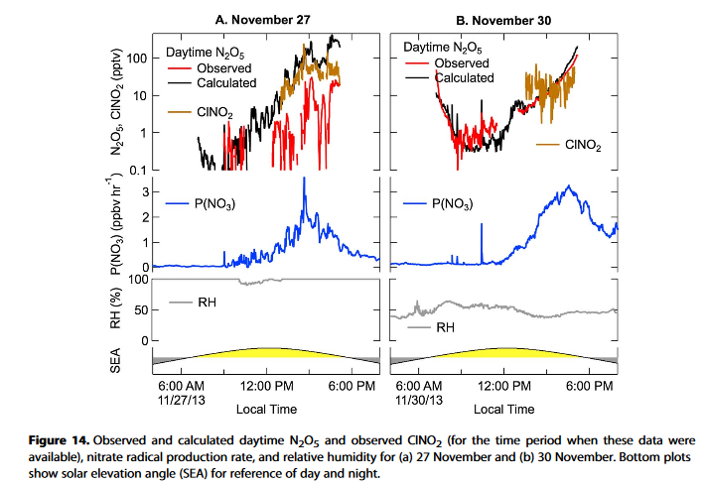
Altitude and RH
How the change in altitude (solar elevation angle) and RH effects the Halide nitrate chemistry

Slide 19
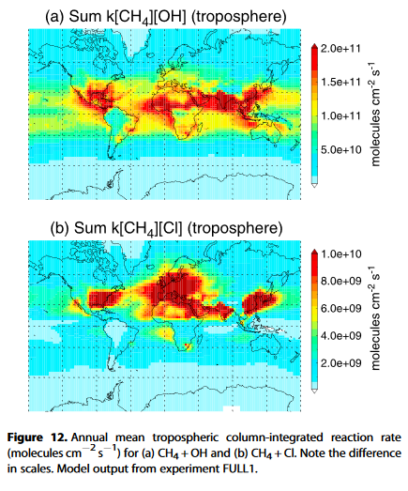
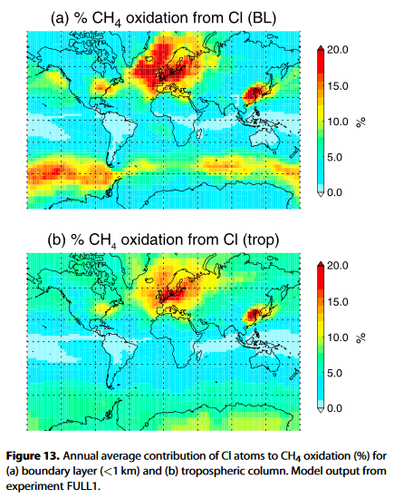
The Original Question: Is methane oxidized by Chlorine radicals
There is still high variability in the impact of Chlorine in methane oxidation by the order of 2 in magnitude.

Slide 20
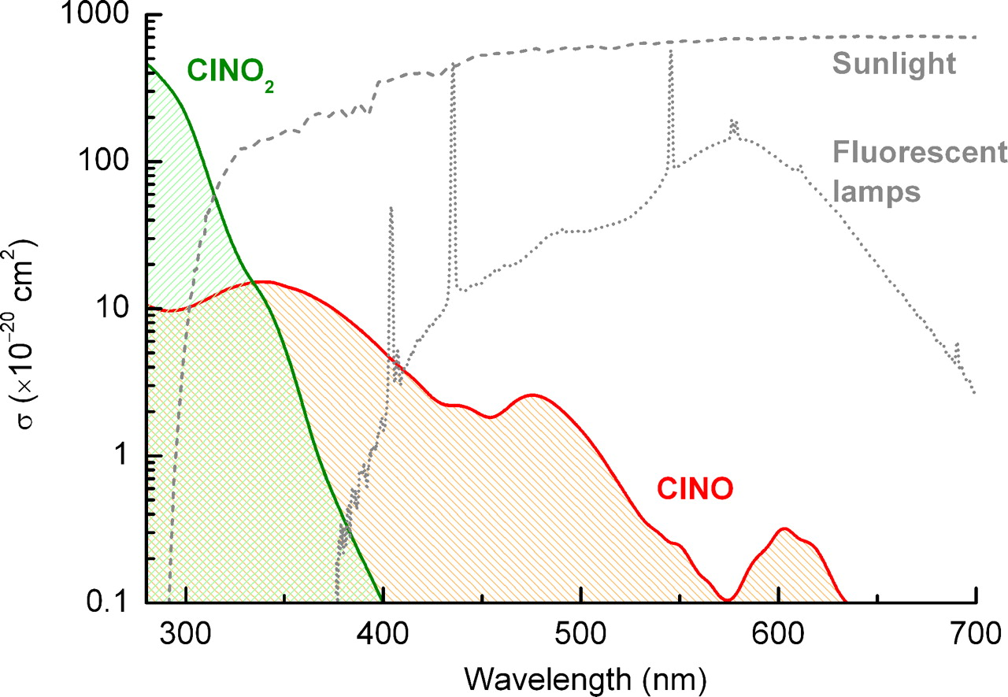
Additional Study
How the concentrations of ClNO2 and ClNO change indoors over the period of the day

Slide 21
Discussion and Conclusion
Initial assumption that Chlorine is a very interesting element stands true.
The chemical models are designed for mostly NO_{x} and VOCs based chemistry and need to be expanded to inclusion of Halide chemistry, with strong relationship with RH.
The opposing results of studies based in Europe and China can be attributed to the former including Br and I O_{x} in the study, which serve as a larger pool, thus compensating the formation of Ozone and Hydroxy radicals by Cl₂ and ClNO₂.
A thorough study measuring the impact of Halides on Methane needs to be conducted.

Slide 22
References
Hossaini, R., Chipperfield, M. P., Saiz-Lopez, A., Fernandez, R., Monks, S., Feng, W., … Von Glasow, R. (2016). A global model of tropospheric chlorine chemistry: Organic versus inorganic sources and impact on methane oxidation, 121(23), 14,214-271,297. https://doi.org/10.1002/2016jd025756
Qiu, X., Ying, Q., Wang, S., Duan, L., Wang, Y., Lu, K., … Hao, J. (2019). Significant impact of heterogeneous reactions of reactive chlorine species on summertime atmospheric ozone and free-radical formation in north China. Science of The Total Environment, 693, 133580. https://doi.org/10.1016/j.scitotenv.2019.133580
Haskins, J. D., Lopez‐Hilfiker, F. D., Lee, B. H., Shah, V., Wolfe, G. M., Digangi, J., … Thornton, J. A. (2019). Anthropogenic Control Over Wintertime Oxidation of Atmospheric Pollutants. Geophysical Research Letters, 46(24), 14826–14835. https://doi.org/10.1029/2019gl085498
Unknown article. (n.d.). https://doi.org/10.1115/nawtec18-3577
Sherwen, T., Evans, M. J., Sommariva, R., Hollis, L. D. J., Ball, S. M., Monks, P. S., … Bloss, W. J. (2017). Effects of halogens on European air-quality. Faraday Discussions, 200, 75–100. https://doi.org/10.1039/c7fd00026j
Hossaini, R., Atlas, E., Dhomse, S. S., Chipperfield, M. P., Bernath, P. F., Fernando, A. M., … Lunder, C. R. (2019). Recent Trends in Stratospheric Chlorine From Very Short‐Lived Substances. Journal of Geophysical Research: Atmospheres, 124(4), 2318–2335. https://doi.org/10.1029/2018jd029400
Farman, J. C., Gardiner, B. G., & Shanklin, J. D. (1985). Large losses of total ozone in Antarctica reveal seasonal ClOx/NOx interaction. Nature, 315(6016), 207–210. https://doi.org/10.1038/315207a0
Ravishankara, A. R. (2009). Are chlorine atoms significant tropospheric free radicals? Proceedings of the National Academy of Sciences, 106(33), 13639–13640. https://doi.org/10.1073/pnas.0907089106
http://zebu.uoregon.edu/text/ozone
Pandis, John H. Pandis and Spyros N. 2016. Atmospheric Chemistry and Physics. s.l. : Wiley, 2016.

