Slide 1
Source and influencing factors of indoor air pollution
Bingqing Zhang
04/14/2020

Slide 2
Outline
Reasons for study indoor air pollution
Pollution category by different sources
Factors affect pollutant emission and transportation
Controlling method

Slide 3
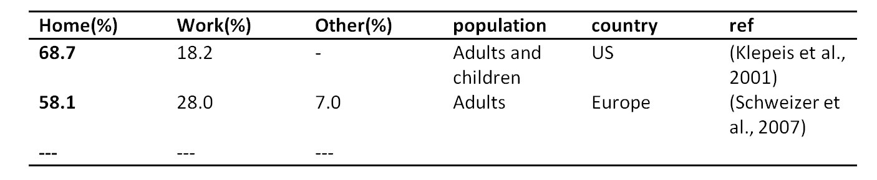
Why we study indoor air quality?
People spend 90% of their time indoors
Indoor air quality has critical effect on people’s health due to long time exposure.
  Immediate effect: show up shortly after a single exposure or repeated exposure to a pollutant, including irritation of eyes, nose and throat, headache, dizziness and
  Long term effect: show up years after exposure or show up only after a long or repeated periods of exposure, such as respiratory disease, hear disease and cancer.

Slide 4
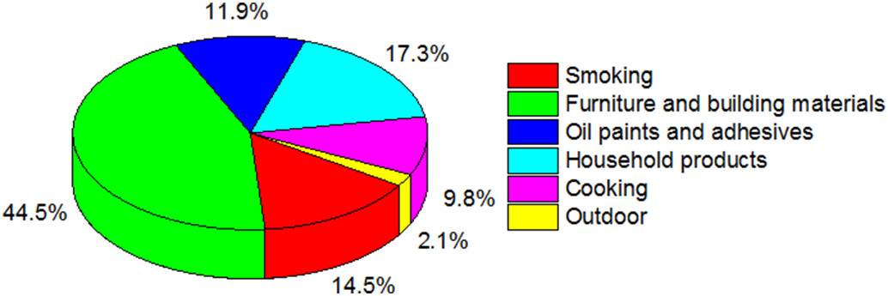
Pollutant category by different sources
Outdoor source;
Indoor source;
  Furniture and building material
  Cooking
  Smoking
  Oil paints and adhesive
  Household products
(Huang et al., 2019)

Slide 5
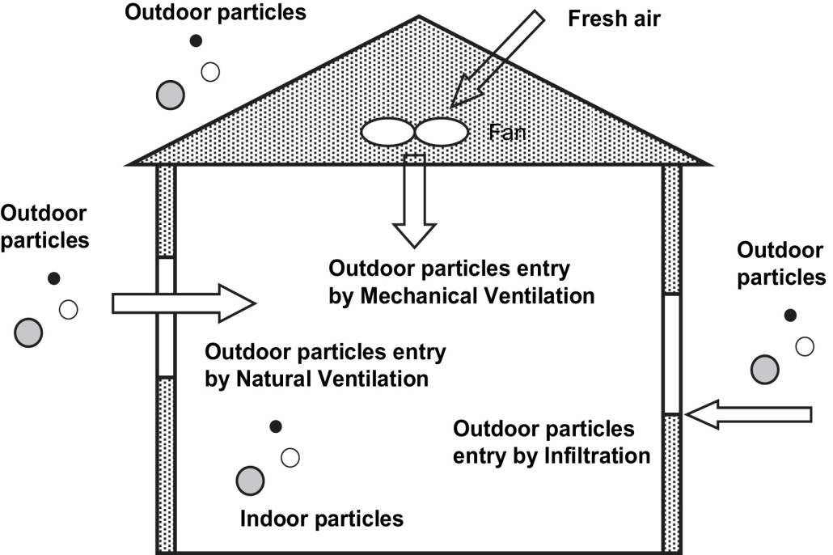
Outdoor source
Outdoor particle concentrations are a major contributor to indoor concentrations, outdoor source causing indoor pollution include automobiles, industry and combustion process;
Three particle get in pathways :
①mechanical ventilation
②natural ventilation
③infiltration
(C. Chen & Zhao, 2011)

Slide 6
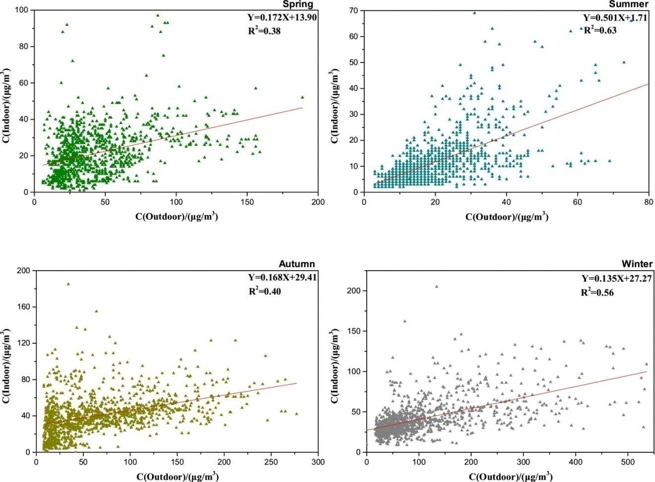
Studies has shown that indoor particle concentration are related to outdoor concentration
Correlation of indoor and outdoor PM2.5 concentration in four seasons
(Bai, He, Li, & Chen, 2020)

Slide 7


Studies has shown that indoor particle concentration are related to outdoor concentration
Contribution factor Contribution rate
Cin, indoor concentration;
Cout, outdoor concentration;
Cig, mass concentration produced
by indoor source;
Qin, emission rate of indoor PM
Ρ, permeability factor of outdoor
to indoor;
Finf, effective penetration factor;
α, air exchange rate;
k, settling rate;
Season | Penetration factor |  | Contribution value(μg/m3) |  | Contribution rate(%)
 | AVG | SD | AVG | SD | AVG | SD
Spring | 0.172 | 0 | 7.302 | 4.958 | 48.134 | 52.963
Summer | 0.501 | 0 | 3.606 | 0.835 | 65.631 | 16.459
Autumn | 0.168 | 0 | 11.217 | 8.963 | 31.034 | 24.149
Winter | 0.135 | 0 | 14.289 | 12.879 | 34.509 | 25.789

Slide 8
Indoor source
Furniture and building material
Building materials are primary source of indoor air pollutant, such as wood products, coatings and floorings. The pollutants mainly include HCHO, toluene and benzene.
(L. Huang et al., 2018)
Flooring materials: residences with solid wood flooring had lower concentrations of alkanes((C8, C10, C14 and C15), terpenes (d-limonene and β-pinene) and alkyl benzenes (toluene, ethylbenzene, trimethylbenzene, xylenes, ethyltoluenes, tetramethylbenzene) than those with composite wood flooring
Sofa materials: residences with leather sofa has significant higher concentration of α-pinene, β-pinene and than those residences with fabric sofa
other built environmental conditions, including building age, proximate traffic condition, time interval since last renovation, times of cooking during sampling period, smoking activities during sampling period, frequency of floor cleaning and use of clothes detergent, did not significantly influent the indoor VOC concentrations.

Slide 9
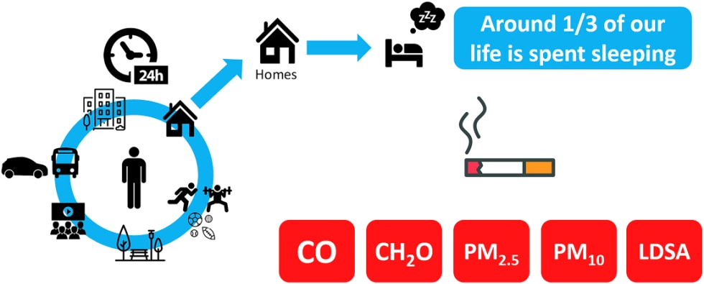
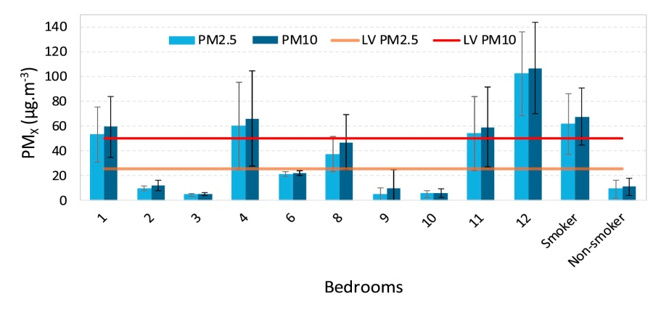
Indoor source
Smoking
(Canha, Lage, Coutinho, Alves, & Almeida, 2019)

Slide 10
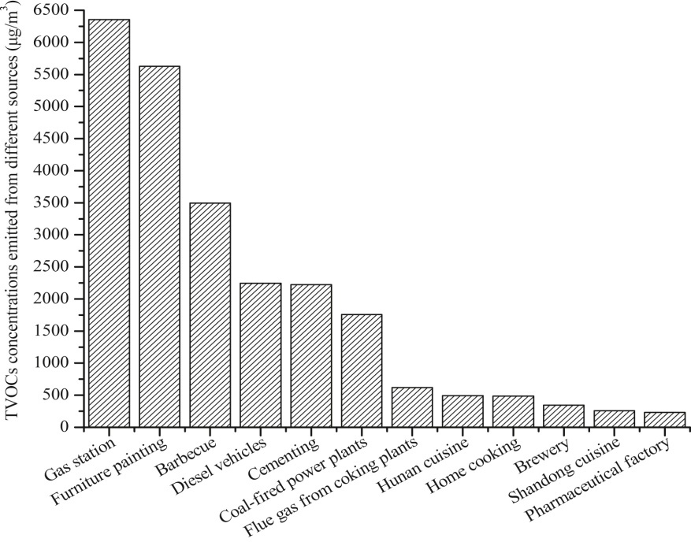
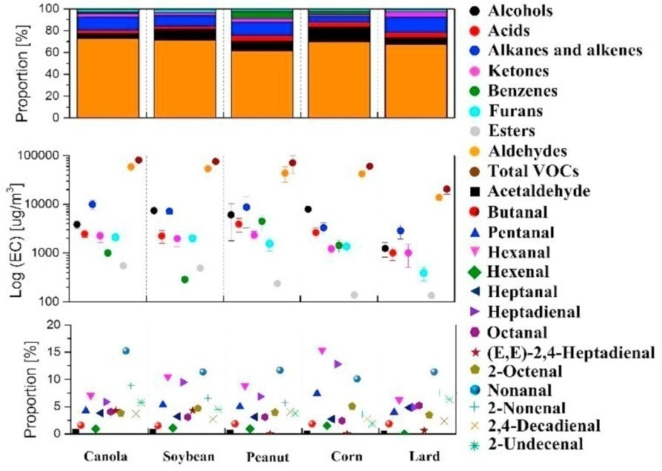
Indoor source
Cooking
(Cheng et al., 2016)
(Zhang, Liu, Jia, Wang, & Han, 2019)

Slide 11
Indoor source
Other sources (Lin, 2019)
  Incense, used in religious ceremonies, residence and some public places including stores and temples.
  Candles, made of paraffin or beeswax containing heavt straight-chain hydrocarbons.
  Mosquito Coil, used to prevent mosquito bite

Slide 12
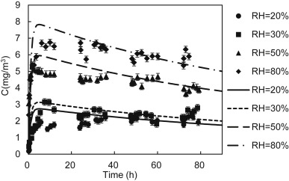
Influencing factors
RH
Humidity can effect pollutant emission parameter: initial concentration, diffusion coefficient and partition coefficient
HCHO measurement of a medium-density fiber board in a dynamic small-scale environment at different RH
(Liang, Lv, & Yang, 2016)
Temperature℃ | Relative humidity (%) | Absolute humidity (g/kg_{air}) | Ventilation rate (h^-1) | Dimensions (mm*mm*mm) | C0 (mg/m^3) | Dm (m2/s) | K
25.5 ± 0.5 | 20 ± 5 | 4.0 ± 0.5 | 1 ± 0.05 | 245 × 140 × 12 | 1.75 × 10⁶ | 3.40 × 10⁻¹⁴ | 6340
25.5 ± 0.5 | 30 ± 5 | 6.1 ± 0.5 | 1 ± 0.05 | 245 × 140 × 12 | 2.00 × 10⁶ | 3.36 × 10⁻¹⁴ | 5514
25.5 ± 0.5 | 50 ± 5 | 10.4 ± 0.5 | 1 ± 0.05 | 245 × 140 × 12 | 3.80 × 10⁶ | 3.50 × 10⁻¹⁴ | 5340
25.5 ± 0.5 | 80 ± 5 | 16.7 ± 0.5 | 1 ± 0.05 | 245 × 140 × 12 | 5.20 × 10⁶ | 3.14× 10⁻¹⁴ | 6218

Slide 13
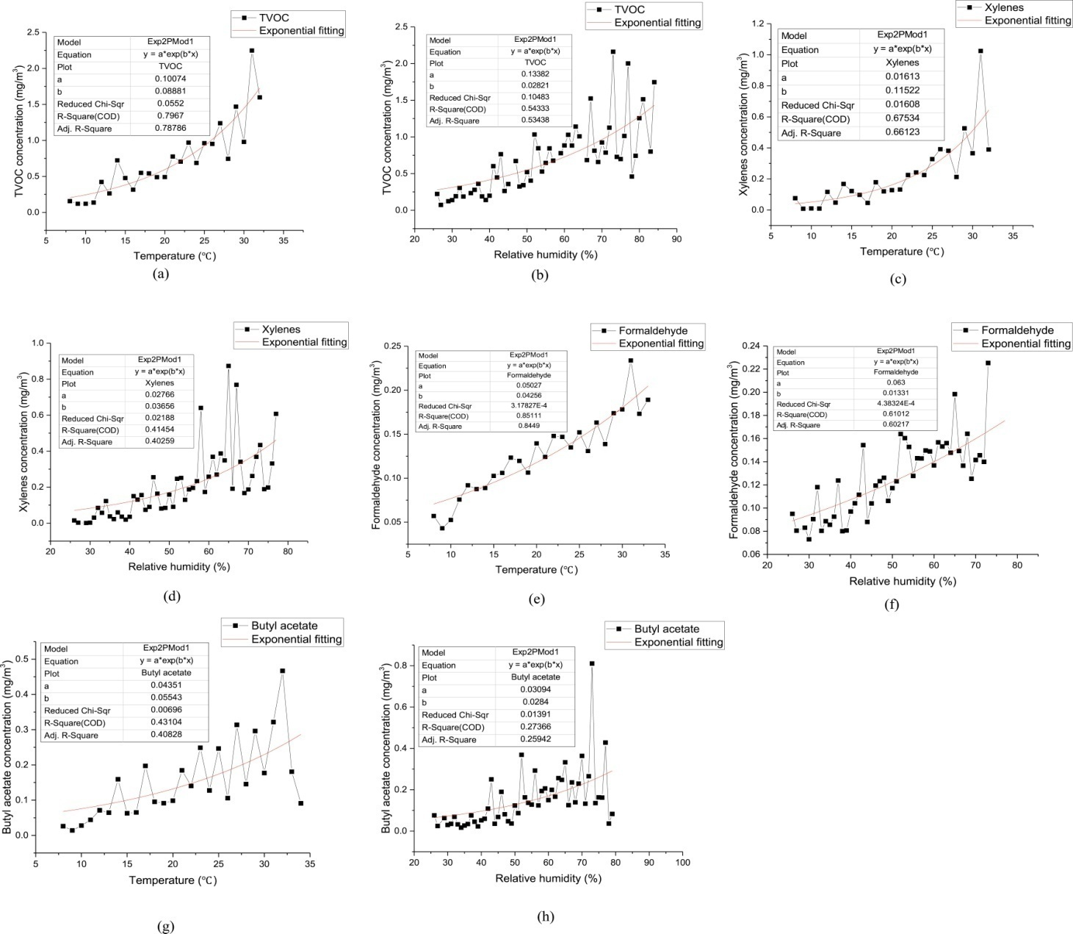
Influencing factors
combined effect on temperature and RH
(C. Zhou et al., 2017)

Slide 14
Influencing factors
combined effect on temperature and RH
Compounds | AM (mg/m3) | Molecular Weight | Melting Point (°C) | Boiling Point (°C) | Water Solubility (g/m3 or mg/L at 25 °C) | Polarity | Henry's Law Constant (Pa·m3/mol at 25 °C) | Temperature effect | Humidity effect
Formaldehyde | 0.142 | 30.026 | −92.0 | −19.1 | 1220000 | high | 0.0331 | +++ | +++
Butyl acetate | 0.184 | 116.158 | −78 | 126.1 | 4955 | medium | 33.44 | + | –
Styrene | 0.067 | 104.15 | −30.65 | 145 | 220 | low | 233 | + | –
Benzene | 0.008 | 78.112 | 5.49 | 80.09 | 55 | low | 557 | + | +
Toluene | 0.179 | 92.139 | −94.95 | 110.63 | 530 | low | 680 | ++ | ++
Xylenes | 0.281 | 106.165 | 13.25 | 138.37 | 134 | low | 730 | +++ | ++
Ethylbenzene | 0.152 | 106.165 | −94.96 | 136.19 | 168 | low | 887 | ++ | ++
n-Undecane | 0.007 | 156.309 | −25.5 | 195.9 | 0.0044 | low | 185000 | +++ | ++
TVOC | 0.882 | – | – | – | – | – | – | +++ | +++
(C. Zhou et al., 2017)

Slide 15
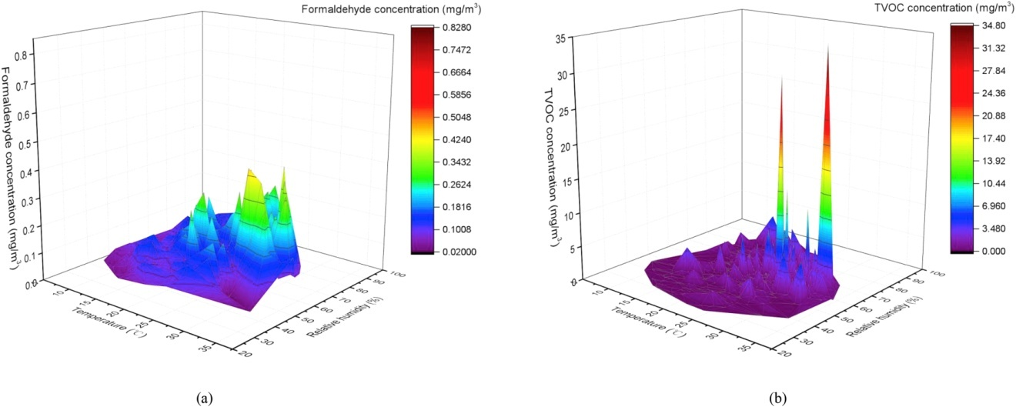
Influencing factors
combined effect on temperature and RH
The concentration of indoor TVOC and indoor formaldehyde increased dramatically under two conditions when(temperature>30℃, RH>60%)
(C. Zhou et al., 2017)

Slide 16
Method for indoor air pollutant controlling
1. use air purification device. Three main mechanism, adsorption, photocatalytic oxidation, catalytic oxidation.
2. ventilation. This method is limited when outdoor air quality is poor.
3. reduction of pollutant source, select environmental friendly raw material and produce building material with low VOC emission
4. suppression and elimination of pollutant in building material

Slide 17
Reference
Klepeis, N. E., Nelson, W. C., Ott, W. R., Robinson, J. P., Tsang, A. M., Switzer, P., . . . Engelmann, W. H. (2001). The National Human Activity Pattern Survey (NHAPS): a resource for assessing exposure to environmental pollutants. Journal of Exposure Science & Environmental Epidemiology, 11(3), 231-252. doi:10.1038/sj.jea.7500165
Schweizer, C., Edwards, R. D., Bayer-Oglesby, L., Gauderman, W. J., Ilacqua, V., Juhani Jantunen, M., . . . Künzli, N. (2007). Indoor time–microenvironment–activity patterns in seven regions of Europe. Journal of Exposure Science & Environmental Epidemiology, 17(2), 170-181. doi:10.1038/sj.jes.7500490
Huang, Y., Su, T., Wang, L., Wang, N., Xue, Y., Dai, W., . . . Ho, S. S. H. (2019). Evaluation and characterization of volatile air toxics indoors in a heavy polluted city of northwestern China in wintertime. Science of The Total Environment, 662, 470-480. doi:https://doi.org/10.1016/j.scitotenv.2019.01.250
Chen, C., & Zhao, B. (2011). Review of relationship between indoor and outdoor particles: I/O ratio, infiltration factor and penetration factor. Atmospheric Environment, 45(2), 275-288. doi:https://doi.org/10.1016/j.atmosenv.2010.09.048
Bai, L., He, Z., Li, C., & Chen, Z. (2020). Investigation of yearly indoor/outdoor PM2.5 levels in the perspectives of health impacts and air pollution control: Case study in Changchun, in the northeast of China. Sustainable Cities and Society, 53, 101871. doi:https://doi.org/10.1016/j.scs.2019.101871
Huang, L., Qian, H., Deng, S., Guo, J., Li, Y., Zhao, W., & Yue, Y. (2018). Urban residential indoor volatile organic compounds in summer, Beijing: Profile, concentration and source characterization. Atmospheric Environment, 188, 1-11. doi:https://doi.org/10.1016/j.atmosenv.2018.06.009
Canha, N., Lage, J., Coutinho, J. T., Alves, C., & Almeida, S. M. (2019). Comparison of indoor air quality during sleep in smokers and non-smokers’ bedrooms: A preliminary study. Environmental Pollution, 249, 248-256. doi:https://doi.org/10.1016/j.envpol.2019.03.021
Cheng, S., Wang, G., Lang, J., Wen, W., Wang, X., & Yao, S. (2016). Characterization of volatile organic compounds from different cooking emissions. Atmospheric Environment, 145, 299-307. doi:https://doi.org/10.1016/j.atmosenv.2016.09.037
Zhang, D.-C., Liu, J.-J., Jia, L.-Z., Wang, P., & Han, X. (2019). Speciation of VOCs in the cooking fumes from five edible oils and their corresponding health risk assessments. Atmospheric Environment, 211, 6-17. doi:https://doi.org/10.1016/j.atmosenv.2019.04.043
Lin, T. S. (2019). Indoor Air Pollution: Unusual Sources☆. In J. Nriagu (Ed.), Encyclopedia of Environmental Health (Second Edition) (pp. 636-642). Oxford: Elsevier.
Liang, W., Lv, M., & Yang, X. (2016). The effect of humidity on formaldehyde emission parameters of a medium-density fiberboard: Experimental observations and correlations. Building and Environment, 101, 110-115. doi:https://doi.org/10.1016/j.buildenv.2016.03.008
Zhou, C., Zhan, Y., Chen, S., Xia, M., Ronda, C., Sun, M., . . . Shen, X. (2017). Combined effects of temperature and humidity on indoor VOCs pollution: Intercity comparison. Building and Environment, 121, 26-34. doi:https://doi.org/10.1016/j.buildenv.2017.04.013
Zhou, X., Liu, Y., Song, C., Wang, X., Wang, F., & Liu, J. (2019). Modelling and testing of VOC source suppression effect of building materials modified with adsorbents. Building and Environment, 154, 122-131. doi:https://doi.org/10.1016/j.buildenv.2019.03.003

