Slide 1
Evaluation of a potential HONO source: A case study in China
Kezhen Chong
April 21, 2020
EAS 6410 Term Project

Slide 2
Outline
Introduction
Data and Methods
Results
Summary

Slide 3
Nitrous acid (HONO)
Introduction | Data and methods | Results | Summary
Important OH source (Kleffmann, 2007 )
$HONO+hν→OH+NO$
Source:
OH + NO
…
${NO}_{2}$ heterogeneous reactions
Aerosol surface
Ground surface
$$hυ$$
HONO
$$hυ$$
$${NO}_{2}$$
OH
VOCs
$${RO}_{2} /{ HO}_{2}$$
$$O_{3}$$
NO

Slide 4
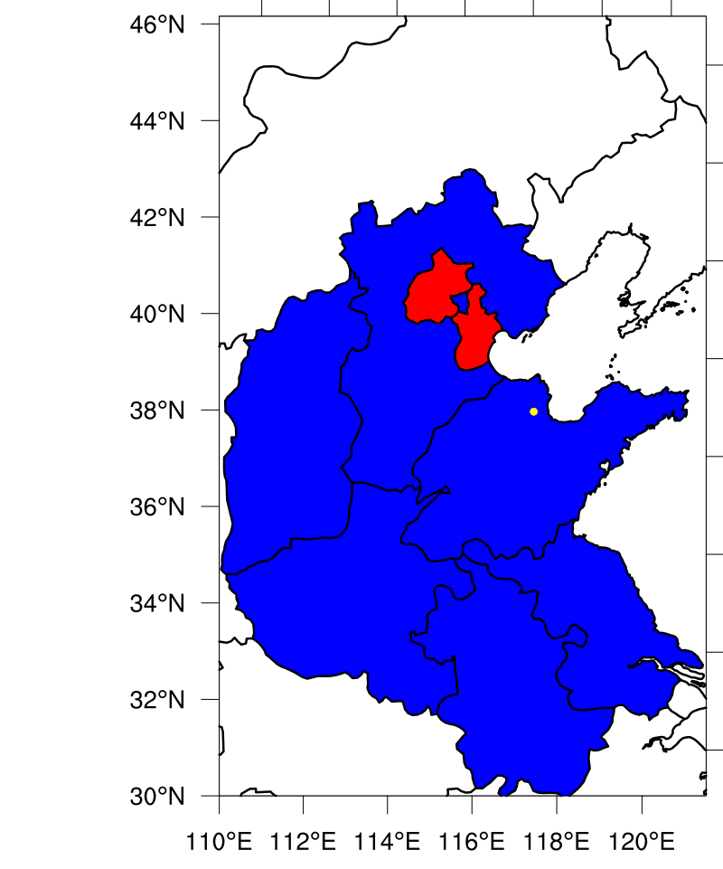
Data and method
Introduction | Data and methods | Results | Summary
1-D Reginal chEmical trAnsport Model (REAM 1-D)
30 layers in troposphere
Concentrations of NO, ${NO}_{2}$, $O_{3}$, CO and NMVOCs are constrained at 1 min time step
Ozone Photochemistry and Export from China Experiment (OPECE)
March and April 2018
Rural coastal site in a wetland reserve
in Dongying, Shandong, China
$O_{3}, {NO}_{x}, CO, VOCs$ and aerosol surface area
LOPAP (Long path absorption photometer) measured HONO surface concentration

Slide 5
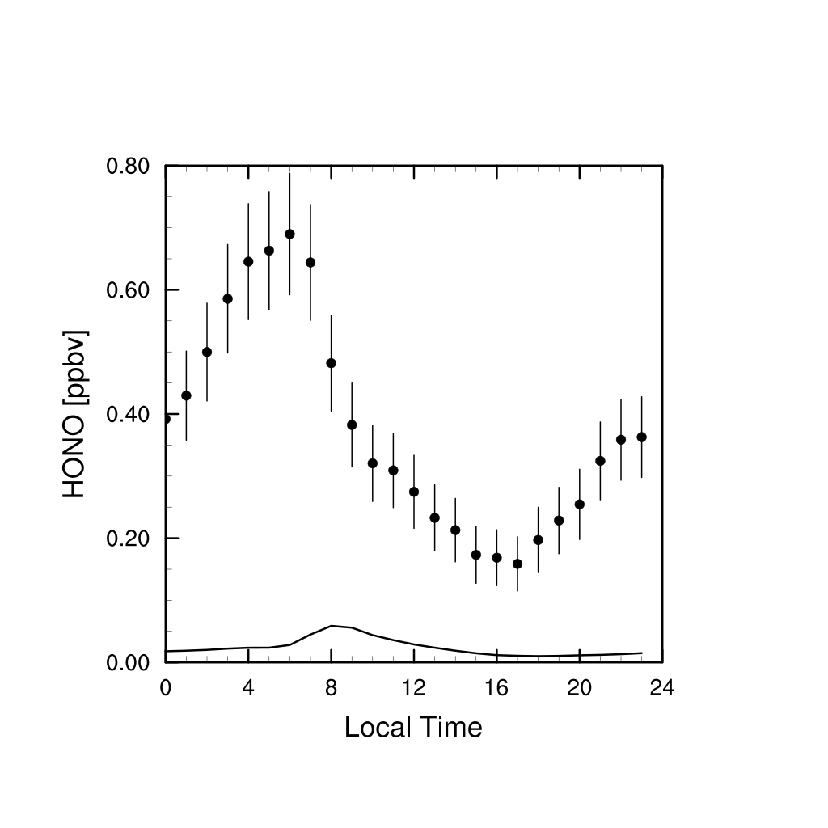
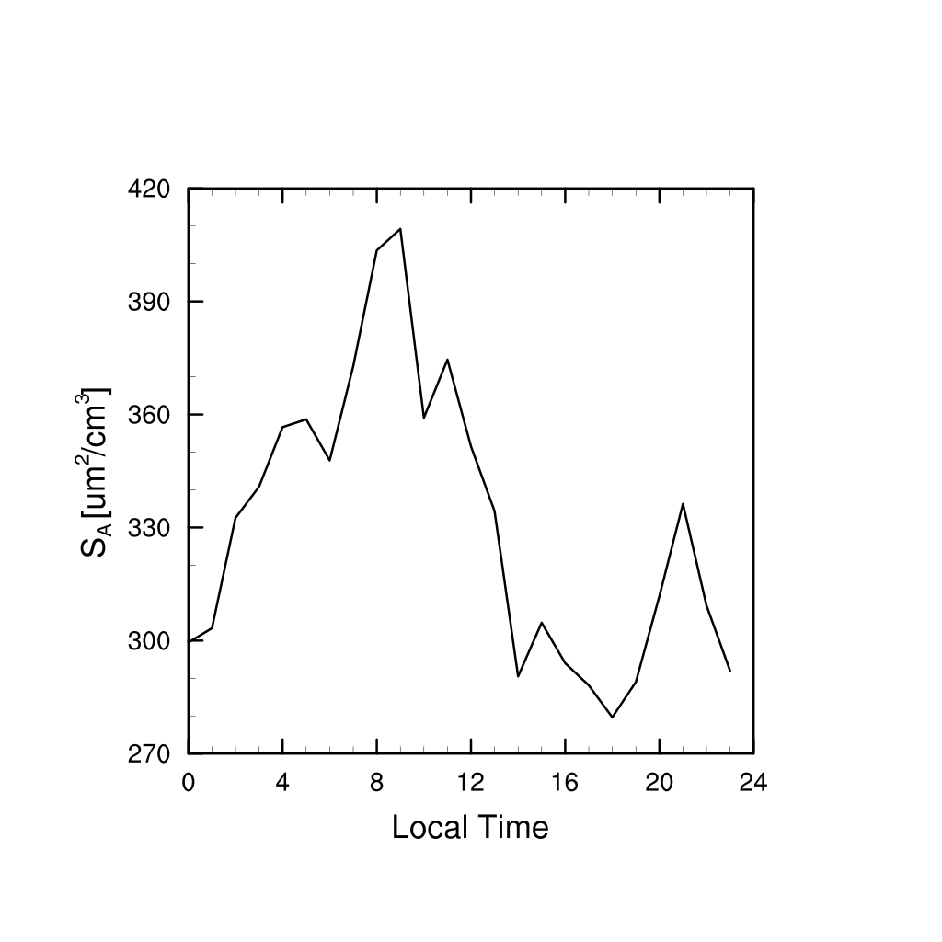
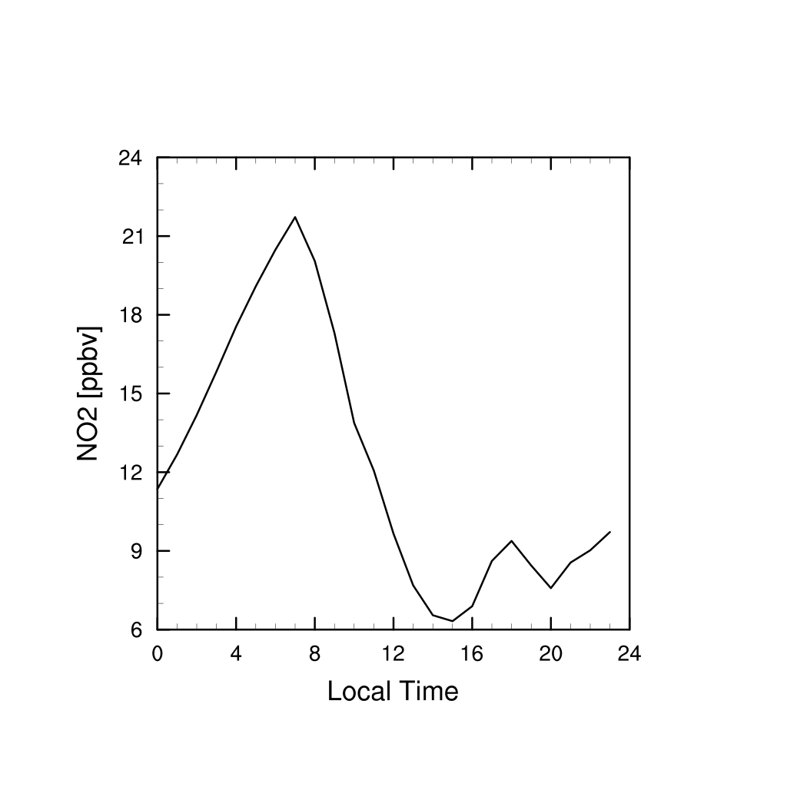
Observations and base simulation (OH + NO)
Introduction | Data and methods | Results | Summary
OH + NO is not enough
Heterogeneous reaction of ${NO}_{2}$
On aerosol surface
On ground surface

Slide 6
HONO source parameterizations (Liu et al., 2014)
Introduction | Data and methods | Results | Summary
Simplified

Slide 7
HONO source parameterizations
Introduction | Data and methods | Results | Summary
Aerosol heterogeneous uptake of ${NO}_{2}$:
First-order rate constant Ka for aerosol uptake of ${NO}_{2}$ is:
$$k_{a}={\left[\frac{r}{D_{g}}+\frac{4}{γω}\right]}^{−1}A$$
where
$D_{g}$ is molecular diffusion coefficient of ${NO}_{2}$;
$A$ is total aerosol surface area;
$r$ is particle radius, 0.1 $μm$;
$ω$ is the mean molecular speed of ${NO}_{2}$ in the air;
and $γ$is sticking coefficient (reactive uptake coefficient) for ${NO}_{2}$ on aerosol surface, 1e-6 (Kleffmen et al., 1998).

Slide 8
HONO source parameterizations
Introduction | Data and methods | Results | Summary
Ground heterogeneous uptake of ${NO}_{2}$:
Instantaneous release of HONO into the first model layer resulted from dry deposition of ${NO}_{2}$, first-order HONO release rate coefficient $k_{g}$ is:
$$k_{g}=f×\frac{V_{d}}{h}$$
where $V_{d}$ is dry deposition velocity for ${NO}_{2}$, output from 3-D REAM
and f is the yield of HONO from ${NO}_{2}$ reaching the surface: 0.08 which is large enough to reproduce observed HONO at night in Beijing (Liu et al. 2014).
(Liu et al. 2014)

Slide 9
Simulation scenarios
Introduction | Data and methods | Results | Summary
Scenarios | Configuration
S0 | NO + OH + M $→$ HONO + M
S1 | S0 + aerosol uptake of ${NO}_{2}$ (constant $γ={10}^{−6}$)
S2 | S0 + ground uptake of ${NO}_{2}$ (constant $f=0.08$)

Slide 10
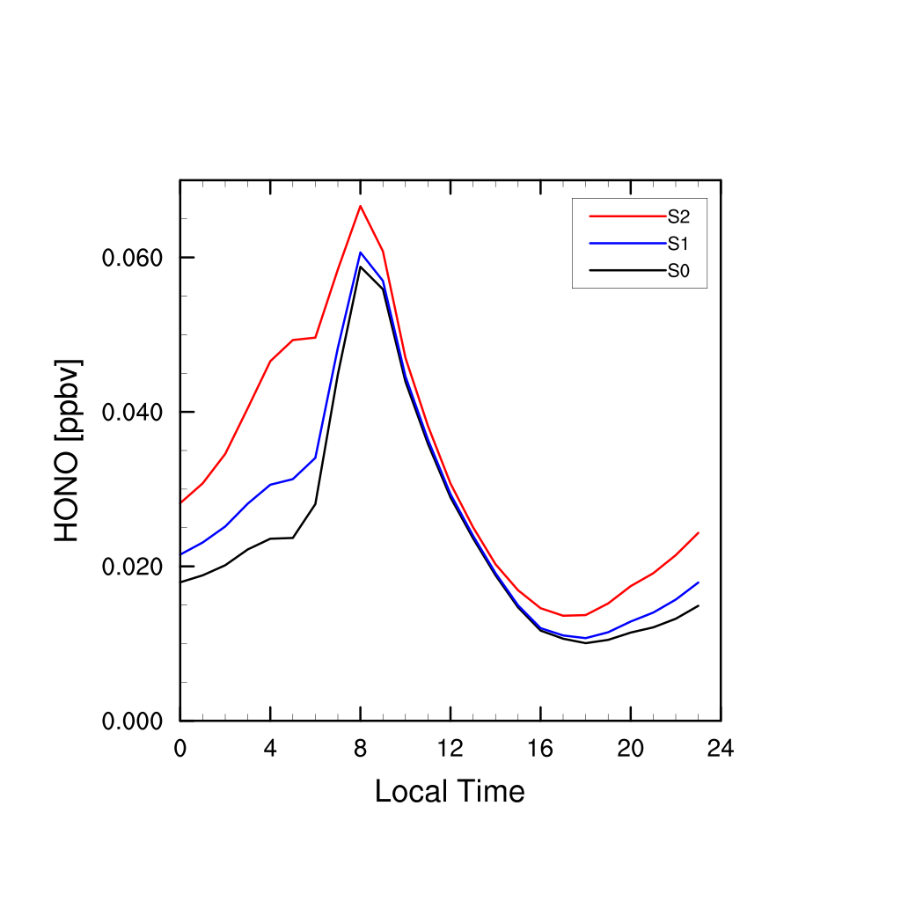
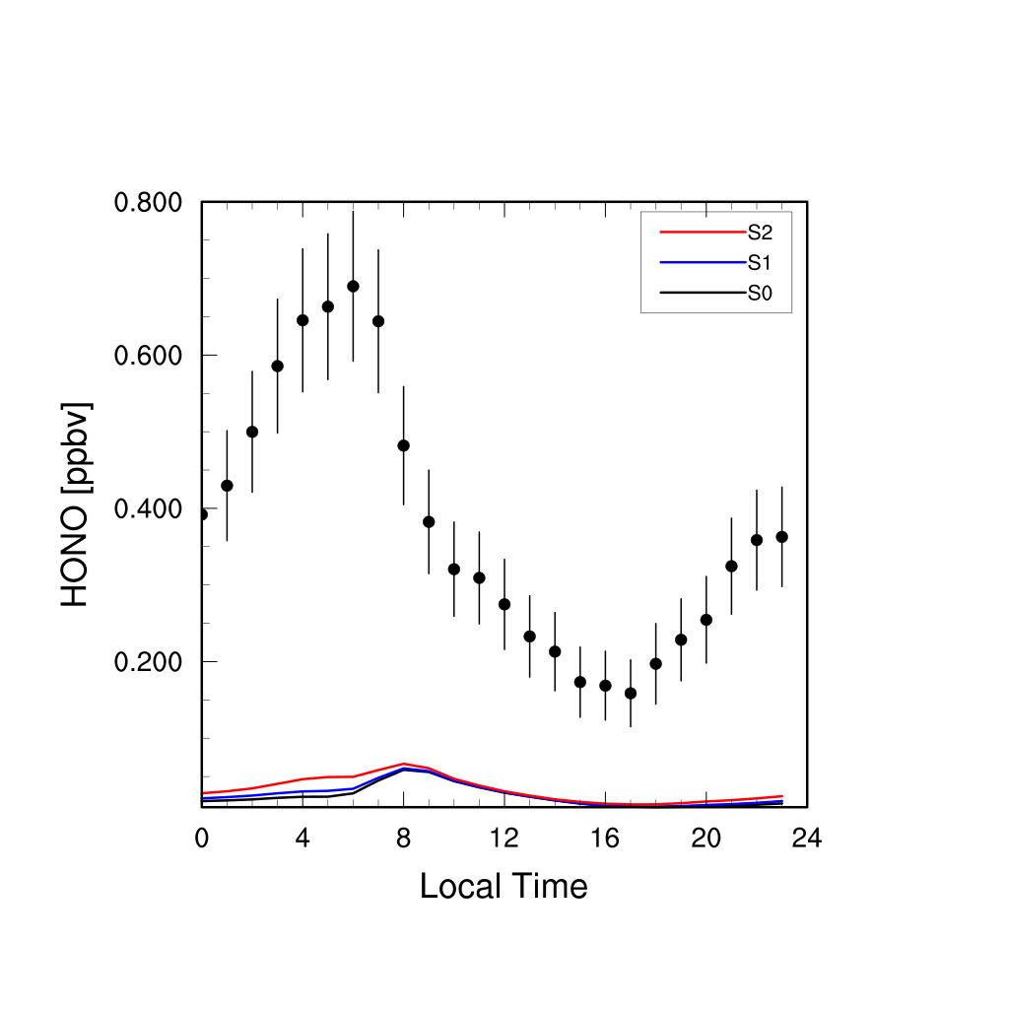
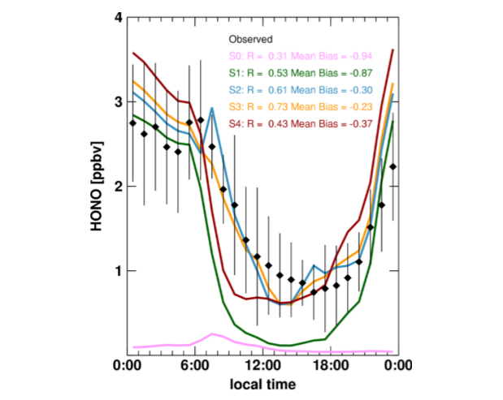
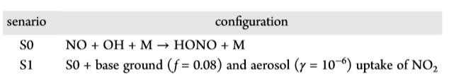
Simulation results
Introduction | Data and methods | Results | Summary
Inaccurate constants taken from previous studies
Oversimplification of source parameterization
(Liu et al., 2014)

Slide 11
f = 0.08 for ground source
Scenarios | Configuration
S0 | NO + OH + M $→$ HONO + M
S1 | S0 + aerosol uptake of ${NO}_{2}$ (constant $γ={10}^{−6}$)
S2 | S0 + ground uptake of ${NO}_{2}$ (constant $f=0.08$)
Deposition velocity too small?

Slide 12
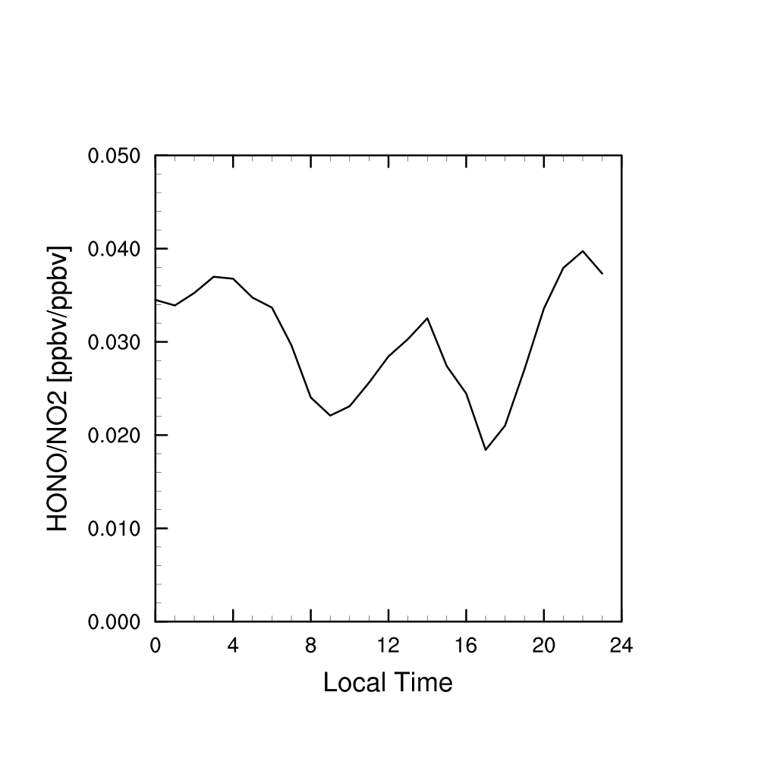
Future work
Introduction | Data and methods | Results | Summary
Photolytically enhanced ground source and aerosol source
Please see more details in the term paper
Scenarios | Configuration
S3 | S0 + photolytically enhanced aerosol uptake ($γ={10}^{−7}×UV_{a}$)
S4 | S0 + photolytically enhanced ground uptake ($f=0.003×UV_{a}$)

Slide 13
Future work
Introduction | Data and methods | Results | Summary
Check deposition velocity first (to make sure it is correct)
Sensitivity tests to find the yield coefficient f for ground term to reproduce nighttime HONO -> f = 0.45 (more details in term paper)
Evaluate if f is reasonable
If not reasonable, other HONO source needed
if reasonable, check daytime production:
If daytime is also reproduced, done
If daytime still not enough:
Photolytically enhanced ground source and aerosol source needed
Scenarios | Configuration
S3 | S0 + photolytically enhanced aerosol uptake ($γ={10}^{−7}×UV_{a}$)
S4 | S0 + photolytically enhanced ground uptake ($f=0.003×UV_{a}$)

Slide 14
Thank you!

