Slide 1
A Comparison of the Impact of VOCs and NO₂ on Surface-Level Ozone in Georgia and California
EAS 6410 Term Paper Presentation Katie Kicklighter

Slide 2
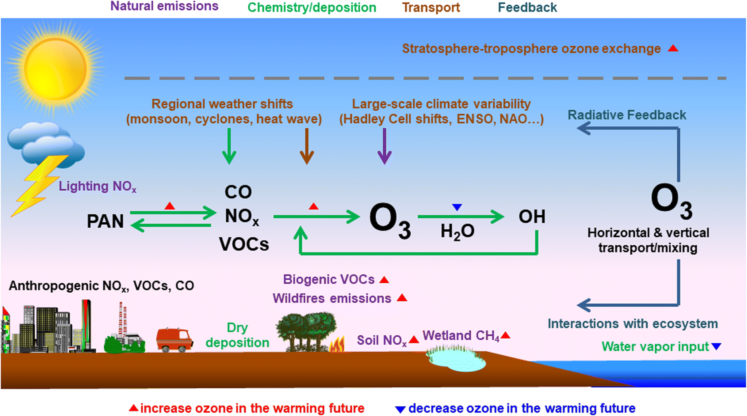
Ozone pollution issues in Recent decades
While stratospheric ozone helps to protect from UV radiation, tropospheric ozone is harmful
Surface-level ozone causes smog and harmful health effects
Stronger regulations put into place in the 1990s and later have helped to reduce pollution, but their impact varies by area
Lu, 2019

Slide 3
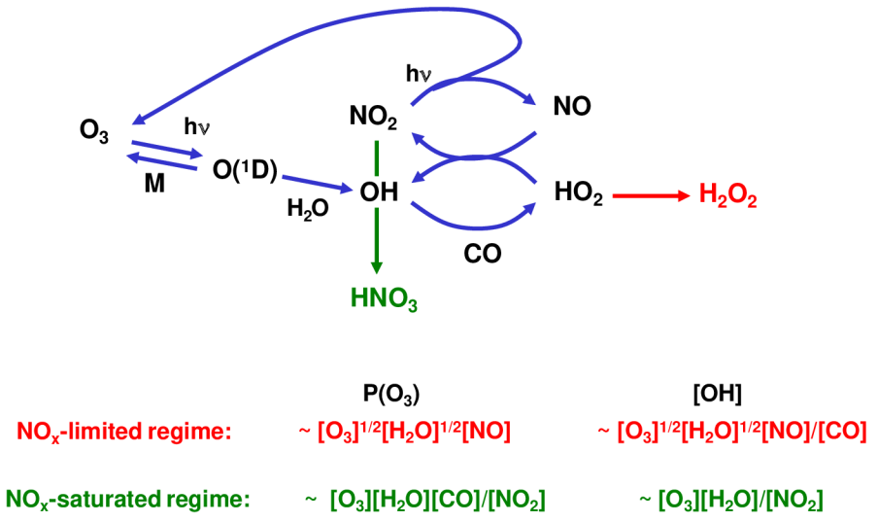
Atmospheric ozone chemistry
Both NOx and VOC emissions contribute to changing concentrations of tropospheric ozone
Areas in NOx-limited and NOx-saturated areas will respond differently to changing emissions in the area.

Slide 4
Ozone trends in 3 representative cities
Atlanta, Los Angeles, and San Francisco were used to determine the relative impact of different emissions on ozone
Will look at local NO2 and VOC concentrations, as well as biogenic source impact
Data obtained from EPA outdoor air quality data

Slide 5
NO₂ and VOC trends in 3 representative cities
Decreases in NO₂ Concentrations were most evident in Los Angeles
VOC concentrations also decreased, but the data could also be influenced by differences in measurements over time
Data obtained from EPA outdoor air quality data

Slide 6
National no₂ and voc emission Trends
Data obtained from EPA air emission inventories

Slide 7
State comparison of No2 and VOC Emissions
GA has demonstrated lower, fairly consistent emissions
CA has a population 3.7x that of GA
Data obtained from EPA air emission inventories

Slide 8
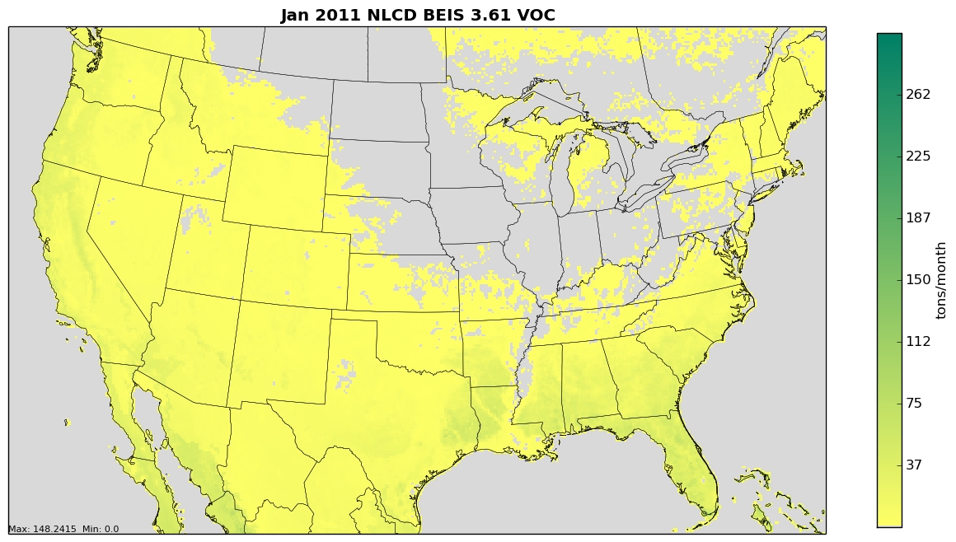
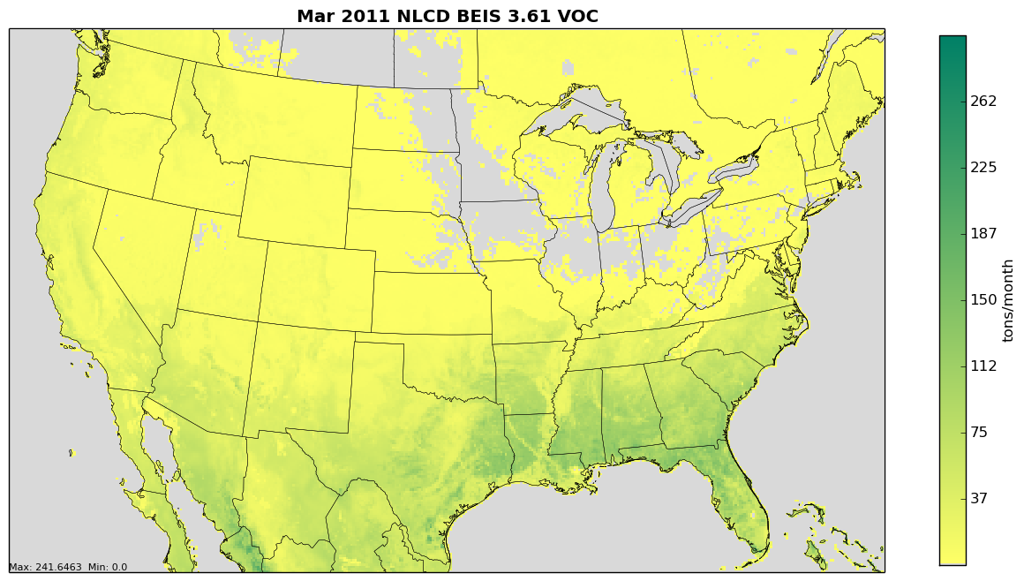
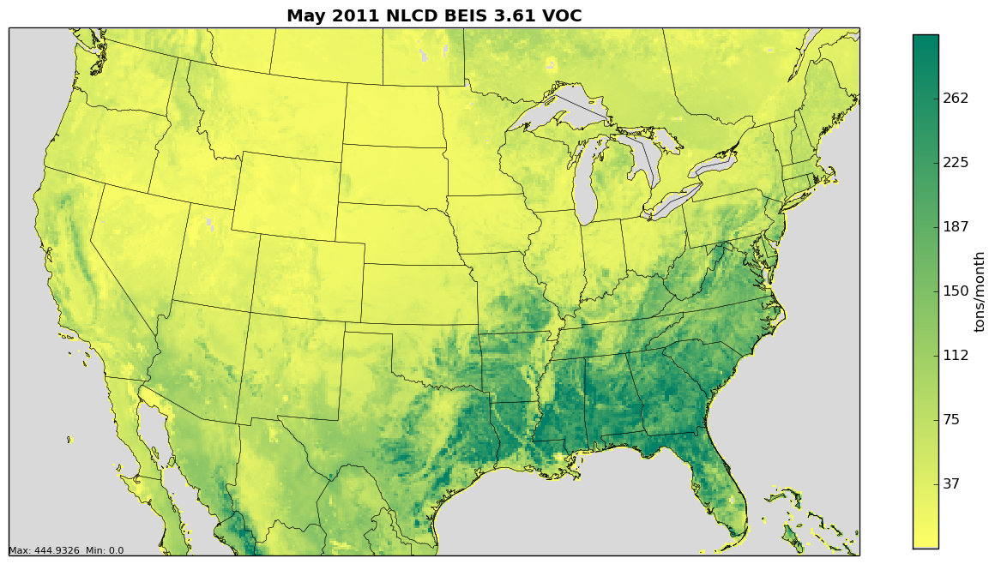
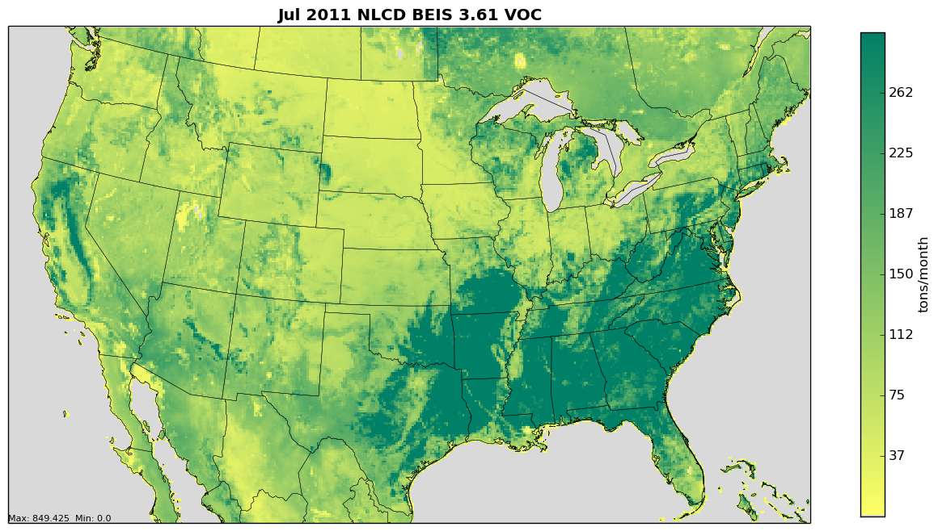
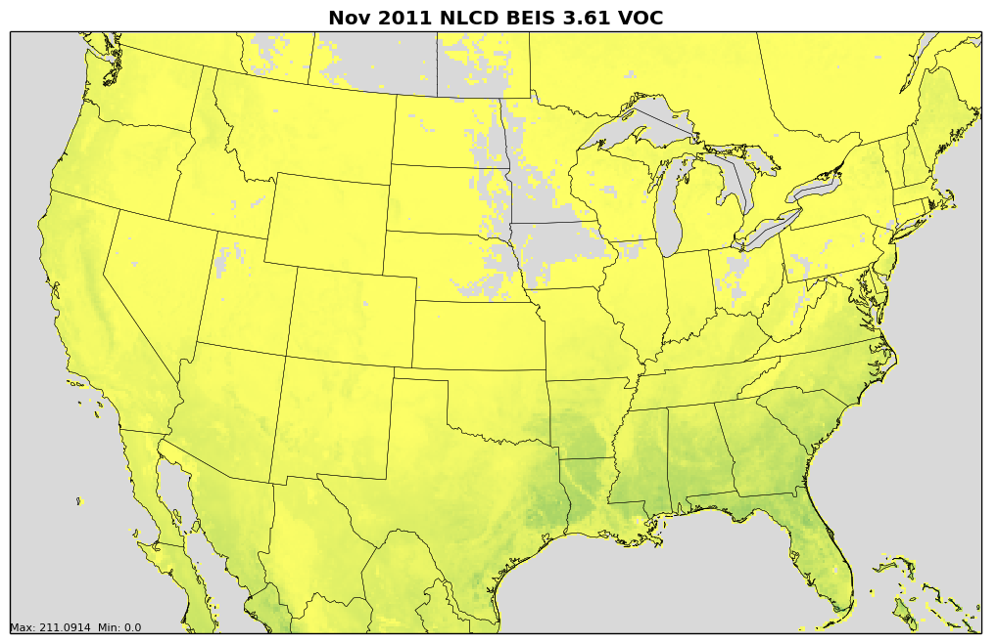
Biogenic VOC Sources
Biogenic VOC Emissions play a stronger role in the southeastern US
Emission maps obtained from Biogenic Emissions Landuse Database, version 4.1 (BELD4.1)

Slide 9
Conclusions and Other works
Ozone Trends Observed:
ATL – slight decrease since ~2000
LA – large decrease following 90s regulations
SF – slight increase since early 90s
California has substantially decreased emissions
Now has similar emissions to GA, which is much smaller and with a smaller population
Georgia has larger biogenic VOC emissions
Decreased anthropogenic VOC emissions has a smaller impact on ozone than in California
Regulations should be area-specific for best results
The models used in Shen, 2019 focused on the potential impacts of climate change and policy relaxation on ozone pollution.
Los Angeles was more impacted by climate change, whereas Atlanta was more impacted by NO2 emission policy relaxation

Slide 10
References
Lu, X., Zhang, L. and Shen, L.: Meteorology and Climate Influences on Tropospheric Ozone: a Review of Natural Sources, Chemistry, and Transport Patterns, Current Pollution Reports, 5(4), 238–260, doi:10.1007/s40726-019-00118-3, 2019.
Shen, H., Chen, Y., Li, Y., Russell, A. G., Hu, Y., Henneman, L. R., Odman, M. T., Shih, J.-S., Burtraw, D., Shao, S., Yu, H., Qin, M., Chen, Z., Lawal, A. S., Pavur, G. K., Brown, M. A. and Driscoll, C. T.: Relaxing Energy Policies Coupled with Climate Change Will Significantly Undermine Efforts to Attain US Ozone Standards, One Earth, 1(2), 229–239, doi:10.1016/j.oneear.2019.09.006, 2019.
Air Data - Concentration Plot, EPA [online] Available from: https://www.epa.gov/outdoor-air-quality-data/air-data-concentration-plot.
Air Pollutant Emissions Trends Data, EPA [online] Available from: https://www.epa.gov/air-emissions-inventories/air-pollutant-emissions-trends-data.
AirData website File Download page, EPA [online] Available from: https://aqs.epa.gov/aqsweb/airdata/download_files.html#Annual.
Biogenic Emission Sources, EPA [online] Available from: https://www.epa.gov/air-emissions-modeling/biogenic-emission-sources.

Slide 11
Questions?

