Slide 1
Term Paper Presentation
Priyansh Sharma

Slide 2
Introduction
Finding a correlation between Particulate Matter (both PM₁₀ and PM_{2.5}) and
Windspeed
Relative Humidity
Precipitation

Slide 3
Methodology
Three years worth of data was collected from DarkSky API.
Simple correlations were analysed graphically and mathematically
Delayed correlations (As in effects are shown not in the subsequent readings not the current one) were drawn
Meteorological factors were divided into bins for individual analysis and further into sub-groups for combined analysis
Notes:
This can be answered by Table 1. The data is classified into
Windspeed (m/s)
High [8, ∞)
Moderate [4, 8)
Low [0, 4)
Precipitation/Rainfall (mm/hr)
Heavy [0.5, ∞)
Moderate [0.05, 0.5)
Low [0, 0.05)
Lag Period
1 hour
2 hours

Slide 4
Observations and Results
Data Authenticity and Excerpts

Slide 5
Correlation (Data Authenticity)
 | CO | NO2 | O3 | PM10 | PM2.5 | SO2 | Wind Speed | Precipitation Intensity | Humidity
CO | 1
NO2 | 0.705144 | 1
O3 | -0.21577 | -0.4738 | 1
PM10 | 0.460527 | 0.42553 | -0.00214 | 1
PM2.5 | 0.772588 | 0.616818 | -0.04229 | 0.749231 | 1
SO2 | 0.563771 | 0.477543 | -0.02648 | 0.337907 | 0.477846 | 1
Wind Speed | -0.20429 | -0.15702 | -0.05605 | -0.05471 | -0.14911 | -0.12449 | 1
Precipitation Intensity | 0.00908 | -0.04047 | 0.028062 | -0.0222 | -0.00737 | -0.02982 | -0.012760826 | 1
Humidity | 0.186513 | 0.012181 | 0.207383 | 0.016947 | 0.166422 | -0.08205 | -0.494910043 | 0.144400745 | 1

Slide 6
PM2.5 against Humidity and Wind Speed
Notes:
A common trend that can be noticed is that at low humidity and high windspeed, PM_{2.5} concentrations go down (Black lines) and vica versa (Red Lines). Although, it is not absolute, as factors such as pressure and temperature come into play.
It is important to note that PM_{2.5} is a chemical pollutant and not a mechanical one like PM_{10-2.5}. This means that the characteristic and components of the particle are subject to change through atmospheric chemistry which can be very rapid and very slow. Thus, a portion of the wavering from any trend based on meteorology can be explained by chemistry.

Slide 7
PM10 against Humidity and Wind Speed
Notes:
PM₁₀ does not have a lot of chemistry to it, thus it can be seen it’s related to windspeed more than humidity. Although the data points with close to 100% RH (signifying rain) show low levels of PM₁₀. This sits in line with the reasoning that rains increase deposition rates

Slide 8
NO2 SO2 and CO against humidity and Windspeed

Slide 9
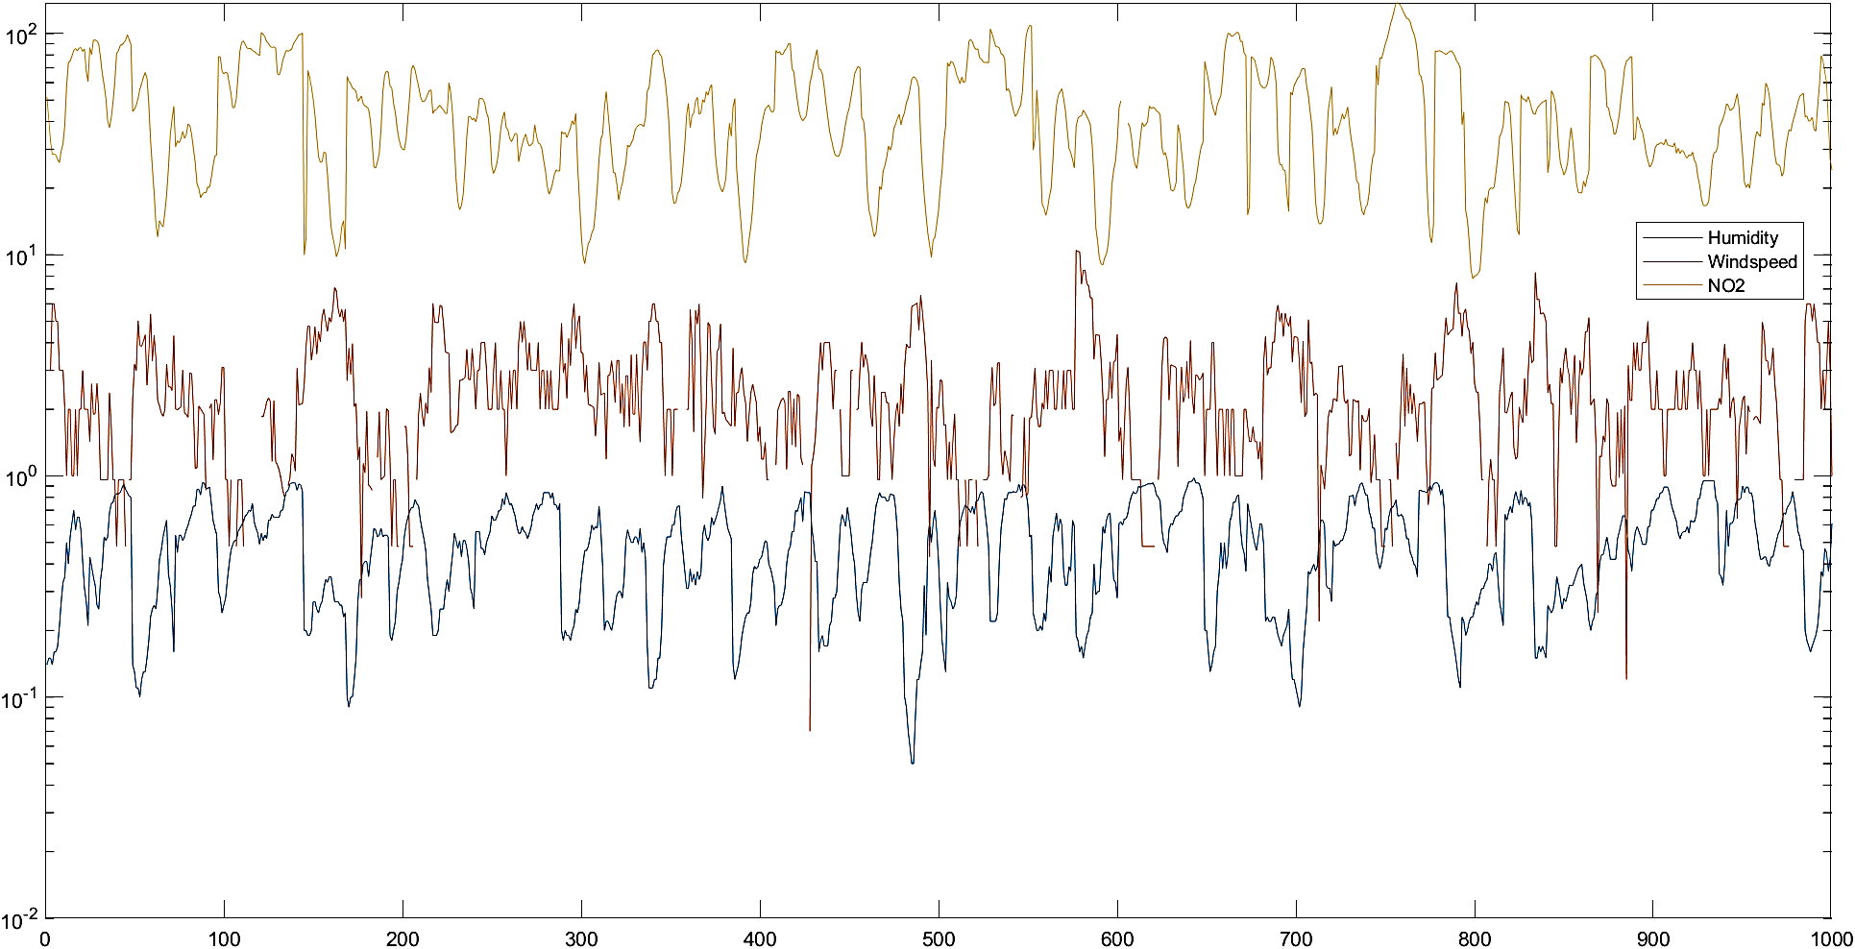
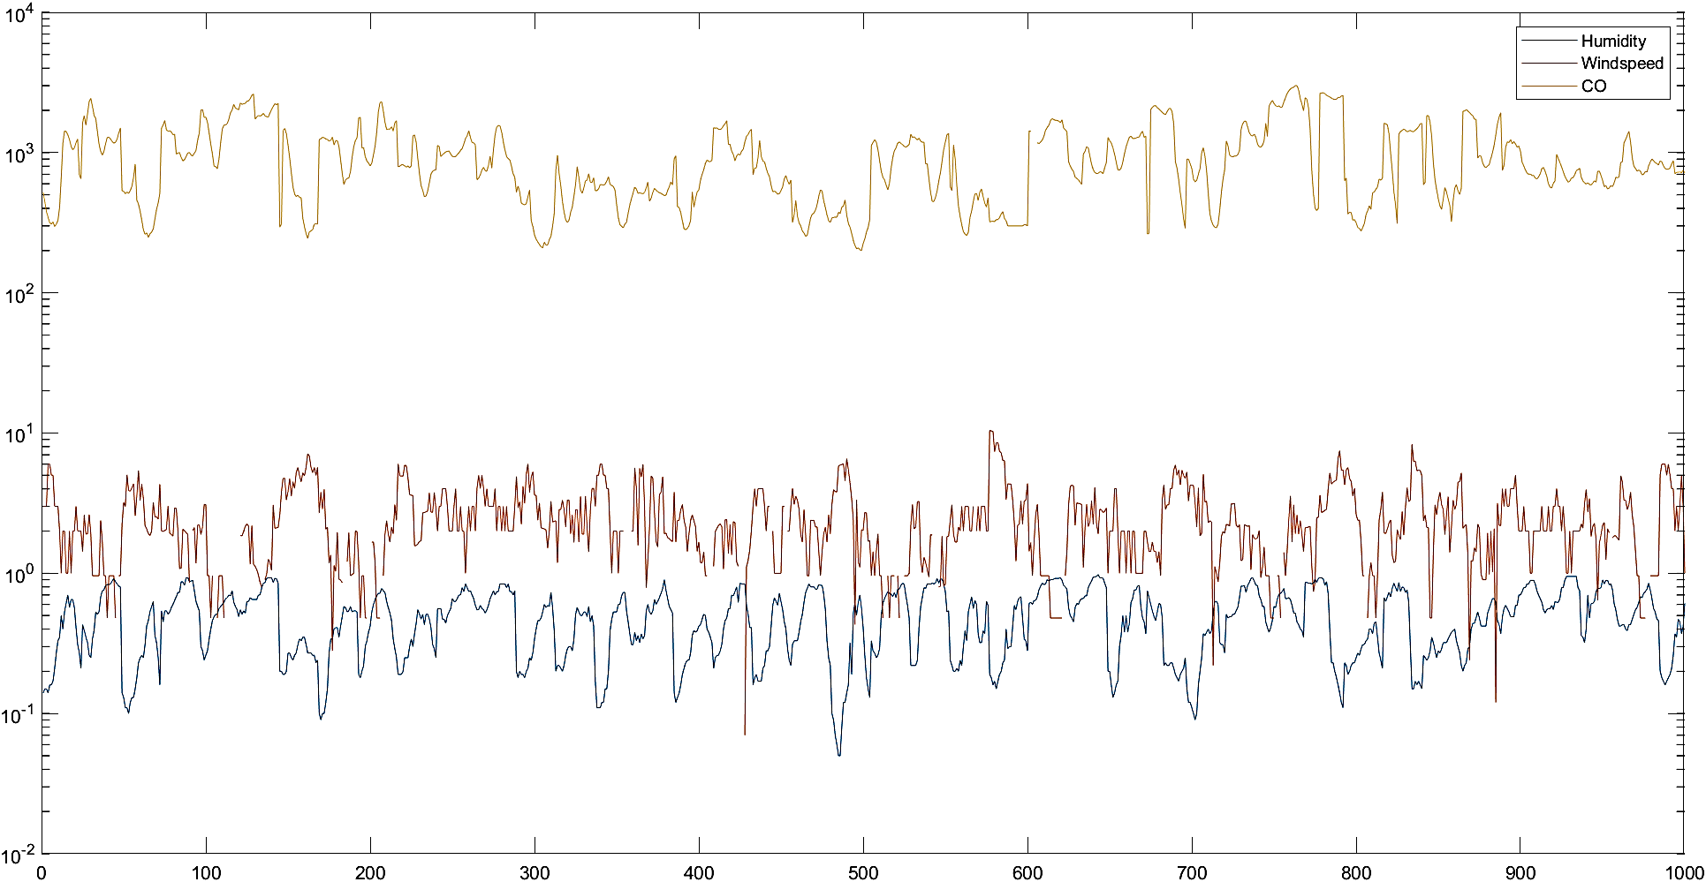
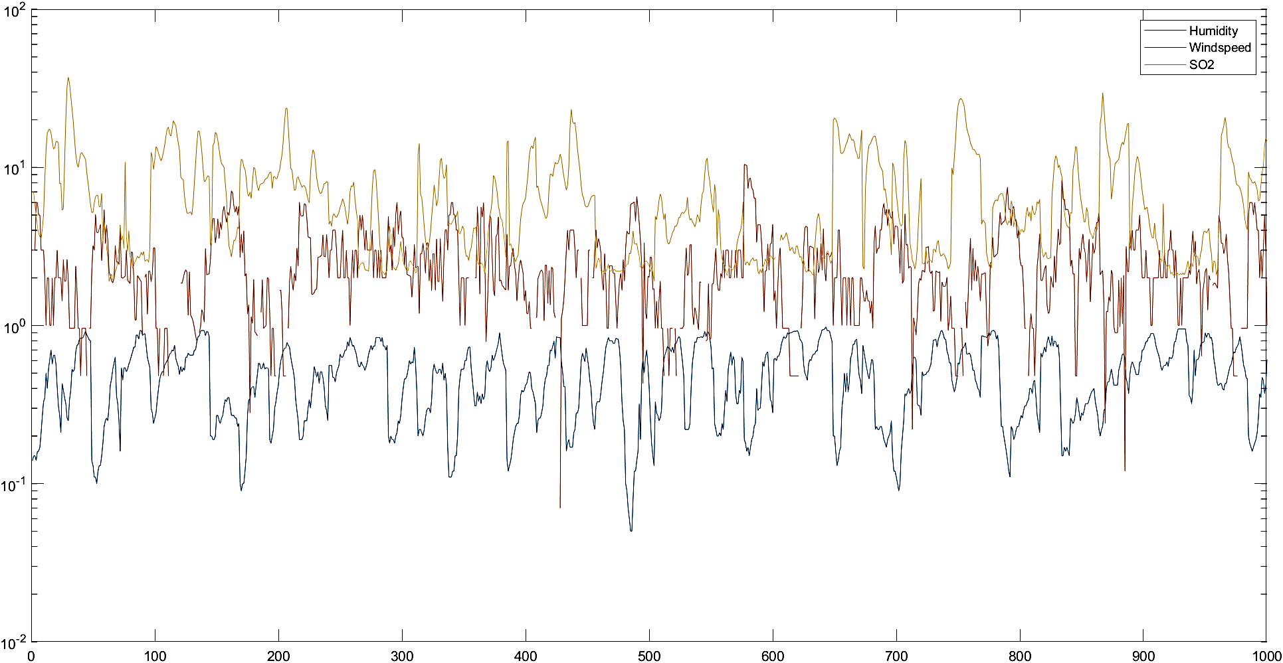
Notes:
NO₂ in the atmosphere is largely guided by humidity, simply because the OH radical is required for its formation in the photo stationary steady state cycle. Windspeed has little to do with NO_{2­}.
The major sink of CO is OH radical, thus it is negatively correlated to humidity. Since it has a comparatively higher lifetime, the observed values of CO are much higher than most pollutants.
SO₂ is closely related to PM_{2.5}. This is because most of it comes from coal combustion, unlike NO₂ which has an alternate atmospheric cycle for its formation. It follows the same trend as PM_{2.5}, it is safe to say so assuming Beijing has high coal combustion levels.

Slide 10
Observations and Results
Data compilations and relations

Slide 11
Particulate Matter and Precipitation
Notes:
The trendline for PM_{2.5} has a positive slope, i.e. shows an increase with increase in windspeed due to the lack of data points for the values of precipitation over 11 mm/hr.

Slide 12
Particulate Matter and Wind Speeds
Notes:
The trendline for PM₁₀ has a positive slope, i.e. shows an increase with increase in windspeed due to the lack of data points for the values of windspeed over 13 m/s.

Slide 13
Atmospheric Slabs
: PM concentrations vs Atmospheric Classes.
Low windspeed and Low Precipitation.
High Windspeed and Low Precipitation.
Low Windspeed and High Precipitation.
High windspeed and High Precipitation.
Extreme Wind and Extreme Precipitation (Thunderstorm)
Notes:
From Figure 3 it can be noted that
PM₁₀ is reduced by increase in both wind and rain. Although as shown in Class 2 vs Class 3, Precipitation has more influence on this category than wind does
Alternatively, PM_{2.5} is influenced more by Windspeed than Precipitation.
Extreme conditions (Class 5) increase the PM concentrations a little more than the conditions in Class 4. This can be explained by uplift of settled particles from the ground.

Slide 14
PM Levels against Winds and Rainfalls
PM Level | PM2.5 |  | PM10 |  | PM2.5 |  | PM10 |  | PM2.5 |  | PM10
Lag | 1st Hour | 2nd Hour | 1st Hour | 2nd Hour | 1st Hour | 2nd Hour | 1st Hour | 2nd Hour | 1st Hour | 2nd Hour | 1st Hour | 2nd Hour
Wind/Rain | High Wind |  |  |  | Moderate Wind |  |  |  | Low Wind
Heavy Rainfall | 17.31 | 116.5 | 88.55 | 139.7 | 42.07 | 37.75 | 61.78 | 57.11 | 48.86 | 48.79 | 69.10 | 69.91
Moderate Rainfall | 39.11 | 46.15 | 68.91 | 81.24 | 32.36 | 36.48 | 59.29 | 64.03 | 46.85 | 47.16 | 66.73 | 66.33
Low Rainfall | 37.32 | 38.42 | 83.50 | 84.63 | 42.15 | 42.25 | 84.23 | 84.65 | 55.16 | 55.10 | 91.53 | 91.39
Notes:
Post High Rainfall and High Windspeed has just one data point, thus it cannot be an accurate representation of the scenario. Assuming, roughly 1.5% of the total data points for a given class is a minimum for data validity, we can say that Heavy rainfall followed by any amount of wind will lower the value of PM concentrations. Higher windspeed will lead to more reduction.
Post Moderate Rainfall will reduce the PM concentrations only if there is minimal wind around. In other cases, it might increase the PM concentrations. This can be attributed to hot wind circling in to the precipitation area, bringing PM with it.
Post Low Rainfall follows a similar trend as wind disrupts the deposition process. Low wind and precipitation lead to simple deposition of PM. Thus, there is a slight decrease only in the last category. The reduction in this category is very low, as deposition is a slow process.

Slide 15
Conclusions
PM Levels are dependent on Precipitation, Humidity and Wind Speed
Lag in the results is expected and observed
Considering individual aspect of meteorology is unfair
Gases vary mostly with Precipitation and RH

