Slide 1
Mechanisms contributing to the Spring ozone maximum in the Northern Hemisphere
by
David Gray

Slide 2
Scientific use
Background ozone
ozone present through natural or nonlocal sources
currently ranges from 20-45 ppb in North America
Rising background ozone could mean non-attainment for much of North America
background trends help shape policy
Current known sources
stratospheric wave propagation and other mechanisms to transport ozone from the stratosphere to the boundary layer
in place ozone production
methane reacting with natural NO_{x}
biogenic VOCs reacting with natural NO_{x}
Long range transport
Notes:
R vingarzan: “A review of surface ozone background levels and trends” Atmospheric Environment 38 (2004) 3431-3442

Slide 3
View Points
Stratosphere – troposphere exchanges (STE) were once considered as the leading cause of ozone maximum in occurring in spring in the Northern Hemisphere (Levy et al. 1985, Logan 1985 etc...)
Was argued that seasonal radioactivity could be linked to STE due from past nuclear tests
Holton 1995 suggested that mass exchange with the stratosphere coupled with synoptic mechanisms would predict max flux in late winter/early spring.

Slide 4
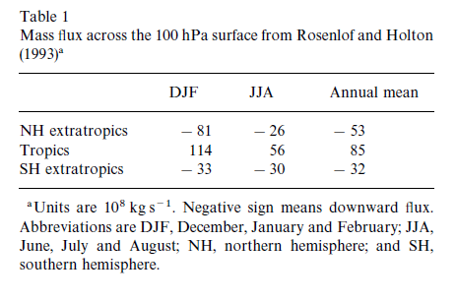
View Points
Ozone max in northern hemisphere greater than in southern hemisphere
G. Vaughan in a communication to P.S. Monk explains that troposphere folding event happen twice as often in Northern Hemisphere than in the Southern Hemisphere
table 1 from Monks (2000)

Slide 5
View Points
Liu et al.(1987),
proposed that ozone distribution might not only be stratospheric in nature but anthropogenic
conceded that some models accurately predicted the spring max without using photo chemistry
related this to increasing background ozone in Mauna Loa, Hawaii from 1973 – 1984
study completed by Oltmans and Komhyr [1986]
they concluded that a change in transport due to El Nino events
other data pointed to increasing anthropogenic emissions
concluded that long lived ozone could be a significant proportion of accumulation in winter, peaking in spring
general agreement with some other papers at the time

Slide 6
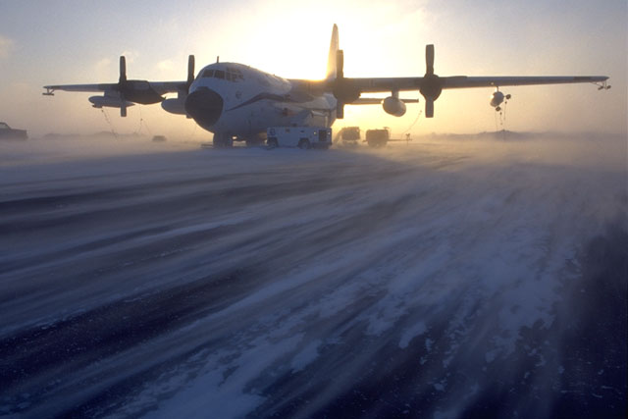
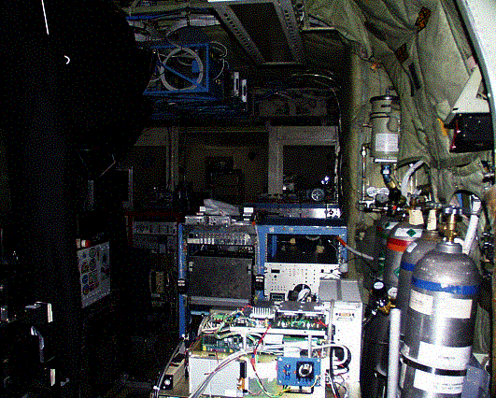
Data gathering
Little data about this event until 2000
Tropospheric Ozone Production about the Spring Equinox (TOPSE)
Investigated the evolution of troposphere over North America during winter/spring transition
Ozone max occurs at this time in the free Troposphere
Many papers attempt to explain

Slide 7
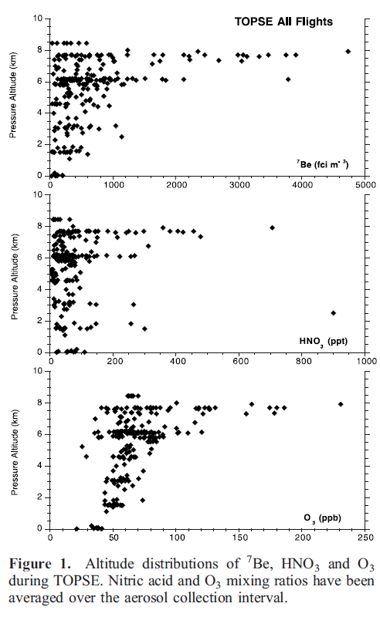
Dibb (2003)
Uses Be, HNO₃ and O₃ to identify the type of air mass they are measuring.
Any spike in all three tracers would indicate air from the stratosphere had propagated downward
A spike in just Be tracers was not included in the definition of stratospherically influenced air

Slide 8
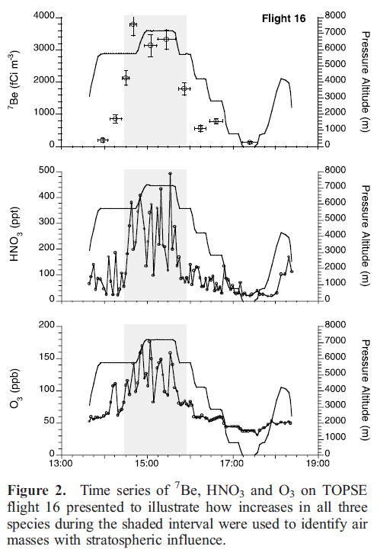
Dibb (2003)

Slide 9
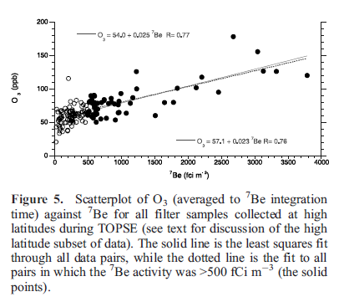
Dibb (2003
The data set has some limitations
the fraction of stratospheric tracers that were ultimately moved into the troposphere
assumes that 100% of Be is non-anthropogenic in this study
try to justify this assumption using Lal et al., (1958)
states that 90% of Be production is from stratosphere
Reasonable data fit but some knowledge gaps remain

Slide 10
Dibb conclusion
Concluded that the positive trend in O₃ production in the high latitude study region is due to a net gain of ozone through photochemical production.
Reportedly consistent with Browell et al., 2003; Allen et al., 2003; and Wang et al., 2003
Also concluded that >85% of the O₃ between the surface and 8km max sampling altitude originated in the stratosphere.

Slide 11
Wang et al, (2003)
Describing the ozone variation from winter/spring
35% to 40% of variation of spring ozone max due to stratospheric source in mid latitudes. (14 ppbv)
11 ppbv is explained by transport plus a favorable photochemical environment
lower in higher latitudes (20%)
Likely reason is there are more vigorous spring time storms in lower latitudes
slow springtime photochemistry enhances the importance of global transport
ozone from lower latitudes dominates ozone variability while reactive air masses tend to dominate spring seasonal trends

Slide 12
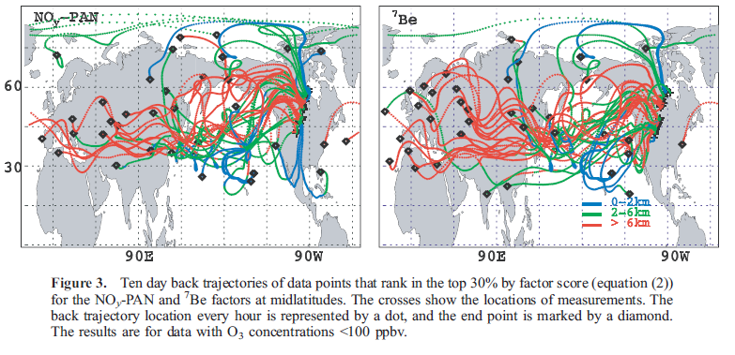
Wang et al. (2003)

Slide 13
The debate continues... summarized by R. Vingarzan (2004)
Our ozone forecast for the future is still in great debate
Ozone production rates from anthropogenic sources may be slowing
likely due to the reduction in ozone precursors
possible feedback relating to background ozone
difficult to measure full effects because of a lack of background ozone monitoring stations
possible reduction from STE due to thinning of stratospheric ozone. (Fusco and Logan (2003))
Models still show increasing ozone mostly due to rising population and continued use of fossil fuel.

