Slide 1
Managing the Risks of Extreme Events and Disasters to Advance Climate Change Adaptation—A Special Report of Working Groups I and II of the Intergovernmental Panel on Climate Change
EAS 6792 Group Project
Yufei Zou, Sean Miller, Tom Loadholt
April 18, 2013
Notes:
The official title of the reading for this group. This is a proposed slide to insert in Yufei’s part.

Slide 2
Report Structure
Executive Summary for Policy Makers
Nine Chapters
Chapter 1
Climate Change: New Dimensions in Disaster Risk, Exposure, Vulnerability, and Resilience
Chapter 2
Determinants of Risk: Exposure and Vulnerability
Chapter 3
Changes in Climate Extremes and their Impacts on the Natural Physical Environment
Chapter 4
Changes in Impacts of Climate Extremes: Human Systems and Ecosystems
Chapter 5
Managing the Risks from Climate Extremes at the Local Level
Chapter 6
National Systems for Managing the Risks from Climate Extremes and Disasters
Chapter 7
Managing the Risks: International Level and Integration across Scales
Chapter 8
Toward a Sustainable and Resilient Future
Chapter 9
Case Studies

Slide 3
Outline
Part I: Introduction & general scope (Chap. 1-2,9)
Part II: Climate extremes & impacts (Chap. 3-4)
Part III: Risk management & adaptation (Chap. 5-8)
Yufei
Sean
Tom

Slide 4
(mpeel@unimelb.edu.au)
Notes:
2003/2006 European heat wave: During the first two weeks of August 2003, temperatures in Europe soared far above historical norms. Initial estimates were of costs exceeding €13 billion, with a death toll of over 30,000 across Europe (UNEP, 2004). The severity, duration, geographic scope, and impact of the event were unprecedented in recorded European history;
(2) Dzud of 2009-2010: In the summer of 2009, Mongolia suffered drought conditions. Rainfall at the end of November became a sheet of ice, and, in late December, 19 of 21 provinces recorded temperatures below -40°C; this was followed by heavy and continuous snowfall in January and February 2010 (Sternberg, 2010; UNDP Mongolia, 2010).Over 50% of all the country herders’ households and their livestock were affected by the dzud (Sternberg, 2010). By April, 75,000 herder families had lost all or more than half their livestock (Sternberg, 2010).
(3) Challenge of adaptation for Small Island Developing States (SIDS): Many SIDS face specific disadvantages associated with their small size, insularity, remoteness, and susceptibility to natural hazards. SIDS are particularly vulnerable to climate change because their key economic sectors such as agriculture, fisheries, and tourism are all susceptible.
(4) Hurricane Sandy in 2012: Extensive damage across several northeastern states due to high wind and coastal storm surge, particularly NY and NJ. Damage from wind, rain and heavy snow also extended more broadly to other states (NC, VA, WV, OH, PA, NH), as Sandy merged with a developing Nor'easter. Sandy's impact on major population centers caused widespread interruption to critical water / electrical services and also caused 131 deaths. Sandy also caused the New York Stock Exchange to close for two consecutive business days, which last happened in 1888 due to a major winter storm.

Slide 5
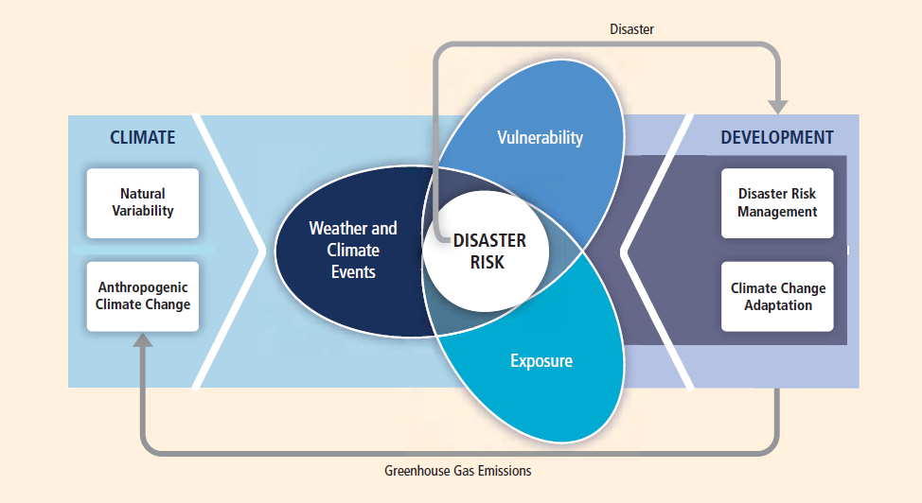
Introduction ---Key concepts & scope
Propensity to be adversely affected
climate variable near the tails of observed values
inventory of elements that can be affected by extreme events
Notes:
The character and severity of impacts from climate extremes depend not only on the extremes themselves but also on exposure and vulnerability.
3 goals:
To assess the concepts, methods, and instruments etc. to advance adaptation to CC;
To assess the new perspectives and challenges of CC;
To assess the mutual implications of the evolution of risk management and adaptation to CC;
Key concepts (P17):
(1) Extreme events: the occurrence of a value of a weather or climate variable above (or below) a threshold value near the upper (or lower) ends (‘tails’) of the range of observed values of the variable.
(2) Disasters: severe alterations in the normal functioning of a community or a society due to hazardous physical events interacting with vulnerable social conditions…
(3) Disaster risk: the likelihood over a specified time period of severe alterations in the normal functioning of a community or a society due to hazardous physical events interacting with vulnerable social conditions
(4) Exposure: the presence (location) of people, livelihoods, environmental services and resources, infrastructure, or economic, social, or cultural assets in places that could be adversely affected by physical events
(5) Vulnerability: the propensity or predisposition to be adversely affected

Slide 6
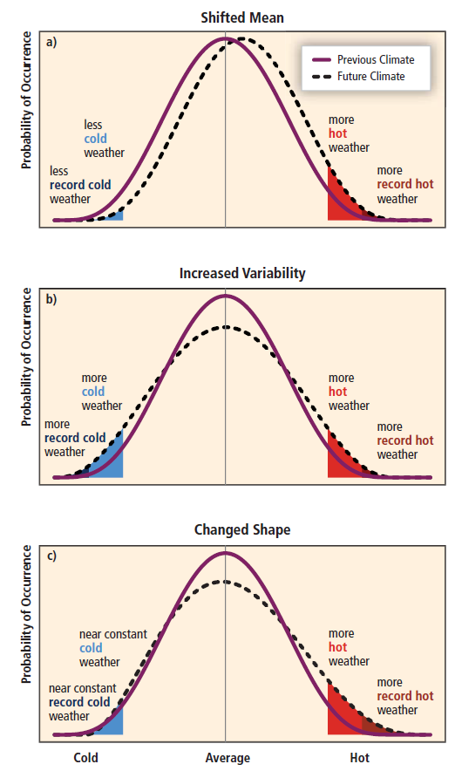
Introduction ---Extremes & their impacts
Changes in natural physical environment
Changes in ecosystems
Adverse effects on human conditions
Notes:
(1) Different types of extremes;
(2) Impacts from climate extremes;
(3) Risk calculation;

Slide 7
Introduction ---Dimensions & trends
“changes in exposure and in some cases vulnerability are the main drivers behind observed trends in disaster losses”
Determinants of Risk:
Hazard:
Exposure:
Vulnerability:
Environmental
dimension
Vulnerable natural systems
Impacts on systems
Social dimension
Economic dimension
Population groups
Mechanisms causing impacts
Responses
Education
Health and well-being
Culture
Economic system
Work and livelihoods
Q: What do you think is the dominant factor of disaster risk? How can we reduce the risk?
Notes:
Exposure and vulnerability are key determinants of disaster risk and of impacts when risk is realized.
Exposure: necessary but not sufficient determinant; vulnerability requires exposure
3 dimensions: p88
Disasters are associated more and more with lesser-scale physical phenomena that are not extreme in a physical sense which can be principally attributed to increases in exposure and associated vulnerability.

Slide 8
Introduction ---Near term vs. Long term response
Disaster risk management: disaster risk reduction +
disaster management
Climate change adaptation: human & natural systems
Disaster risk: likelihood of severe alterations due to hazardous physical events
Risk = Probability x Consequence
Notes:
DRM (risk transfer mechanism):
risk reduction-a policy goal or objective and the strategic and instrumental measures employed for anticipating future disaster risk, reducing existing exposure, vulnerability and improving resilience;
Disaster management-a social processes for designing, implementing, and evaluating strategies, policies, and measures that promote and improve disaster preparedness, response, and recovery practices at different organizational and societal levels.
ACC:
in human systems-the process of adjustment to actual or expected climate and its effects in order to moderate harm or exploit beneficial opportunities;
In natural systems-the process of adjustment to actual climate and its effects;

Slide 9
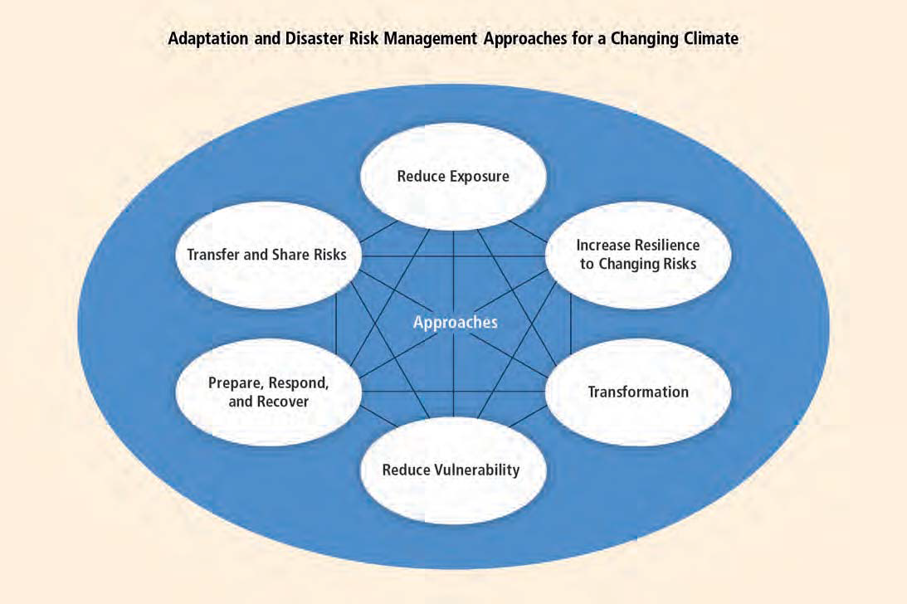
Introduction ---Approaches to react
Climate change will complicate management of some disaster risks;
Share a common interest in understanding and reducing the risk;
Both seek allocations of risk reduction, risk transfer and disaster management efforts;
Notes:
Climate change will complicate some DRM; very likely to increase the occurrence and vary the location of physical events, which in turn will affect the exposure faced by many communities.
Adaptation to climate change contributes to DRM;
DRM and ACC share concepts, goals and processes;
Determinants of risk and their dimensions and trends;
Disaster risk management and adaptation approaches;

Slide 10
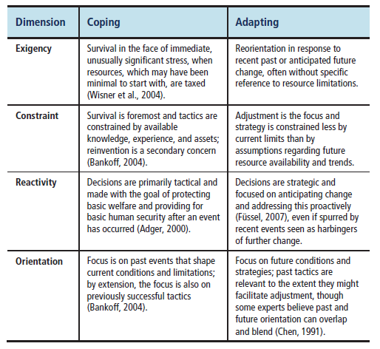
Introduction --- Coping vs. Adapting
Coping: “the action of overcoming a problem or
difficulty”
---focuses on the moment, constraint and survival;
Adapting: “rendering suitable, modifying”
---focuses on the future, where short-term survival is less in question
Notes:
Definition distinctions
Relationships between coping, coping capacity, adaptive capacity and the coping range

Slide 11
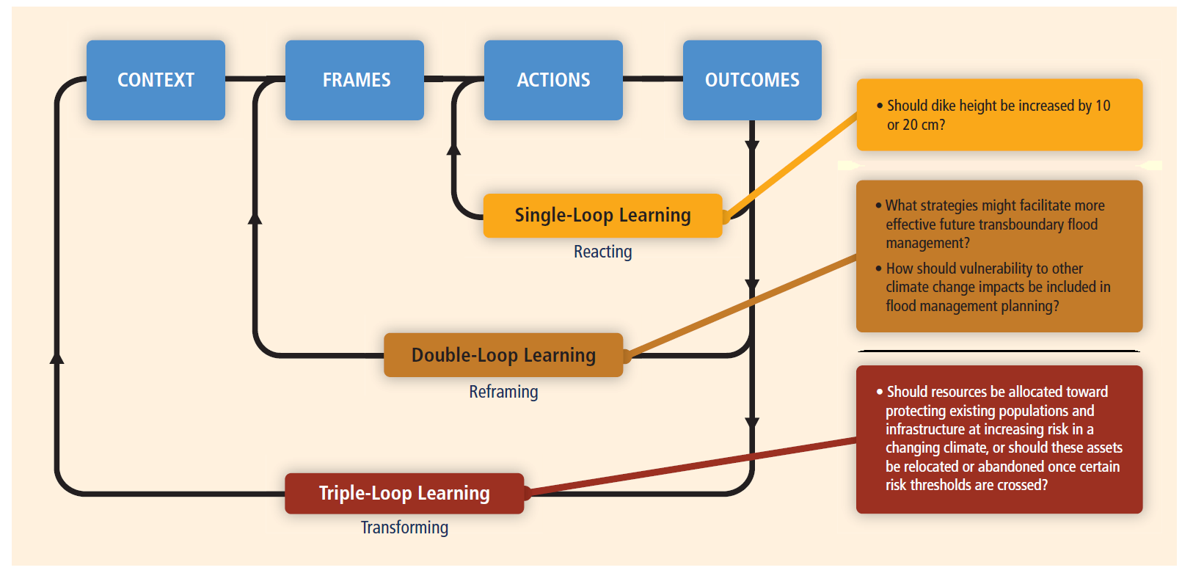
Introduction --- A key process: Learning
Q: How to overcome adaptation barriers and lead to robust adaptation?
Notes:
Single: focused on improving the efficiency of action and answering the question of “whether things are being done right”. In flood management, for example, when floodwaters threaten to breach existing flood defenses, flood managers may ask whether dike and levee heights are sufficient and make adjustments accordingly
Double: whether management goals and strategies are appropriate. For instance, in a floodplain protected by levees built to withstand a 500-year flood, a shift in the annual exceedance probability from 0.002 to 0.005 ill prompt questions about whether the increased likelihood of losses justifies different risk management decisions, ranging from increased investments in flood defenses to changed insurance policies for the vulnerable populations.
Triple: questions how the social structures, cultural norms, dominant value structures, and other constructs that mediate risk and risk management (see Box 1-3) might be changed or transformed. Extending the flood control example, tripleloop learning might entail entirely new approaches to governance and participatory risk management involving additional parties, crossing cultural, institutional, national, and other boundaries that contribute significantly to flood risk, and planning aimed at robust actions instead of strategies considered optimal for particular constituents.

Slide 12
Extreme Climate and Weather Events
Changing climate leads to changes in the frequency and intensity of weather and climate extremes
Could lead to extreme impacts and disasters
Accumulation of non-extreme events (Floods, Droughts)
Events are grouped as ‘Climate Extremes’
“Occurrence of a weather or climate variable above (or below) a threshold near the upper (or lower) ends of the range of observed values of the variable.”
Quantitative Definitions for Climate Extremes:
1) Related to their probability of occurrence
Percentiles of distribution functions or return frequencies
2) Related to a specific (possibly impact related) threshold
EX: temperature range causing heat stress in a population
Notes:
Idea to look at changes in weather and climate extremes relevant to extreme impacts and disasters
Non extreme events → can still get extreme conditions or impacts →cross critical system (social, eco, phys syst) threshold or occurring with other events
Compound events → combination of simultaneous events that, while not extreme, lead to high impacts or crossing of impact threshold
Climate Extreme → Often values with less than a 10, 5, 1% or lower chance of occurrence for a given time (month, season, etc) during a specified reference period (1961-1990)
Specific (absolute) impact threshold example: critical temperatures for health impacts
Extreme event definition will vary with location (hot day in the tropics v. high latitudes)
Def 1) Express wrt given percentiles of the distribution fns of the vrbls –or- wrt return frequencies (e.g., ‘100 year event’)
Def 2) Compound events which are extreme statistically (tails of dist. fns of clim vrbls) or assoc. w/specific threshold

Slide 13
Climate Extremes
Changes in extremes can be linked to changes in the mean, variance, or shape of probability distributions, or all of these
Changes in variability and shape of probability distributions must be considered in addition to changes in the mean to project future changes in extremes
Many extreme weather and climate events continue to result from natural climate variability
Natural variability shapes future extremes in addition to anthropogenic climate change
Notes:
EX: Change in freq of hot days → from change in mean daily maxT and/or chg in variance or shape of freq distrib of daily maxT

Slide 14
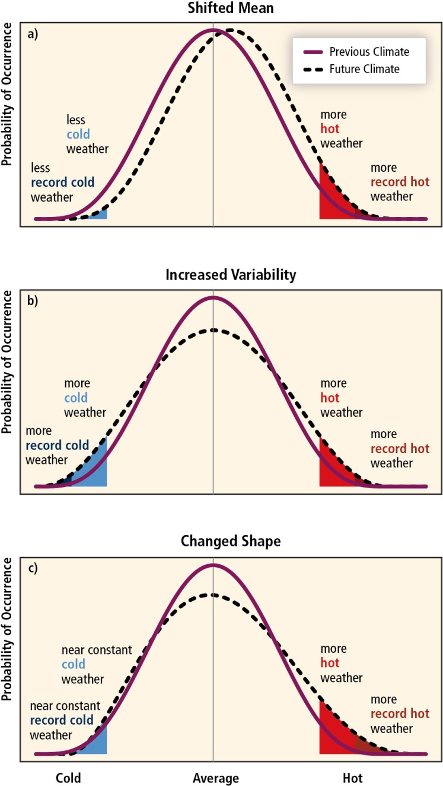
Example: Temperature
Potential changes in temperature distributions between a present and future climate will affect the extreme values of the distributions:
(a) effects of a shift toward a warmer climate
(b) effects of an increase in variability with no shift in the mean
(c) effects of an altered shape of the distribution, with an asymmetry toward the hotter part of the distribution.

Slide 15
Temperature Extremes
Global scale increase in warm days and nights and decrease in cold days and nights is very likely
Warm spells and heat waves are likely to increase over most land areas
Increased drought frequency and severity for some regions in conjunction with rainfall variability changes
Changes have great impact on natural physical environment and on human systems and ecosystems
High confidence in projections globally
Notes:
Strong agreement among GCM projections for T related extremes: heat wave length to increase
T extremes on land to warm faster than global mean T in many regions/seasons → large changes in extremes for some areas even for global warming of +2-3 C
How did we get the confidence?
+Observed Changes
Quality and quantity of available data and studies analyzing it
Regional variation and different extreme types
+Projected Changes
Extreme type
Region and Season; Data Availability
Level of physical understanding of underlying processes and reliability of their simulation
Global versus regional scale trends

Slide 16
Projected Tmax Changes 2081-2100
Days where Tmax is projected to be > 90th percentile for that day
Increasing Standard Deviation
Tmax variability increasing→more warm days→more extreme events
Multimodel ensemble with 14 members
Color shading→66% (10/14) of GCMs agree on sign of change
Stippling→90% (13/14) GCMs agree on sign of change
Grey shading → insufficient agreement
High confidence in projections globally
Notes:
Coupled Model Intercomparison Project phase 3 (CMIP3) multimodel ensemble
Projected ANN, DJF, JJA changes 2081-2100 wrt to 1980-1999 values
The 2081-2100 values are based on simulations for emission scenario SRES A2 (high growth scenario)
1980-1999 is from corresponding simulations for the 20th century
Based on 14GCMs contributing to CMIP3 (Coupled Model Intercomparison Project phase 3 multimodel ensemble)
L: days where Tmax > 90th percentile for that day (from 1961-1990 reference period) STD – derived from detrended annual/seasonal estimates
C: days where Tmax < 10th percentile for that day (from 1961-1990 reference period) STD – derived from detrended annual/seasonal estimates
R: days with Tmax > 30°C – differences in percentages points
Mechanics: computed as (fractions/percentages 2081-2100) - (fractions/percentages 1980-1999)
Color shading where 66% (10 out of 14) GCMs agree on sign of change
Striping where 90% (13 out of 14) GCMs agree on sign of change
Grey shading → insufficient model agreement (<66%)
Warm day and cold day changes are expressed in units of standard deviations, derived from detrended per year annual or seasonal estimates, respectively, from the three 20-year periods 1980-1999, 2046-2065, and 2081-2100 pooled together. Tmax >30°C changes are given directly as differences in percentage points.
Comparisons of observed and simulated climate demonstrate good agreement for some climate variables such as mean temperature,
especially at large horizontal scales (e.g., Räisänen, 2007). For instance, Figure 9.12 of the AR4 (Hegerl et al., 2007) compares the ability
of 14 climate models to simulate the temporal variations of mean temperature through the 20th century. When the models included
both natural and anthropogenic forcings, they consistently reproduced the decadal variations in global mean temperature. Without the
anthropogenic influences the models consistently failed to reproduce the multi-decadal temperature variations. However, when the same
models’ abilities to simulate the temperature variations for smaller domains were assessed, although the mean temperature produced by
the ensemble generally tracked the observed temperature changes, the consistency among the models was poorer than was the case for
the global mean (Figure 9.12; Hegerl et al., 2007), partly because averaging over global scales smoothes internal variability or ‘noise’
more than averaging over smaller domains (see also Section 3.2.2.1). We can conclude that the smaller the spatial domain for which
simulations or projections are being prepared, the less confidence we should have in these projections (although in some limited cases
regional-scale projections can have higher reliability than larger-scale projections; see Section 3.1.6).
In summary, since 1950 it is very likely that there has been an
overall decrease in the number of cold days and nights and an
overall increase in the number of warm days and nights at the
global scale, that is, for land areas with sufficient data. It is likely
that such changes have also occurred at the continental scale in
North America, Europe, and Australia. There is medium confidence
in a warming trend in daily temperature extremes in much of Asia.
Confidence in historical trends in daily temperature extremes in
Africa and South America generally varies from low to medium
depending on the region. Globally, in many (but not all) regions
with sufficient data there is medium confidence that the length or
number of warm spells or heat waves has increased since the
middle of the 20th century. It is likely that anthropogenic
influences have led to warming of extreme daily minimum and
maximum temperatures at the global scale. Models project
substantial warming in temperature extremes by the end of the
21st century. It is virtually certain that increases in the frequency
and magnitude of warm days and nights and decreases in the cold
days and nights will occur through the 21st century at the global
scale. This is mostly linked with mean changes in temperatures,
although changes in temperature variability can play an important
role in some regions. It is very likely that the length, frequency,
and/or intensity of warm spells or heat waves (defined with
respect to present regional climate) will increase over most land
areas. For the SRES A2 and A1B emission scenarios a 1-in-20 year
annual hottest day is likely to become a 1-in-2 year annual
extreme by the end of the 21st century in most regions, except in
the high latitudes of the Northern Hemisphere where it is likely
to become a 1-in-5 year annual extreme. In terms of absolute
values, 20-year extreme annual daily maximum temperature (i.e.,
return value) will likely increase by about 1 to 3°C by mid-21st
century and by about 2 to 5°C by the late 21st century, depending
on the region and emissions scenario (Figure 3-5). Moderate
temperature extremes on land are projected to warm faster than
global annual mean temperature in many regions and seasons.
Projected changes at subcontinental scales are less certain than
is the case for the global scale. Regional changes in temperature
extremes will differ from the mean global temperature change.
Mean global warming does not necessarily imply warming in all
regions and seasons.

Slide 17
Precipitation Extremes
Frequency or proportion of total rainfall from heavy rain events will likely increase for many areas
Particularly in high lat. and tropical regions
Regions of reduced precipitation may still see an increase in heavy rainfall events
Caveat: strong regional and subregional trends
Medium confidence in projections globally
Notes:
Because climates are so diverse across different parts of
the world, it is difficult to provide a single definition of extreme or heavy
precipitation. In general, two different approaches have been used:
(1) relative thresholds such as percentiles (typically the 95th percentile)
and return values; and (2) absolute thresholds [e.g., 50.8 mm (2 inches)
day-1 of rain in the United States, and 100 mm day-1 of rain in China].

Slide 18
Projected Precip. Changes 2081-2100
Days where wet day intensity is projected to change
Increasing Standard Deviation
Variability increasing→wet day intensity increasing→more extreme events
Multimodel ensemble with 17 members
Color shading→66% (12/17) of GCMs agree on sign of change
Stippling→90% (16/17) GCMs agree on sign of change
Grey shading → insufficient agreement
Medium confidence in projections globally
Notes:
Projected ANN, DJF, JJA changes 2081-2100 wrt to 1980-1999 values
The 2081-2100 values are based on simulations for emission scenario SRES A2
1980-1999 is from corresponding simulations for the 20th century
Based on 17 GCMs contributing to CMIP3
L: Wet Day Intensity; Standard Deviation derived from detrended per year annual or seasonal estimates
C: % days with precipitation above the 95% quantile of daily wet day precipitation for that time of year (1961-1990 reference period); percentage points
R: Fraction of days with precipitation > 10 mm (.3”); detrended per year annual or seasonal estimates
Mechanics: computed as (fractions/percentages 2081-2100) - (fractions/percentages 1980-1999)
Color shading where 66% (12 out of 17) GCMs agree on sign of change
Striping where 90% (16 out of 17) GCMs agree on sign of change
Grey shading → insufficient model agreement (<66%)
frequency, distribution, and intensity of heavy precipitation is more poorly simulated as are observed changes in heavy precipitation
projections of changes in temperature
extremes tend to be more consistent across climate models (in terms of sign) than for (wet and dry) precipitation extremes
and significant inconsistencies are also found for projections of agricultural (soil moisture) droughts
In summary, it is likely that there have been statistically significant
increases in the number of heavy precipitation events (e.g., 95th
percentile) in more regions than there have been statistically
significant decreases, but there are strong regional and subregional
variations in the trends (i.e., both between and within regions
considered in this report; Figure 3-1 and Tables 3-2 and 3-3). In
particular, many regions present statistically non-significant or
negative trends, and, where seasonal changes have been
assessed, there are also variations between seasons (e.g., more
consistent trends in winter than in summer in Europe). The overall
most consistent trends toward heavier precipitation events are
found in North America (likely increase over the continent). There
is low confidence in observed trends in phenomena such as hail
because of historical data inhomogeneities and inadequacies in
monitoring systems. Based on evidence from new studies and those
used in the AR4, there is medium confidence that anthropogenic
influence has contributed to intensification of extreme precipitation
at the global scale. There is almost no literature on the attribution
of changes in hail extremes, thus no assessment can be provided
for these at this point in time. Projected changes from both global
and regional studies indicate that it is likely that the frequency
of heavy precipitation or proportion of total rainfall from heavy
falls will increase in the 21st century over many areas on the
globe, especially in the high latitudes and tropical regions, and
northern mid-latitudes in winter. Heavy precipitation is projected
to increase in some (but not all) regions with projected decreases
of total precipitation (medium confidence). For a range of emission
scenarios (A2, A1B, and B1), projections indicate that it is likely that
a 1-in-20 year annual maximum 24-hour precipitation rate will
become a 1-in-5 to -15 year event by the end of 21st century in many
regions. Nevertheless, increases or statistically non-significant
changes in return periods are projected in some regions.

Slide 19
Drought and Floods
Drought Intensification
Changes well projected for some seasons and areas only
Portions of Europe, N/C America, NE Brazil, and S. Africa most at risk
Medium confidence in drought intensification with many caveats
Flooding
Low confidence in fluvial (river) flood changes
Limited evidence and complex regional changes
Medium confidence in pluvial (runoff) flooding
Rainfall increases in some areas will result in local runoff issues

Slide 20
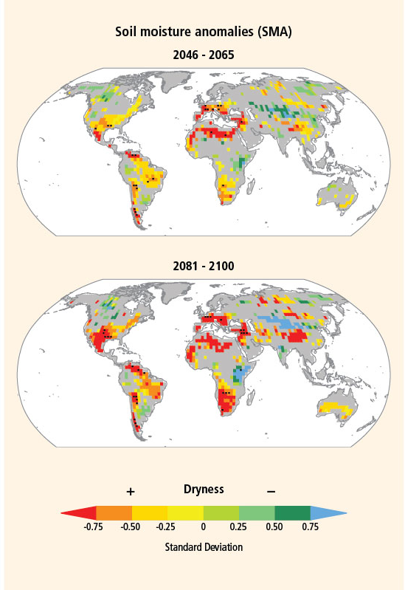
Drought
Soil moisture anomalies projected to change in some areas
Increasing standard deviation→drier soil→more extreme events
Multimodel ensemble with 15 members
Color shading→66% (10/15) of GCMs agree on sign of change
Stippling→90% (14/15) GCMs agree on sign of change
Grey shading → insufficient agreement
Notes:
L: changes in annual maximum number of CDD (days w/precip < 1mm); standard deviation of the interannual variability
R: Changes in soil moisture anomalies; standard deviation of the interannual variability
Mechanics: Results based on 17 (CDD) and 15 (SMA) GCMs contributing to CMIP3.
Shaded: 66% model agreement (12/17 CDD, 10/15 SMA) on sign of change
Stippling 90% model agreement (16/17 CDD, 14/15 SMA) on sign of change
Grey shading → insufficient model agreement (<66%)
Figure SPM.5 | Projected annual changes in dryness assessed from two indices. Left column: Change in annual maximum number of consecutive dry days (CDD: days with
precipitation <1 mm). Right column: Changes in soil moisture (soil moisture anomalies, SMA). Increased dryness is indicated with yellow to red colors; decreased dryness with
green to blue. Projected changes are expressed in units of standard deviation of the interannual variability in the three 20-year periods 1980–1999, 2046–2065, and 2081–2100.
The figures show changes for two time horizons, 2046–2065 and 2081–2100, as compared to late 20th-century values (1980–1999), based on GCM simulations under emissions
scenario SRES A2 relative to corresponding simulations for the late 20th century. Results are based on 17 (CDD) and 15 (SMA) GCMs contributing to the CMIP3. Colored shading
is applied for areas where at least 66% (12 out of 17 for CDD, 10 out of 15 for SMA) of the models agree on the sign of the change; stippling is added for regions where at least
90% (16 out of 17 for CDD, 14 out of 15 for SMA) of all models agree on the sign of the change. Grey shading indicates where there is insufficient model agreement (<66%).
[3.5.1, Figure 3-9]

Slide 21
Summary: Climate Extremes
High confidence in global scale warming of extreme daily max/min temperatures
Medium confidence in global scale intensification of extreme precipitation
Medium confidence in drought intensification and increased localized flooding
Likely contribution to increasing extreme coastal high water
Low confidence in tropical cyclone intensity and frequency changes
Uncertainty in historical record and incomplete understanding of physical mechanisms relating tropical cyclone metrics to climate change
Notes:
Sea Level Rise
Very likely to contribute to upward trends in extreme coastal high water
Areas experiencing erosion/inundation will continue to do so in the future
Tropical Cyclones
Average maximum wind speeds likely to increase in some basins
Global frequency changes uncertain; some projections of decrease while others suggest the number remaining unchanged or possibly increasing
Changes in past observing capability increases uncertainty
Combined Impacts
Island states very likely to experience problems from extreme coastal high water in conjunction with increasing tropical cyclone maximum wind speeds

Slide 22
Climate Extremes Impacts
Climate impacts on humans determined by exposure and vulnerability
Exposure
Assets and activities in areas affected by climate extremes
More subject to hazards
Vulnerability
Susceptibility of what is exposed to harm
Capacity for recovery
Climate Impacts to Ecosystems
Can determine species mortality and which species survive in an ecosystem
Notes:
EXPOSURE: Temporal and spatial scales are also important. Exposure can be
more or less permanent; for example, exposure can be increased by
people visiting an area or decreased by evacuation of people and
livestock after a warning. As human activity and settlements expand
into an exposed area, more people will be subject to and affected by
local climatic hazards
VULNERABILITY: For example, those whose livelihoods are weather-dependent
or whose housing offers limited protection from weather events will be
particularly susceptible to harm (Dodman and Satterthwaite, 2008).
Others with limited capacity to recover include those with limited
personal resources for recovery or with no access to external resources
such as insurance or aid after an event, and those with limited personal
support networks (Handmer and Dovers, 2007). Knowledge, health, and
access to services of all kinds including emergency services and political
support help reduce both key aspects of vulnerability.
Refugees, internally displaced people, and those driven into marginal
areas as a result of violence can be dramatic examples of people
vulnerable to the negative effects of weather and climate events, cut off
from coping mechanisms and support networks (Handmer and Dovers,
2007). Reasons for the increase in vulnerability associated with warfare
include destruction or abandonment of infrastructure (e.g., transport,
communications, health, and education) and shelter, redirection of
resources from social to military purposes, collapse of trade and
commerce, abandonment of subsistence farmlands, lawlessness, and
disruption of social networks (Levy and Sidel, 2000; Collier et al., 2003).
The proliferation of weapons and minefields, the absence of basic
health and education, and collapse of livelihoods can ensure that the
effects of war on vulnerability to disasters are long lasting, although
some also benefit (Korf, 2004). These areas are also characterized by an
exodus of trained people and an absence of inward investment.
ECOSYSTEMS: Many ecosystems are dependent on climate extremes for reproduction
(e.g., through fire and floods), disease control, and in many cases
general ecosystem health (e.g., fires or windstorms allowing new
growth to replace old). How such extreme events interact with other
trends and circumstances can be critical to the outcome. For example,
floods that would normally be essential to river gum reproduction may
carry disease and water weeds (Rogers and Ralph, 2010).
Climate extremes can cause substantial mortality of individual species
and contribute to determining which species exist in ecosystems
(Parmesan et al., 2000). For example, drought plays an important role in
forest dynamics, as a major influence on the mortality of trees (Villalba
and Veblen, 1997; Breshears and Allen, 2002; Breshears et al., 2005).

Slide 23
Increased Exposure and Vulnerability
Population Growth
Changes exposure and vulnerability
Migration into flood prone areas
Deficient Risk Perception
Economic Development
Land Use Changes
Altered rainfall-runoff patterns
Changes to flood frequency and intensity
Poor Water Management Practices
Over-cultivation and deforestation
Desertification and/or stress on water system
Human induced hydrological drought
Notes:
Changes in socioeconomic status are a key component of exposure; in
particular, population growth is a major driver behind changing exposure
and vulnerability (Downton et al., 2005; Barredo, 2009). In many
regions, people have been encroaching into flood-prone areas where
effective flood protection is not assured, due to human pressure and lack
of more suitable and available land\
MAN MADE DROUGHT: An extreme example of a human-made, pronounced
hydrological drought comes from the Aral Sea basin in Central Asia. Due
to excessive and non-sustainable water withdrawals from the
tributaries (Syr Darya and Amu Darya), their inflow into the Aral Sea has
shrunk in volume by some 75% (Micklin, 2007; Rodell et al., 2009)
resulting in severe economic and ecological impacts.

Slide 24
System and Sector Based Aspects of Vulnerability, Exposure, and Impacts
Water
Vulnerability increases as demands placed on resource (EX: hydrologic drought)
Exposure increases as more assets encounter flooding
Ecosystems
Contraction of distribution range for species habitat
Extinction risk to plants and animals
Food Supply and Security
Food production, storage, delivery impacted
Price increases particularly impact developing countries
Impacts on subsistence farming
Notes:
Sectors and systems considered here include water; ecosystems; food systems and
food security; human settlements, infrastructure, and tourism; and
human health, well-being, and security
WATER: vulnerability increases as more
demands are placed on the resource (due to increased water consumption,
for example, or increased discharge of polluting effluent) or exposure
increases as more property, assets, and lives encounter flooding.
DROUGHT: Water supply shortages may be triggered by a shortage of river
flows and groundwater, deterioration in water quality, an increase in
demand, or an increase in vulnerability to water shortage
C CHANGE AND DROUGHT--TIED TO CHPT 3: There is medium confidence that the projected duration and intensity of
hydrological drought will increase in some regions with climate change
(Section 3.5.1), but other factors leading to a reduction in river flows or
groundwater recharge are changes in agricultural land cover and
upstream interventions. A deterioration in water quality may be driven
by climate change (as shown for example by Delpla et al., 2009;
Whitehead et al., 2009; Park et al., 2010), change in land cover, or
upstream human interventions. An increase in demand may be driven by
demographic, economic, technological, or cultural drivers as well as by
climate change (see Section 2.5). An increase in vulnerability to water
shortage may be caused, for example, by increasing reliance on specific
sources or volumes of supply, or changes in the availability of alternatives.
Indicators of hydrological and water resources drought impact include
lost production (of irrigated crops, industrial products, and energy), the
cost of alternative or replacement water sources, and altered human
well-being, alongside consequences for freshwater ecosystems (impacts
of meteorological and agricultural droughts on production of rain-fed
crops are summarized in Section 4.3.4).
C CHANGE AND FLOODING—TIED TO CHPT 3: Climate change has the potential to change river flood characteristics
through changing the volume and timing of precipitation, by altering the
proportions of precipitation falling as snow and rain, and to a lesser
extent, by changing evaporation and hence accumulated soil moisture
deficits. However, there is considerable uncertainty in the magnitude,
frequency, and direction of change in flood characteristics (Section
3.5.2).
ECOSYSTEMS:
Contraction of dist. Range for species habitat → resulting from increase in lg-scale disturbances from extreme wx/clim events
19 studies: 20 to 30% of studied plant and animals →incr risk for extinction IF warming is + 2 to 3°C above preindustrial
Ecosystem shift possible: exceedance of critical temperature thresholds, w/psbl loss of ecosystem services depe. on prev state
FOOD: Food systems and food security can be affected by extreme events that
impair food production and food storage and delivery systems (food
logistics). Impacts transmitted through an increase in the price of food
can be especially challenging for the urban poor in developing countries
(FAO, 2008). Global food price increases are borne disproportionally by
low-income countries, where people spend more of their income on
food (OECD-FAO, 2008).
TRANSPORT ISSUES: When agricultural production is not consumed where it is produced, it
must be transported and often processed and stored. This process
involves complex interdependent supply chains exposed to multiple
hazards. At every step of the process, transport and associated
infrastructure such as roads, railways, bridges, warehouses, airports,
ports, and tunnels can be at risk of direct damage from climate
events, making the processing and delivery chain as a whole at risk of
disruption resulting from damage or blockages at any point in the
chain.
SMALL SCALE FARMING: The economies of many developing countries rely heavily on agriculture,
dominated by small-scale and subsistence farming. People’s livelihoods
in this sector are especially exposed to weather extremes (Easterling
and Apps, 2005; Easterling et al., 2007). Subsistence farmers can be
severely impacted by climate and weather events. For example, the
majority of households produce maize in many African countries, but
only a modest proportion sells it – the great majority eat all they
produce. In Kenya for example, nearly all households grow maize, but
only 36% sell it, with 20% accounting for the majority of sales (FAO,
2009). Both such famers and their governments have limited capacity
for recovery (Easterling and Apps, 2005).
WARMING TRENDS AND CROP YIELD: Evidence that the current warming trends around the world have
already begun to impact agriculture is reported by Lobell et al. (2011). They
show that crop yields have already declined due to warmer conditions
compared to the expected yields without warming. Both Schlenker and
Roberts (2009) and Muller et al. (2011), after their evaluation of projected
temperature effects on crops in the United States and Africa, concluded
that climate change would have negative impacts on crop yields. These
effects were based on temperature trends and an expected increase in
the probability of extremes during the growing season; however, there
is also the potential occurrence of extreme events after the crop is
grown, which could affect harvest and grain quality. Fallon and Betts
(2010) stated that increasing flooding and drought risks could affect
agricultural production and require the adoption of robust management
practices to offset these negative impacts. Their analysis for Europe
showed a probable increase in crop productivity in northern regions
but a decrease in the southern regions, leading to a greater disparity in
production.
FOOD SECURITY: Food security is linked to our ability to adapt agricultural systems to
extreme events using our understanding of the complex system of
production, logistics, utilization of the produce, and the socioeconomic
structure of the community. The spatial variability and context sensitivity
of each of these factors points to the value of downscaled scenarios of
climate change and extreme events.

Slide 25
System and Sector Based Aspects of Vulnerability, Exposure, and Impacts
Human Settlements
Concentrate exposure of humans and their assets
Informal and coastal settlements at very high risk
Infrastructure
May become inadequate where climate extremes change
Heavy precipitation events potentially taxing
Tourism
Major income source in many developing countries
Impacts to infrastructure, landscape, and perception
Human Health, Well Being, and Security
Heat waves, floods, and droughts have direct impact
Substantial lasting mental health effects
Notes:
INFORMAL RISK: Occupants of informal settlements are typically more
exposed to climate events with no or limited hazard-reducing
infrastructure. The vulnerability is high due to very low-quality housing
and limited capacity to cope due to a lack of assets, insurance, and
marginal livelihoods, with less state support and limited legal protection
INFORMAL FLOOD RISK: These urbanization
issues are universal but often at their worst in informal settlements,
which are generally the most exposed to flooding and usually do not
have the capacity to deal with the issues (Hardoy et al., 2001). Flooding
regularly disrupts cities, and urban food production can be severely
affected by flooding, undermining local food security in poor communities
(Douglas, 2009; Aggarwal and Singh, 2010). A further concern for lowand
middle-income cities as a result of flooding, particularly in developing
countries, is human waste, as most of these cities are not served by
proper water services such as sewers, drains, or solid waste collection
Services
INFORMAL LANDSLIDE RISK: Informal settlements are often exposed
to potential slope failure as they are often located on unstable land with
no engineering or drainage works
COASTAL RISK: these settlements have affected the ability of
natural coastal systems to respond effectively to extreme climate events
by, for example, removing the protection provided by sand dunes and
mangroves. Small island states, particularly small island developing
states (see Case Study 9.2.9), may face substantial impacts from climate
change-related extremes.
ADDTL RISK: tropical cyclone intensity (coastal), urban heat island/heat waves (urban)
INFRASTRUCTURE: Inadequate
infrastructure design may increase the impacts of climate and weather
extremes, and some infrastructure may become inadequate where climate
change alters the frequency and severity of extremes, for example, an
increase in heavy rainfalls may affect the capacity and maintenance of
storm water, drainage, and sewerage infrastructure (Douglas et al., 2008).
In some infrastructure, secondary risks in case of extreme weather may
cause additional hazards (e.g., extreme rainfall can damage dams). The
same is true for industrial and mining installations containing hazardous
substances (e.g., heavy rainfall is the main cause of tailings dam failure,
accounting for 25% of incidents worldwide and 35% in Europe; Rico et
al., 2008).
TOURISM: Approximately 10% of global GDP is
spent on recreation and tourism, constituting a major source of income
and foreign currency in many developing countries
There are three broad categories of impacts of climate extremes that
can affect tourism destinations, competitiveness, and sustainability (Scott
et al., 2008): (1) direct impacts on tourist infrastructure (hotels, access
roads, etc.), on operating costs (heating/cooling, snowmaking, irrigation,
food and water supply, evacuation, and insurance costs), on emergency
preparedness requirements, and on business disruption (e.g., sun-and-sea
or winter sports holidays); (2) indirect environmental change impacts
of extreme events on biodiversity and landscape change (e.g., coastal
erosion), which may negatively affect the quality and attractiveness of
tourism destinations; and (3) tourism-adverse perception of particular
touristic regions after occurrence of the extreme event itself. For example,
adverse weather conditions or the occurrence of an extreme event can
reduce a touristic region’s popularity among tourists during the following
season.
HUMAN HEALTH, ETC:
HEAT WAVES: Heat waves have affected developed countries, as exemplified by the
2003 European heat wave (see Case Study 9.2.1 and Box 4-4). In much of
the developed world, societies are aging and hence can be more
sensitive to climate extremes, such as heat waves (Hennessy et al.,
2007). Heat extremes can claim casualties even in tropical countries,
where people are acclimatized to the hot climate; McMichael et al.
(2008) evaluated the relation between daily temperature and mortality
in middle- and low-income countries, and reported that higher mortality
was observed on very hot days in most of the cities, including tropical
cities, such as Bangkok, Thailand; Delhi, India; and Salvador, Brazil.
FLOOD: Floods can cause deaths and injuries and can be followed by infectious
diseases (such as diarrhea) and malnutrition due to crop damage (see
Section 4.4.2.3). In Dhaka, Bangladesh, the severe flood in 1998 was
associated with an increase in diarrhea during and after the flood, and
the risk of non-cholera diarrhea was higher among those from a lower
socioeconomic group and not using tap water (Hashizume et al., 2008).
Floods may also lead to a geographical shift of malaria epidemic
regions by changing breeding sites for vector mosquitoes. Outbreaks of
malaria were associated with changes in habitat after the 1991 floods in
Costa Rica’s Atlantic region (Saenz et al., 1995; for another example, see
Case Study 9.2.6). Malaria epidemics can also occur when people with
little immunity move into endemic regions, although the displacement
of large populations has rarely occurred as a result of acute natural
disasters (Toole, 1997).
DROUGHT: Drought can affect water security, as well as food security through
reduction of agricultural production (MacDonald, 2010), and it can be a
factor contributing to human-ignited forest fires, which can lead to
widespread deforestation and carbon emissions (D’Almeida et al., 2007;
van der Werf et al., 2008; Field et al., 2009; Phillips et al., 2009; Costa
and Pires, 2010). Also, drought can increase or decrease the prevalence
of mosquito-borne infectious diseases such as malaria, depending on the
local conditions (Githeko et al., 2000), and is associated with meningitis
(Molesworth et al., 2003). Studies indicate that there is a climate signal
in forest fires throughout the American West and Canada and that there
is a projected increase in severe wildfires in many areas (Gillett et al.,
2004; Westerling et al., 2006; Westerling and Bryant, 2008). As described
by McMichael et al. (2003a), the direct effects of fire on human health
can include burns and smoke inhalation, with indirect health impacts
potentially resulting from loss of vegetation on slopes, increased soil
erosion, and resulting increased risk of landslides.

Slide 26
Integration of Climate and Disaster Response Communities
“The Special Report brings together scientific communities with expertise in three very different aspects”:
Disaster recovery
Disaster risk management
IPCC WG1 and WGII
Physical science of climate change
Climate change impacts, adaptation and vulnerability

Slide 27
Perspectives on the Impacts of Extreme Events
Disaster recovery – First Responders. Keys are facilitating coping and recovery. Focus is on current activities.
Disaster risk management – Evaluators of adaptation and mitigation. The keys are reduction of vulnerability and exposure. Focus is longer term human and economic cycles.
IPCC – Evaluators of impacts for near and distant future. Keys are trends in means and variances over decades or centuries.
Notes:
It might be good to interject here that while the scientific community seems unified that anthropogenic factors are sufficient to alter both consequences of weather and in the longer term climate, the report acknowledges natural variation must be considered as well.

Slide 28
“Relief is politically more appealing than disaster risk management …” It works for both donors and recipients.
Local Now
Cope with risk often using long standing local traditions and resources. Supplements through humanitarian relief agencies when needed.
Population movement. A potential contentious solution that could be aggravated by climate change.
Recovery and reconstruction to original state
Local Future (Desired)
Understanding and communication of risk factors
Early warning to avoid disaster
Maintenance of ecosystems through land use
Proactive building of response plans and capabilities
Adaptation to increased risk

Slide 29
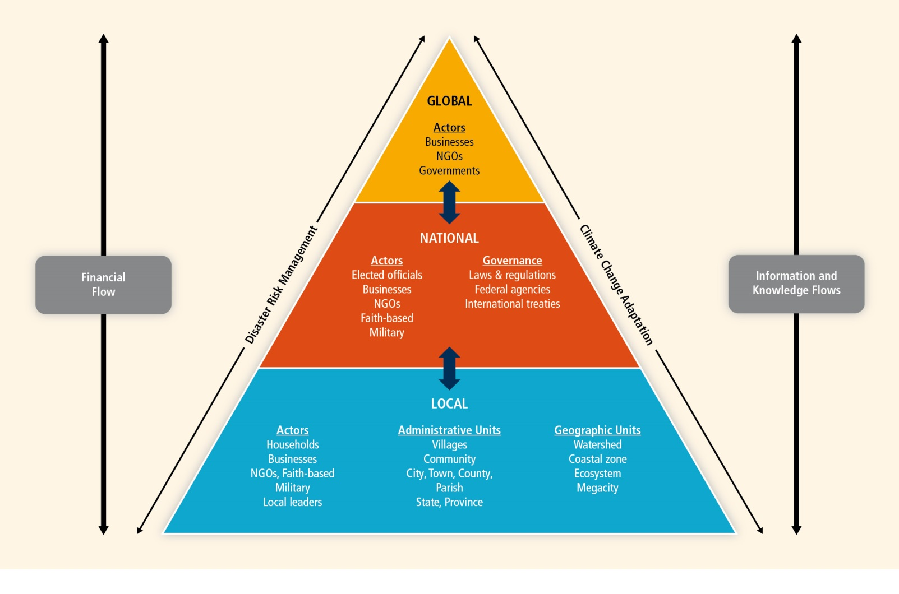
Report dedicates a full chapter to each of local, national and
International issues related to extreme events (9 total). This is where
the authors merge climate change science into
the socio- and econ- sciences.
Notes:
NGO: Non-government organization such as Earthwatch, Greenpeace, The Climate Project. 5 Gyres.

Slide 30
Managing Risks from Climate Extremes at the Local Level (520)
Extreme events escalated to disasters are most acutely experienced at the local level
Disaster response improves with early warning, improved forecasting, understanding consequences of extreme and compounded events
Sustainable land management is an effective disaster risk reduction tool
Ecosystem management and restoration activities are essential to protecting and sustaining local livelihoods in the face of climate extreme
Integration of science and policy at local level key to risk management
Coping versus proactive management – Social-Economic factors inhibit uniform solutions
Focus shifts from short term impact to longer term trends and resilience
Notes:
Sandy. Drought + Heat wave + fire.

Slide 31
Managing Risks from Climate Extremes at the National Level
National government is central to providing risk management-related public goods and has financial and organizational authority in planning and implementing these goods
Referenced Hyogo Framework (10 year plan with 5 action priorities)
Strong institutional basis for disaster risk reduction
Early warning strategy for identity and risk assessment
Reduction of risk factors
Ecosystem protection
Effective preparedness nation-wide for response and all levels
Assumption of Liability
Explicit – law and contracts
Implicit – moral - quality of life, maintenance of resources
Notes:
The Hyogo Framework for Action (HFA) is the first plan to explain, describe and detail the work that is required from all different sectors and actors to reduce disaster losses. It was developed and agreed on with the many partners needed to reduce disaster risk - governments, international agencies, disaster experts and many others - bringing them into a common system of coordination. The HFA outlines five priorities for action, and offers guiding principles and practical means for achieving disaster resilience. Its goal is to substantially reduce disaster losses by 2015 by building the resilience of nations and communities to disasters. This means reducing loss of lives and social, economic, and environmental assets when hazards strike.

Slide 32
Managing Risks from Climate Extremes at the National Level
Social Responsibilities
Health
Water resources
Infra-structure
Housing
Cities
Transportation
Energy
Flood/Drought Management
Natural Ecosystems and Forestry
Agriculture and Food Security
Coastal and Fisheries Management

Slide 33
Managing Risks from Climate Extremes at the International Level
Systemic risks at the global level
International trade, finance, shared geography and resources
Underlying biogeochemical systems and cycles
International environmental law
Funding, transfer of risk, transfer of technology
Influence response protocols avoiding weather version of CNN effect.

Slide 34
Managing Risks from Climate Extremes at the International Level
Integration of temporal scales
Recall disaster management and risk reduction focuses on (relatively) near future time spans
Climate change analysis extends decades or centuries
Evaluation of climate adaptation costs at global scale

Slide 35
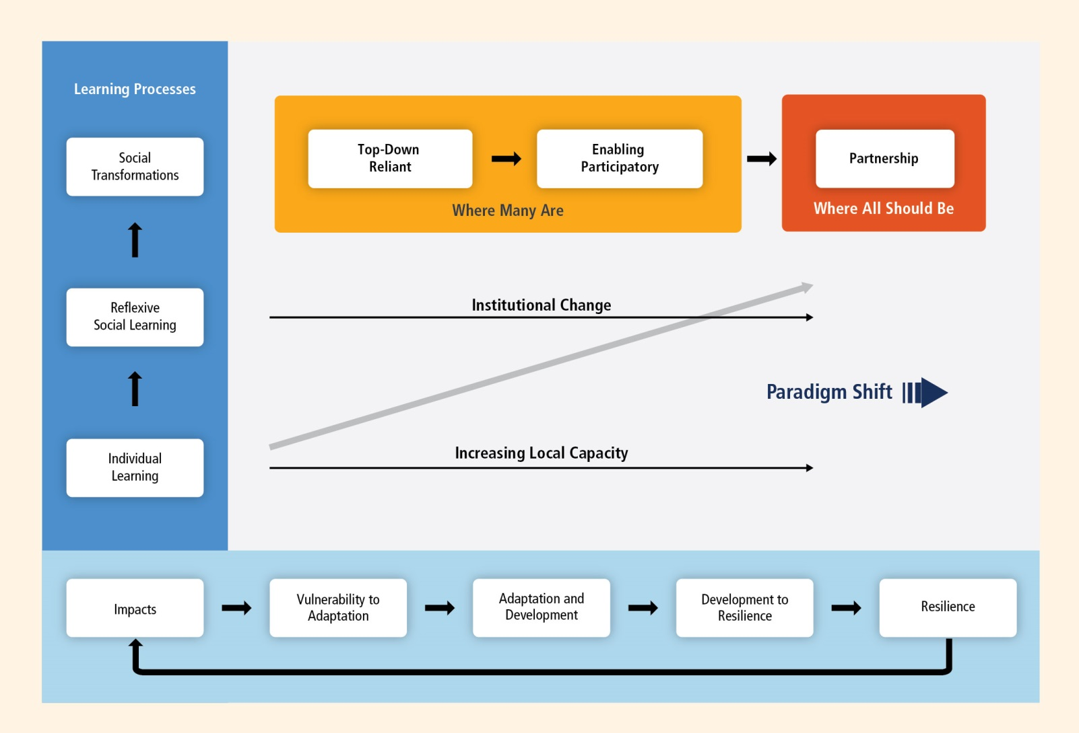

Slide 36
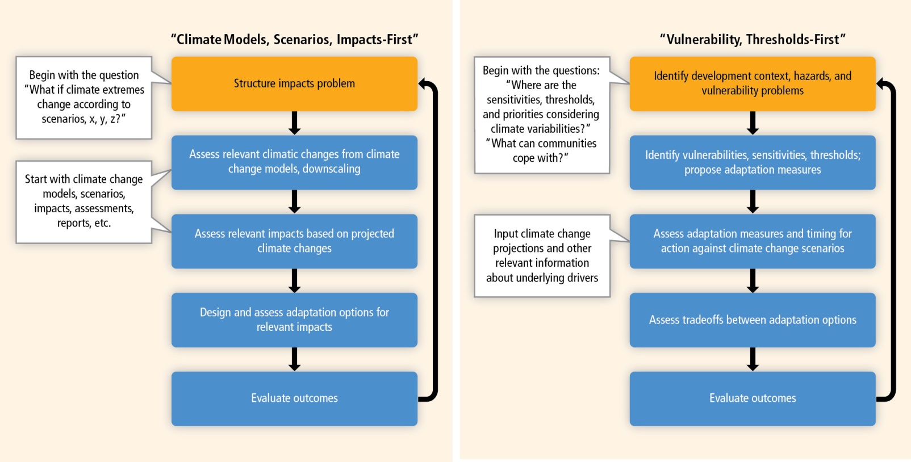
Two ways to look at the consequences of climate change
Top-down scenario, impacts-first approach (left panel) and bottom-up vulnerability,
thresholds-first approach (right panel) – comparison of stages involved in identifying and evaluating
adaptation options under changing climate conditions. Adapted from Kwadijk et al. (2010) and Ranger et al. (2010)

Slide 37
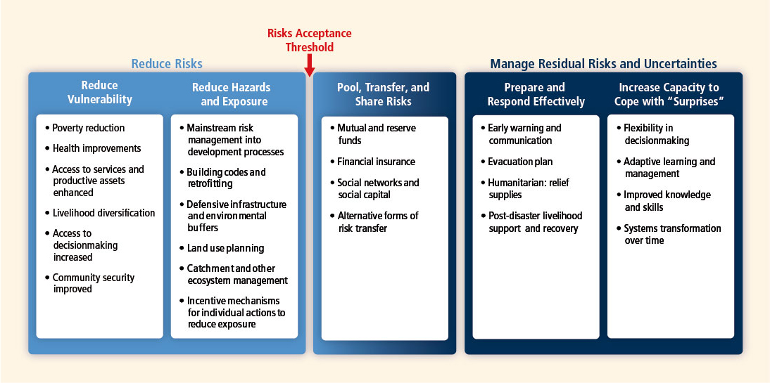

Slide 38
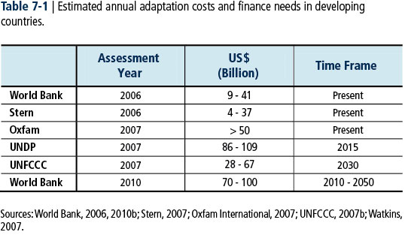
Disaster Risk Management is approached with modeling analogous to the way natural sciences approaches biogeochemical impacts of climate change.
A World Bank researcher is lead author on the consequences of > 2 ⁰C
global mean temperature rise.
(Hallegette,S., et. al., 2010, A Note on the Economic Cost of Climate Change and the Rationale to Limit it Below 2 ⁰C. Background Paper to the 2010 World Development Report, Policy Research Working Paper 5179, World Bank, Washington, DC., pp19).

Slide 39
“Toward a Sustainable and Resilient Future”
Disaster risk – reminder that this community includes all hazards with climate/weather as a subset, tsunamis, earthquakes, volcanoes are also within its scope
Climate adaptation – disaster is not just cyclone, flood and drought but also “creeping” long term shifts in temperature, precipitation or cryosphere
Common ground – floods, droughts, heat waves
The underlying theme is reduce risks and understand the potential for thresholds and tipping points.

Slide 40
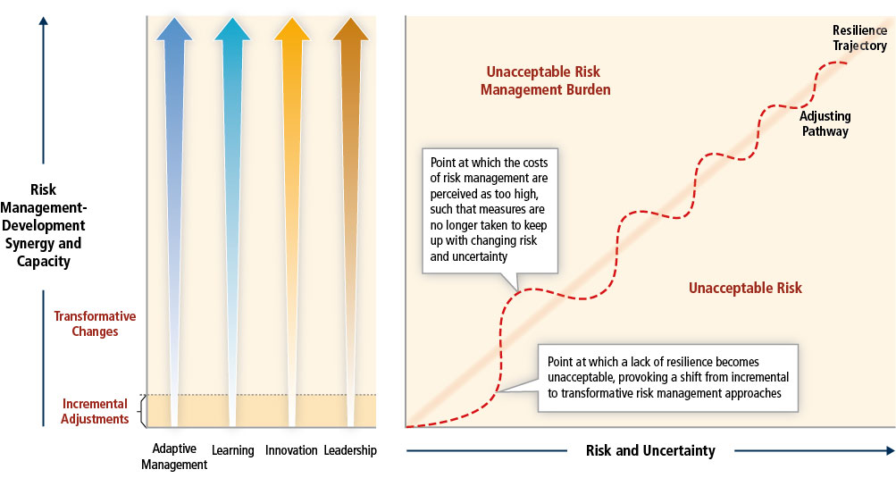
Incremental and transformative pathways to resilience
(The story line that emerges from the three communities)

Slide 41
Urban and Rural Mitigation Strategies
Urban – concentration of population, wealth and government influence (consistent with Megacities report)
Critical for energy consumption
Critical for emission patterns
Critical for disaster risk reduction
Rural
Primary focus for climate change mitigation
Geographically majority of the Earth’s surface
Boreal and rain forests
Agriculture and agri-forests
Wetlands, watersheds and tundra
Cryoshere and oceans

Slide 42
Climate Tipping Points
Current concerns
Decay of Greenland ice sheet
Recession of Amazon rain forest
Changes in Indian monsoon
Encroachment of woody vegetation into savannas
Algae populations on coral reefs
Fresh water eutrofication

Slide 43
Extreme Value Theory
An approach to estimate extreme value probabilities from the tail of a probability distribution.
Estimation of probabilities outside observable data ranges
Recall Dr. James Elsner’s talk on violent tornados (EAS Seminar)

Slide 44
Conclusions - Synthesis of Lessons from Case Studies
Need greater amount of useful information on risks before events occur including early warnings.
Better investment in DRR/DRM plans, strategies and tools for adaptation to reduce needed response to extreme events.
Successful DRR/DRM requires legal and regulatory framework for effective coordination of activities and use of funds.
Risk transfer provides incentives for reduction of vulnerability and exposure.
Research that integrates natural, social, health and engineering sciences provides the justification for risk reduction.

Slide 45
Thank You
Questions?

Slide 46
Q: Climate Model Projections
How might you determine the robustness of a climate model simulation so you can assign a confidence level to the projected changes of an extreme?

Slide 47
A: Robustness of Model Simulations
Is the result seen among multiple models and with multiple simulations?
Suggests robust consequence of underlying assumptions
Not due to arbitrary choices marking the differences between different models
Does the result make physical sense?
If the magnitude of the effect makes theoretical sense then credibility is added
If it matches with observations even more credibility is added
Robust and non-Robust Results
Robust → warming planet as a function of increased greenhouse gasses, changes in water vapor with temperature
Non-Robust → ENSO changes as a result of climate forcings, impacts of hurricanes
Source: realclimate.org

Slide 48
Question 2 Part 1 of 2

Slide 49
Question 2 Part 2 of 2

Slide 50
Question 2: Biogeochemical Cycles
Is CO₂ emission short circuiting natural biogeochemical cycles?

Slide 51
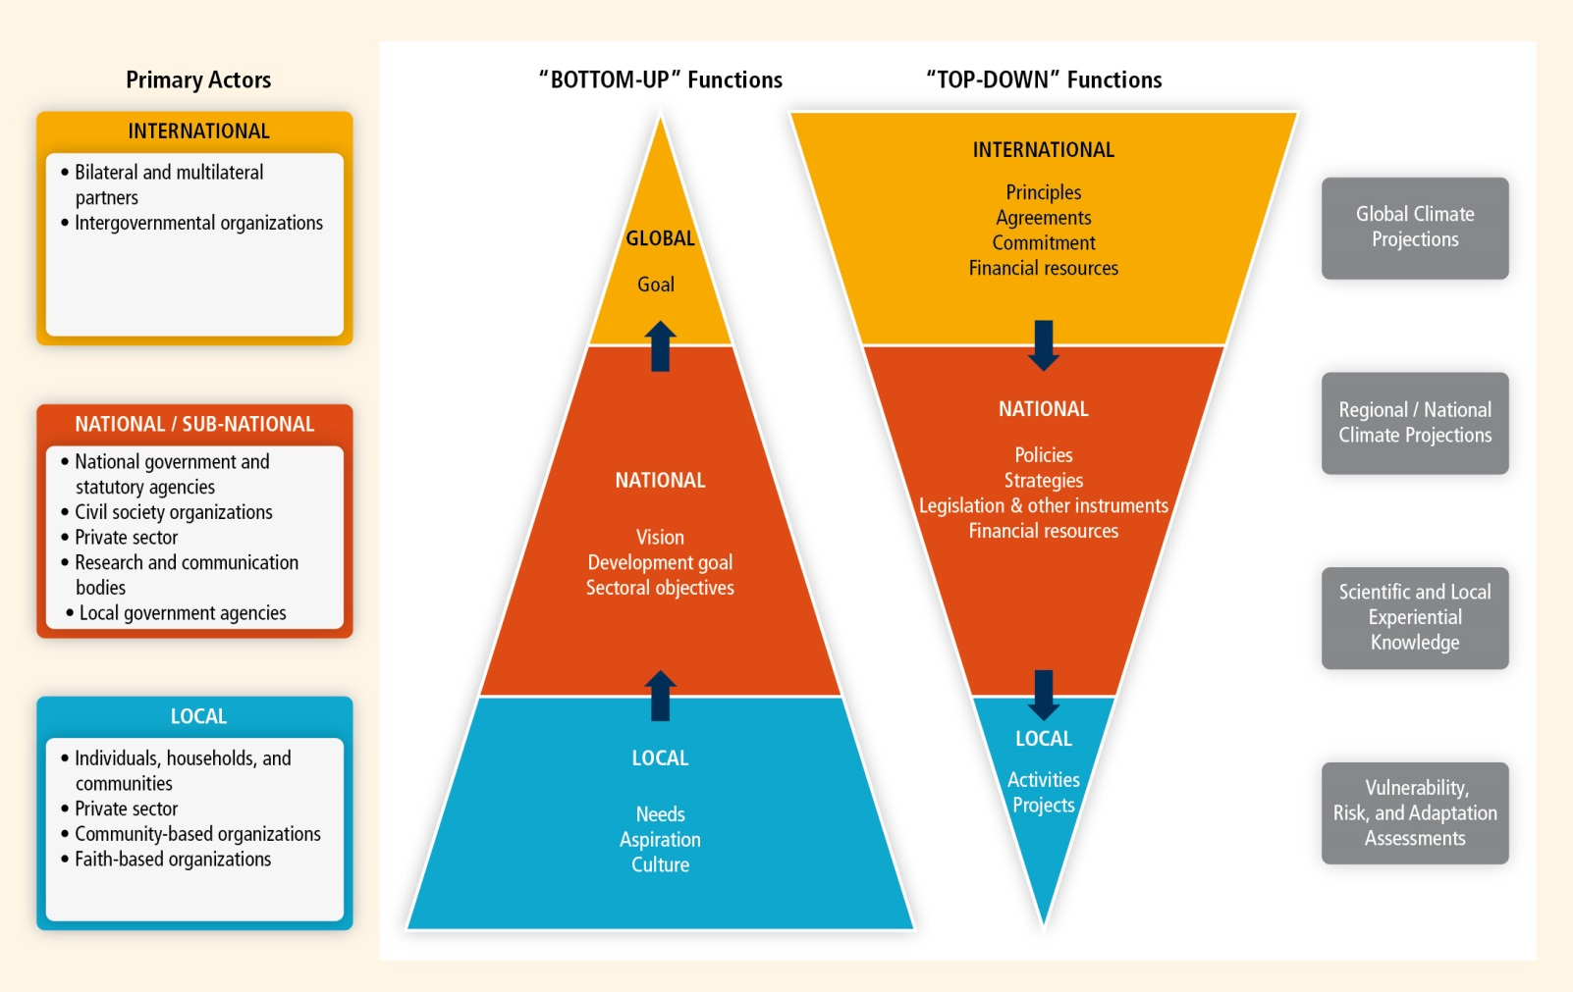

Slide 52
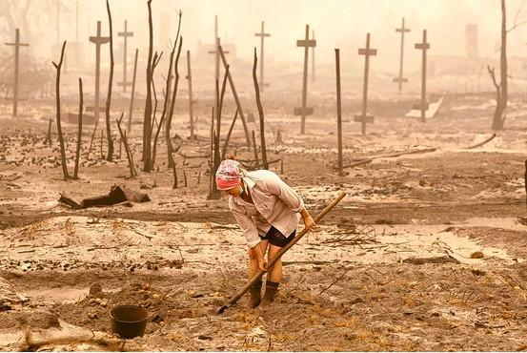
Case studies ---European Heat Waves of 2003 and 2006
“Economic costs exceeding €13 billion
with a death toll of over 30,000 across Europe (UNEP, 2004)”

Slide 53
Case studies ---Dzud disaster in Mongolia

Slide 54
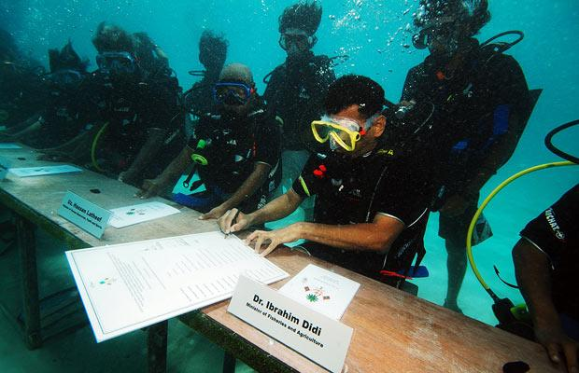
Case studies ---Small Island Developing States: The Challenge of Adaptation
Disadvantages including small size, insularity, remoteness, and susceptibility to natural hazards
Vulnerable due to susceptible key economic sectors such as agriculture, fisheries, and tourism
Maldives underwater Cabinet
Meeting in 2009

Slide 55
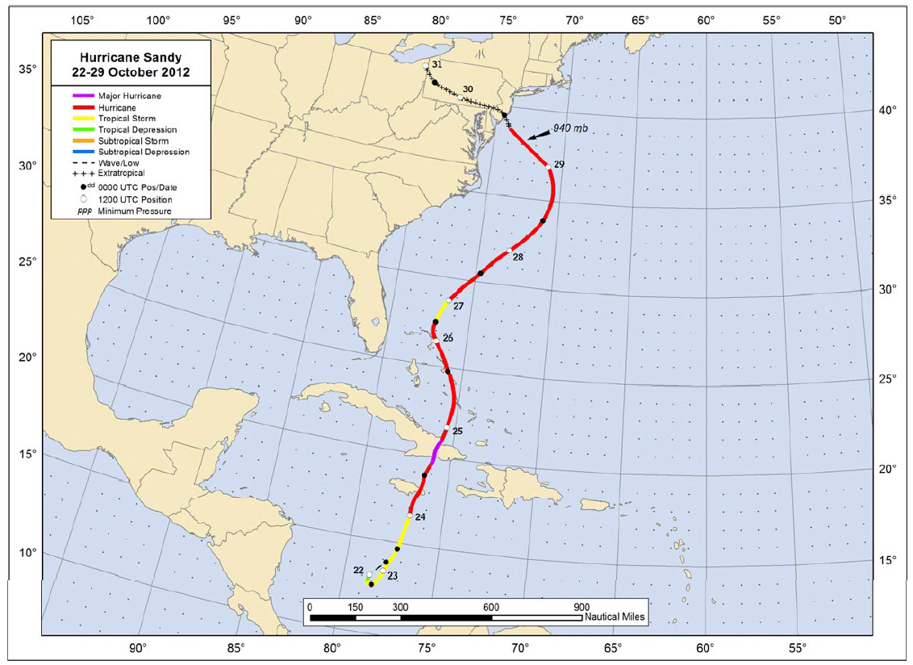
Case studies ---Hurricane Sandy: A billion-dollar event that has nothing to do with climate change?
a classic late-season hurricane
147 direct deaths
$75 billion damage as the second-costliest cyclone in US
2 business days close in the New York Stock Exchange
“Many uncertainties remain about the effects of climate change on hurricanes”
Notes:
"Attribution of single extreme events to anthropogenic climate change is challenging.“ from IPCC special report

