Slide 1
Organic Carbon and Elemental Carbon in Atlanta Area
Chao Wu

Slide 2
Overview
Introduction
Method
Results
Conclusion
Notes:
Southeastern Center for Air Pollution & Epidemiology

Slide 3
Introduction
Particulate Matter (human health, climate)
Carbonaceous particles are the most important constituents of the fine fraction of PM. (PM 2.5)
Carbonaceous particles
organic carbon (OC) (Primary OC, Secondary OC)
elemental carbon (EC)
Notes:
Particulate matter (PM) is considered to be a health hazard since it can be absorbed into human lung tissue during breathing. Previous study has demonstrated that urban and industrial air pollution could inhibit precipitation from clouds (Rosenfeld, 2002). PM2.5 is too small, you cann’t cough it out. usually classified into two categories—organic carbon (OC) and elemental carbon
(EC).
OC represents a large variety of organic compounds that can be classified into general compound classes such as aliphatic, aromatic compounds, acids, etc. EC is actually a mixture of graphite-like particles and light-absorbing organic matter.
EC is directly
emitted whereas particulate OC exists in two forms: primary OC (OCpri), which is directly emitted to the atmosphere, and secondary OC (OCsec), which is formed through atmospheric oxidation of reactive organic gases and subsequent gas-to-particle conversion processes.
It is important to determine the relative contributions of OCpri and OCsec to the ambient aerosol burden, so that policymakers may determine which portion of the organic aerosol complex to target in their control strategy selection process.
Since EC is predominately emitted from combustion sources, it has often been used as a tracer of primary OC.

Slide 4
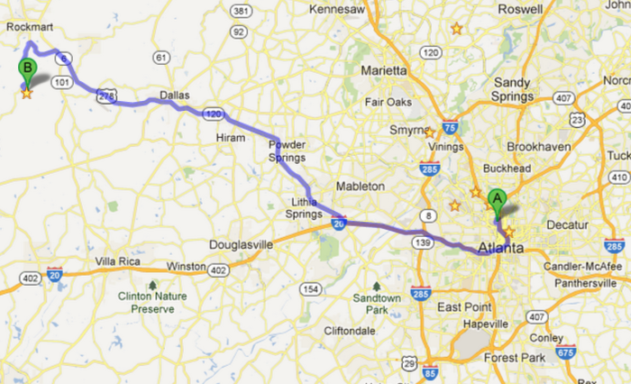
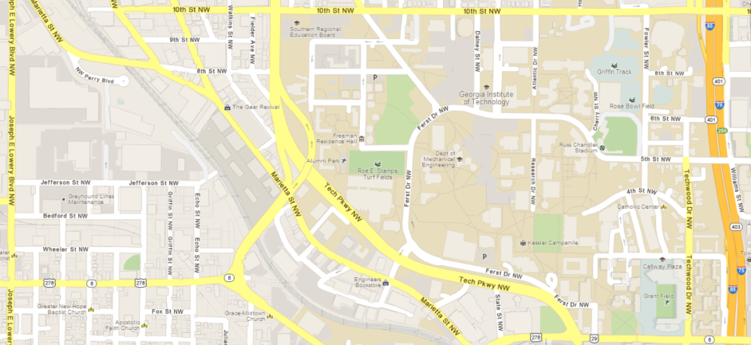
Method
Sites
4. YRK: Rural site
Atlanta
2. GIT: 400m from road site
Rooftop of EST building
3. JST: ATL central site
2300m from road site
Georgia Tech
1.RS: aside of I-75/85
Notes:
Temporal and spatial distribution. JST is a fixed site. We used a trailer to go to the other sites. RS: aside of I-75/85
280,000 vehicles per day [Georgia-DOT, 2006] GT: Near-road site 4.1 km from JST Rooftop of EST building JST: ATL central site
8km from ATL center YRK: Rural site 70km west of ATL

Slide 5
Instrument
Sampling:
Particle Composition Monitor (PCM)
Analysis:
Lab OC-EC Aerosol Analyzer (Sunset Inc)
thermal-optical method
Notes:
We use quartz filters to collect PM2.5
This instrument uses a proven thermal-optical method to analyze for OC-EC aerosols collected on quartz filters.
We know the flow rate and sampling time, we can calculate the ambient concentration.

Slide 6
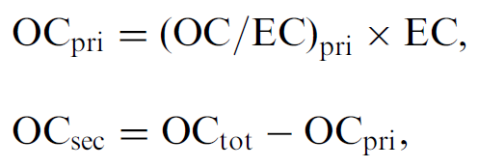
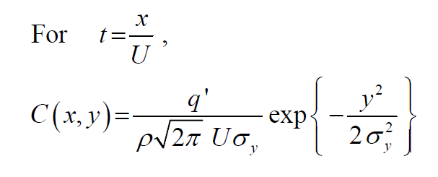
Determine OCsec (SOA)
Gaussian Plume for Continuous Line Source
σy: Pasquill-Gifford coefficients, Atmospheric Chem&Phys
Notes:
Since EC is predominately emitted from combustion sources, it has often been used as a tracer of primary OC. I used the minimum of OC/EC ratio as OC/EC pri. I assumed on the day when OC/EC ratio reach the minimum, there was no SOA. It’s simple and old. Not accurate. I just do a approximate evaluation of SOA, not accurate.
Assume it’s neutral. Use Pasquill-Gifford coefficients to calculate the segam y, Atmospheric Chem&Phys

Slide 7
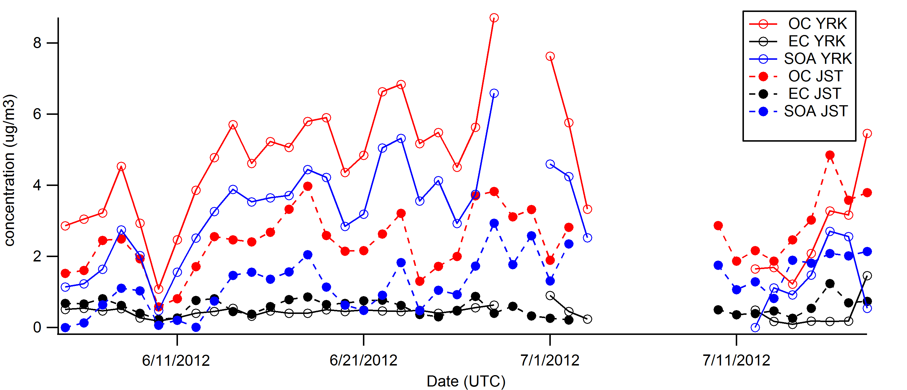
Results
YRK vs JST Jun 5 -Jul 18
Notes:
Solid line with open points is YRK, dashed line with closed point is JST.
The time-series of daily observed OC and EC concentration at YRK are shown in Fig. OC concentration is higher at YRK than at JST. The average of OC is 4.37 ug/m3 at YRK and 2.55 ug/m3 at JST. The higher SOA concentration at YRK than JST contributed a lot to the higher OC. Based on the calculation, the average of SOA is 2.88 ug/m3 at YRK and 1.30 ug/m3 at JST. The ratio of SOA to OC is 65.9% at YRK and 51.0% at JST. It is likely because the high VOCs concentration at YRK due to more trees emission in rural, and these VOCs contributes to the formation of SOA. Also, the hot weather in summer favored the formation of SOA. The difference between EC at JST and YRK is much smaller. EC at JST is a little higher, the average of EC is 0.441 ug/m3 at YRK and 0.556 ug/m3 at JST. This is mainly due to the human source in the urban area. The valley maybe is due to the rain on that day. There was a thunderstorm.

Slide 8
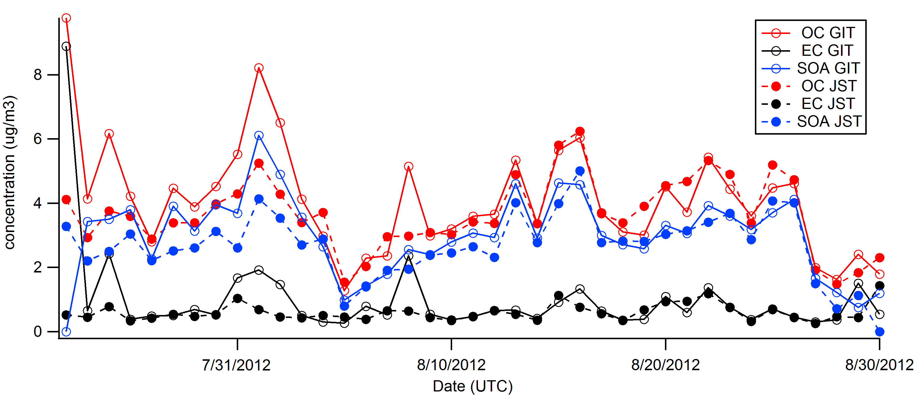
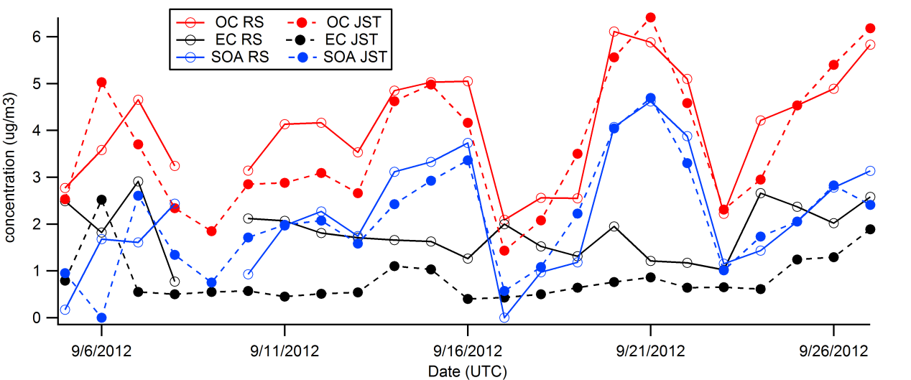
GIT vs JST Jul 23 -Aug 30
RS vs JST Sep 5 - 27
Notes:
The results at JST and GIT from July 23 to August 30 are shown in figure. As these two sites are not that different as JST and YRK, OC didn’t show a very large difference as JST-YRK comparison in June to July. The average of OC is 4.23 ug/m3 at GIT and 3.67 ug/m3 at JST. For SOA, they are 3.01 ug/m3 and 2.69 ug/m3 respectively. The average of EC is 1.01 ug/m3 at GIT and 0.60 ug/m3 at JST. No matter for OC or EC, the concentration at GIT was higher, mainly because GIT is more near the interstate highway I-75/85. SOA contributes the most part of OC at both sites. The ratio of SOA to OC is 71.2% at GIT and 73.3% at JST. The valley maybe is due to the rain on Aug 6
Figure shows the results at RS and JST from September 5 to 27. The EC is apparently higher at RS than JST. The average of EC is 1.82 ug/m3 at RS and 0.83 ug/m3 at JST. The impact of highway’s emission is very obvious. For OC, the average is 4.10 ug/m3 at RS and 3.72 at JST. The highway emission play a less important role in OC than EC, may because SOA contribute a lot to OC, however, highway contribute most EC. The average of SOA is 2.19 ug/m3 at RS and 2.07 ug/m3 at JST. The ratio of SOA to OC is 53.4% at RS and 55.6% at JST

Slide 9
Use GIT observation data to calculate the JST’s concentration.
C(x,y) ~(1/σy)*exp(-y^2/2/σy^2)
Notes:
Apply the Gaussian Plume to GIT-JST comparison. This is the Gaussian plume formula for line source. We can treat this part as constant for a certain time, so ,the concentration is proportional to this. We can calculate segma y, because we know the distance and height.

Slide 10
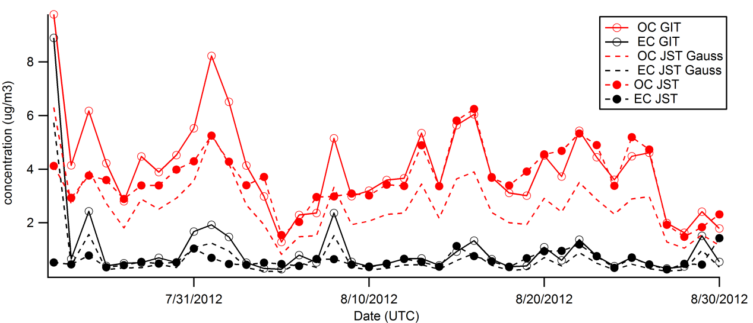
GIT, JST & JST Gauss
Notes:
Compared to the observation results (OC: 3.67 ug/m3, EC: 0.60 ug/m3 ), Gaussian Plume’s results are lower. So the highway maybe contribute some fraction to the JST, there are likely some local source for OC and EC.

Slide 11
Conclusion
OC is much higher in rural area (YRK) than in urban area (JST), SOA contributes most to this difference.
Highway emission contributes a lot to EC, but not much to OC.
When using Gaussian Plume to calculate the spatial distribution, it is found that local source can’t be neglected at JST.

Slide 12
Thanks!

