Slide 1
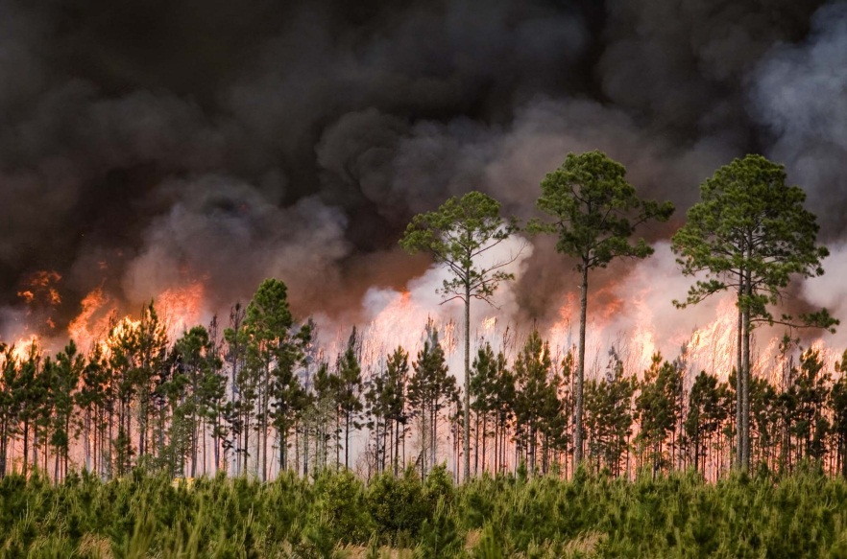
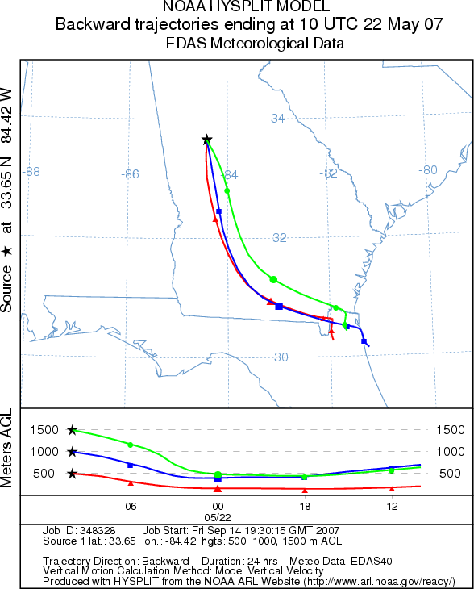
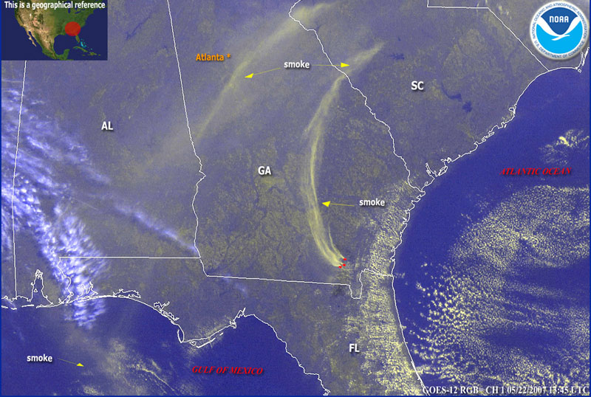
Smoke Transport during the Georgia/Florida Fires of 2007
Sean Miller
EAS6792
Notes:
Fire occurred in / around Okefenokee Swamp from April-June 2007
Bugaboo Island → named in 1874 after a hunter mistook the sound of a bullfrog for a bull booing.
Sound was trees rubbing together in the wind. Friends teased him about the “booing” → bugaboo.

Slide 2
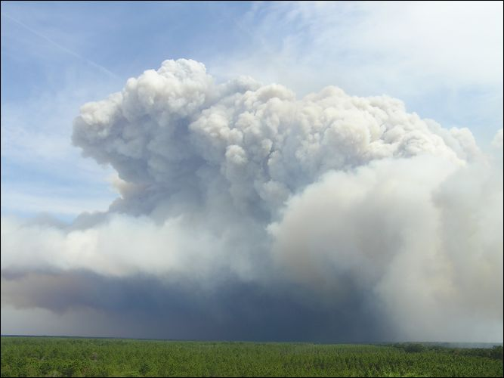
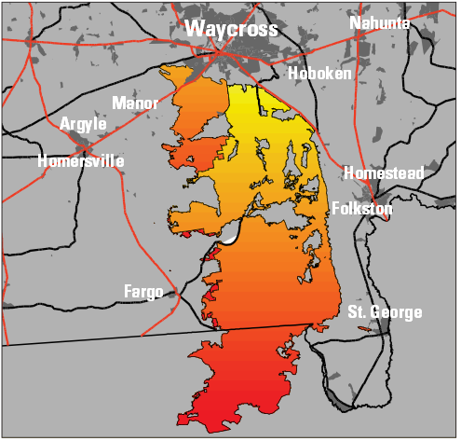
Georgia Bay Complex Fires
Series of fires began in/around Okefenokee swamp during spring 2007
Fires merged and continued through early summer
Antecedent conditions favorable for wildfire development and spread
  Extreme Drought
  Dry soil; low RH
  Strong wind from Subtropical storm Andrea

Slide 3
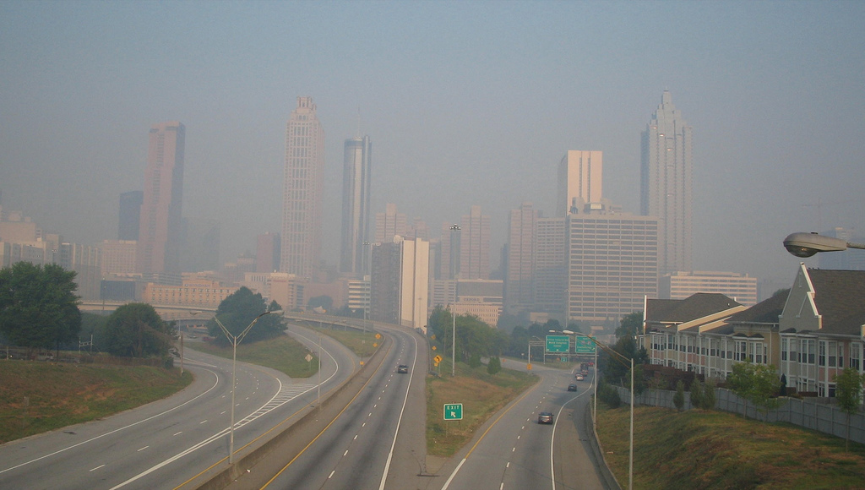
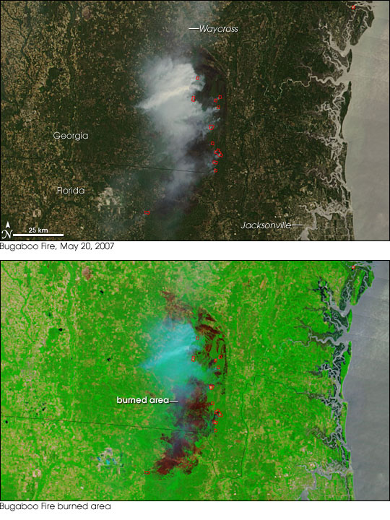
Georgia Bay Complex Fires
Burned over 2,300 km² in SE GA/NE FL in 2007
Smoke advected over 300 km to Atlanta metro
PM_{2.5} reached unhealthy levels several times
Notes:
Fire History:
Fires began in spring 2007
Downed power line on 4/20 → sweat farm fire
Lightning on Bugaboo Island 5/8 → bugaboo scrub fire
Fires merged in May → Bugaboo Scrub /
Preceding conditions:
Drier than average spring → area in D3 (extreme) drought prior to event
PM 2.5 in Atlanta:
Reached unhealthy levels several times from mid to late may 2007
Trajectory analysis supports fire as main (or at least contributing) factor

Slide 4
Purpose
Track mesoscale smoke transport from the fire region using active and passive remote sensing in conjunction with model back trajectories and surface observations
Use model reanalysis data to determine the mean meteorological conditions favorable for smoke transport from the fire region to Atlanta

Slide 5
Methods
Find Acceptable Study Days
  Daily PM_{2.5} concentrations must violate NAAQS in the Atlanta region (mass concentrations >35.5 µg m⁻³)
  Suitable remotely sensed and/or surface based datasets must be available to infer smoke influence on PM_{2.5}
Track the smoke plume
  Using a combination of MODIS AOD, CALIPSO backscatter, surface PM_{2.5} concentrations, and HYSPLIT backward trajectories
Determine favorable conditions for transport
  Using NCEP/NCAR reanalysis of meteorological fields for the chosen study days

Slide 6
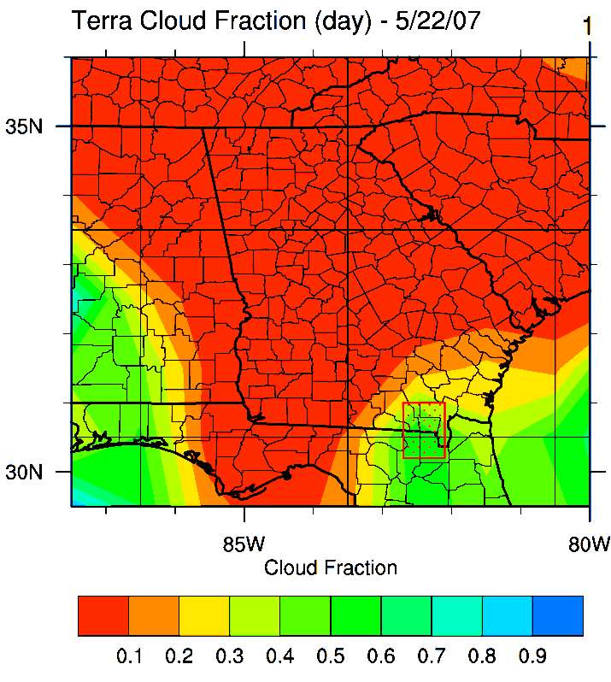
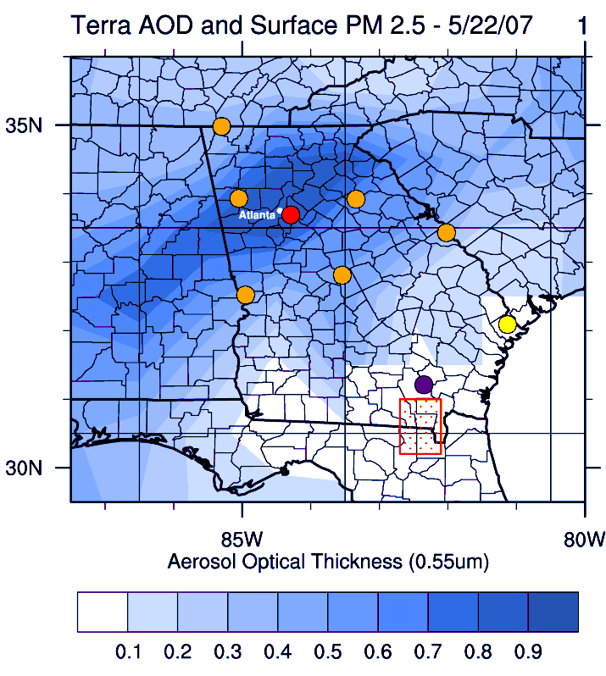
MODIS AOD
Aerosol Optical Depth
  Indicates particle abundance in atmospheric column
  Obtained from MODerate resolution Imaging Spectroradiometer sensors (MODIS)
  MODIS located aboard Terra and Aqua polar orbiting satellites
  2 overpasses each day
  1°x1° spatial resolution regridded data
  Cloud fraction /masking → remove cloud contaminated pixels
Notes:
Why not just use ground-based observations?
Ground based monitors provide near continuous record of surface PM 2.5
Discrete nature makes them ineffective for obtaining a clear spatial picture though
Column Integrated AOD
helps augment sparseness of ground based PM 2.5 monitors
retrievals provide important information about the spatial distribution of particulates within the PBL
def: “Unitless measure of light extinction through the atmosphere at a specific wavelength and is
defined as the integral of the aerosol extinction coefficients along the vertical atmospheric column”
Temporal / Spatial Resolution
Terra chosen for study → less cloud contamination
Terra crosses GA ~ 5-15 minutes after its 10:30 a.m. equatorial crossing time
Under certain conditions a linear relationship exists between AOD and ground level particle mass loading

Slide 7
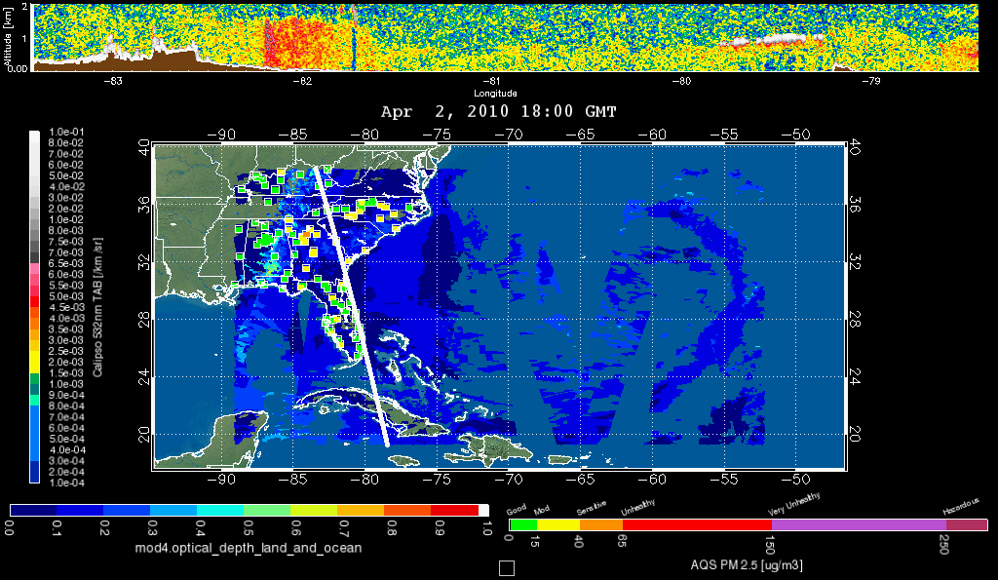
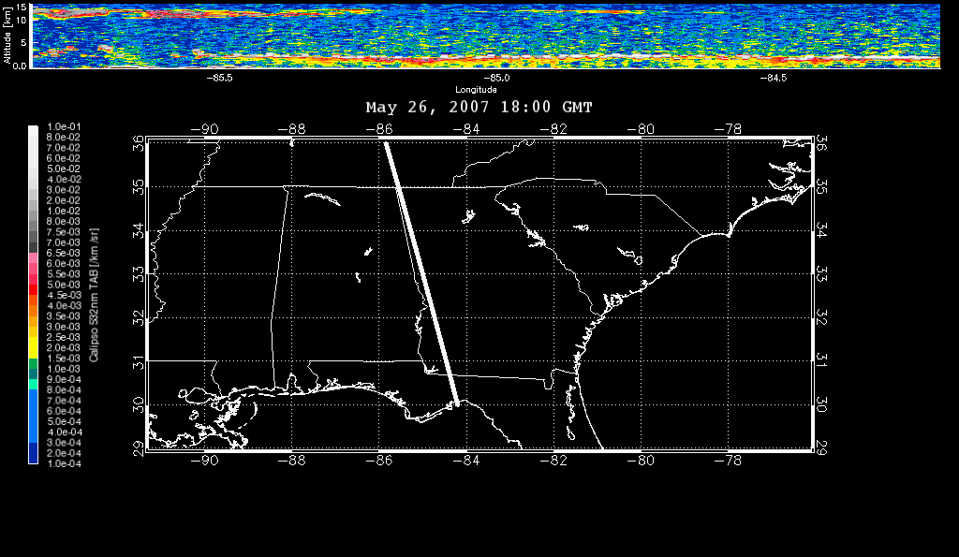
CALIPSO Backscatter
CALIOP Backscatter
  Cloud-Aerosol Lidar with Orthogonal Polarization (CALIOP)
  Located aboard Cloud-Aerosol Lidar and Infrared Pathfinder Satellite Observation (CALIPSO) polar orbiting satellite
  Active Lidar measures vertical profile of backscattered intensity
  Provides profile of vertical distribution of aerosol and clouds
  Surface footprint of 70 m; vertical resolution of 30 m
  Able to penetrate clouds
Notes:
Surface footprint: 70 m. Vertical resolution: 30 m.
Measures: total attenuated backscatter at 532 nm.
Provides single-shot lidar profile illustrating the vertical distribution of aerosol and clouds.
Can tell us about the vertical distribution of smoke aerosols

Slide 8
Finding Acceptable Days
  Daily PM_{2.5} concentrations must violate NAAQS in the Atlanta region (>35.5 µg m⁻³)
  Evaluate surface PM_{2.5} concentrations
Suitable remotely sensed and/or surface based datasets must be available
  MODIS AOD retrievals → cloud fraction for un-obscured conditions
  CALIPSO backscatter if available
Study Days Chosen
  5/22, 5/23, 5/26, 5/27, 5/28, 5/31, 6/1

Slide 9
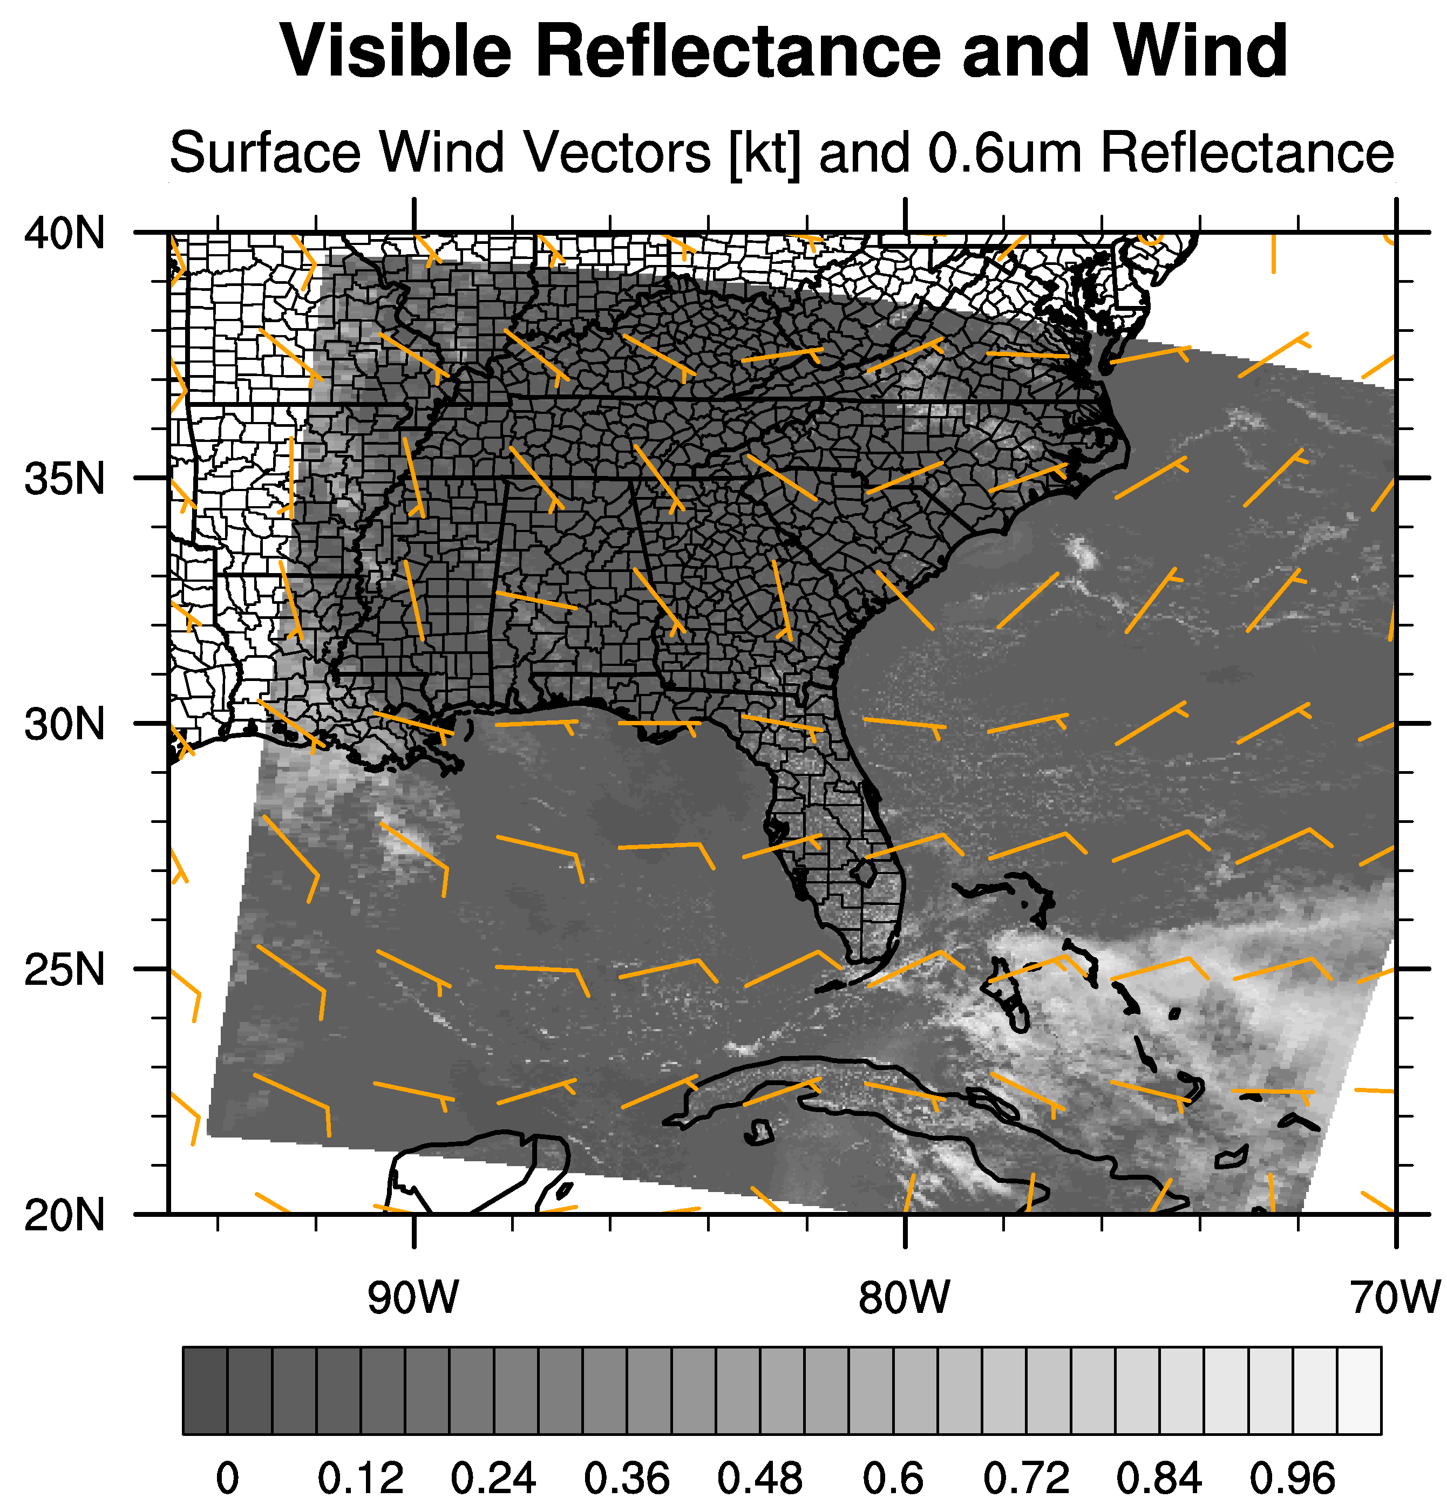
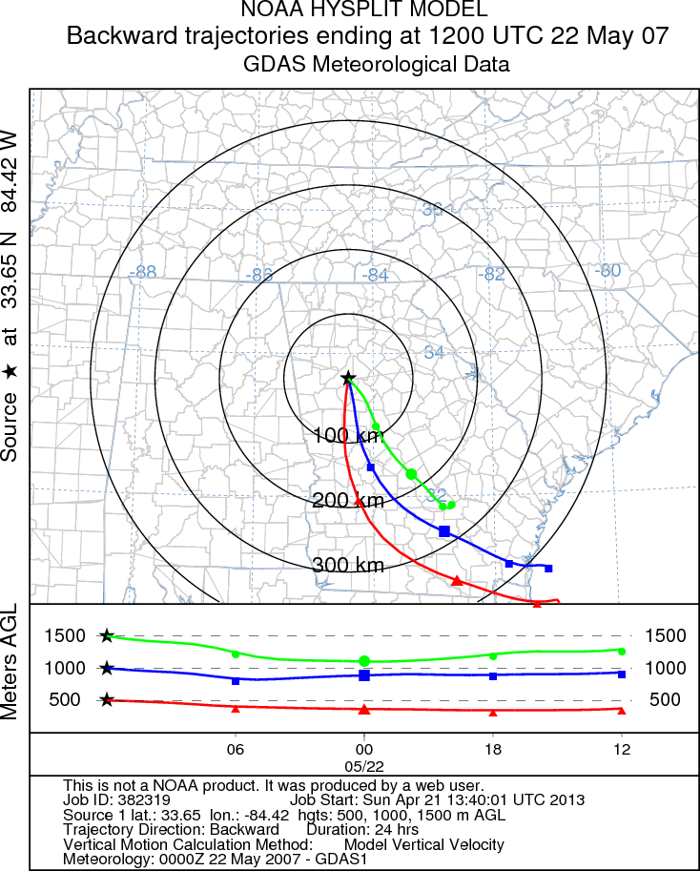
Tracking the plume
Example high PM 2.5 day in Atlanta
Dry and stable
Smoke transported NE from fire region towards Atlanta
Notes:
HYSPLIT: Hybrid Single-Particle Lagrangian Integrated Trajectory
Uses gridded met data with interpolation
Advective motion with random component to the motion at each step
according to the atmospheric turbulence at that time.

Slide 10
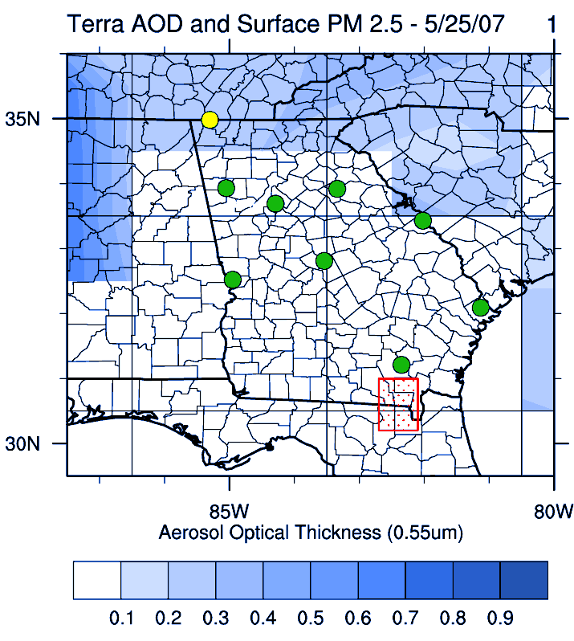
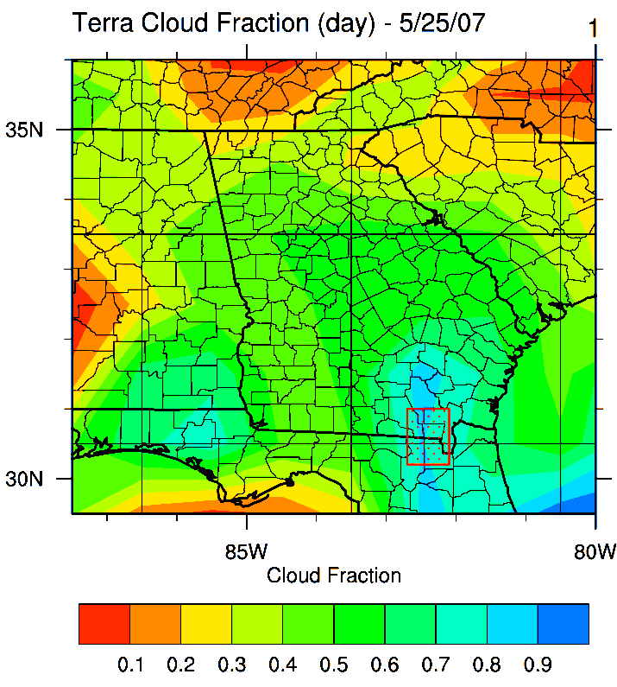
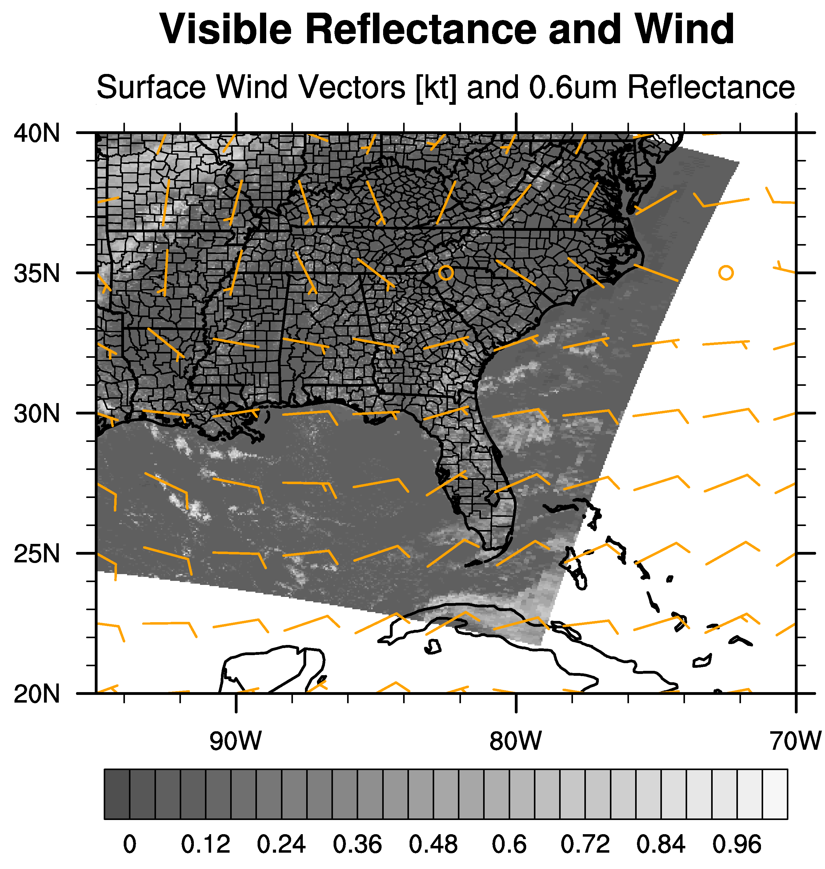
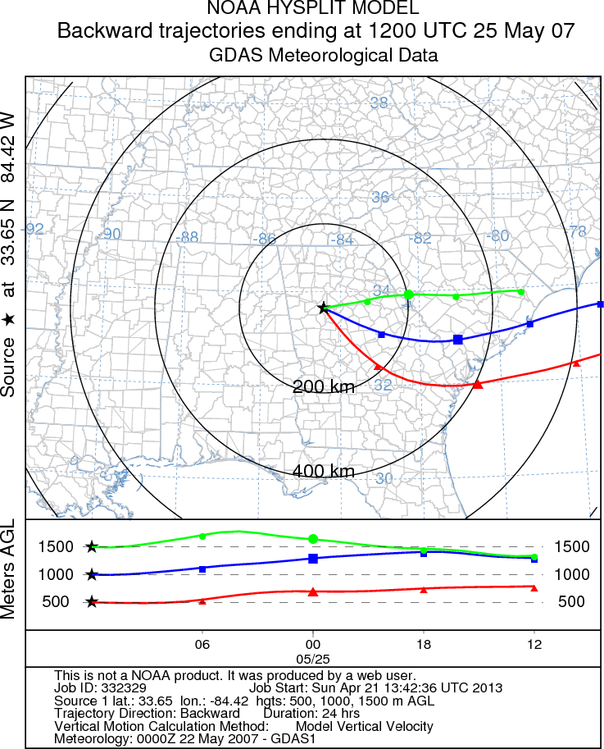
Tracking the plume
Example low PM 2.5 day in Atlanta
Moist and unstable
Smoke transported E from fire region away from Atlanta

Slide 11
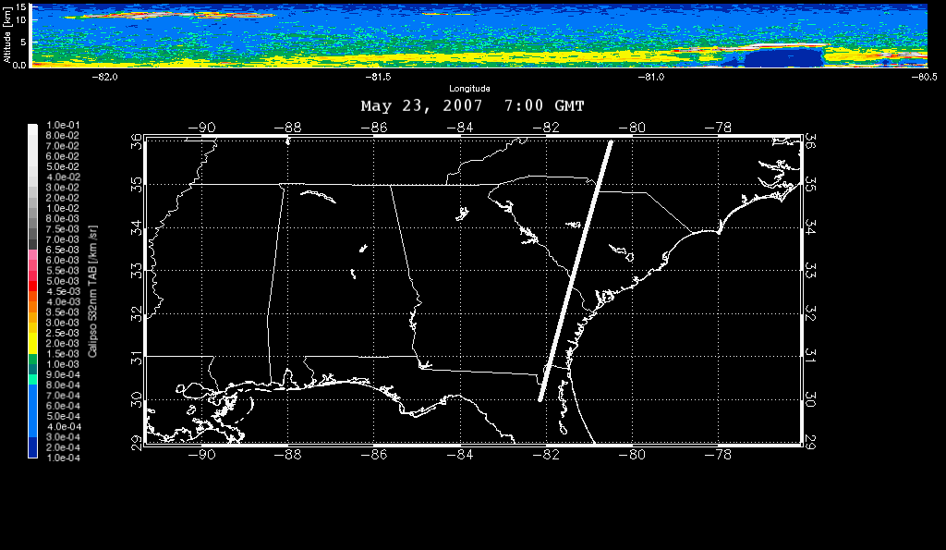
Tracking the plume
CALIPSO Backscatter
Elevated aerosol layer in fire region (top)
Aerosol layer in western Georgia (bottom)

Slide 12
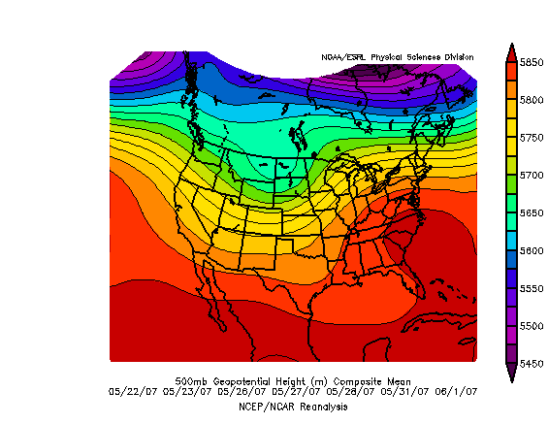
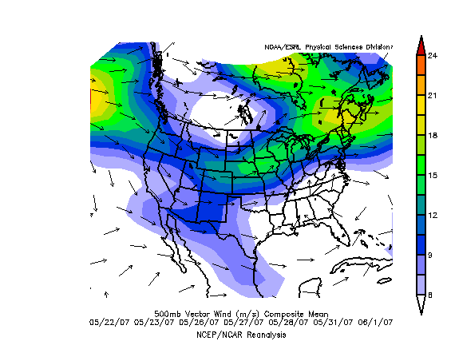
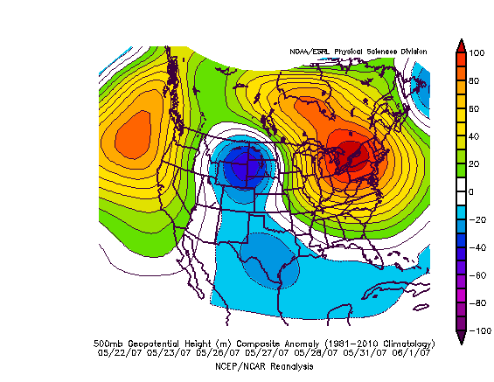
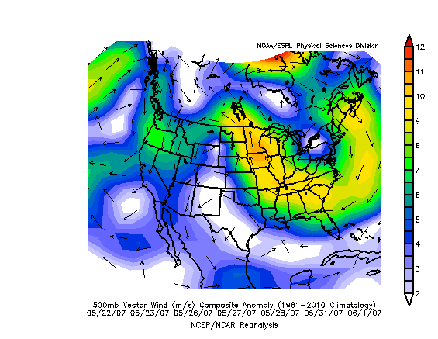
Smoke Transport and Meteorology
L
H
Notes:
NCEP/NCAR reanalysis: Composite of regridded surface wind fields (1° x 1° resolution)
as obtained from the deterministic Global Forecast System (GFS) model

Slide 13
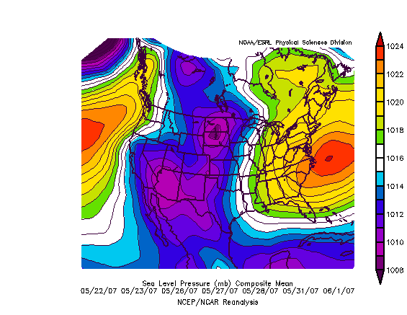
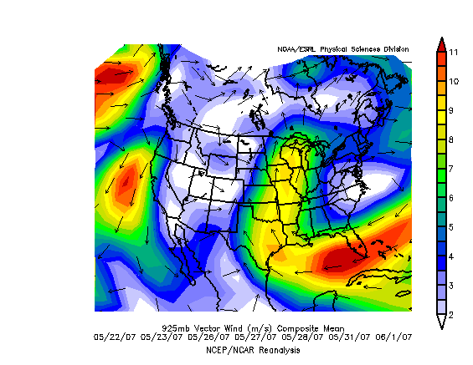
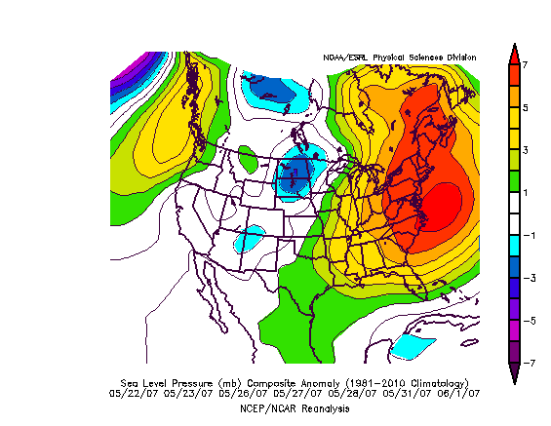
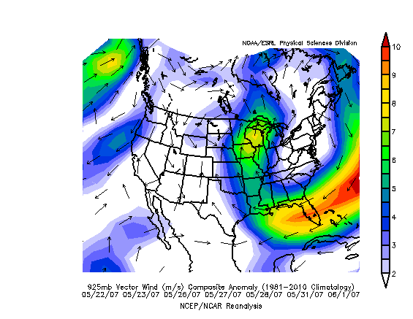
Smoke Transport and Meteorology
L
H
Notes:
NCEP/NCAR reanalysis: Composite of regridded surface wind fields (1° x 1° resolution)
as obtained from the deterministic Global Forecast System (GFS) model

Slide 14
Conclusion
Favorable Conditions for Smoke Transport to Atlanta during fire episode
  Anomalous mid-level ridging from Southeast into Great Lakes region; upper steering pattern favors anomalous northeasterly transport over the Southeastern region
  Anomalous surface ridging from the Southeast into New England; low-level flow again favors northeasterly transport over the Southeast region
These meteorological patterns match the observed movement of the smoke plume via remotely sensed and surface-based datasets and are supported by computed backwards trajectory analysis

Slide 15
References
Alston, J., I. Sokolik, and G. Doddridge. 2011. Investigation into the Use of Satellite Data in aiding Characterization of Particulate Air Quality in the Atlanta, Georgia Metropolitan Area, Journal of Air & Waste Management Association 61:211-225, doi:10.3155/1047-3289.61.2.211
Christopher, S., P. Gupta, U. Nair, T.A. Jones, S. Kondragunta, Y-L Wu, J. Hand, and X. Zhang. Satellite Remote Sensing and Mesoscale Modeling of the 2007 Georgia/Florida Fires, IEEE J. of Selected Topics in Applied Earth Sciences and Remote Sensing, 2009.
National Ambient Air Quality Standards for Particulate Matter: Final Rule 40 CFR
Part 50. Fed. Regist. 2006, 71, 61444-61233.
Li, Z., M.C. Cribb, F. Chang, and P. Trishchenko. Validation of MODIS-Retrieved
Cloud Fractions Using Whole Sky IAGER Measurements at Three ARM Sites,
Fourteenth ARM Science Team Meeting Proceedings, Albuquerque, New Mexico,
March 22-26, 2004.

Slide 16
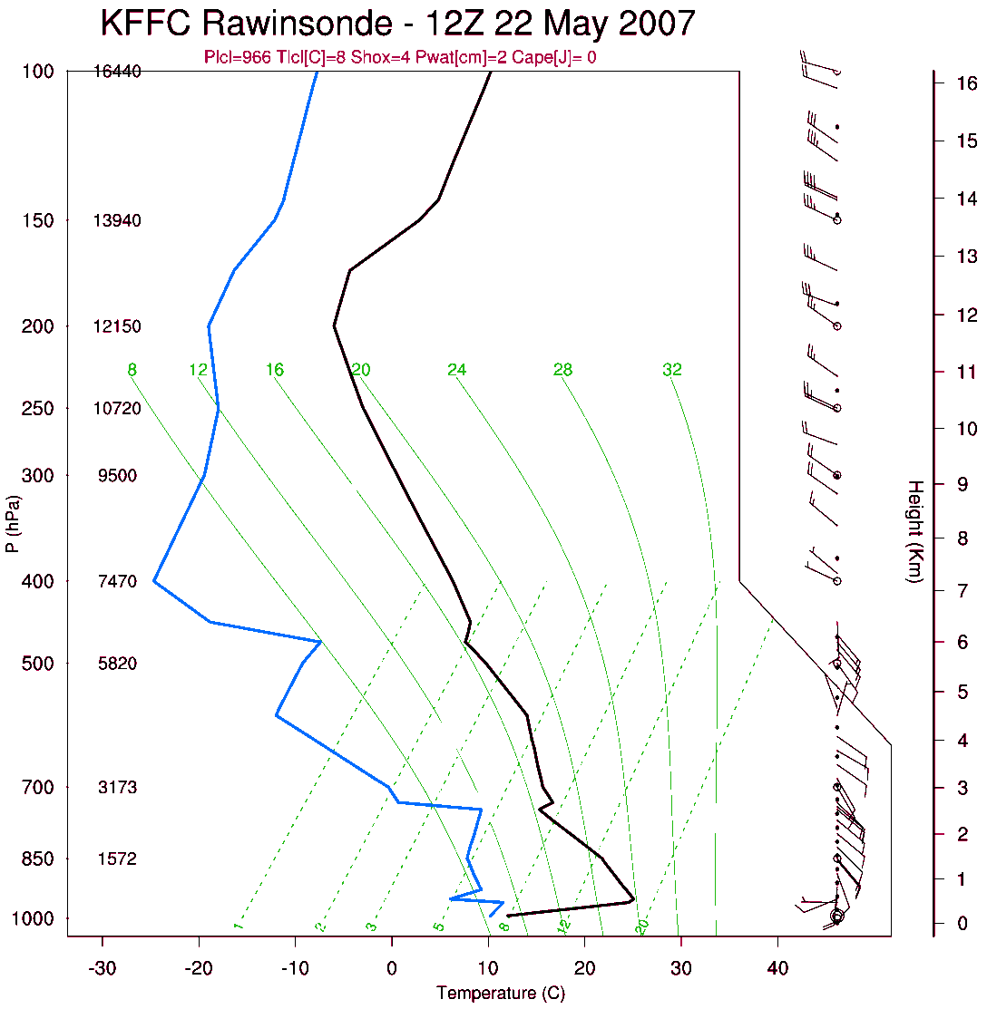
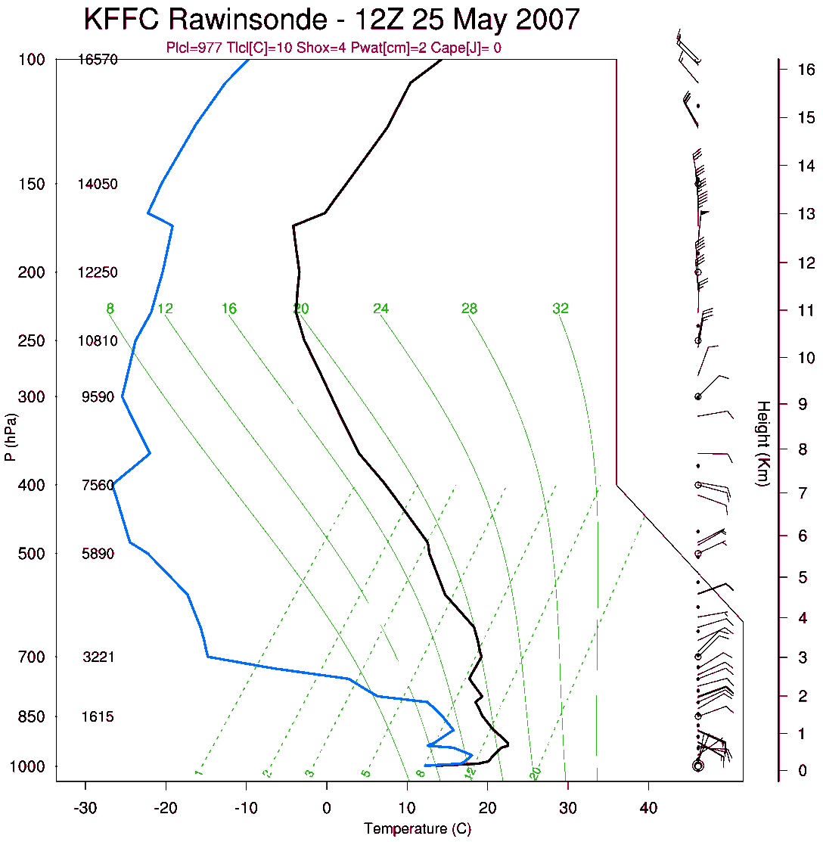
S1: Stability Comparison

Slide 17
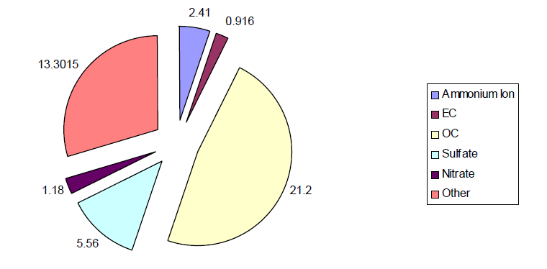
S2: Speciation
Speciation for South DeKalb monitoring site on 5/27/07
  Uncharacteristically high concentrations of organic and elemental carbon
  Combined elemental and organic carbon makes up nearly 50% of the particle species detected
  These are markers for fire

Slide 18
S3: Forecasting Issues
Forecast challenges associated with smoke event
  Meteorology played large role in daily fluctuations
  Large source for error and uncertainty in daily PM forecasts for metropolitan Atlanta and Columbus areas

Slide 19
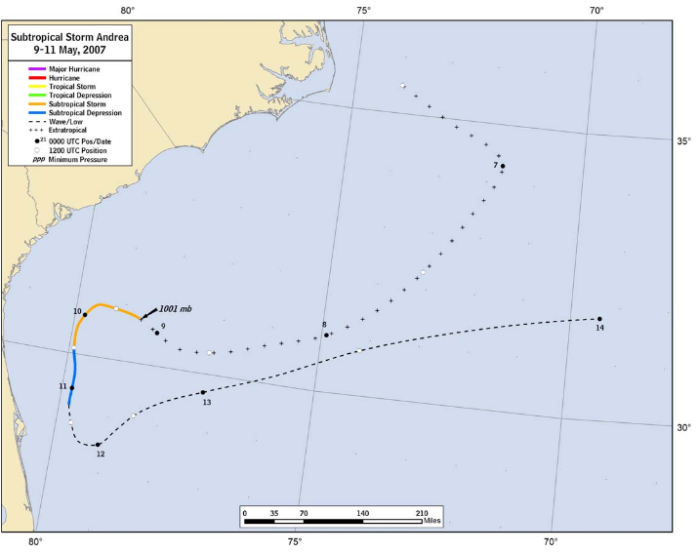
S4: Subtropical Storm Andrea

