Slide 1
Effects on Indoor Air Quality of Outgassing of Household Materials
Or
How The Things Your House Is Made of Are Trying to Slowly Kill You
Michael Mckenzie

Slide 2
Indoor Air Quality
Most people familiar with common pollutants such as dust, CO, methane (natural gas leaks), asbestos, etc.
Others are at least aware of other less prominent problems: O3 from machines, radon, cleaning supplies, cooking fumes
Almost no thought given to solid objects

Slide 3

What Solid Objects Should I be Scared Of?
Furniture, Upholstery, Plywood, Particle Board, Faux Wood Laminates, Dried Adhesives and Paints, Carpets, Cosmetics, Foam Insulation, Glass Fiber Insulation, Faux Leather, Plastic Toys, Plastic Kitchen Ware, Stucco, Concrete, Bricks, Dyed Fabric, Window Frames, Synthetic Windows, Rubbers, Waxes…..Need I say More?

Slide 4
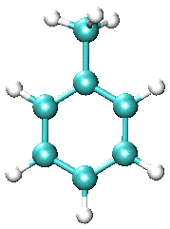
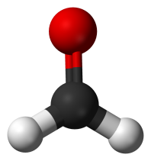
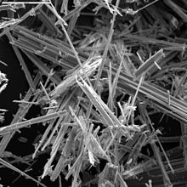
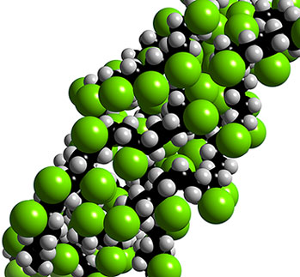
What Comes Out of Them?
VOC’s: Toluene, Benzene, Naphthalene, Formaldehyde
Plasticizers: (phthalates)- used in plastics for softness and flexibility
Organochlorines: found in plastics and electronics, (tink PVC and PCB)
Particles: Dust, fibers, toxic metals, etc
These chemicals responsible for familiar smells, (“new car smell,” “clean house smell,” etc)
Many of these cause chronic illness and are carcinogenic

Slide 5

Sick Building Syndrome
Buildings that make inhabitants feel “icky” to dysfunctional
Caused by poor lighting, poor ventilation, presence of various pollutants, including those outgassed by common objects and construction materials
Big problem for older offices and housing

Slide 6
Multiple Chemical Sensitivity
Describes people with severe symptoms triggered by exposure to chemicals
Symptoms can range from general nausea, headache, and fatigue, to flu-like sickness, to severe dysfunction of entire body, (Jean Enwright).
Exact details controversial in medical community; opposing theories include psychological issues and pre-existing sensitivities/ allergies

Slide 7
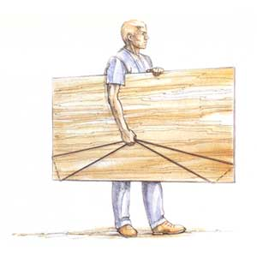
Focus on Formaldehyde
Good representative of outgassed chemicals due to prevalence in so many products, (widely known as embalming fluid).
Background outdoor concentration: 0.01-0.03ppm from combustion
Can smell it at ~0.1ppm→ This is a standard indoor air safety limit
Homes and workplaces often register 1-3ppm in bad cases
Outgassing increased with temperature and humidity
Acts as strong irritant; can cause headaches, dizziness, breathing problems; in the long term, can affect nervous system and is a likely carcinogen
Already banned in one type of insulation, but still allowed in smaller amounts in many products.
Case Study: Occupational Exposure in Plywood/ Particle Board Manufacture
The average personal exposure was to 1.13ppm of formaldehyde. Exposure to formaldehyde was associated with… several respiratory symptoms and diseases, including cough, phlegm, asthma, chronic bronchitis, and chest colds. The results of the study support the hypothesis that chronic
exposure to formaldehyde induces symptoms and signs of chronic obstructive lung disease.

Slide 8
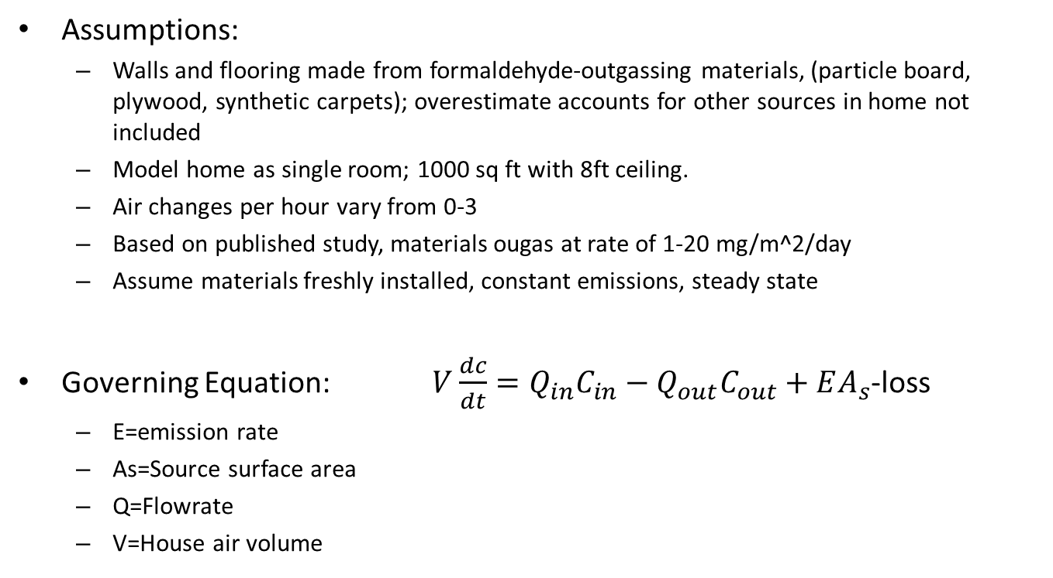
Simple Box Model: Formaldehyde Exposure In a 3 person Home
Assumptions:
  Walls and flooring made from formaldehyde-outgassing materials, (particle board, plywood, synthetic carpets); overestimate accounts for other sources in home not included
  Model home as single room; 1000 sq ft with 8ft ceiling.
  Air changes per hour vary from 0-3
  Based on published study, materials ougas at rate of 1-20 mg/m^2/day
  Assume materials freshly installed, constant emissions, steady state
Governing Equation: $V\frac{dc}{dt}=Q_{in}C_{in}−Q_{out}C_{out}+EA_{s}$-loss
  E=emission rate
  As=Source surface area
  Q=Flowrate
  V=House air volume

Slide 9
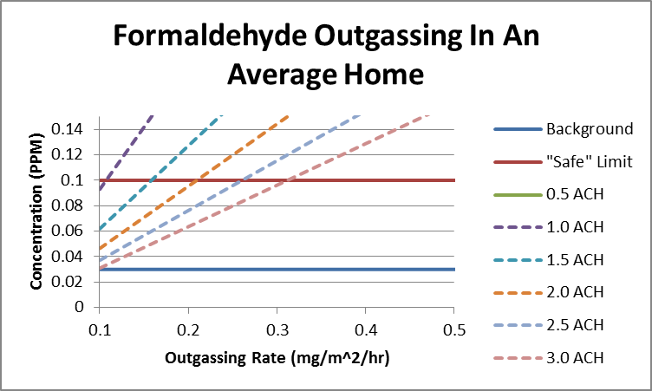
Model Results
To achieve safe levels, with high outgassing, need to increase ventilation X2-5 times largest average residential systems.

Slide 10
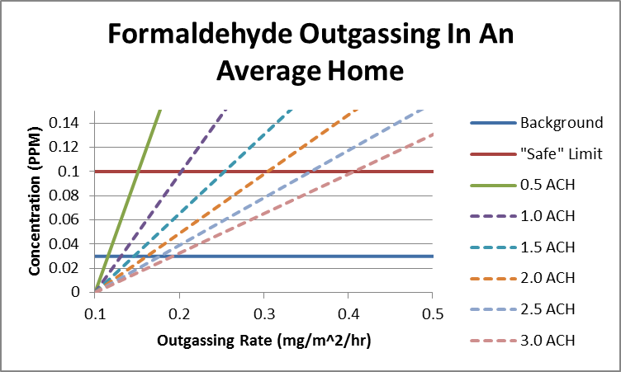
House Full Of 20 Plants

Slide 11
What To Do Now
Important to understand the wide array of potential health impacts common items can have
Even if you aren’t noticeably chemically sensitive, why take risks?
  Make sure indoor environments are well ventilated at minimum.
  Consider swapping outgassing materials for more stable/ natural ones.
  Give potentially harmful products time to outgass before bringing them into your home/ office, (anywhere from several days to weeks).
  Buy housplants known to filter out VOC’s
    Boston fern, pot mum, date palm, etc.

Slide 12
References
(In Case You Don’t Believe Me)
Rousseau, David. Your Home, Your Health and Well Being. Ten Speed Press. 1988
Dunford, Randall Earl. Your Health & the Indoor Environment, 2nd ed. NuDawn Pub. 1994
Tan Malaka M.D., Dr. P.H. & Arthur M. Kodama Ph.D. (1990): Respiratory Health of Plywood Workers Occupationally Exposed to Formaldehyde, Archives of Environmental Health: An International Journal, 45:5, 288-294
USA Consumer Product Safety Commission. An Update on Formaldehyde. Publication 725. 2013 Revision.
Rogozen, Michael B. et al. Formaldehyde: A Survey of Airborne Concentrations and Sources. Prepared for State of California Air Resources Board by Science Applications, Inc. 25 June 1984.
Baumann, Melissa G.D. et al. Terpene Emissions From Particleboard and Medium-Density Fiberboard Products. Composites and Manufactured Products. Forest Products Journal. Vol 49. No1. January 1999.
Wolverton, B.C., Wolverton, John D. Plants and Soil Microorganisms: Removal of Formaldehyde, Xylene, and Ammonia From the Indoor Environment. Wolverton Environmental Services. Journal of the Mississippi Academy of Sciences. Vol 38, No 2. August/ September, 1993.

