Slide 1
Convection scheme
Yanqing Su, Ye Cheng

Slide 2
Mostly often used scheme
Manabe et al (1965)
Convective adjustment
When the lapse rate of a saturated area exceeds the moist adiabatic lapse rate
All condensed water is removed as precipitation
Kuo (1974)
Partitioning between moistening and precipitation
Arakawa and Schubert (1974)
Entraining plume
Convection consume the instability at a rate at which the grid scale supplies the instability
Similar to Grell 1 model
Lack generality

Slide 3
Kuo’s model
Moistening parameter b:
determine fraction of supplying moister is used to increase moisture of the column
Critical relative humidity:
below which only moistening occurs
Mean environmental relative humidity
Moisture supply:
1, large-scale convergence
2, surface evaporation
Assumption:
Cumulus cloud air dissolves into environment at a same rate generated by moisture supply
Anthes 1977

Slide 4
Observation basis
Not bulk entraining plume
Fluctuations in vertical direction are larger than horizontally average value
Velocity
Temperature
Water vapor
Liquid water content
Penetrative downdrafts
Turbulent mixing of dry environmental air at the cloud top
The plume model
cannot mimic the transports in which updrafts and downdrafts are equally important
Emanuel, K. A. (1991)

Slide 5
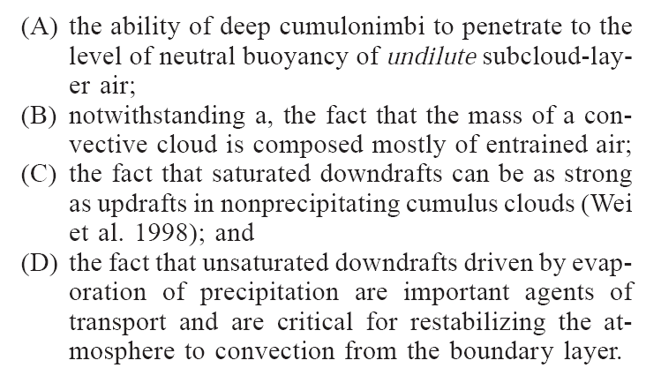
Observed Cumulus Cloud
Emanuel, K. A., and M. Živković-Rothman (1999)

Slide 6
Ema
Initiated when the level of neutral buoyancy is greater than the cloud base level
mixing in clouds (episodic, inhomogeneous)
convective fluxes
an idealized model of sub-cloud-scale updrafts and downdrafts
Physical base model
auto-conversion of cloud water into precipitation
Ice process
Emanuel (1991); Emanuel and Zivkovic-Rothman (1999)

Slide 7
Basics of E91
The buoyancy sorting hypothesis
An open the issue of the rate of mixing between the plume and its environment
In laboratory plumes, experiments and dimensional analysis
strongly support mixing as a simple function of the mean upward velocity of the plume
mixing hypothesis (subcloud-layer quasi-equilibrium hypothesis (Raymond, 1995))
together with buoyancy sorting determine the net mass flux, given the net upward mass flux

Slide 8
Basics of E91
the fraction of condensed water that is converted to precipitation
the remainder will contribute to moistening the environment
stochastic coalescence
the Bergeron-Findeisen mechanism
converting all cloud water in excess of a threshold content to precipitation within each sample of cloud air (E91)
Convection is assumed to originate from that level has the highest value of moist static energy

Slide 9
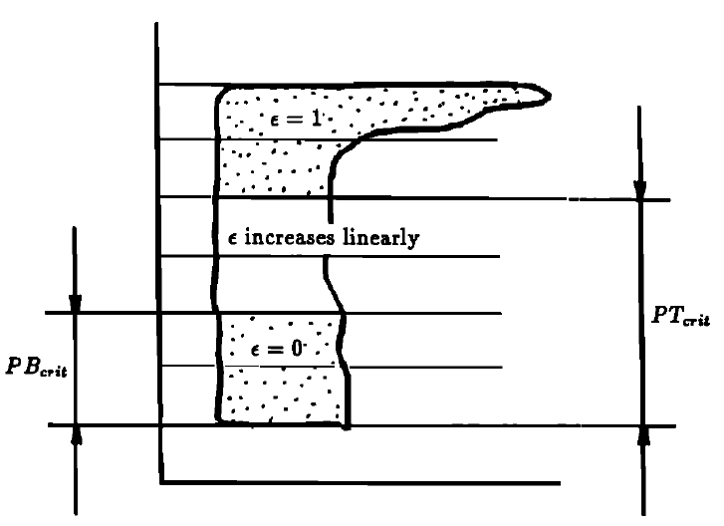
Microphysical parameters
Parcel precipitation efficiencies
Fraction of precipitation
Fractional area covered by precipitating downdrafts
Critical draft thickness
Rennó, N. O., K. A. Emanuel, and P. H. Stone (1994)

Slide 10
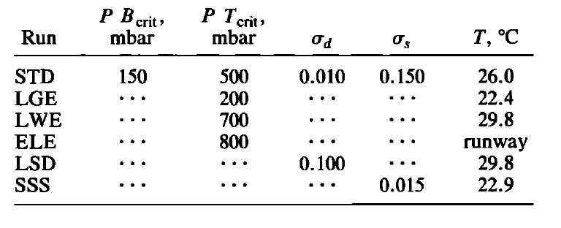
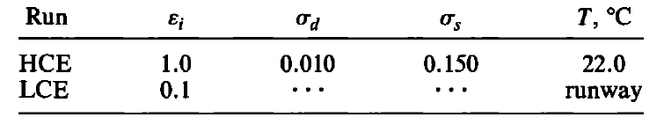
Climatic Sensitivity of the Parameters
Vertically varying precipitation efficiency
Rennó, N. O., K. A. Emanuel, and P. H. Stone (1994)

Slide 11
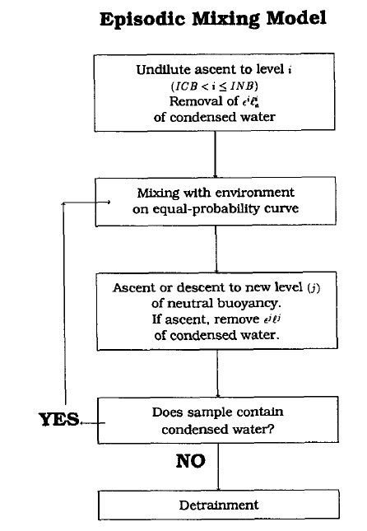
Emanuel, K. A. (1991); Rennó, N. O., K. A. Emanuel, and P. H. Stone (1994)

Slide 12
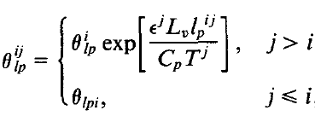
Liquid water potential temperature
Sub-cloud air elevated from i to j
Environment air elevated displaced adiabatically from i to j
Fraction of environment air in the mixture from i to j
Mass flux of a mixture from i to j

Slide 13
Rate of evaporation of precipitation at different level
Undiluted updraft mass fluxes
Convective available
potential energy

Slide 14
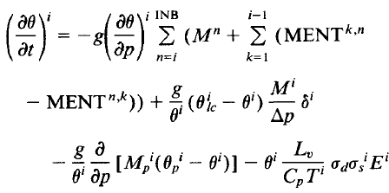
Total convective tendency of potential temperature
Saturated up/downdraft
Unsaturated downdraft
Input: Theta(z), r(z), P(z)
Output: Theta(t), r(t), E(t)
Water mixing ratio tendency
Parameters need to be specified/diagnosed (2N+1):
N Parcel precipitation efficiencies
N Fraction of precipitation
Fractional area covered by precipitating downdrafts

Slide 15
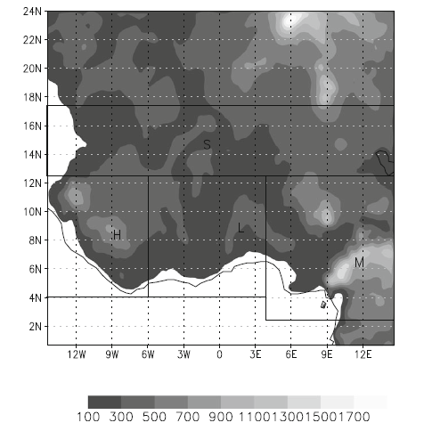
Precipitation during the Septembers of 1989 over West Africa
RegCM 4.0
The regional climate model of the International Centre for Theoretical Physics
West African Monsoon
Adeniyi, M. O. (2014)

Slide 16
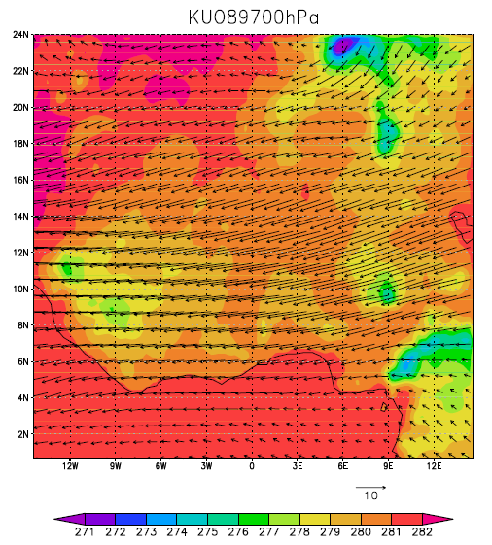
General circulation of the atmosphere and the Sahara thermal low (STL)
Anti-clockwise
Anti-Clockwise
Consistent with Flaounas et al. 2011

Slide 17
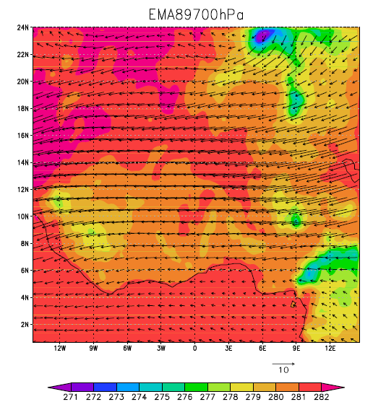
General circulation of the atmosphere and the Sahara thermal low (STL)
Clockwise
Consistent with Flaounas et al. 2011
Anti-Clockwise

Slide 18
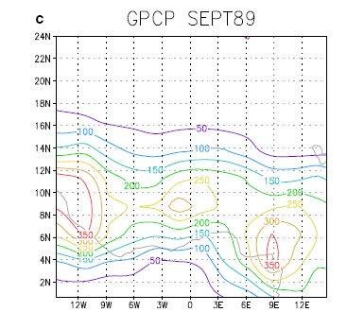
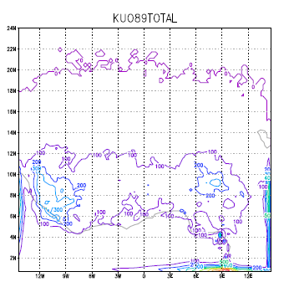
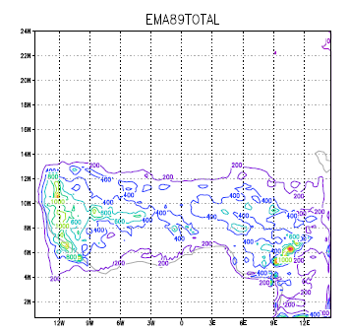
Total = convective + large scale
Total 1989 September precipitation (mm) from GPCP version 2 land and ocean precipitation data
Underestimation
Overestimation

Slide 19
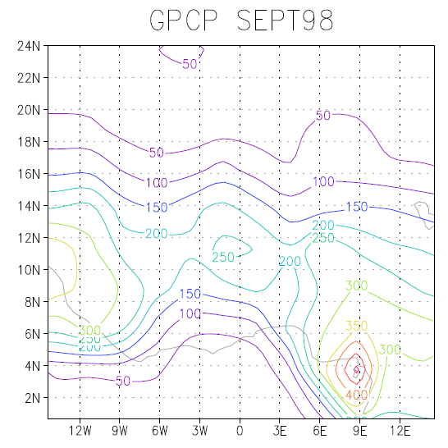
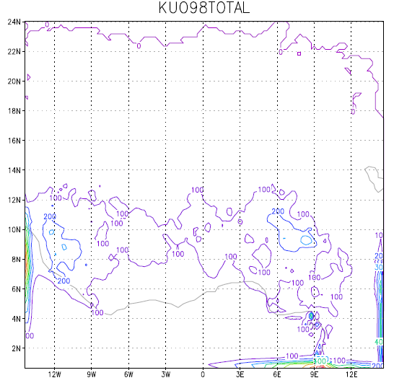
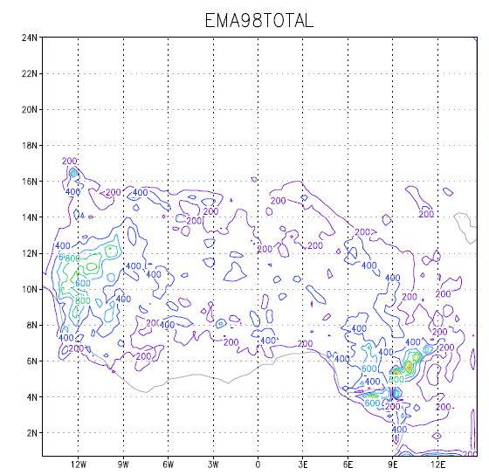
Total = convective + large scale
Total 1998 September precipitation (mm) from GPCP version 2 land and ocean precipitation data

Slide 20
Grell Scheme -Geog A. Grell
RegCM:
Grell1 1993
Grell2 2006
WRF：
Grell-Devenyi 2002
Grell_Freitas 2013
Grell 3 2008

Slide 21
Grell Scheme
two steady-state circulations
an updraft
a downdraft
Direct mixing at the top and bottom of the circulations
- cloudy air and environmental air
no entrainment or detrainment along the cloud edges
Closure for equation solutions
AS74-Grell1
FC80-Grell2
Grell (1993)

Slide 22
Static control
The static control determines the updraft or down draft properties, and includes such mechanism as entrainment, detrainment, and microphysics.
(1)
μ is the total net fractional entrainment rate of the buoyant element, m is the mass flux.
(2)
Where λ is the cloud type, μue is the gross fractional entrainment rate and μu and μd are the total net fractional entrainment rate and detrainment rate of the updraft, respectively.
Grell (1993)

Slide 23
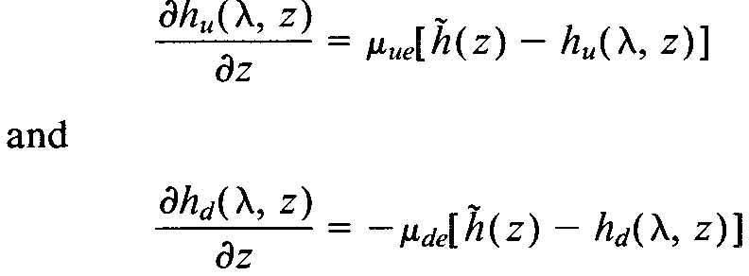
(3)
α is a thermodynamic variable in an infinitesimal layer of updraft, tilde denotes an environmental value and u denotes the updraft property. S stands for sources or sinks.
Together (2) and (3) we get
(4)
The same for downdraft:
(5)
(A) For moist static energy
(6)
Together with (5)
(7)
(8)
Grell (1993)

Slide 24
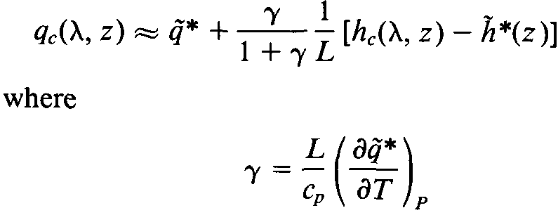
(b) For moisture budget
(9)
(10)
Su is the total water that is rained out, C0 is a rainfall conversion parameter and could be a function of cloud size or wind shear, ql is the suspended liquid water content in cloud and qu is the water vapor mixing ratio inside the updraft.
So, for updraft and downdraft we have :
(11)
(12)
Here Sd is the source, namely, evaporation in rain.
(13)
Approximate equation:
Grell (1993)
(14)

Slide 25
(c) For mass fluxes
(15)
(16)
(17)
(18)
Mb is the updraft base mass flux and m0 is the downdraft base mass flux. Is the normalized mass-flux profile.
To leave only one unknown variable, it follow Houze et al (1979), and make the originating mass flux of the downdraft a function of updraft mass flux and reevaporation of convective condensate. So the condensate in updraft is
(19)
(20)
(21)
Grell (1993)

Slide 26
(22)
where I1 is the normalized updraft condensation, I2 is the normalized downdraft evaporation, and β is the fraction of updraft condensation that re-evaporates in the downdraft. β depends on the wind shear and typically varies between 0.3 and 0.5. Rainfall is given by
(23)
The levels of maximum and minimum moist static energy indicate the originating levels of the updraft and downdraft, respectively. That is the boundary conditions:

Slide 27
Feedback
The feedback specifies the modification of the environment by convection. It distributes the total integrated heating and drying in the vertical.
(24)
(25)
(26)
(27)
(28)
Fs is the flux of dry static energy, Fq is the flux of water vapor, Fl is the flux of suspended cloud liquid water and Rc is the convective-scale sink of cloud water

Slide 28
Dynamic control
The dynamic control determines the modulation of the convection by environment. It gives how and where the convection will be.
(29)
Where Bu is the acceleration due to buoyancy and Fr is the deceleration due to the friction
Multie ρu and wu :
(30)
Using
(31)
D is the updraft-scale kinetic energy dissipation.

Slide 29
(32)
(33)
The same for downdraft
(34)
(35)
Add (32)-(35) we have the total cloud work function:
(36)
(37)

Slide 30
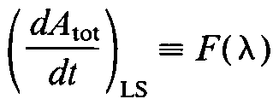
AS separated the change of the cloud work function into two parts: one is due to the change in the large-scale variable:
(38)
One is due to the modification of the environment by clouds.
(39)
(40)
K(λ，λ’) are the kernels, which are an expression for the interaction between clouds (updrafts and downdrafts)
Grell (1993)

Slide 31
Grell 1
Directly implements the quasi-equilibrium assumption of AS74.
It assumes that convective clouds stabilize the environment as fast as non-convective processes destabilize it as follows:
(41)
where ABE is the buoyant energy available for convection, ABE′′ is the amount of buoyant energy available for convection in addition to the buoyant energy generated by some of the non-convective processes during the time interval Dt, and NA is the rate of change of ABE per unit mb. The difference ABE′′ −ABE can be thought of as the rate of destabilization over time Dt. ABE′′ is computed from the current fields plus the future tendencies resulting from the advection of heat and moisture and the dry adiabatic adjustment.
Grell (1993)

Slide 32
Grell 2:
A stability based closure assumption, the FC80 type closure assumption. In this closure, it is assumed that convection removes the ABE over a given time scale as follows:
(42)
The fundamental difference between the two assumptions is that the AS74 closure assumption relates the convective fluxes and rainfall to the tendencies in the state of the atmosphere, while the FC80 closure assumption relates the convective fluxes to the degree of instability in the atmosphere.
Grell (1993)

Slide 33
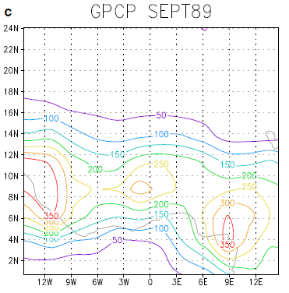
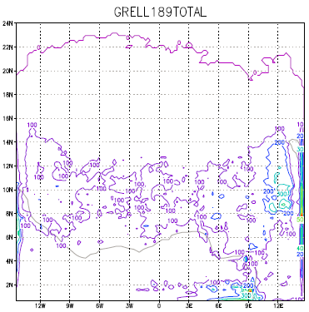
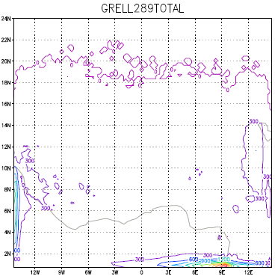
Observed
Grell 1
Grell 2
Fig 1, precipitation comparation

Slide 34
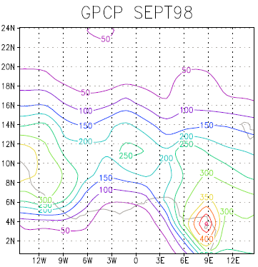
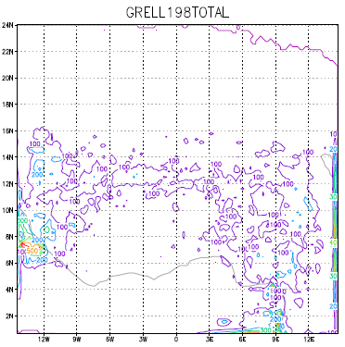
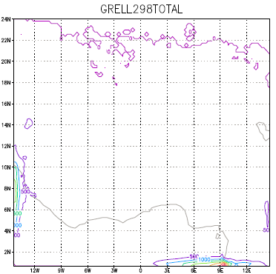
Fig. 3 Total simulated September precipitation (mm) for the four RegCM4.0 simulations in 1989

