Slide 1
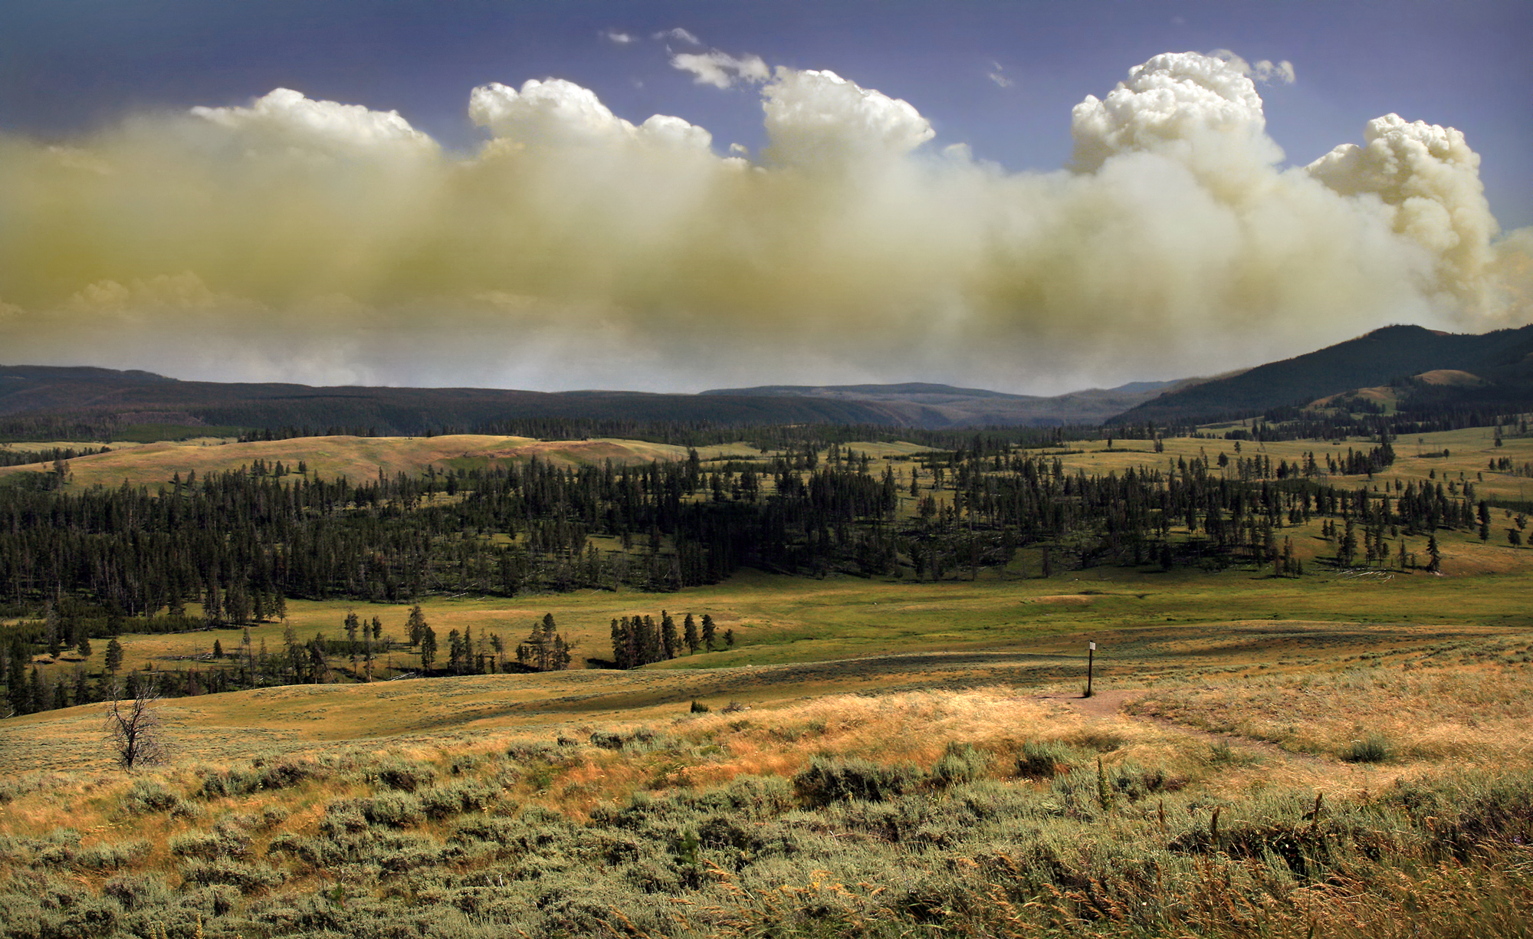

Biomass Burning
Group Members
Kevin Whitmore, Patrick Kim and Young-Ro Lee

Slide 2
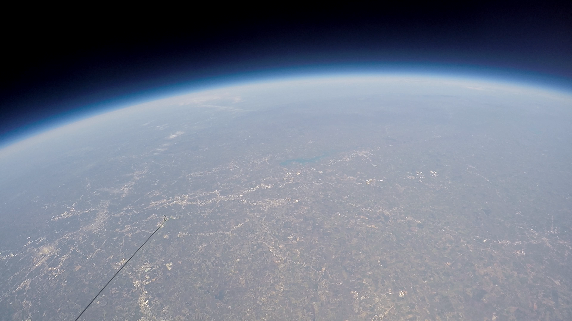
Outline
Photo Credit: Geophysical Institute

Slide 3
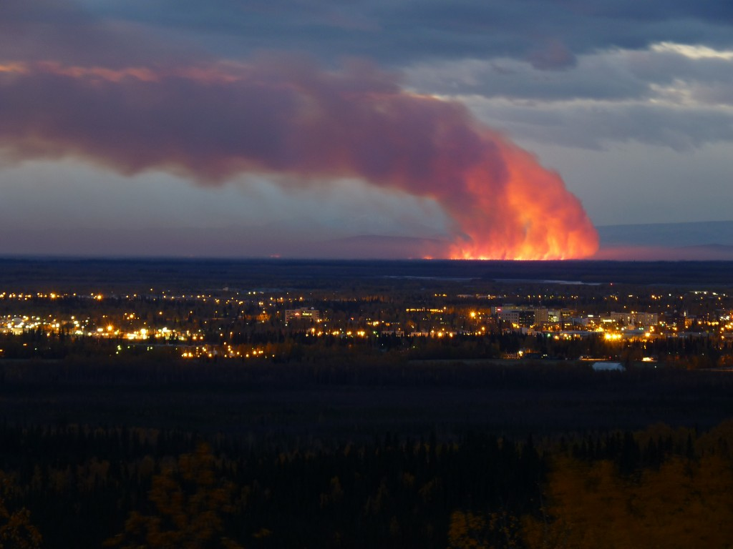
Outline
1. Ignition and Emissions
(Kevin)
2. Plume Injection Heights
(Patrick)
3. Plume Evolutions
(Young Ro)
Photo Credit: Geophysical Institute

Slide 4
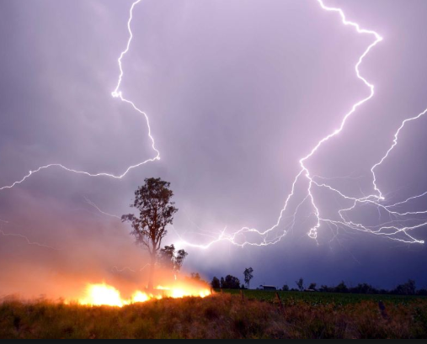
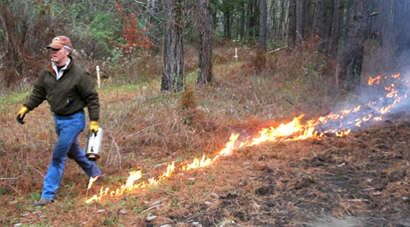
Introduction
Large scale fires can be classified into 2 categories
  Wildfires
  Prescribe Fires
.3% of the US burned in 2018
  Tropical ecosystem fires consume as much as 80% of the total biomass burned each year
  Fires in the USA only produce 2-3% of global emissions [1]
Human Impacts
  Aggravated Asthma
  Chronic Bronchitis
  Decreased Lung Function
  Congestive Heart Failure
  Premature Death
Photo: Google Image
Notes:
Prescribe fires are a tool used for land management and account for the majority of the area burned in the US each year. Prescribed fires are burned to reduce fuel accumulation due to underbrush build up. They are burned as to minimize air quality impacts on local and regional populations. Mostly in the southeast.
Wildfires are uncontrolled burnings that typically happen in the western half of the US, although they can happen anywhere if the right conditions are present. This type is of major concern to public health as these plumes often effect large population centers. They can occur by lightning or human intervention
Global estimations of mass burned are based on a combination of laboratory-scale fire tests, field measurements from fires, and detailed experiments conducted in outdoor settings in the US.

Slide 5
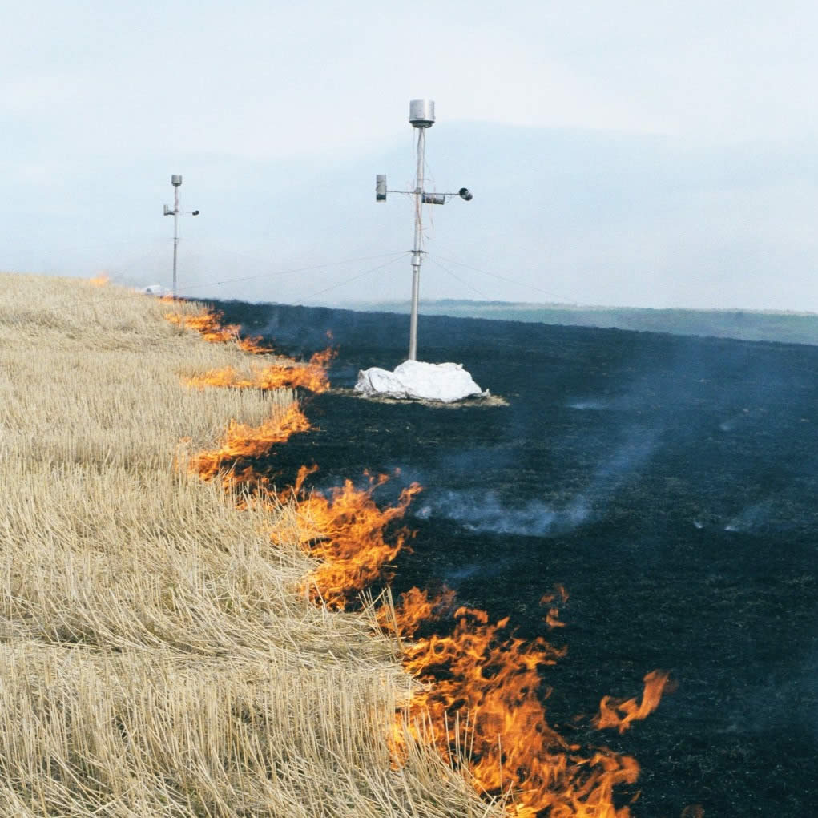

Primary Fire Emission Factors
Fuel Conditions
  Type, Structure, Quantity, and Moisture Content
Fire Intensity
  Energy output from fire ($Wm^{−2}$)
Fire Weather
  Cumulative Temperature, Relative Humidity, Wind Speed, Precipitation
The total amount of emissions can be quantified
  Emissions $=A∗B∗CE∗EF$
  A – area burned, B – mass of fuel per area, CE – combustion efficiency,
  EF – emission factor
Photo: Google Image
Notes:
These factors can quickly change as a fire burns and can even be different in across the landscape within a single fire
Accurate fire prediction is difficult to do. This can be done on a seasonal scale fairly well, but there is usually not enough information available to predict small scale fire growth and sperad.
A good example of the current uncertainty in emission factors can be found in the recent work of Liu et al. [2016] comparing statistics from the recent SEAC4 RS study with previous observations. Liu et al
CH3CN has emerged as the most reliable conservative tracer of biomass combustion, being widely measured in more recent airborne field studies to diagnose fire influence [de Gouw et al., 2003].

Slide 6
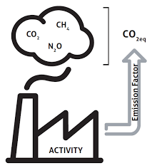

Emission Factors (EF)
Emission factors are measured as $\frac{grams of compound emitted}{kilogram of dry biomass burned}$
Non methane organic compounds (NMOCs) influence secondary organic aerosol (SOA ) and ozone formation
One estimate suggests 400$\frac{Tg}{yr}$ of NMOCs are emitted globally.
Notes:
Emission factors for open and domestic biomass burning for use in atmospheric models S. K. Akagi1 , R. J. Yokelson1 , C. Wiedinmyer2 , M. J. Alvarado3 , J. S. Reid4 , T. Karl2 , J. D. Crounse5 , and P. O. Wennber
https://www.fs.fed.us/rm/pubs_other/rmrs_2010_akagi_s001.pdf
Emission factors use a carbon mass balance method (Ward and Radke, 1993) The method assumes that all burned carbon is volatilized or contained in the emitted aerosol and that all major carbon-containing species have been measured.

Slide 7

Combustion Efficiency (CE)
CE is the fraction of fuel carbon converted to ${CO}_{2}$
CE depends strongly on the relative contribution
  Flaming Combustion
    Rapid reaction of $O_{2}$ converts C, H, N, and S into highly oxidized gases
    Produces most of the black carbon particles
    ~1400 K
  Smoldering Combustion
    Surface oxidation (gasification) and pyrolysis (thermal breakdown of solid fuel to gas)
    Produces $CO$, ${CH}_{4}$, NMOCs, and primary organic aerosols
    ~800-1000 K
Modified CE (MCE) is used to estimate CE defined as $\frac{∆{CO}_{2}}{∆{CO}_{2}+∆CO}$
Notes:
A Higher CE indicates more flaming combustion.
Flaming combustion typically involves solid biomass fuel and is common in foliage or dry aboveground biomass.
CE is hard to measure but MCE is used to estimate CE and is accurate within a few %.
Pure flaming has an MCE near 0.99 while the MCE of smoldering varies over a larger range (∼0.65–0.85), but is most often near 0.8. Thus an overall fire-integrated MCE near 0.9 suggests roughly equal amounts of biomass consumption by flaming and smoldering
CH4 - methane

Slide 8
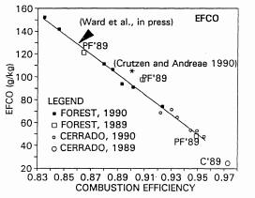
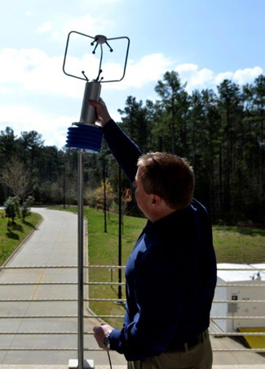
Methods of Measuring Emissions[1]
Micro-combustion
Controlled Laboratory Combustion
Ground-Based Sampling
Airborne Sampling
Satellite Techniques
Measurement Technique
  Ex: FTIR, PTR-MS, GC-MS, CIMS
Resolution
Scale
Ward et al. 1992
Notes:
Microcombustion – small scale burning. Very detailed results such as mechanisms and products produced, very small scale
CLC – can use very precise and sophisticated instruments for detailed analysis but cannot duplicate large scale phenomena except for very low intensity fires
Ground-Based Sampling – Sample fires downwind near the fire. Allows for study of emissions from natural fuel sources. Difficult to set up and expensive. Use towers and support cables to position measuring devices. Gives good data on fuel type
Airborne Sampling – uses airborne lidar measurements. Can collect a huge amount of data very quickly but it is expensive. Allows for observing interactions with overhead clouds.
Satellites are the best candidate for being able to measure global emissions.
Ptr-ms proton transfer reaction mass spectrometery, Gas chromatography–mass spectrometry, chemical ionization mass spectrometry

Slide 9
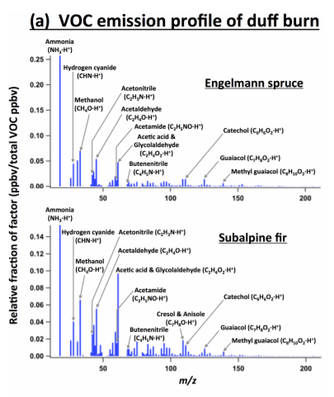
Why are Fire Emissions Important
A large variety of VOCs are produced during fire events
  Obtaining a complete profile of VOCs is very difficult
  This leads to a large degree of uncertainty in the chemical and physical evolution of the plume
An accurate profile of emissions are needed to assess:
  Human health impact
  Plume chemistry
Sekimoto et al. 2018
Notes:
Pyrolysis is the thermal decomposition of materials at elevated temperatures in an inert atmosphere.

Slide 10


Uncertainty Measuring Fire Emissions
Uncertainty in emission modeling makes fire prediction difficult^{[3]}
Each factor in the emissions equation must be estimated
  Multiple orders of magnitude of error can exist for each variable
Photochemistry of the plume depends on NO_{x} content
  NO_{x} content can vary widely based on location of the plume
  Emissions $=A∗B∗CE∗EF$
  Emissions $=A∗B∗CE∗EF$
Notes:
For example, the ratio of smoldering combustion to flaming combustion can affect CE and EF. Local weather effects such as RH can impact fire growth
Wildfires in eastern Texas in August and September 2000: Emissions, aircraft measurements, and impact on photochemistry

Slide 11
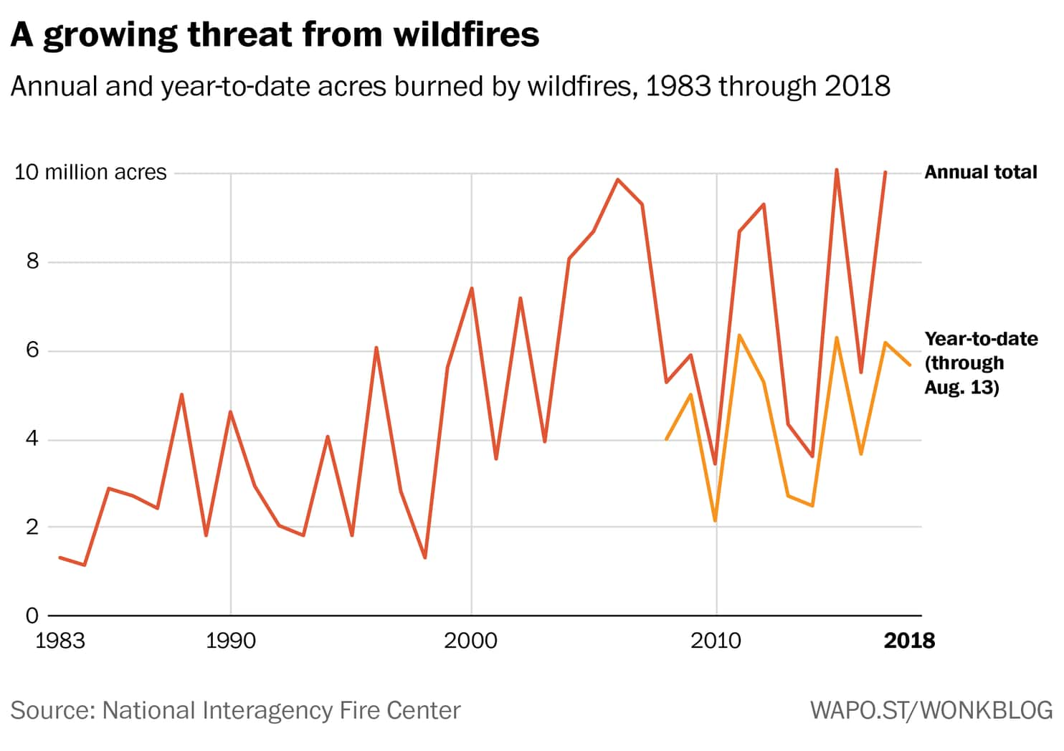
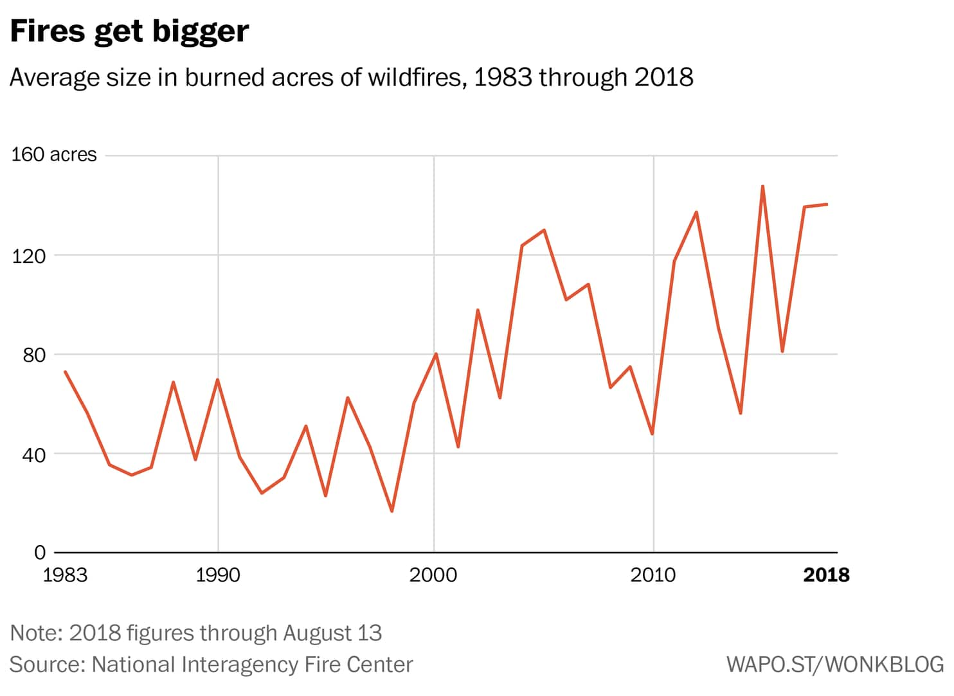
Trend in the United States
Wildfire trend in the western US
Westerling et al., 2006.

Slide 12
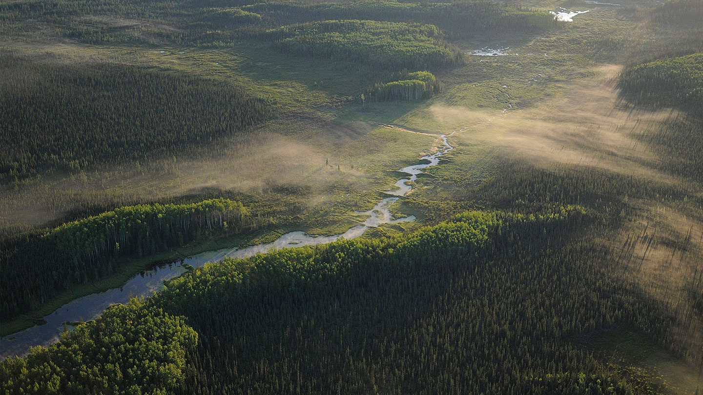
Global Trends of Wildfire
    A surface warming trend at high northern latitudes (i.e., Canada and Russia) will lead to an increase in boreal fires; a trend toward increased burning has already been detected – positive feedback.
    Increased forest fire activity is expected to be an early and significant result of a trend toward warmer and drier conditions, accelerating the rate of vegetation shifting.
Stocks et al., 1998.

Slide 13
Fire Plume
the motion generated by a source of buoyancy which exists by virtue of combustion and may incorporate an external source of momentum.
  The buoyancy source may be due to glowing or flaming combustion of a solid or liquid, with no external source of momentum, or due to gaseous, liquid, spray, or aerosol discharge from an opening at various mixes of mass flow and momentum.
Pyro-convection
Atmospheric convection is one of the most complex problems in geophysical fluid dynamics.
The evolution of deep convection depends on the ambient profiles of temperature, humidity and wind shear.
In the case of convection triggered by forest fires, the fire emissions of sensible heat, latent heat in the form of water vapor, and aerosol particles acting as CCN are additional parameters influencing cloud dynamics.
Heskestad et al., 1998; Luderer et al., 2006

Slide 14
Vertical lifting of pyro-convection
The intensity of pyro-convection and therefore the vertical lifting of the fire emissions depends on the size and type of the wildland fire and the convective potential of the atmosphere.
Large, intense crown fires combined with conditionally unstable atmospheric conditions can lead to extreme convection with the potential to transport fire emissions into the upper troposphere (UT) and even into the lower stratosphere (LS).
Why is plume height important?
Since aerosols lofted into the free troposphere (FT) are often carried hundreds or thousands of kilometers downwind, plume height measurements, to a kilometer or better, are of major value for aerosol transport modeling.
Aerosols confined to the boundary layer typically fill this well-mixed, near-surface layer but remain near the source region.
Trentmann et al., 2006; Kahn et al., 2007.

Slide 15
Factors of Fire Plume Height
Williamson et al., 2016

Slide 16
Difference between wildfire and the others
A wildfire does not have an initial vertical velocity.
Fire creates a buoyant plume, which draws in air from the surrounding surface region. Energy involved in wildland fires is typically on the scale of MJ (megajoules) released over hours.
Volcanic plumes are also dissimilar from wildland fire smoke plumes.
  The scale of volcanic eruptions is much greater than that of wildland fires.
Anderson et al., 2011.

Slide 17
In-situ measurements of plume height
Satellite-based instruments: MISR, CALIOP
MISR: Multiangle Imaging SpectroRadiometer (on Terra)
    Can retrieve total column aerosol optical thickness and the altitude of the atmospheric cloud or aerosol layer over cloud-free land and water surfaces
  CALIOP: Cloud-Aerosol Lidar with Orthogonal Polarization (on CALIPSO)
    Uses lidar to get vertical profiles of clouds and aerosols
12 July 2013 in New Mexico, observed by MISR at 18:09 UTC.
Nelson et al., 2013.

Slide 18
Example of fire plume models
Atmospheric Dispersion Index (ADI) model
  By Lavdas (1986)
  Gaussian dispersion over the depth of the mixing layer to give a numerical index of potential smoke dispersion.
  It does not simulate smoke plumes nor predict plume heights.
PLUMP
  By Latham (1994)
  1D smoke plume model
  Freitas et al. (2007) used to estimate CO emission from biomass burning
Daysmoke
  By Achtmeier et al. (2011)
  Simpler model for prescribed burns
  Does not incorporate adiabatic expansion
Photo Credit: Geophysical Institute

Slide 19
A different approach: estimation of penetration height
Focusing on the penetration height of the plume given a specific amount of heat injected into the atmosphere.
Following thermodynamic principles, plume height is estimated by modifying a column of air affected by the fire, with the plume top height corresponding to the top of buoyant rise, or level of thermal equilibrium.
An easy method - can be quickly calculated for the hundreds of satellite-detected hotspots.
Photo Credit: Geophysical Institute

Slide 20
A different approach: estimation of penetration height
Two factors needed: the energy being released into the atmosphere by the fire and the ambient (environmental) lapse rate.
An appropriate amount of heat is mixed through a column of air above the fire until the column reaches thermal balance as represented by the dry adiabatic lapse rate.
Anderson et al., 2011.

Slide 21
A different approach: estimation of penetration height
The energy released from a wildland fire can be determined using Byram’s equation (1959): I = Hwr
  I = intensity of a fire per unit length of fire front [typically measured as kW m-1]
  H = heat of combustion [kJ kg-1], w is
  w = weight of the fuel consumed per unit area [kg m-2]
  r = rate of spread [m s-1 but normally measured as m min-1]
  (the heat of combustion H is a constant, typically 18 000 kJ kg-1 for dry wood)
Following a similar format, the energy released by the fire: Q = HwA
  A = area burned
Anderson et al., 2011.

Slide 22
A different approach: estimation of penetration height
Anderson et al., 2011.

Slide 23
A different approach: estimation of penetration height
Anderson et al., 2011.

Slide 24
A different approach: estimation of penetration height
Anderson et al., 2011.

Slide 25
A different approach: estimation of penetration height
In its current form, Δz (plume height) cannot be isolated to provide a solution from equation 17 for the plume height, rather one must use an iterative procedure which converges on the answer by entering an estimate of the plume height into the equation and the resulting value of Q is compared to the value of Q from the fire. The plume height is then adjusted and the calculations are redone.
Anderson et al., 2011.

Slide 26
Disadvantages of the model
The model does not consider:
  Development of the boundary layer
    Solar heating throughout the day
  Variable environmental lapse rate
    Constant lapse rate assumed
  Condensation
    Does the plume rise past LCL? – becoming a pyrocumulus cloud
  Vertical wind shear
    Not considered – the calculated height is the maximum height possible
  Energy balance
    Heat loss?
Anderson et al., 2011.

Slide 27
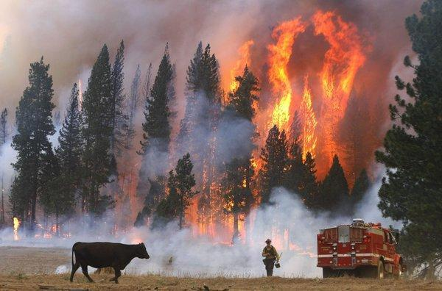
Plume Evolution
Open biomass burning
O₃
chemical and physical transformation
Aerosol
Open Biomass Burning
Rapid Photochemistry in plumes
Biomass burning (BB)
E.g. wildfires, prescribed agricultural burning, forest management burns
Accounted for 32% of PM2.5 emitted in the US (NEI 2014)
Complex mixture of VOCs, NOx and particles emitted from primary emission
O₃ and PAN enhancement in plumes of several types of BB
Crutzen 1979; Talukdar et al., 1995; Roberts et al., 2007; Fischer et al., 2014

Slide 28

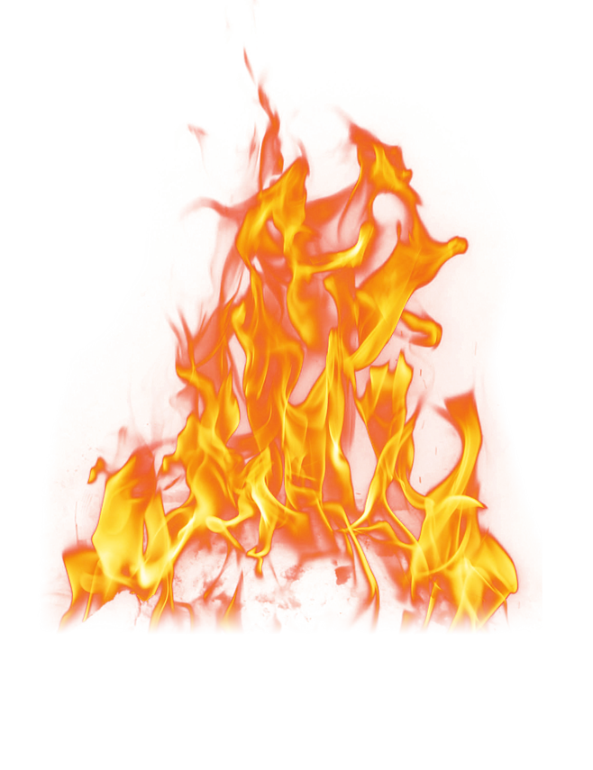


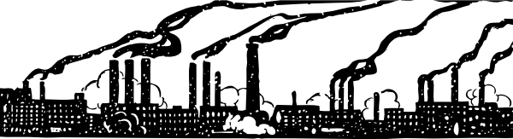



Impacts on Air Quality
Climate
Regional Air Quality
Primary emissions from fire emit reactive trace gases and aerosols
Evolution of these species impacts local and regional air quality.
Local Air Quality
Chemical & Physical Evolution
Plume Dispersion Transport
Dry & Wet Deposition
H₂O, CO₂, CH₄, NOx, VOCs, SO₂, NH₃, PM, Halogens

Slide 29
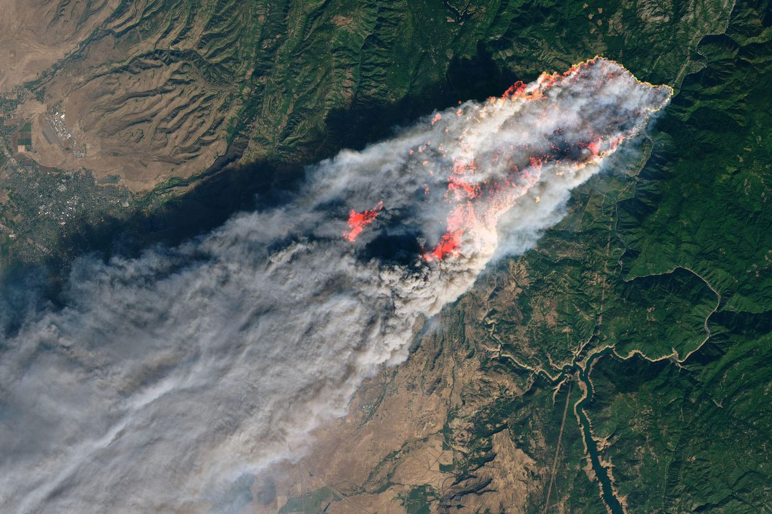
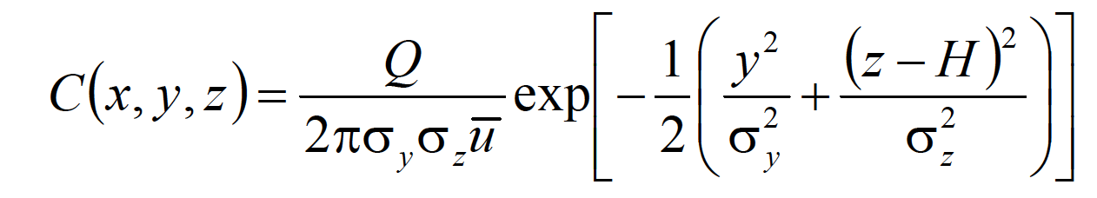
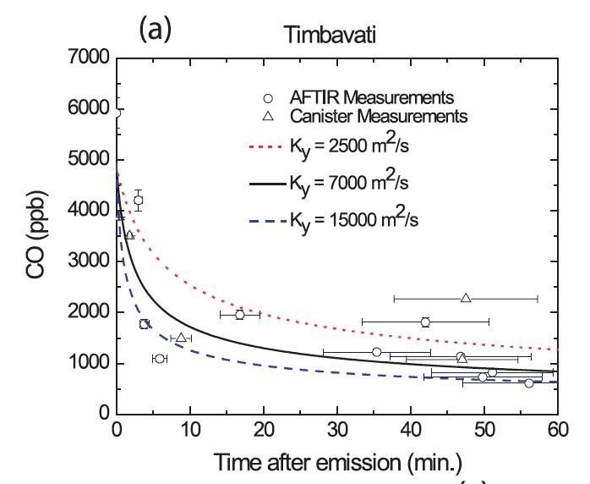
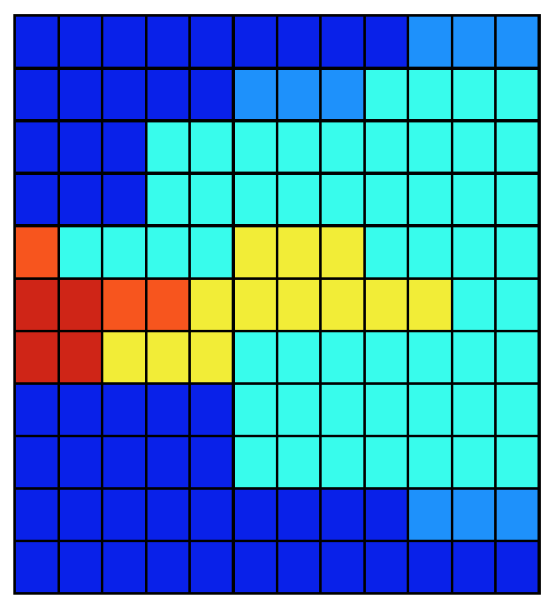
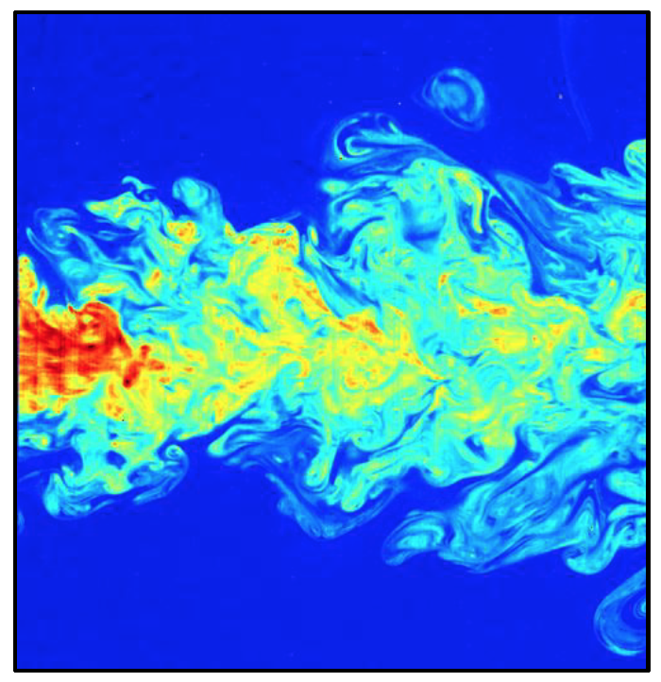
Plume Dispersion
Reality
Gaussian?
Wind Velocity
Numerical Dispersion?
Background
Horizontal
Dispersion
Background

Slide 30
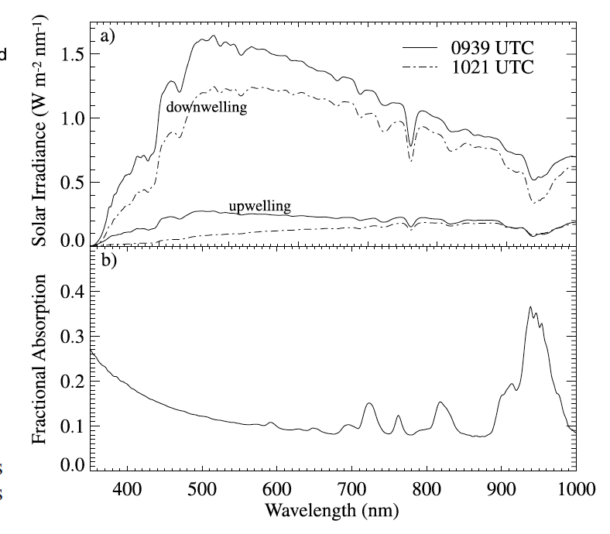
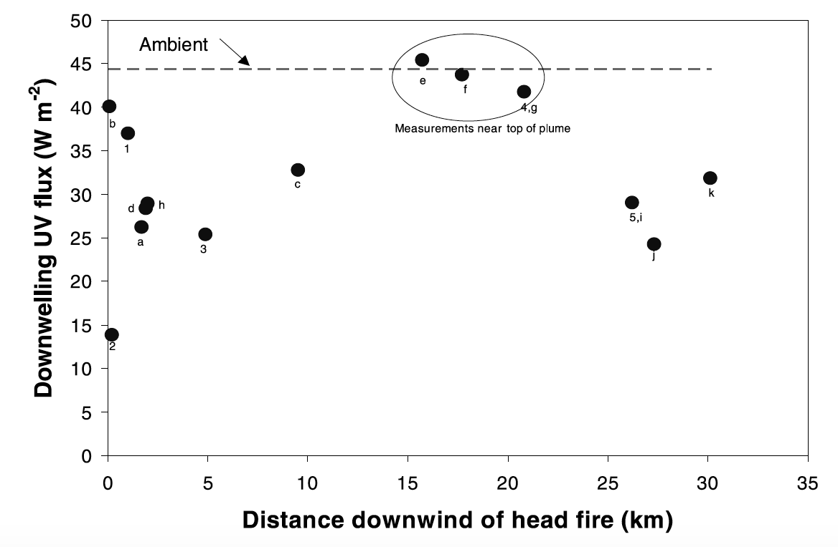
Scattering and Absorption
Near the center of the plume, the UV flux was about two-thirds of that near the top of the plume.
The smooth continuum-type absorption is due to the smoke particles
water vapor absorption is evident in the band centered at 940 nm as well as several other smaller bands in the near-infrared.
Absorption by H₂O vapor
Hobbs et al., 2003

Slide 31
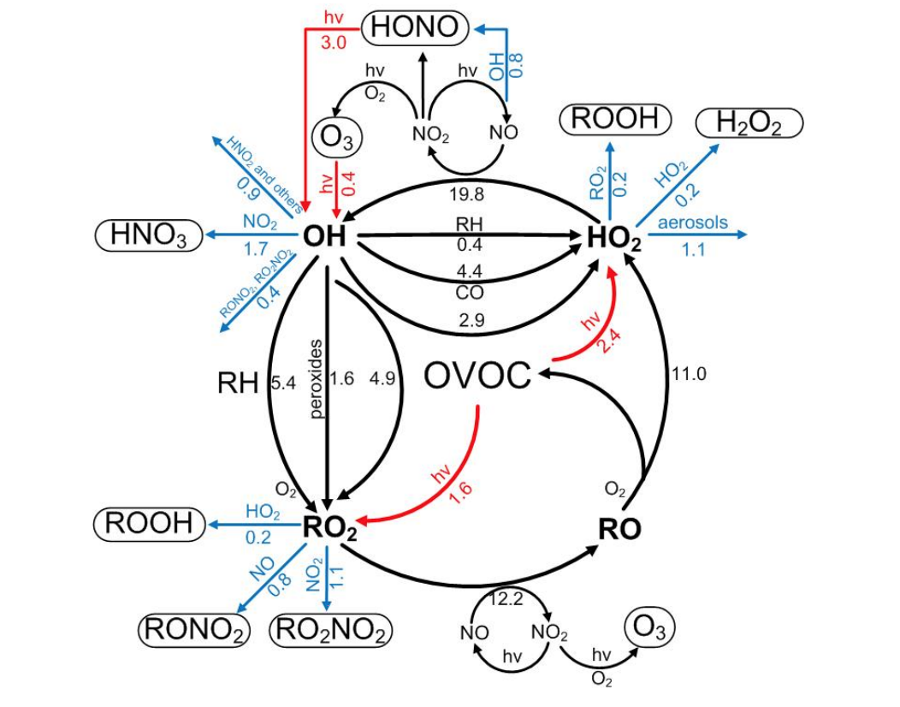
Simplified Chemical Scheme
Ozone Production and destruction have been observed in Fire plumes
Rapid radical cycling (HOx)
Rapid conversion of NO_{x} to NO_{z} (HNO₃ + RONO₂ + RO₂NO₂ + etc.)
Oxidation of VOCs (many in oxygenated form)
Secondary Aerosol Formation
Liu et al., 2012

Slide 32
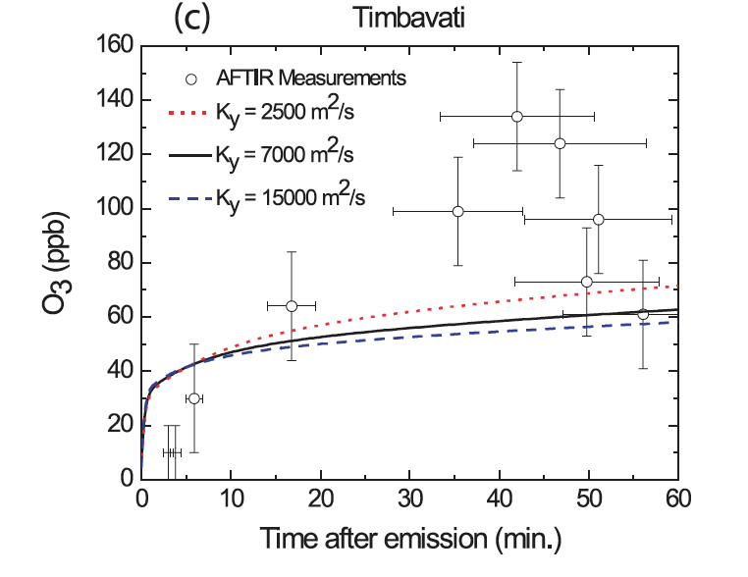
Chemical Evolution of Ozone
Case Study: Hobbs et al., 2003 and Alvarado et al., 2009
Nonlinear VOC-NOx Chemistry
Missing compounds
Heterogeneous Formation

Slide 33
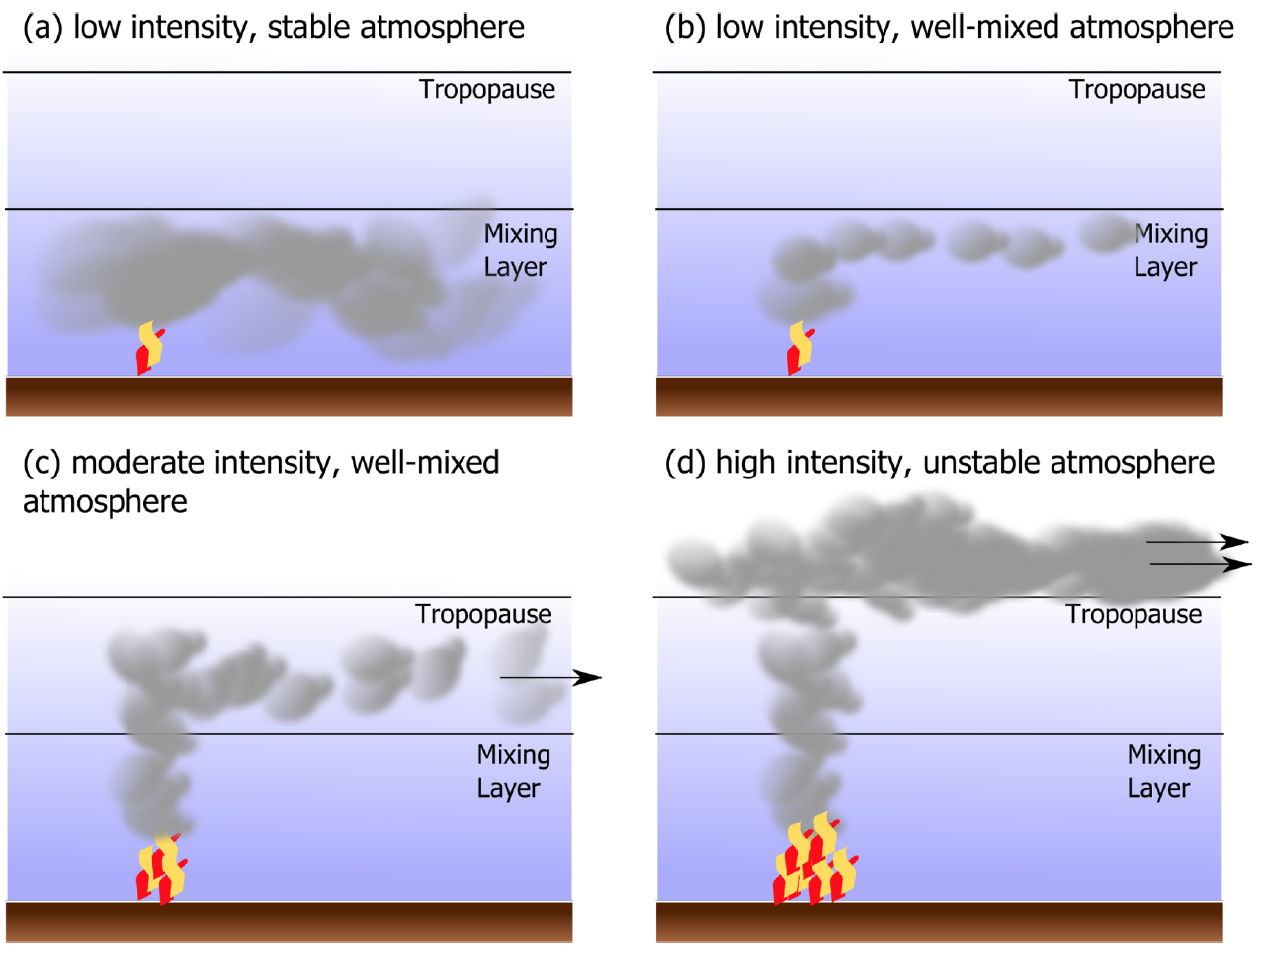
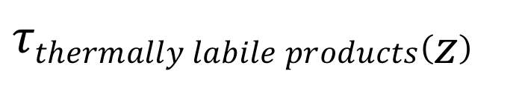
Propagation of uncertainty
Different emissions lead to different chemistry
Different injection heights lead to different chemistry
Large uncertainty in fire emissions
Stability condition impacts on pollutant concentration
$$τthermally labile products\left(z\right)$$
Uncertainty_{plume height}
Uncertainty_{Emissions}

Slide 34
Discussion Questions
Effects of anthropogenic activity on biomass burning
How do we control the human activities (Regulation and Policy)?
Effects of biomass burning on climate change
Effects of biomass burning on human health

Slide 35
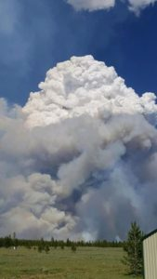
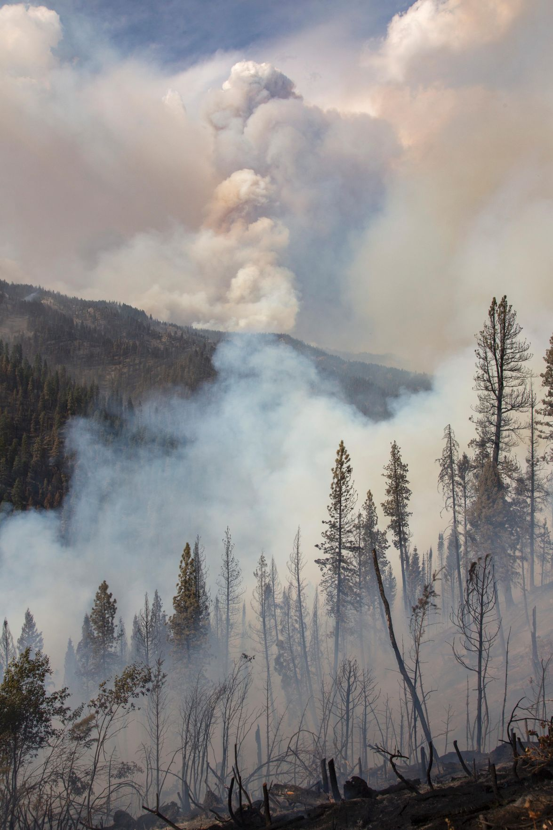
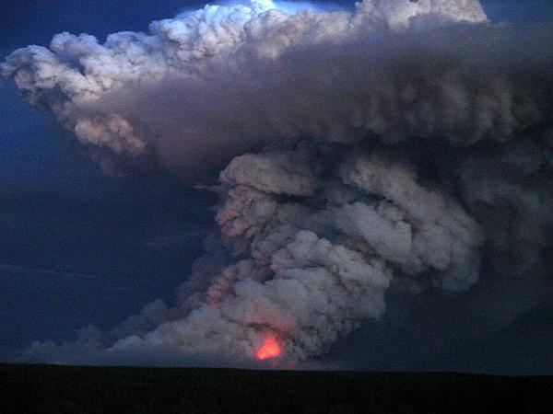
Thank you

Slide 36
References
Anderson, K.; Pankratz, A.; Mooney, C. (2011). A thermodynamic approach to estimating smoke plume heights. Pages 9.2-9.9 in Proceedings of the Ninth Symposium on Fire and Forest Meteorology, October 17-20, 2011, Palm Springs, California. American Meteorological Society, Boston, Massachusetts, USA.
Byram, G.M. (1959). Combustion of forest fuels. Pages 61-89 in K.P. Davis, ed, Forest Fire: control and use. McGraw-Hill Book Co., New York.
Heskestad, G., Bishop, S. R., & Drysdale, D. D. (1998). Dynamics of the fire plume. Philosophical Transactions of the Royal Society of London. Series A: Mathematical, Physical and Engineering Sciences, 356(1748), 2815-2833. doi:10.1098/rsta.1998.0299
Kahn, R. A., Li, W. H., Moroney, C., Diner, D. J., Martonchik, J. V., & Fishbein, E. (2007). Aerosol source plume physical characteristics from space-based multiangle imaging. Journal of Geophysical Research, 112(D11). doi:10.1029/2006jd007647
Luderer, G., Trentmann, J., Winterrath, T., Textor, C., Herzog, M., Graf, H., & Andreae, M.O. (2006). (2006). Modeling of biomass smoke injection into the lower stratosphere by a large forest fire (Part II): sensitivity studies. Atmospheric Chemistry and Physics, 6(12), 5261-5277. doi:10.5194/acp-6-5261-2006
Mao, J., Eastham, S., Yokelson, B., Holmes, C., & Lonsdale, C. (2017). Issues of modeling fire plumes. NCAR presentation.
Nelson, D. L., Garay, M. J., Kahn, R. A., and Dunst, B. A. (2013). Stereoscopic Height and Wind Retrievals for Aerosol Plumes with the MISR INteractive eXplorer (MINX), Remote Sens., 5, 4593–4628, doi:doi:10.3390/rs5094593.
Peterson, D. A., Hyer, E. J., Campbell, J. R., Fromm, M. D., Hair, J. W., Butler, C. F., & Fenn, M. A. (2015). The 2013 Rim Fire: Implications for Predicting Extreme Fire Spread, Pyroconvection, and Smoke Emissions. Bulletin of the American Meteorological Society, 96(2), 229-247. doi:10.1175/bams-d-14-00060.1
Stocks, B. J., Fosberg, M. A., Lynham, T. J., Mearns, L., Wotton, B. M., Yang, Q., . . . McKENNEY, D. W. (1998). Climate Change and Forest Fire Potential in Russian and Canadian Boreal Forests. Climatic Change, 38(1), 1-13. doi:10.1023/a:1005306001055
Trentmann, J., Luderer, G., Winterrath, T., Fromm, M., Servranckx, R., Textor, C., Herzog, M., Graf, H-F., and Andreae, M. (2006). Modeling of biomass smoke injection into the lower stratosphere by a large forest fire (Part I): reference simulation. Atmospheric Chemistry and Physics, 6(12), 5247-5260. doi:10.5194/acp-6-5247-2006
Westerling, A. L., Hidalgo, H. G., Cayan, D. R., & Swetnam, T. W. (2006). Warming and earlier spring increase western U.S. forest wildfire activity. Science, 313(5789), 940-943. doi:10.1126/science.1128834
Emissions Measurements from Vegetation Fires: A Comparative Evaluation of Methods and Results 1 2 D.E. WARD and L.F. RADKE
Open-path Fourier transform infrared studies of large-scale laboratory biomass fires Robert Yokelson
Wildfires in eastern Texas in August and September 2000: Emissions, aircraft measurements, and impact on photochemistry Allen et al

