Slide 1
Relationship between change in column density and the change in rate of emission of CO from wildfire
Seungchan Kim (Patrick)
EAS 6792 Air Pollution Meteorology

Slide 2
Mendocino Complex Fire
A large complex of two wildfires, occurred in 2018.
River Fire & Ranch Fire (single-largest recorded wildfire in California)
Mendocino Complex Fire is the largest recorded fire complex in California history
Fire started between 12 PM and 1 PM on July 27th, 2018 and fully contained on September 18th, 2018.
Burned 459,123 acres (≈ 1,858 km²)
Incident Information System, CALFIRE (Retrieved on April 2019)

Slide 3
The Washington Post (Retrieved on April 2019)

Slide 4
Emissions from fire
Major emissions of wildfire: CO2, CO, carbonaceous aerosols (organic carbon/elemental carbon), PM, etc.
Why is CO used to track wildfire emissions?
CO: produced by incomplete combustion of fuels – woods
Lifetime of carbon monoxide (1~2 months) is long enough to track pollutants from the fire & short enough to detect changes in the ambient atmosphere.
NRC (2004), Liang et al. (2004)

Slide 5
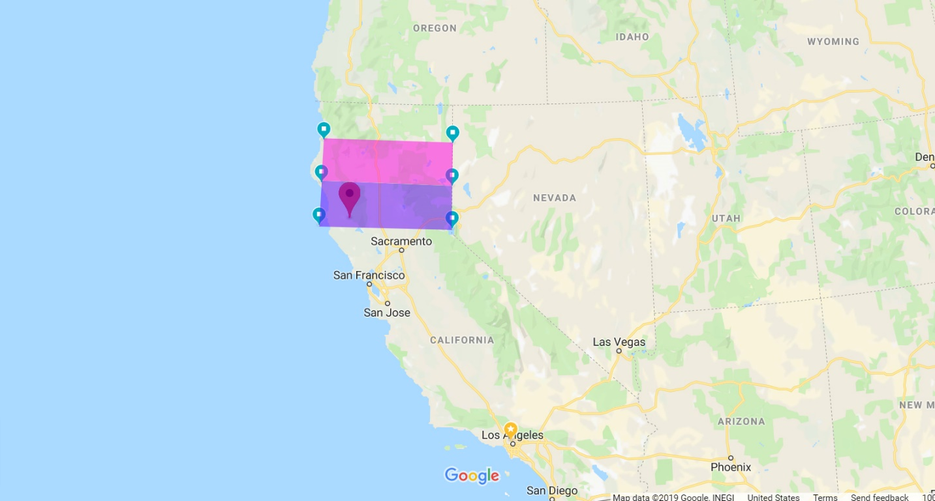
Study area
Purple: Mendocino Complex Fire
Latitude: 39 °N - 40 °N
Longitude: 124 °W – 120 °W
Pink: Carr Fire
Latitude: 39 °N - 41 °N
Longitude: 124 °W – 120 °W

Slide 6
Mendocino Complex Fire region only

Slide 7
Mendocino + Carr

Slide 8
Outliers removed
Mendocino Complex Only
Mendocino Complex + Carr

Slide 9
Possible factors for the error
Jet streams
Strong surface winds
Vertical transport time
Other wildfires in effect
Natchez Fire

Slide 10
References
CAL FIRE, State of California, “http://cdfdata.fire.ca.gov/incidents/incidents_details_info?incident_id=2175”. Retrieved April 17, 2019.
CAL FIRE, State of California, “http://cdfdata.fire.ca.gov/incidents/incidents_details_info?incident_id=2178”. Retrieved April 17, 2019.
Liang, Q., Jaeglé, L., Jaffe, D. A., Weiss-Penzias, P., Heckman, A., & Snow, J. A. (2004). Long-range transport of Asian pollution to the northeast Pacific: Seasonal variations and transport pathways of carbon monoxide. Journal of Geophysical Research: Atmospheres, 109(D23). doi:10.1029/2003jd004402
Mendocino Complex Information - InciWeb the Incident Information System, https://inciweb.nwcg.gov/incident/6073/. Retrieved on April 17, 2019.
NASA/JPL-Caltech, “https://www.jpl.nasa.gov/spaceimages/details.php?id=PIA22492”.
NRC (National Research Council): Committee on Air Quality Management in the United States, Board on Environmental Studies and Toxicology, Board on Atmospheric Sciences and Climate, Division on Earth and Life Studies, 2004, Air Quality Management in the United States. National Academies Press [ISBN 0- 309-08932-8].
The Washington Post, https://www.washingtonpost.com/news/capital-weather-gang/wp/2018/08/10/what-californias-fire-onslaught-would-look-like-in-different-places-around-the-country/?utm_term=.0dbaabfa3436. Retrieved April 18, 2019.

