Slide 1

Vertical profiles of aromatics in DISCOVER-AQ 2014
Fanghe Zhao
EAS 6792
04/2021

Slide 2
Outline
Introduction
Data and Methods
Objective
Result
Summary

Slide 3
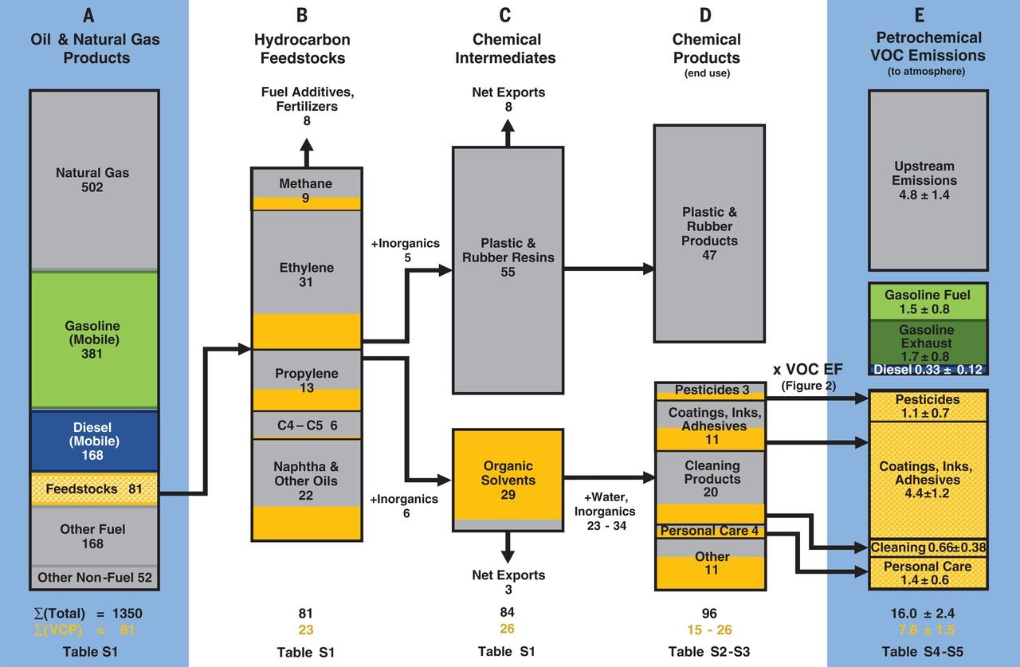
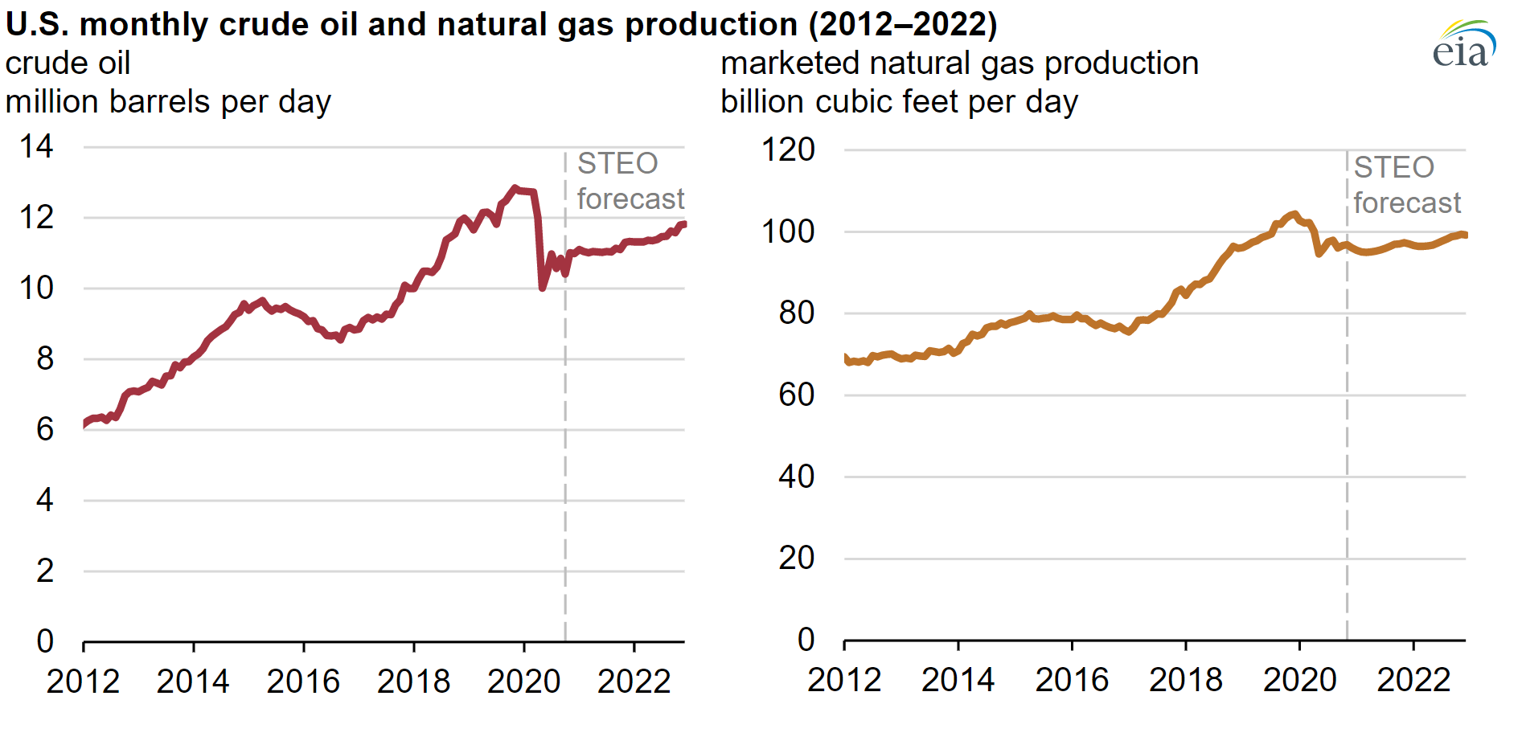
Introduction
Oil and Natural Gas Production
U.S. Energy Information Administration, Short-Term Energy Outlook (STEO)
McDonald et al. 2018

Slide 4
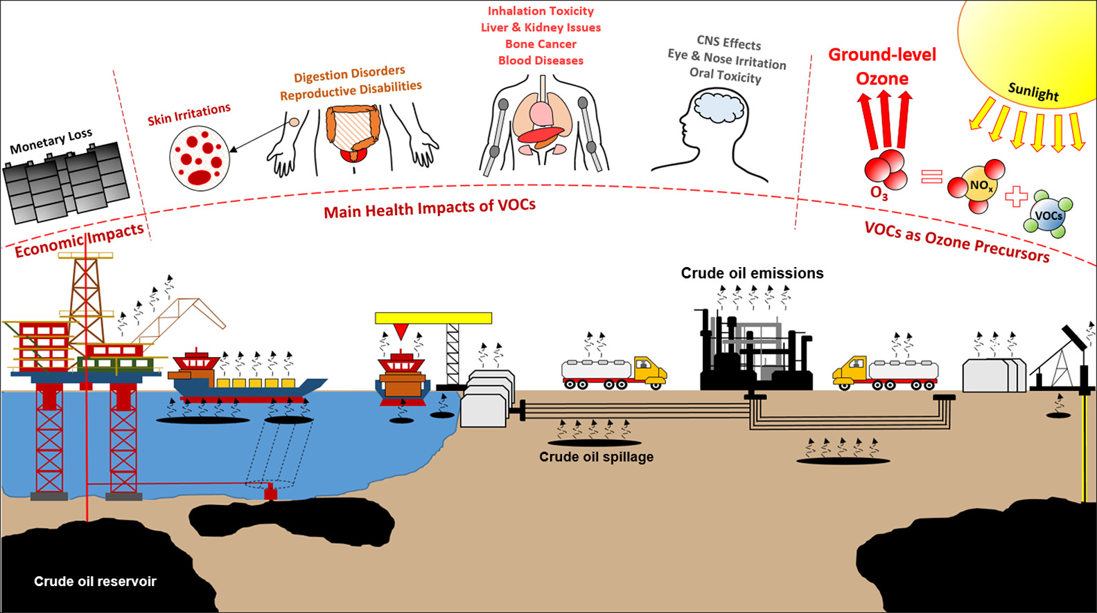
Introduction
Oil and Natural Gas Production
Rajabi et al. 2020

Slide 5
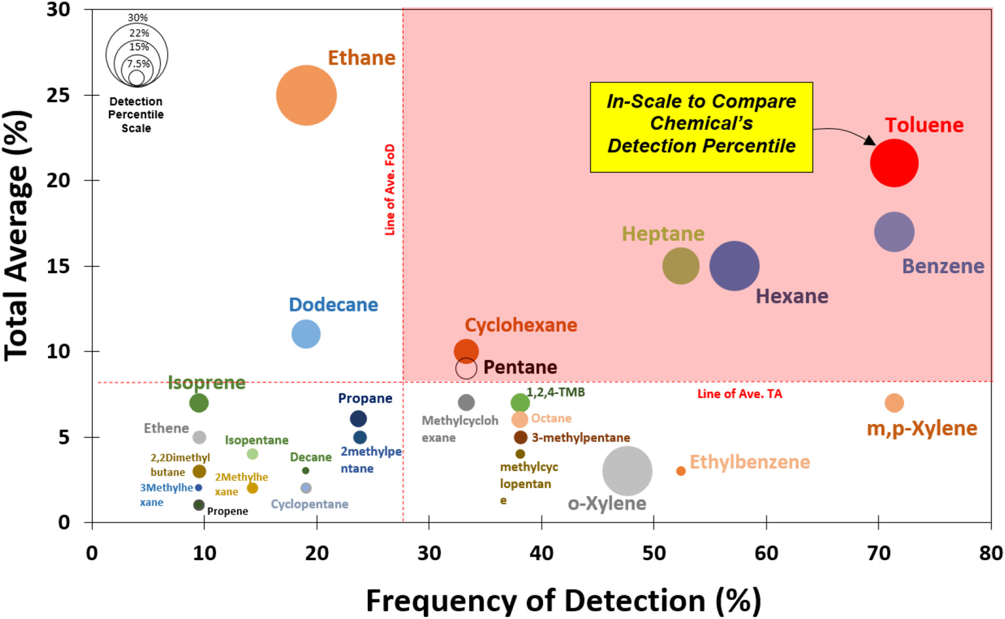
Introduction
Oil and Natural Gas Production
Rajabi et al. 2020

Slide 6
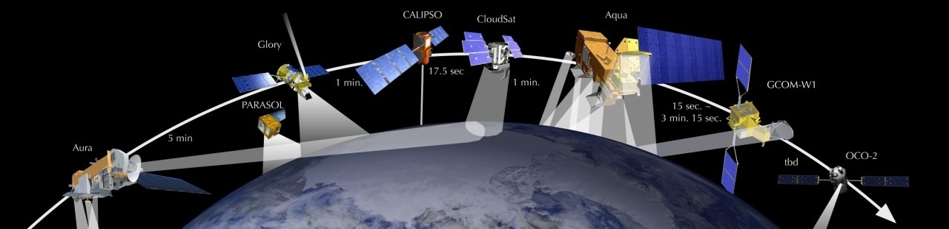
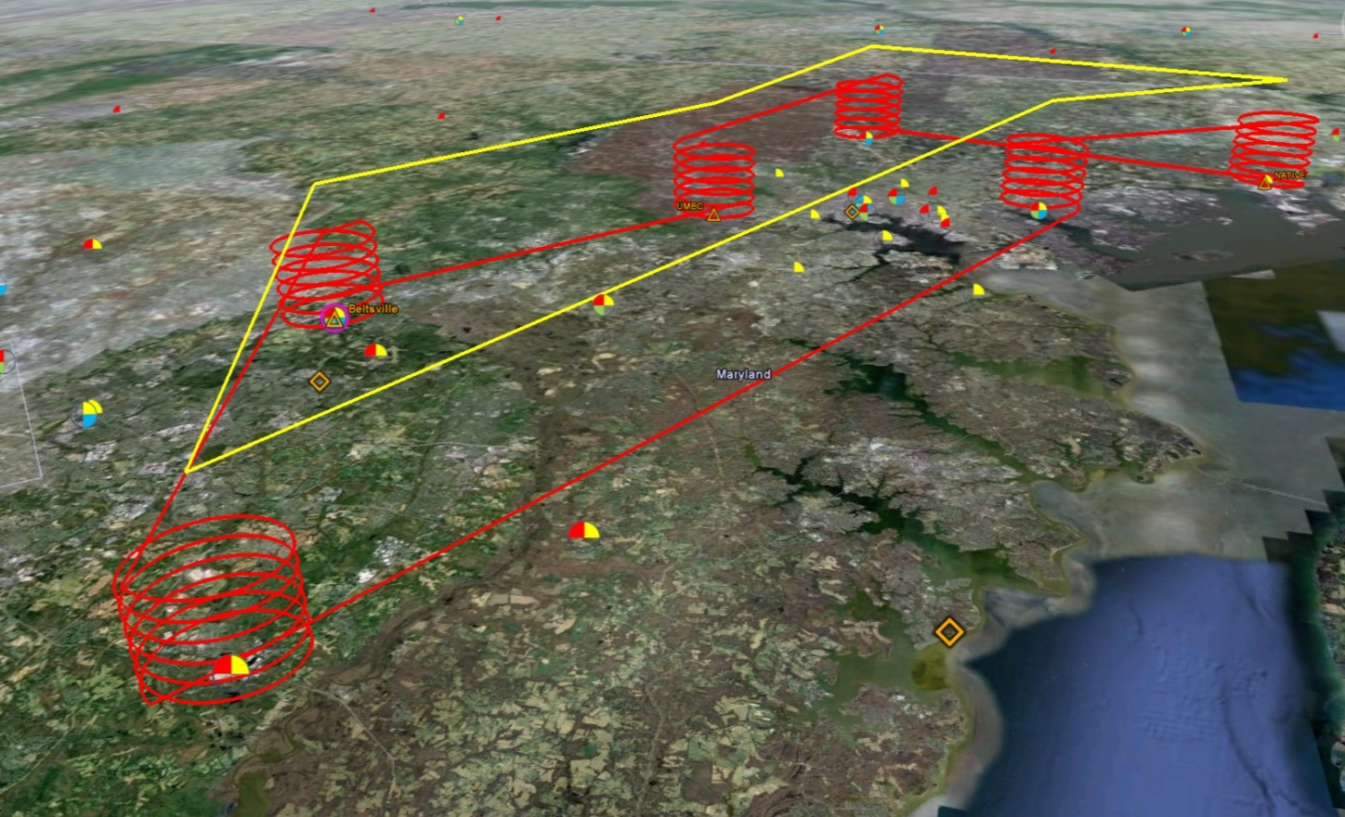
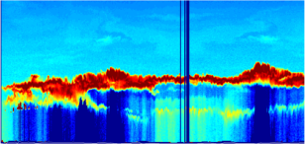

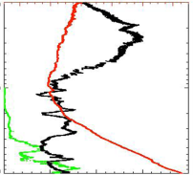
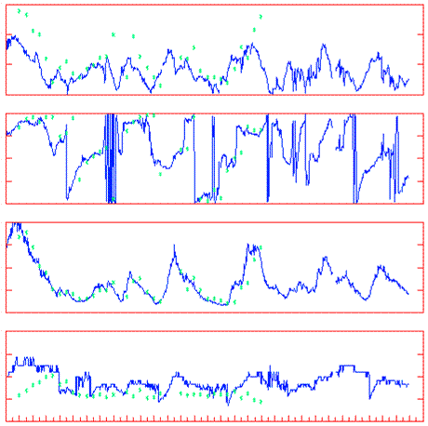
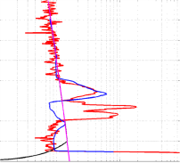
Data and Method
Deriving Information on Surface Conditions from COlumn and VERtically Resolved Observations Relevant to Air Quality (DISCOVER-AQ)
Systematic and concurrent observation of column-integrated, surface, and vertically-resolved distributions of aerosols and trace gases relevant to air quality as they evolve throughout the day.
6
Ken Pickering et al. 2014 AGU meeting

Slide 7
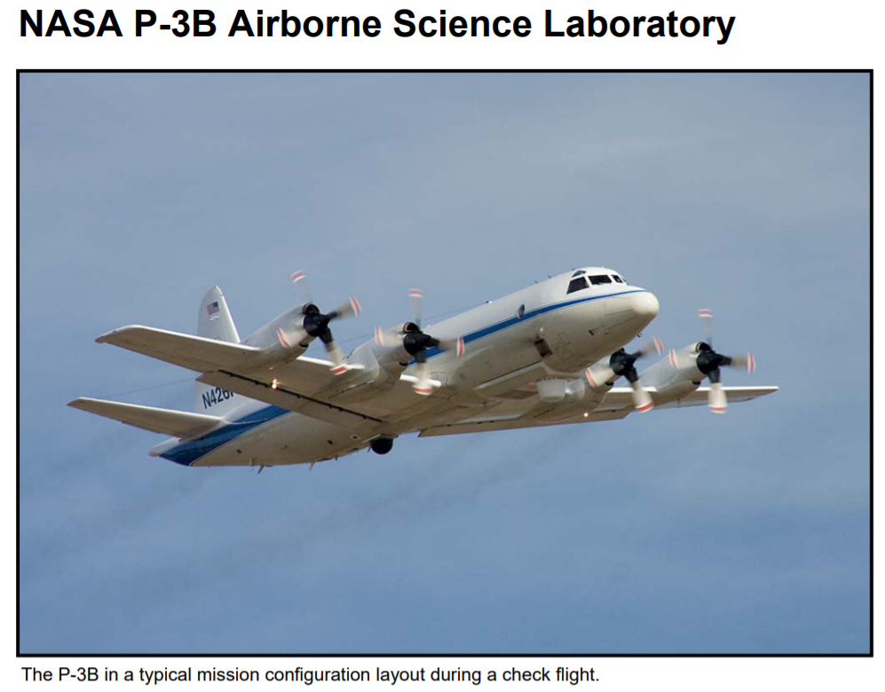
Data and Method
Mission Height range : 1400m-5700m
NMVOCs emission measurement : PTR-TOF-MS
Ozone and NOx : 4-channel chemiluminescence instrument
HCHO : Difference Frequency Generation Absorption Spectroscopy

Slide 8
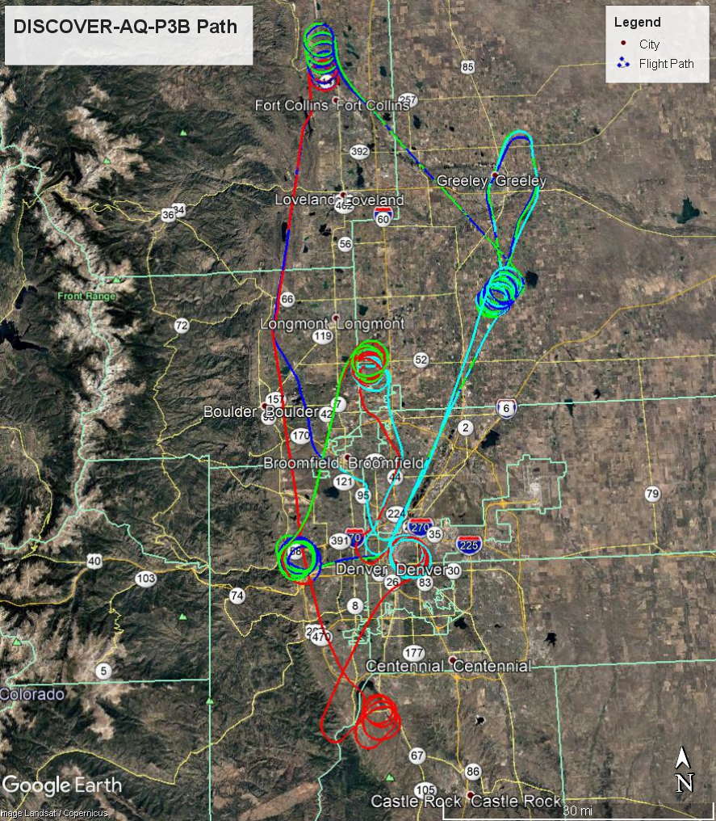
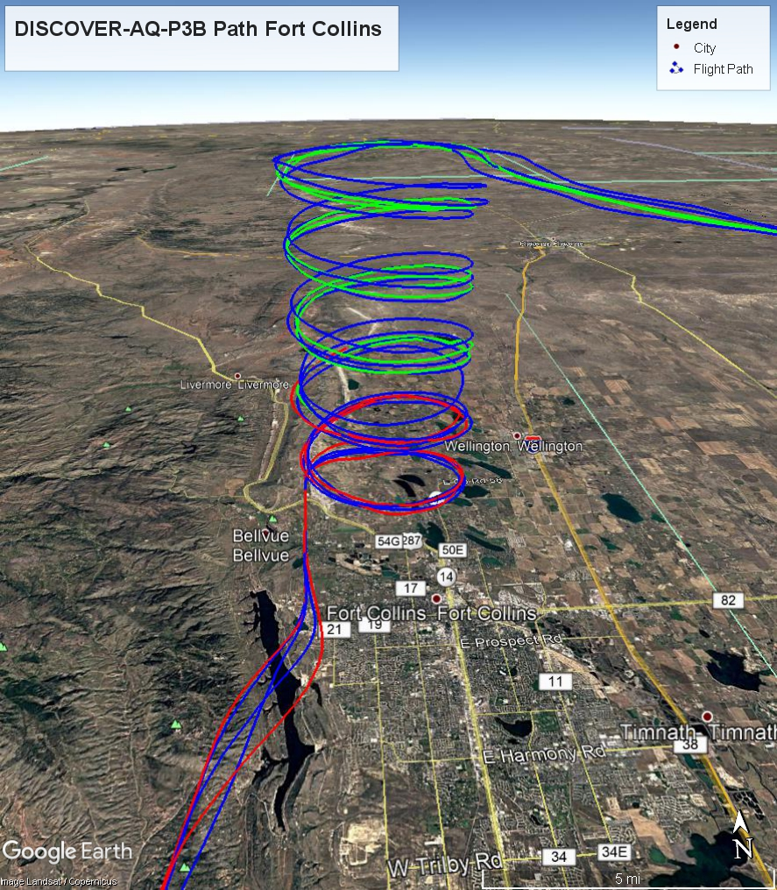
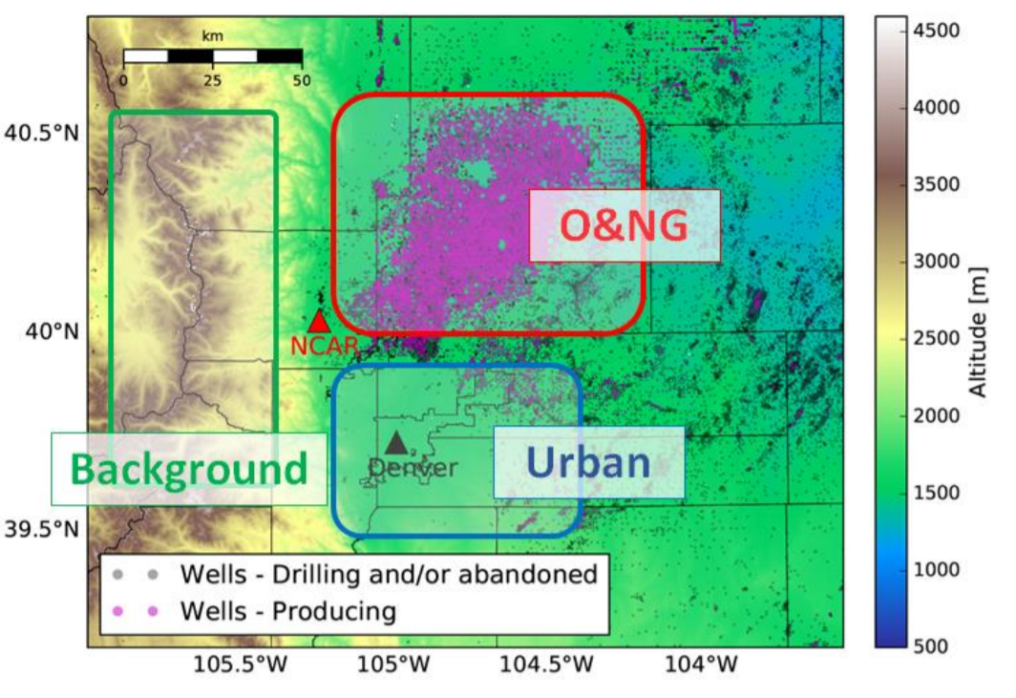
Data and Method
BAO
Fort Collins
Platteville
Golden
Chatfield
Denver

Slide 9
Objective
Does the Oil and Natural Gas Production effect on high level Aromatics concentration?

Slide 10
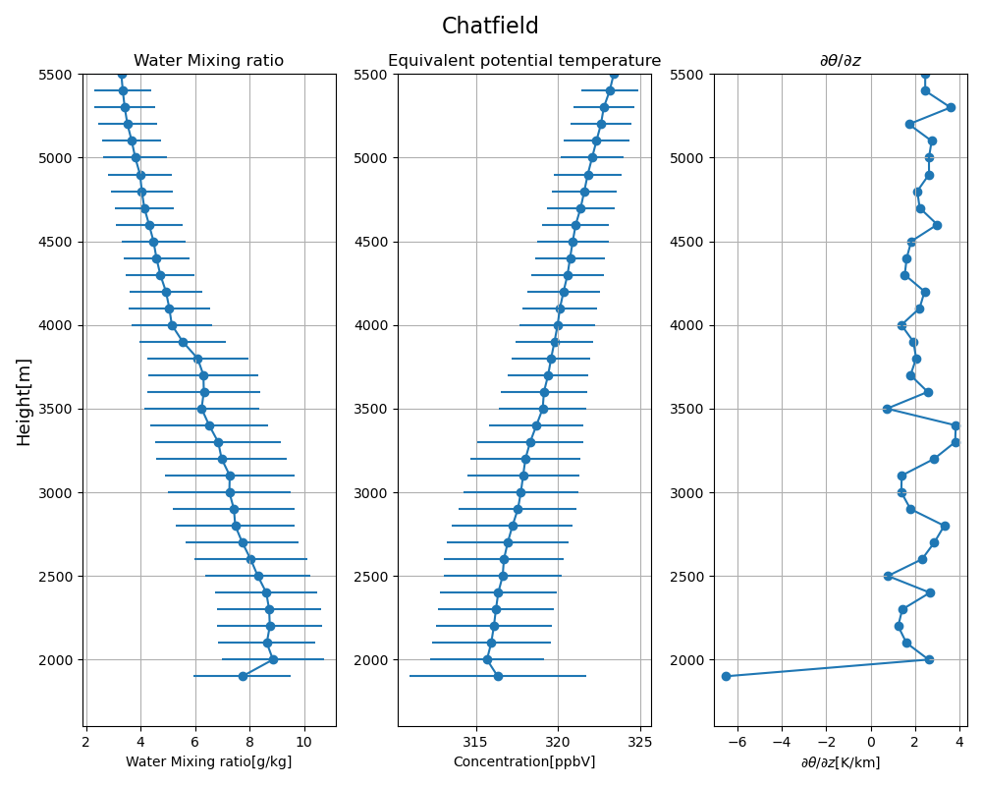
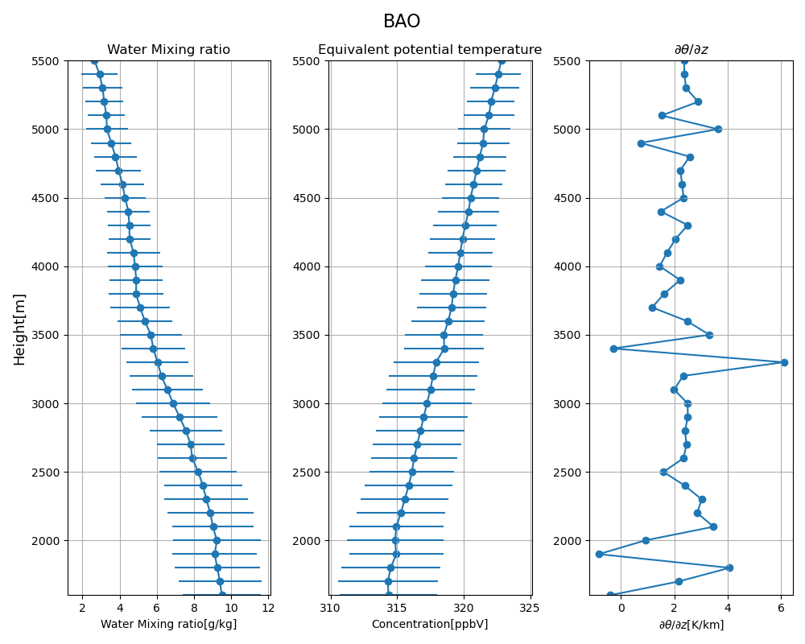
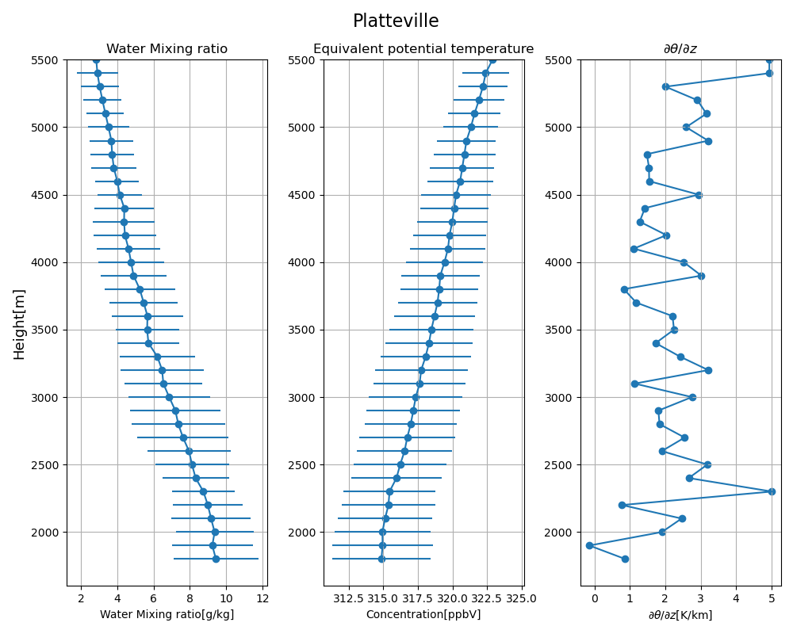
Result
BAO
Platteville
Chatfield

Slide 11
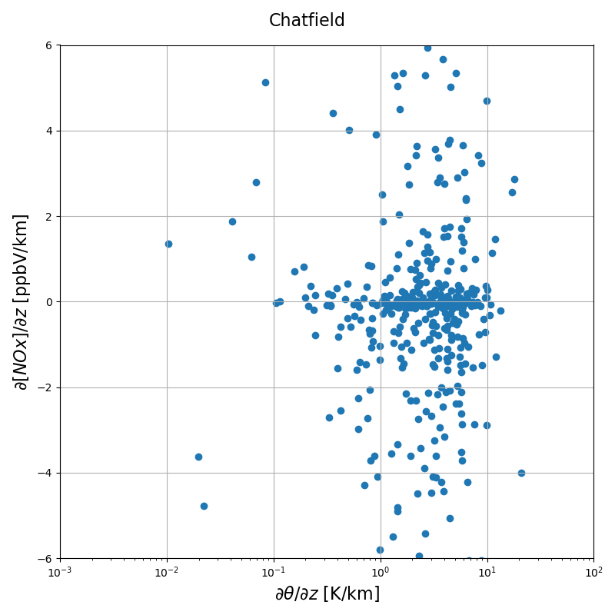
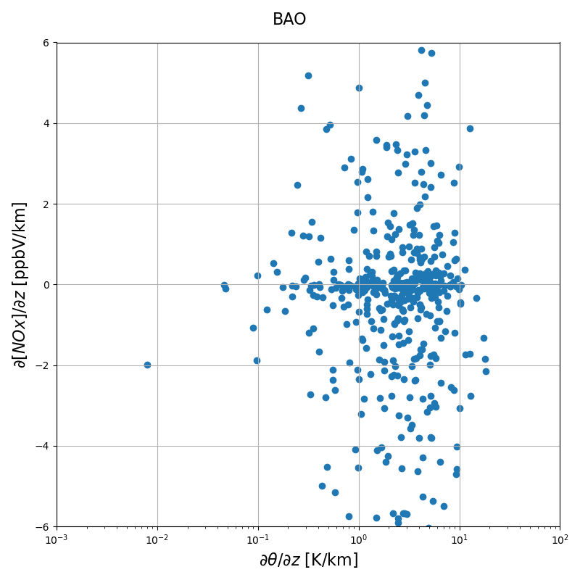
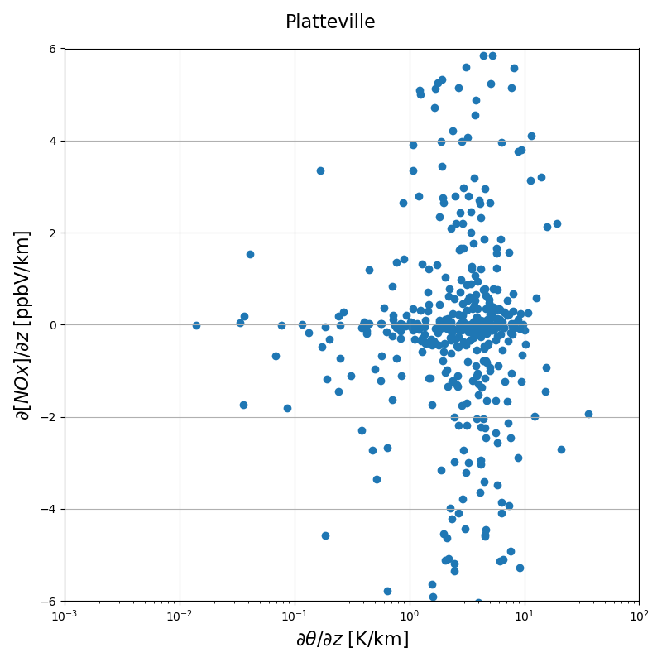
Result

Slide 12
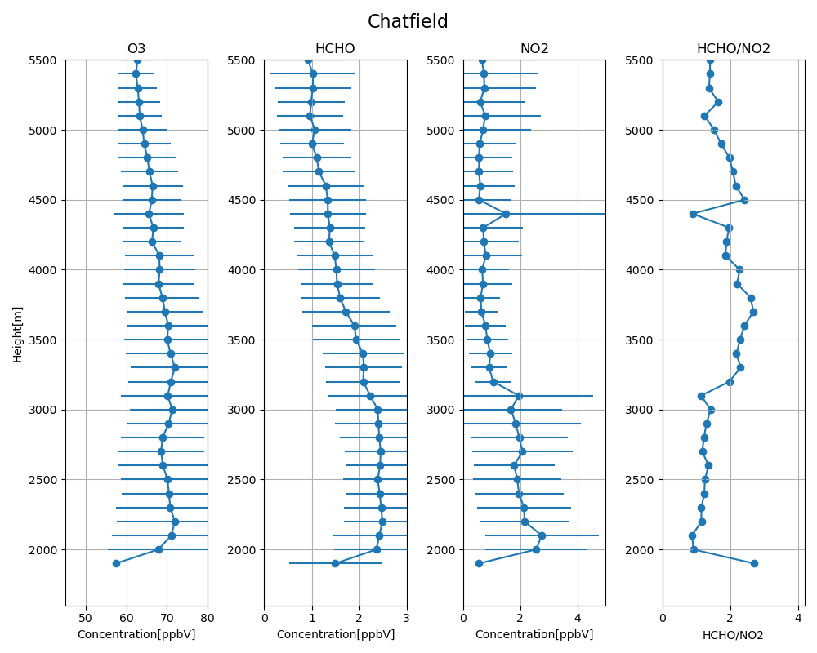
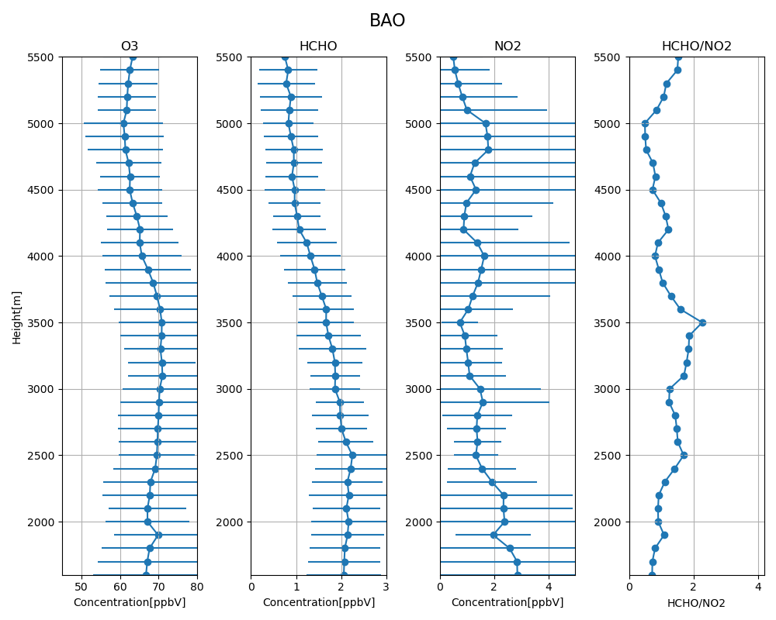
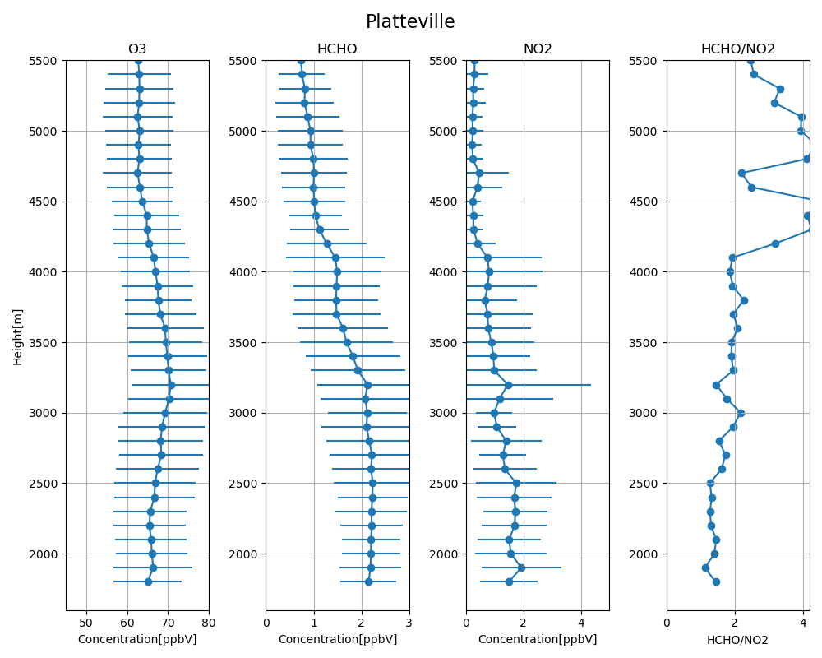
Result

Slide 13
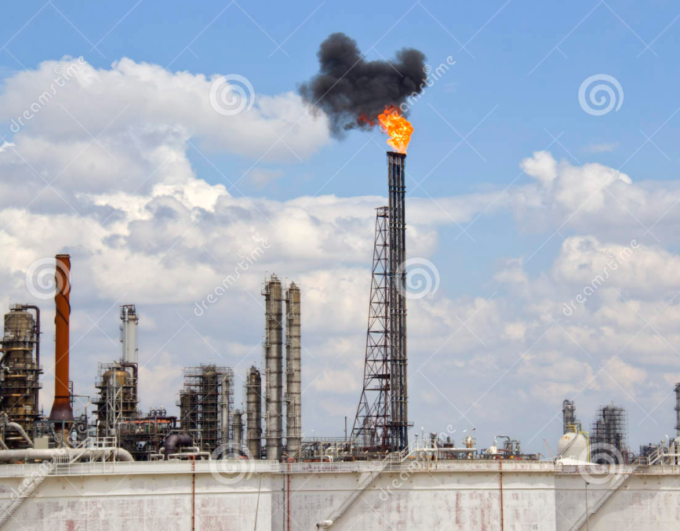
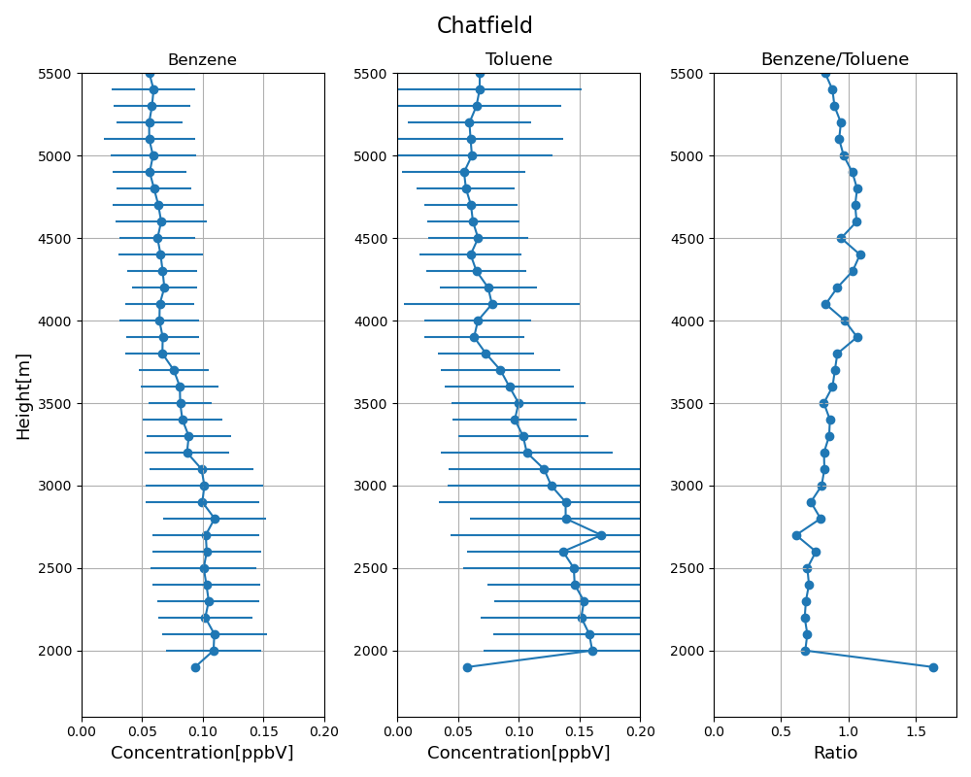
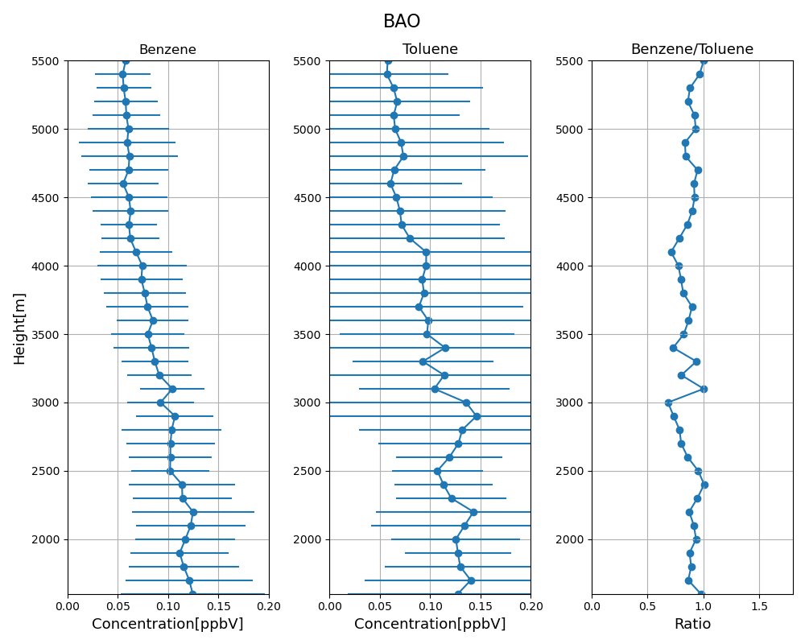
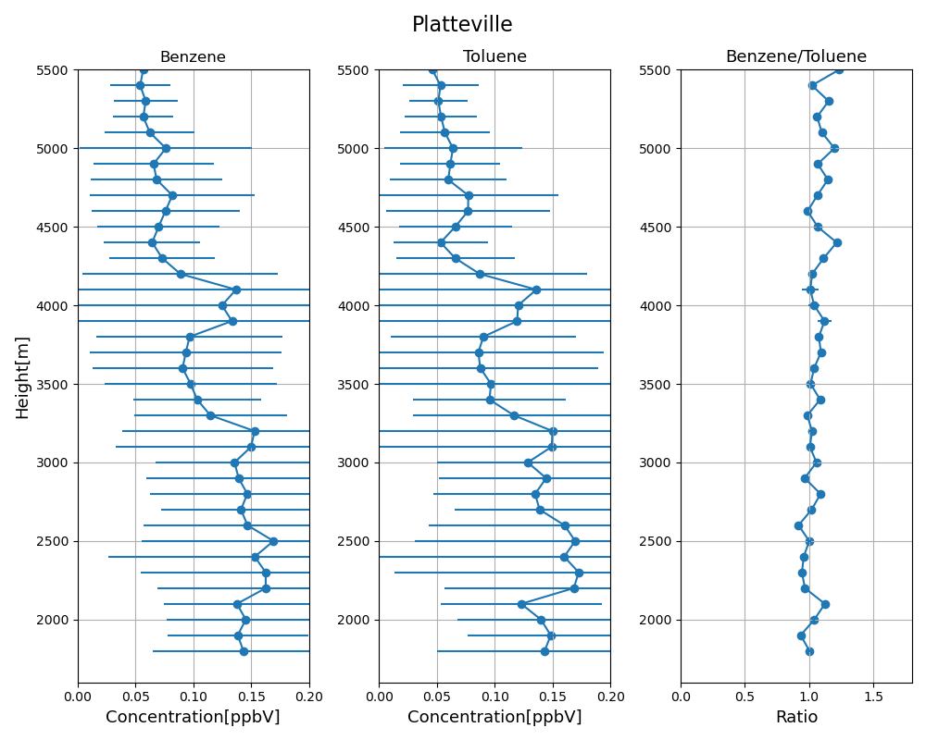
Result

Slide 14
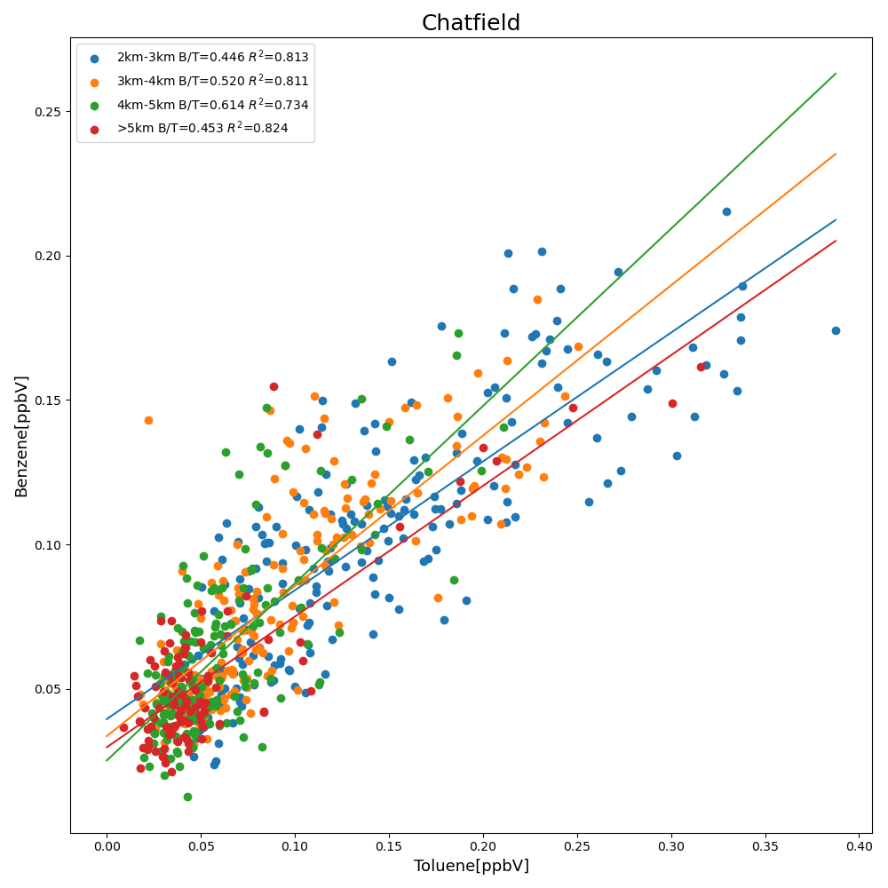
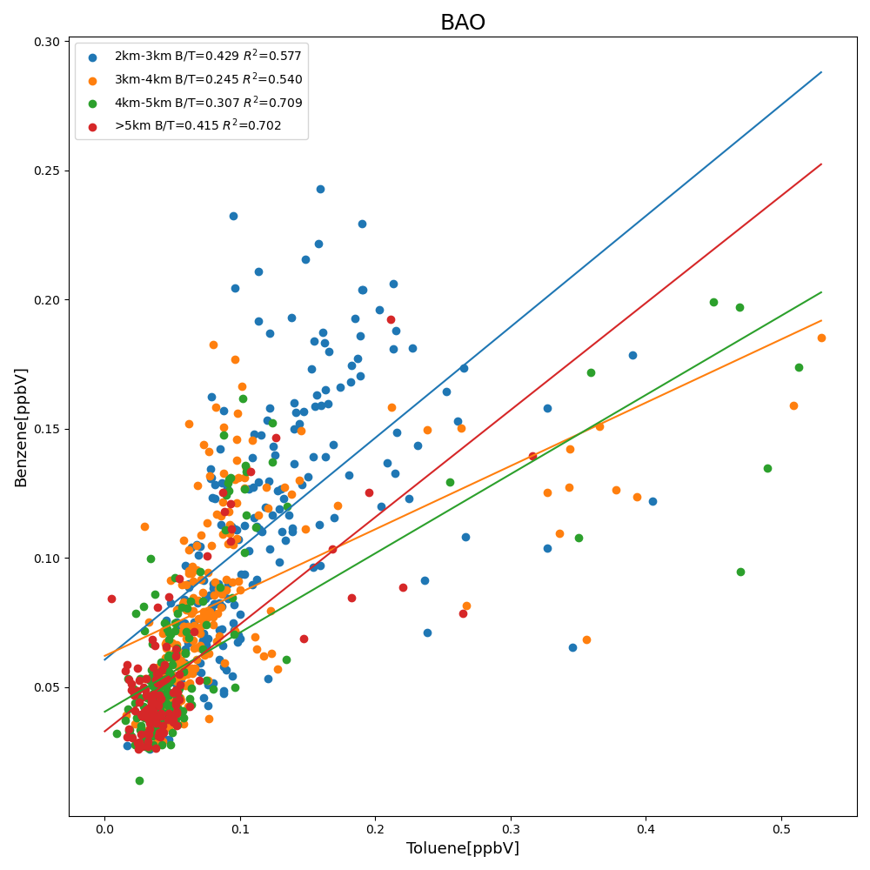
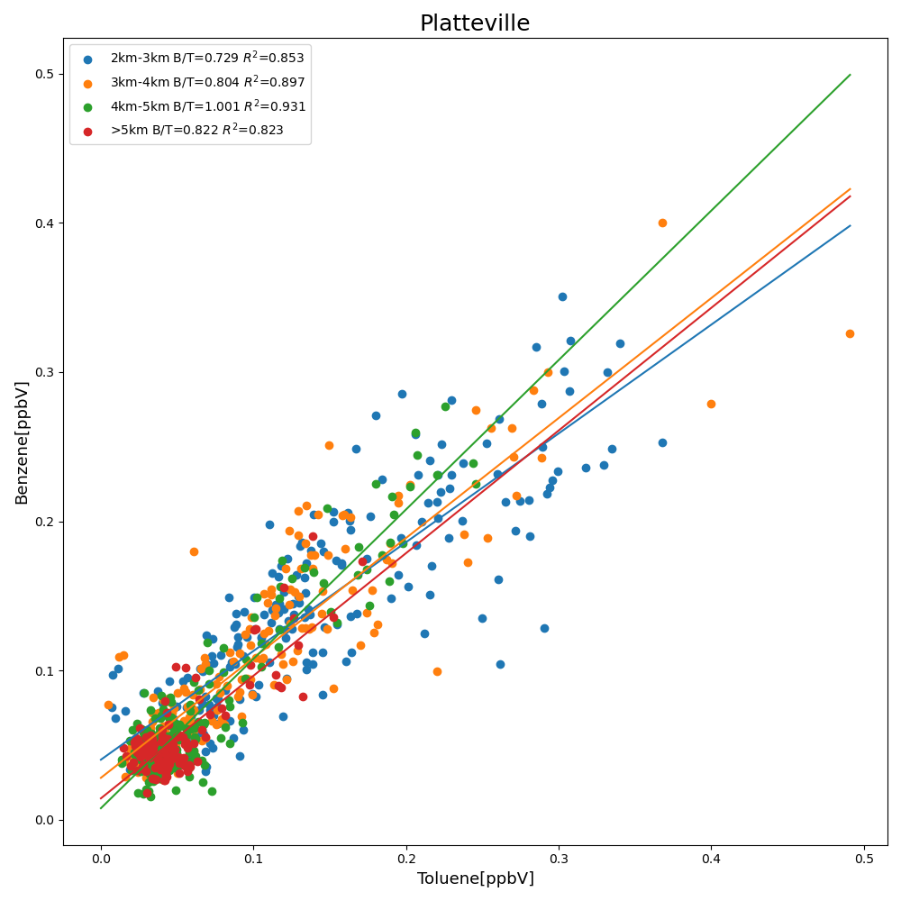
Result

Slide 15
Summary
Oil and Gas production effect the vertical profile of aromatics at high level in the troposphere.
Coefficient of relationship of vertical profile ratio between benzene and toluene is a possible factor to qualify the impact of Oil and Nature Gas Production.
Different HCHO/NO2 ratio may implied the chemistry regime in different height layer.

Slide 16
Thank you

Slide 17
